Slide 1

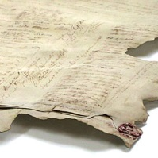
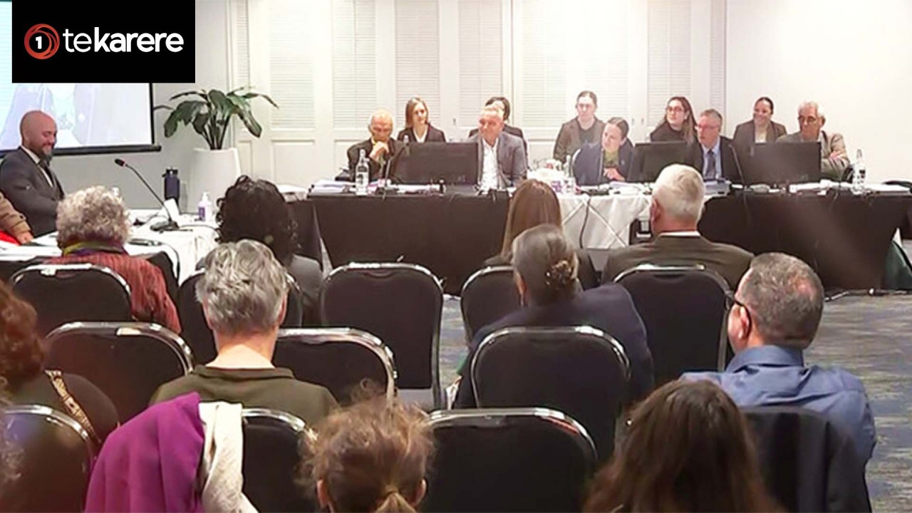

Wai 3553: Waitangi Tribunal Urgent Hearing – A critique of history curriculum resets 2021-2026
PPTA Māori Teachers’ Conference July 03 2026
Associate Professor Richard Manning: University of Canterbury. https://profiles.canterbury.ac.nz/Richard-Manning
Associate Professor Richard Manning: richard.manning@Canterbury.ac.nz

Slide 2

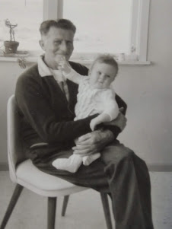
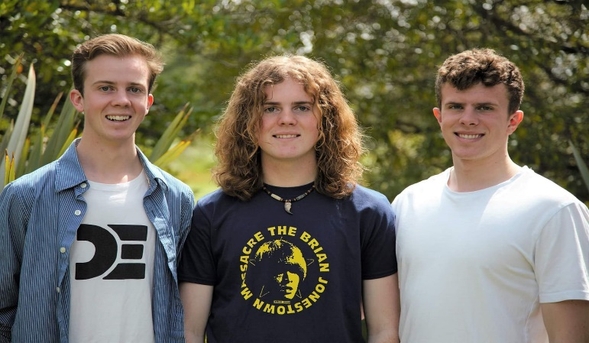

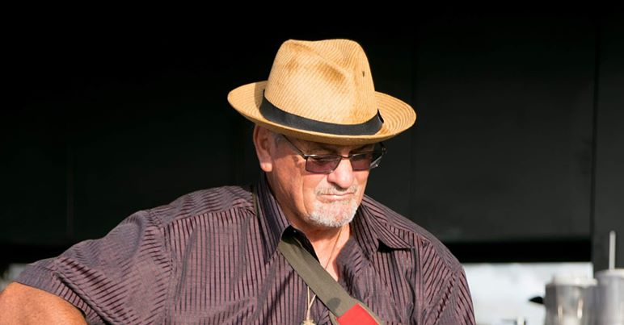
Kō wai au? My positionING in relation to the kaupapa

Slide 3
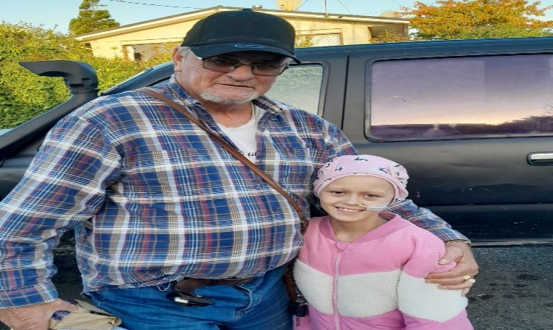
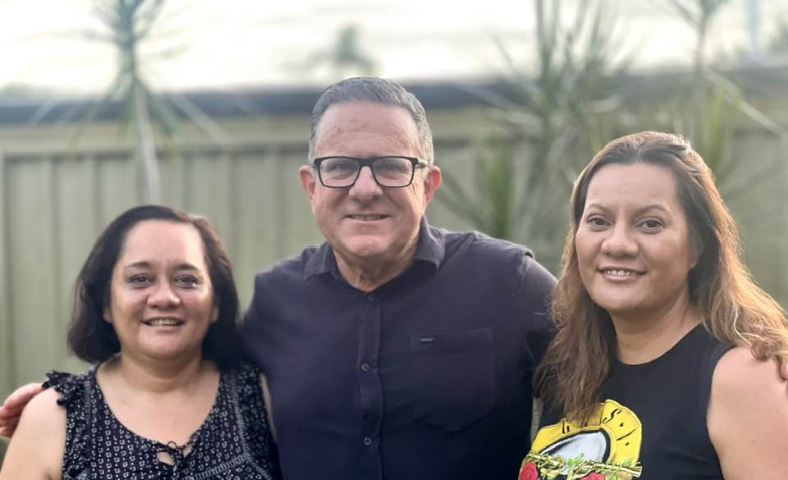
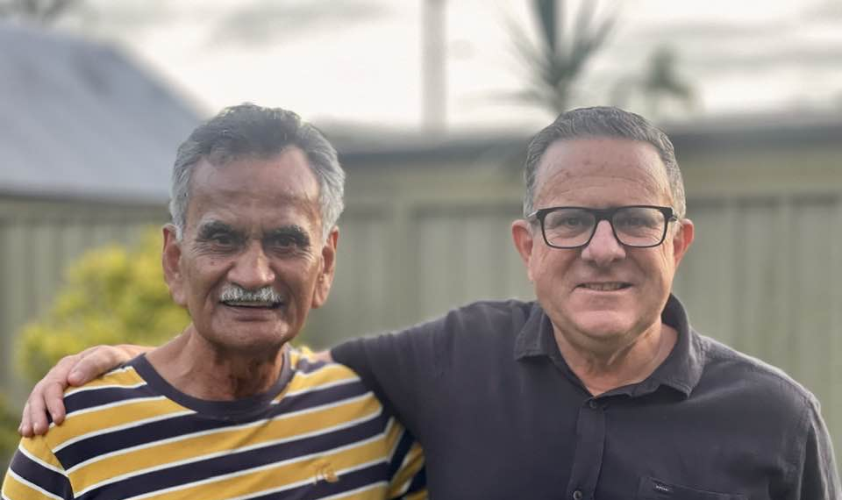
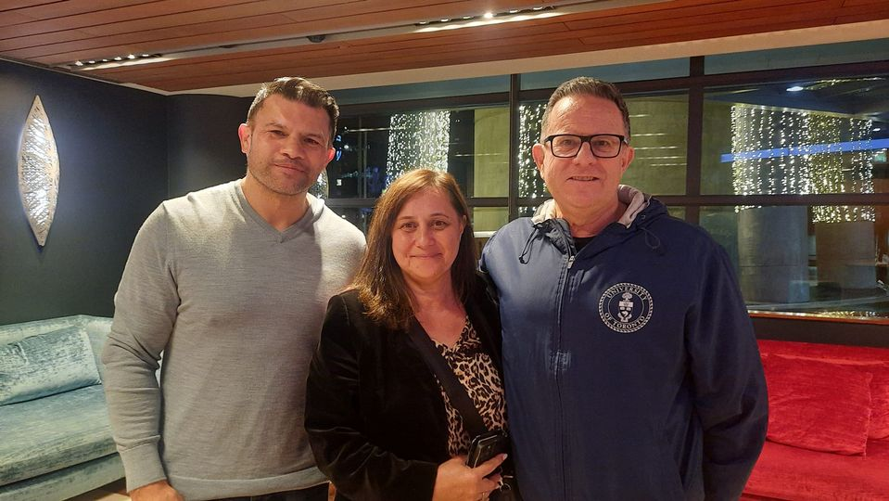
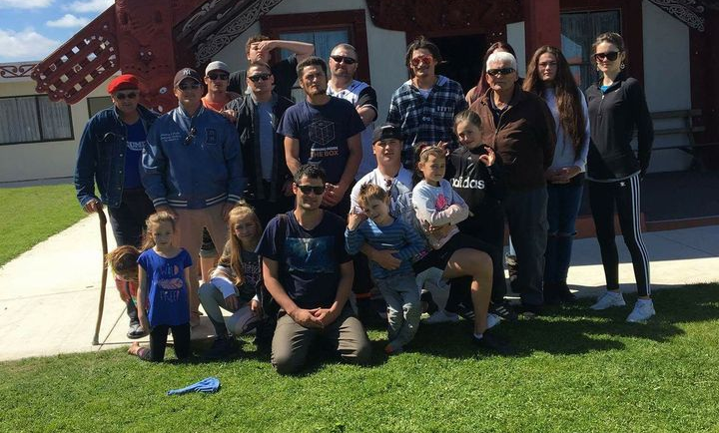
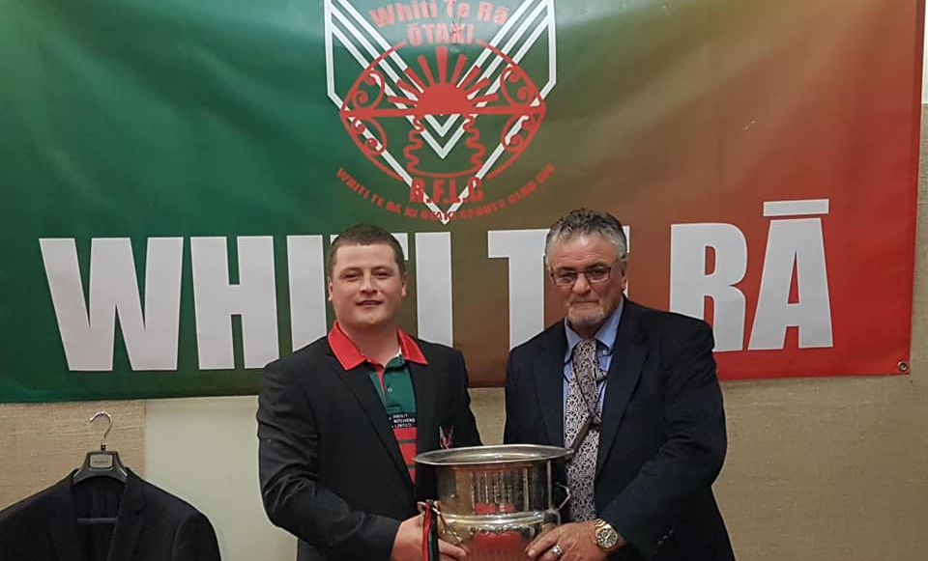
Positionality: “Why am I here?” My work as a researcher and teacher involves more than just an academic exercise but familial obligations.

Slide 4
Introduction
OVERVIEW
Positioning in relation to the kaupapa
Context: The Atlas Network & what the critics said about the Aotearoa NZ histories Curriculum
A new Government (2023) and a convenient ERO report (2024)
A flawed draft social sciences curriculum (2025)
The WAI 3553 claim (Overview)
Focus of my key brief of evidence (Issues G & J)
Other briefs of evidence presented
The Tribunal Reports (Phases 1-2)
PĀTAI?

Slide 5
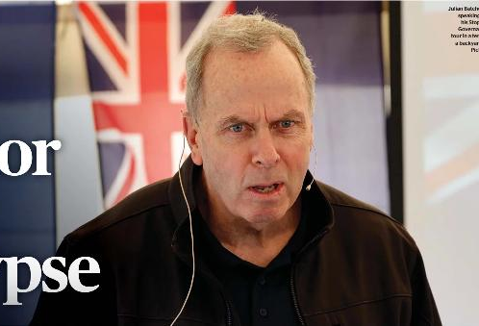
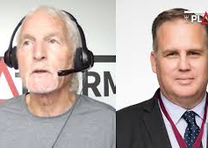

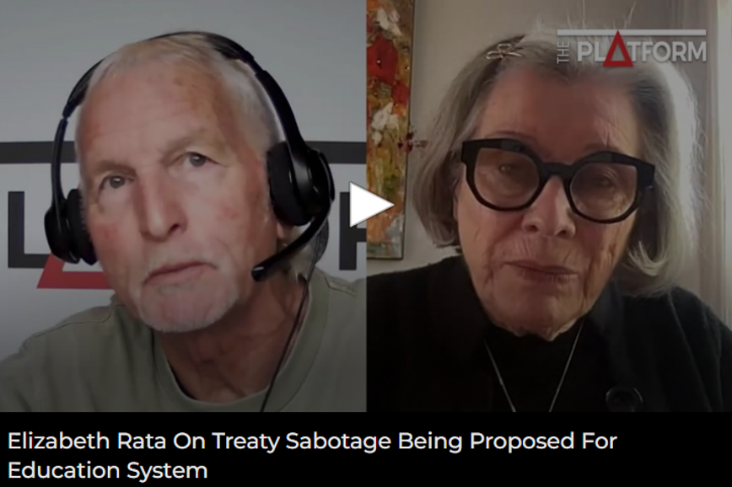
1. The context: Global “culture wars”
The Atlas network & what right-wing critics said about the Aotearoa New Zealand’s Histories Curriculum 2021 - 2026
The Atlas Network: An influential global ecosystem
Julian Batchelor (Retired/registered Primary Teacher)
Roger Childs (Retired/registered Secondary Teacher)
Professor Paul Moon (Auckland University of Technology)
Professor Elizabeth Rata (University of Auckland)

Slide 6
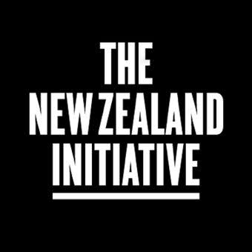


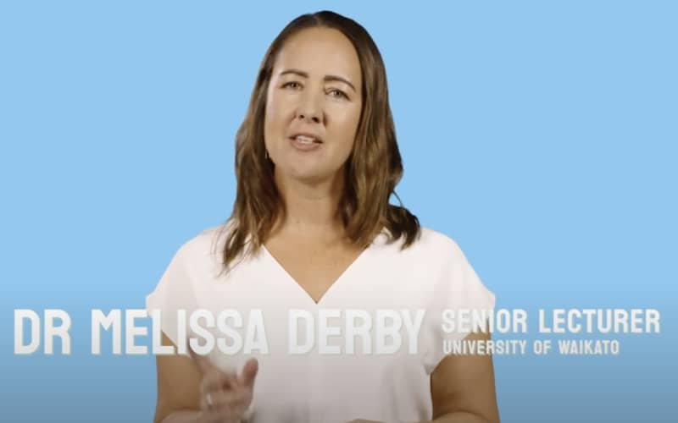
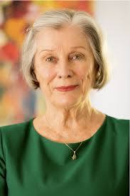
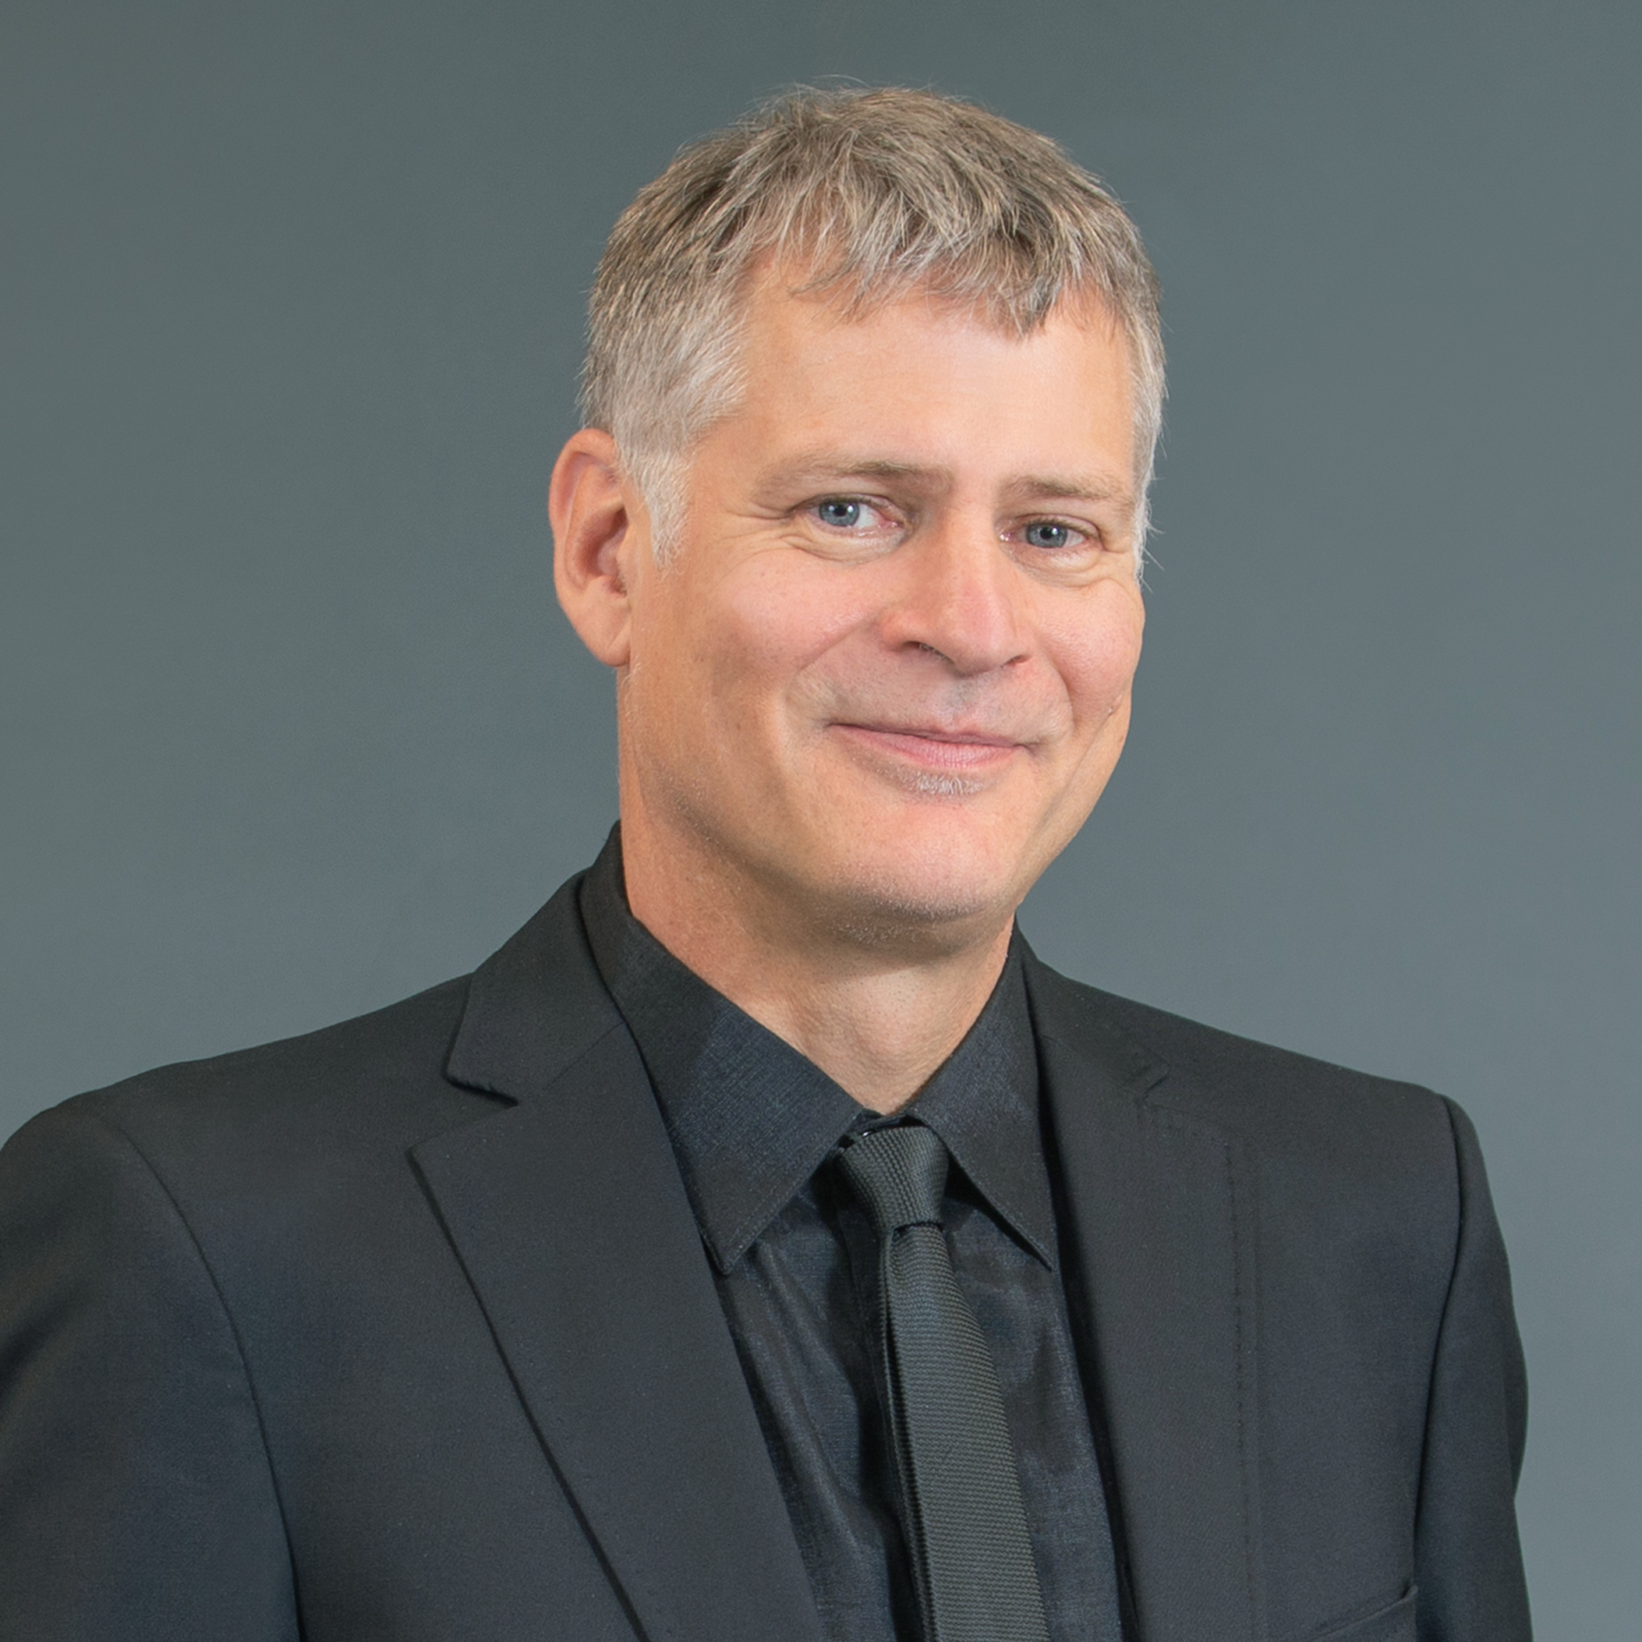
The Atlas Network: A global network and its sphere of influence in Aotearoa
The Atlas Network, is a Washington D.C.-based non-profit organization. It operates in Aotearoa by funding and training free-market think tanks and advocacy groups (i.e. the Free Speech Union). Its sphere of influence includes promoting neoliberal economic policies—such as deregulation, privatization, and limited government—while shaping public sentiment through media engagement. In Aotearoa New Zealand, there are two fully fledged ‘members’ of the Atlas Network:
The New Zealand Initiative
The NZ Taxpayers Union (*Which initiated the development of the Free Speech Union)
Both the NZ Initiative (NZI) and Free Speech Union (FSU) have had significant input into Curriculum reforms since 2023, thanks to the Minister’s appointment of NZI & FSU allies (Michael Johnston, Elizabeth Rata & Melissa Derby) to her Advisory Group (MAG). Now I will pay attention to the History curriculum:

Slide 7

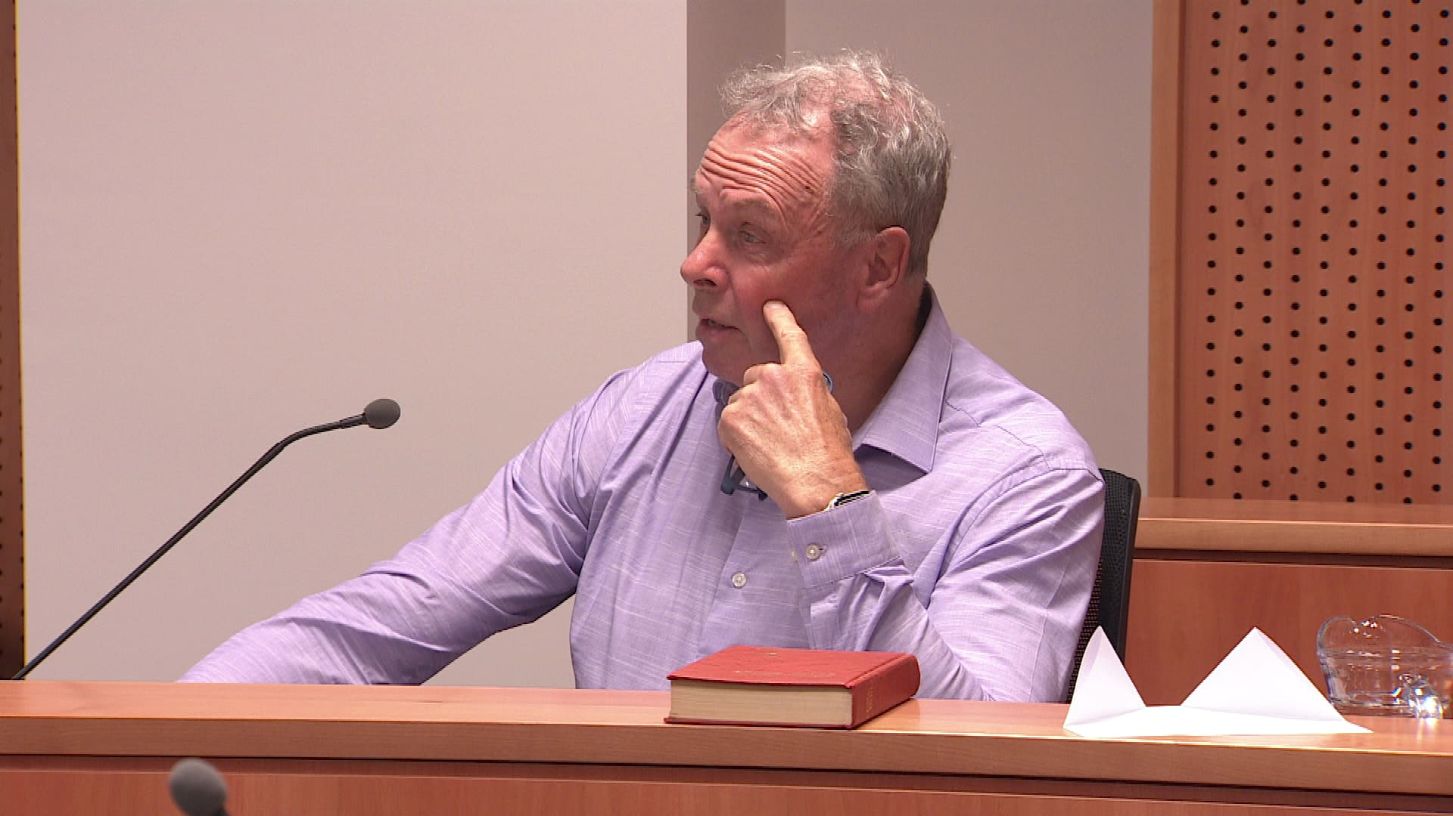
Critic #1: Julian Batchelor Retired (still registered) primary teacher and evangelical preacher:
(Stop Co-Governance Campaign: 2023-)
On his Stop Co-Governance website (2023), Julian Batchelor warned parents that schools are “grooming” their children. He still supports this assertion (2026). His website still claims that schools have purchased copies of a graphic novel about the Treaty of Waitangi – written by Toby Morris, Ross Calman and Mark Derby (2019):
“We believe it to be an attempt to brainwash your children at school with Treaty misinformation […] Your children are being groomed to believe that Māori have been hard done by. The exact opposite is true. Māori get special privileges […] and huge steps have been taken to redress valid injustices (the Sim commission and the full and final settlements of the Waitangi Tribunal). We must go forward to the future based on the truth, not fabrications that come from a revision of history” (Batchelor 2023).
Batchelor’s Stop Co-Governance tour campaign (2023) was eventually inspected by the Electoral Commission (Mitchell 2023). The Commission received complaints that Batchelor’s tour pamphlet flouted the Electoral Act (MacManus 2025). It was alleged that some 550,000 prints of this pamphlet asserted that “a group of elite Māori were planning a coup of New Zealand democracy” (MacManus 2025).
The Commission was also informed that Batchelor’s pamphlet insisted that expecting children to learn te reo Māori is akin to “child abuse,” and that saying words like “kia ora” is equivalent to “heil Hitler” (McManus 2025).
Links to a very rich media mogul: https://www.stuff.co.nz/nz-news/360984942/judge-rejects-billionaire-jim-grenons-bid-stop-media-reporting
(MacManus 2025).

Slide 8
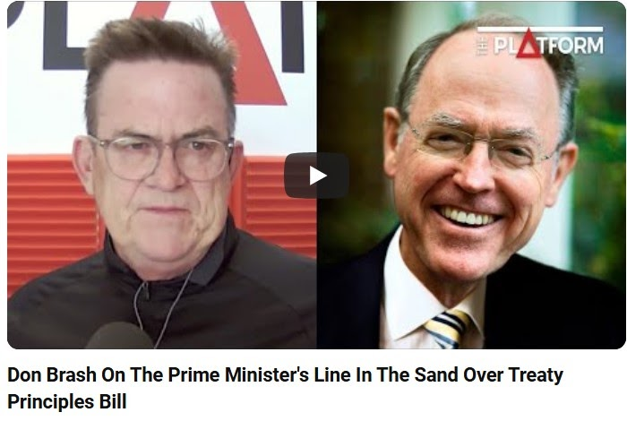
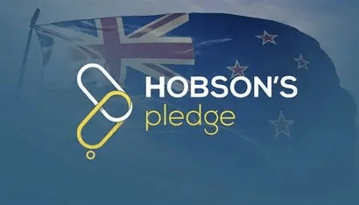
Critic #2: Roger Childs: A retired History teacher’s response to draft Aotearoa NZ Histories Curriculum (ANZHC)
– Supported by Hobson’s Pledge
A former secondary school history teacher, Roger Childs (2021) wrote a select committee submission critical of the draft ANZHC. This was shared on the Hobson’s Pledge website. Amongst his “general comments”, Childs (2021) argued that:
When it was first announced that New Zealand History would become compulsory for Year 1-10 students, respected historian Paul Moon [ my emphasis] remarked that a “warts and all” approach was essential. Moon observed: “Of course there are risks to that if done poorly, compulsory history in our schools could veer into the realm of indoctrination” [My emphasis]. Unfortunately, the developers have fallen into that trap. The draft [ANZHC] document reads more like a syllabus statement for Māori studies than a blueprint for our youngsters studying the history of our country. Of course, the coverage of Māori history is important, but it should not dominate […] Many statements come across as emphatic truths but are in fact debatable opinions. For example, big idea number one, Māori history is the foundational history of Aotearoa New Zealand.”

Slide 9
New Zealand’s History curriculum: Education or Indoctrination?
Roger Childs (2023) published a book critical of the ANZHC. It was published just before the 2023 election: This book was entitled: New Zealand’s history curriculum: Education or indoctrination? It was published by Tross Publishing Company – disparaged for trying to disseminate “racist propaganda” in schools (McCulloch 2023). In addition to Professor Paul Moon, Childs was influenced by Professor Elizabeth Rata. For example, Childs quoted Rata (2022) to advise:
“A well-designed national [History] curriculum of prescribed academic knowledge is the only way to ensure that all New Zealand children are taught the knowledge that builds secondary intelligence. It is the intelligence needed for a modern democratic society. This is the case because democracy is itself an abstract idea – built on networks of abstractions such as freedom, equality and citizenship. The alternative is returning to the pre-modern world of our ancestors. The tribal world managed successfully using primary thinking. This is because kinship relations are material not abstract – we can literally ‘see’ our relations. In contrast, democracy is justified by abstract ideas and abstract relationships – the main one is that of citizenship. For us to understand these abstractions, we must have secondary intelligence.” (Rata 2022a)
Anti-tribalism arguments have been a feature of Rata’s work over the years, and recently rejected in the public domain by Dr Vincent Olsen Reeder (2026) who explains that scholars like Ngūgī wa Thiong’o and Moana Jackson have long reasoned that the word ‘tribe’ is a colonial construct, weaponized by right-wing ideologues to undermine the validity of Indigenous peoples’ political structures and aspirations (Olsen-Reeder 2026, cited in Manning & Mahuika 2026).

Slide 10
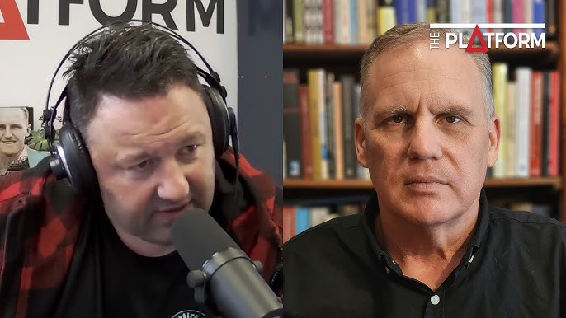
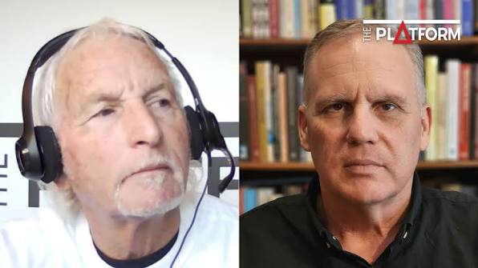
Critic #3: Professor Paul Moon (AUT): 2021-2026
1. Professor Moon argued that: the Ministry of Education had “obfuscated” the details of those academics and teachers who wrote it (Moon 2021a). This claim echoed Karl Du Fresne’s widely publicised assertion that a history curriculum “power grab” was now in motion (Du Fresne, 2021). Roger Partridge of the New Zealand Initiative similarly bemoaned an “unbalanced” compulsory New Zealand History curriculum. Professor Moon would continue to promote this argument re. the “need for “balance”) on right-wing/conservative social media platforms. Yet, his claim was not supported by evidence.
FACT: The Ministry of Education widely publicised the names of those who were involved in writing the draft Aotearoa NZ Histories Curriculum (including its website).
2. Professor Moon also used his appearances on right-wing/social media platforms (to challenge the emphasis the ANZHC placed on a local curriculum approach to enable kaiako (teachers) to engage with Mana whenua, around Aotearoa. This stance notably aligned with that of his former FSU ally Professor Elizabeth Rata (discussed later), and was evident when he drew upon a small amount of anecdotal evidence to advise Dr James Kierstad (NZI) that:
I’ve met with about six or seven history teachers from around Auckland now […]. History teachers now have to develop this curriculum, and it has to contain a great deal. We don’t know how much, of localized content. So, they’re now trying to, I know in the North Shore for example […]. trying to excavate information on that area. And then [teachers] try to produce resources based on that, and content, and assessments. and have that all ready for next year. That’s a big undertaking! A student from Invercargill will not have access to that, they’ll have large part of their curriculum based on Invercargill’s history. (Moon interviewed by James Kierstad, NZ Initiative, 2022)
FACT: This argument is purely based on anecdotal evidence. NZCER and ERO research (shared later) paints a very different picture of teachers enjoying the ANZHC. Both Rata & Moon appear to fear a localised curriculum because of its “decolonizing” potential (Rata).

Slide 11
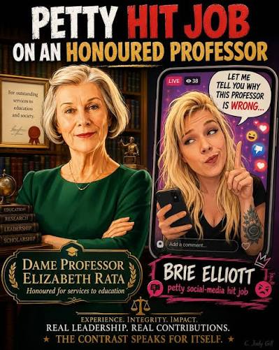
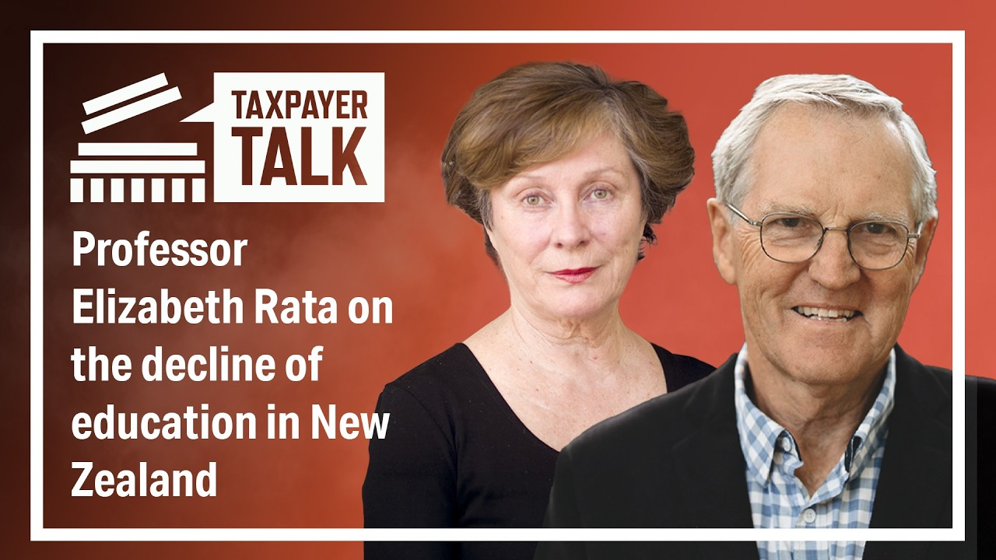
Critic # 4: Professor Elizabeth Rata
On primary (modern democratic) vs secondary (tribal) knowledge: “It is the intelligence needed for a modern democratic society. This is the case because democracy is itself an abstract idea – built on networks of abstractions such as freedom, equality and citizenship. The tribal world managed successfully using primary thinking. This is because kinship relations are material not abstract – we can literally ‘see’ our relations. In contrast, democracy is justified by abstract ideas and abstract relationships – the main one is that of citizenship. For us to understand these abstractions, we must have secondary intelligence.” (the Knowledge Rich Curriculum)
On Ngāi Tahu becoming a “rentier class?” In an op-ed published in the Otago Daily Times, Rata(2025) warned that tribal corporations risk undermining New Zealand’s democratic stability. She argued that large-scale Treaty settlements could shift groups like Ngāi Tahu toward "rentier" status rather than “productive” ones. She also alleged that the History curriculum, like the Treaty settlements process was “ahistorical” and that it needed to be fixed because it was too localised & promoted decolonization. Her view is that Colonisation is not the problem & decolonisation is not the solution.
Te Tiriti & the local curriculum guidelines: Rata argues that democratic nations have been damaged by the forces of localisation, arguing that knowledge which ought to take students 'beyond’ their experience is now replaced by local (“tribalist”) knowledge based in ‘experience.’

Slide 12
A new Government (2023) & ERO’s review of the implementation of the ANZHC (2024)
Minister Stanford’s rationale for the restoration of “balance” was informed by only one piece of research. This ERO report (2024) is flawed for these reasons:
• The ERO only reviewed the implementation of the ANZHC in English Medium schools, thus ignoring Kaupapa Māori and Māori Medium. The ERO Report therefore marginalised Kaupapa Māori and Māori Medium Education settings & paid scant regard to the implementation of Te Takanga o Te Wā (Māori histories curriculum) because:
• Only one kaumatua was interviewed. The ERO research team did not interview Iwi or hapū historians etc. No Māori academic experts
• ERO withheld information re. the identities of “academic experts” it advised the authors (Manning & Mahuika) were involved in this study (Our correspondence with ERO, and the Ombudsman, is available from Richard Manning on request).
• The report was conducted in great haste. Data began to be collected less than a year after the commencement of mandated teaching had commenced (2023). Kura and schools required more time and resources to implement the ANZHC effectively before its effectiveness was evaluated by the ERO.
• An independent (NZCER) research team expressed grave concerns that ERO had overlooked the fact that the ANZHC had only recently been implemented. They concluded that teachers were understandably focused on strengthening the teaching of Māori and local histories –because these subjects constituted new content (Bolstad, Bright, Palmer, Durie, and Barnes, 2024).
The Minister of Education (2024), and ERO officials (2024) also seem to have overlooked findings to emerge from the ERO data that indicated there was also much to celebrate:
• ERO found three quarters of teachers it surveyed felt confident in understanding the content and 90% enjoyed teaching it, because they can make learning more meaningful and relevant to the lives of the ākonga they teach (Gerritsen 2024).
• ERO concluded that the ākonga it surveyed are twice as likely to enjoy ANZHC when learning about New Zealand’s place in the world, and twice as likely to enjoy it when learning is directly connected to their whānau, community and people like them. Māori and Pasifika students especially enjoyed the new ANZHC.

Slide 13
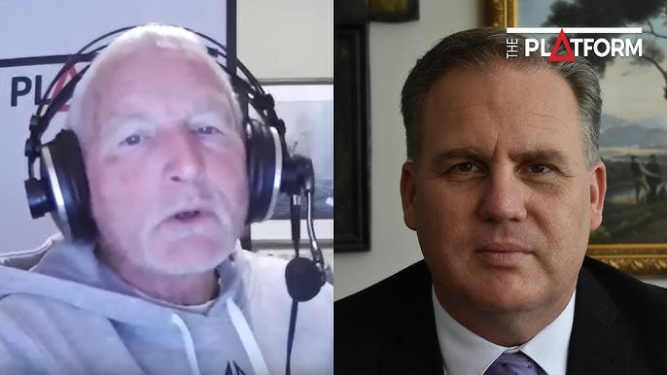
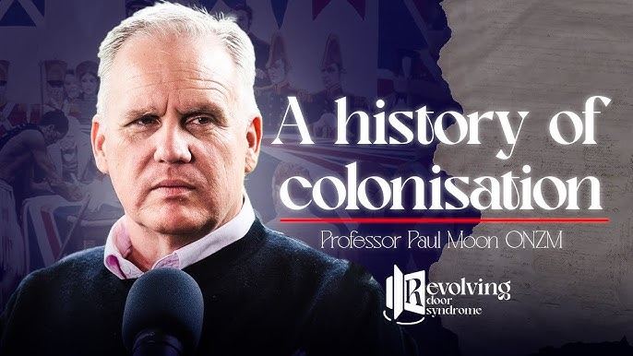
The Draft Social Sciences Curriculum (2025): Significant concerns re. secrecy & content
Who wrote the draft Social Sciences Curriculum?
When we used the Official Information Act to request this “public information” from Minister Stanford, she claimed she only spoke to Professor Moon on the “telephone” for “five minutes” (not the 30 minutes she entered in her proactive diary releases). Stanford insisted they simply discussed the draft Social Sciences curriculum, “before it was released” for public consultation (Erica Stanford, personal communication, 27 February 2026: available on request).
A few days after his discussion with Stanford (29 October 2025), Moon wrote an opinion piece for The Post that coincided with the recent release of the draft Social Sciences curriculum. From the outset of that article, Moon insisted he was politically “neutral” and that he had enjoyed working with Ministry officials to develop the draft Social Sciences curriculum.
Moon’s claim to political neutrality does not appear plausible given his well-documented ties to his former FSU colleagues within the Minister’s Advisor Group (MAG). As noted earlier, Erica Stanford appointed Professor Elizabeth Rata to the Ministerial Advisory Group (MAG). She was joined on the MAG by Dr Melissa Derby. Both Rata and Derby were well known to each other and to Professor Moon. Like Moon, they had collaborated as active members of New Zealand’s Free Speech Union (FSU).
The FSU sits within the global ATLAS Network’s sphere of influence due to its close ties to the New Zealand Taxpayer’s Union (NZTU). The FSU has shared leadership and office space with the NZTU which is indicative of its members’ tacit alignment with the libertarian ideology central to the global ATLAS Network’s project (Williams 2025). It must also be recognized that Professor Elizabeth Rata and Professor Moon co-chaired the FSU’s crusade to end “cancel culture” within universities (Free Speech Union 2025).

Slide 14

2. WAI 3553: Urgent Claim
Setting the scene (video): https://www.youtube.com/watch?v=DRIT_9Ut3jg
My role in this claim? My Evidence was written and presented upon a request for support from Te Riu Roa/New Zealand Education Institute which covered the following issues of concern. As a result, I worked closely with Annette Sykes, claimants’ counsel. I also collaborated with PPTA members – particularly Bevan Holloway & Alicia Poroa in the development of the claim.
My contribution (RM), initially focused on Issue J, but I was soon asked to write another two other briefs to cover all the issues listed below.
The focus of this presentation, however, will be to discuss the evidence I presented to the Tribunal critical of the Government’s attack on the Aotearoa NZ Histories Curriculum / Te Takanga o te wā (Issues G & J):
  Issue (e) — To what extent was the removal of Section 127(1)(d) inconsistent with the principles of te Tiriti?
  Issue (g) — In what ways will the proposed curriculum framework change the significance of te Tiriti as a foundational principle? Specifically, how will it change the way te reo Māori, tikanga Māori, mātauranga Māori, and Aotearoa histories are taught?
  Issue (h) — Does the timeframe for the public submissions process allow for meaningful change? [Te Marautanga o Aotearoa]
  Issue (i) — Has the Crown's engagement with Māori over curriculum changes been te Tiriti-compliant?
  Issue (j) — What prejudice, if any, arises for Māori as a result of the proposed curriculum changes?

Slide 15
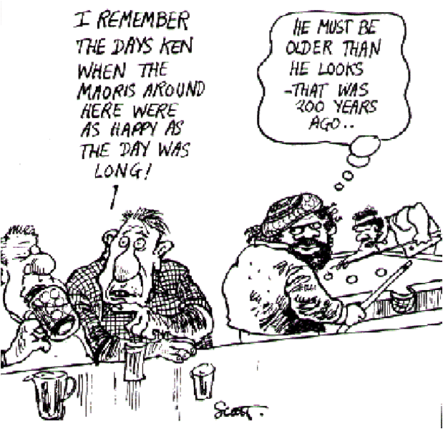
3. Focus of my joint brief of evidence: Issues G & J
(Co-authored with Dr Nēpia Mahuika: Ngāti Porou)
The focus of this affidavit addressed three issues:
The political drivers behind the government’s push to “restore balance” to the Aotearoa New Zealand Histories Curriculum & Te Takanga o te wā (Ministry of Education 2022).
Who has, and has not, been included in the writing and review of the History Strand within the draft Social Sciences Curriculum (Ministry of Education 2025).
The prejudicial impact of a standardised national history curriculum.

Slide 16
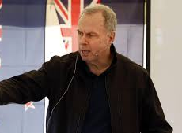

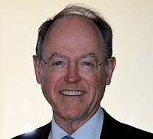
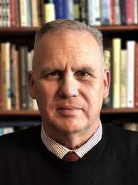
Affidavit issue #1:
What were the political drivers behind the NACT government’s push to “restore balance” to the Aotearoa New Zealand Histories Curriculum & Te Takanga o te wā?

Slide 17
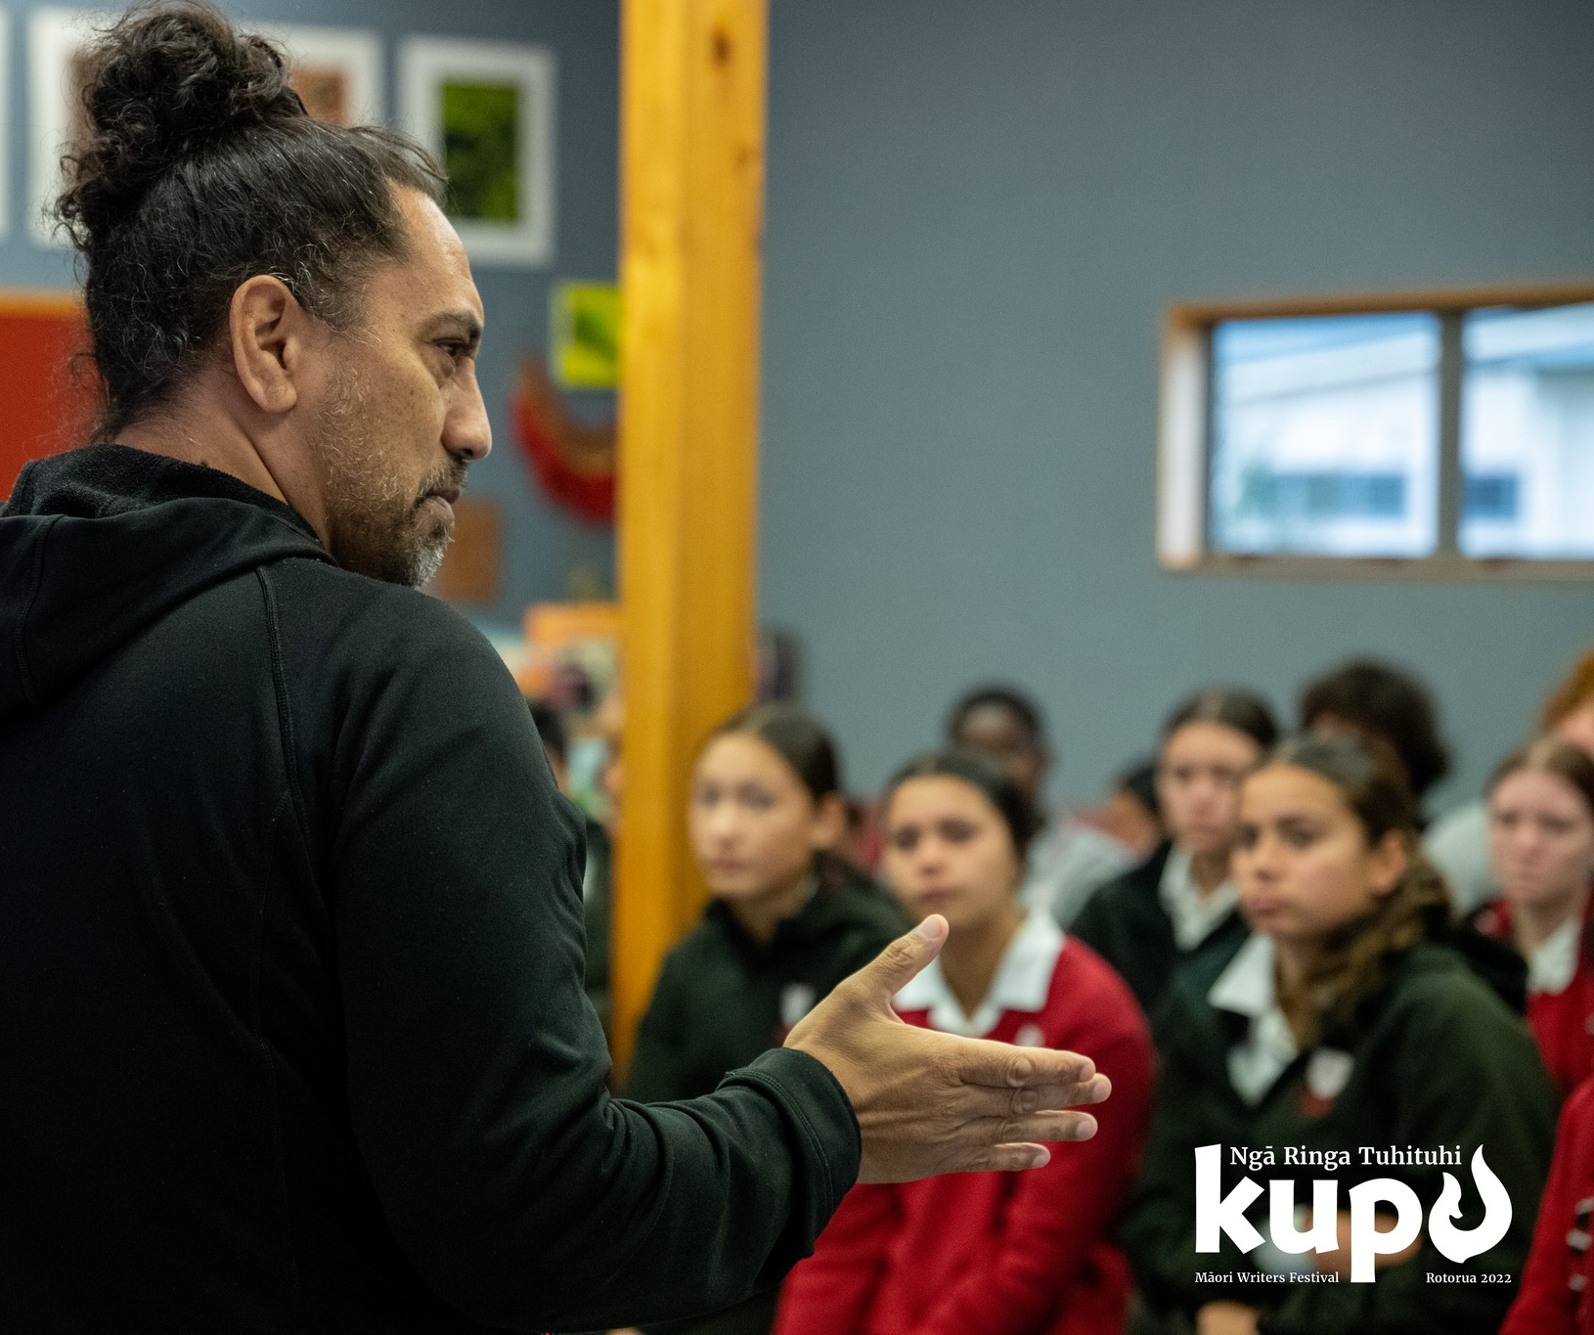
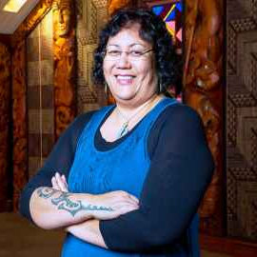
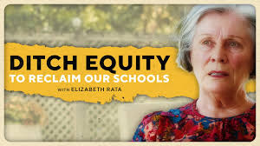
Affidavit issue #2:
Who has, and has not, been included in the writing and review of the History Strand within the draft Social Sciences Curriculum (*My refusal)

Slide 18

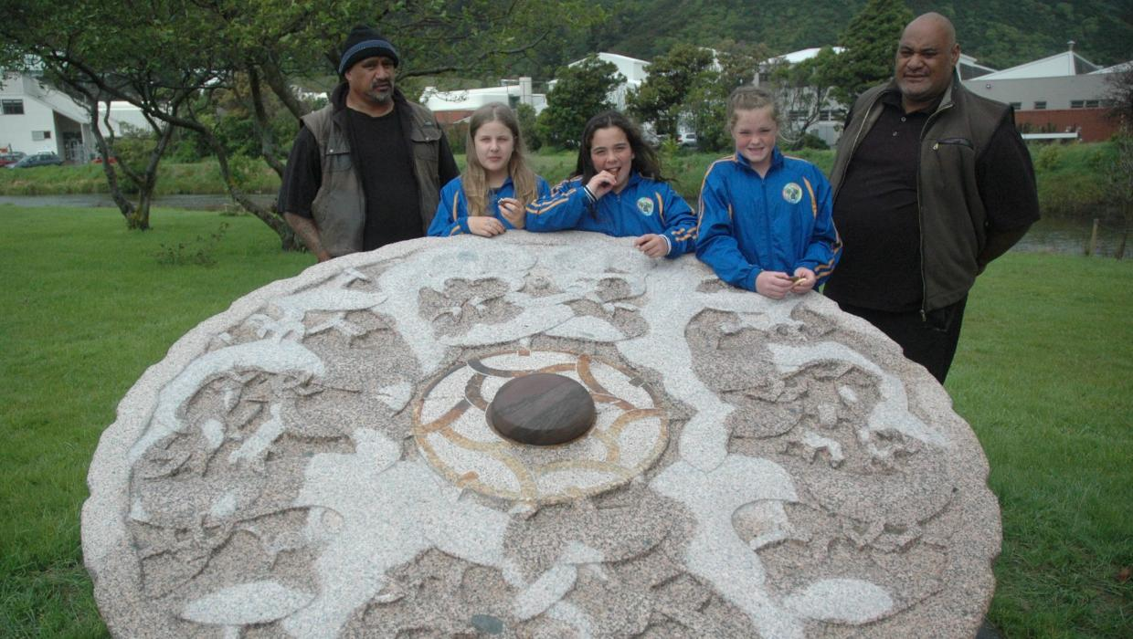
Affidavit issue #3
The prejudicial impact of a standardised national history curriculum: What do you think?
https://www.stuff.co.nz/entertainment/arts/86374845/third-sculpture-on-the-waiwhetu-sculpture-walk-tastefully-unveiled
https://www.stuff.co.nz/timaru-herald/news/71215160/arowhenua-maori-schools-place-based-learning-works-says-principal

Slide 19
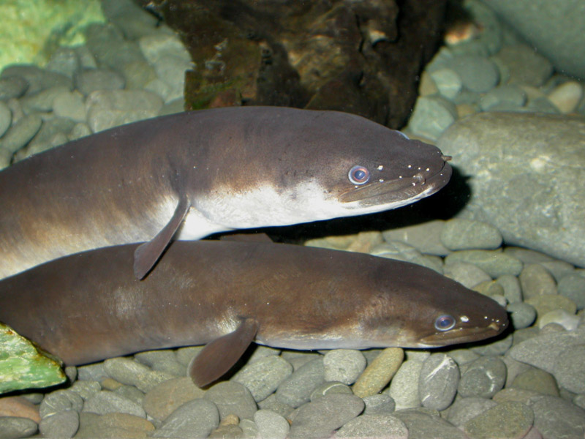

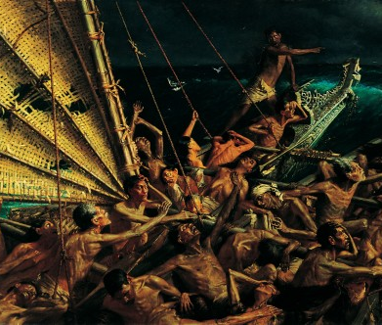
Key concerns about the draft Social Sciences Curriculum History Strand:
History is only a strand within an already overcrowded (hīnaki-like) Social Sciences curriculum – where it must compete for time & space with other subjects
No guarantees local or Manawhenua histories will be taught (only optional)
Lack of a conceptual understanding framework to guide critical thinking & skills development
History education or indoctrination? (Push for “balance” resembles Great replacement myth)
Social Darwinist logic re. positioning of pre-European Māori histories alongside “stone age cultures”
A Eurocentric curriculum = colonial cringe
Sins of omission: Many things are missing and, most notably, freeze-framing Moriori histories in the musket wars era only reinforces negative stereotypes

Slide 20
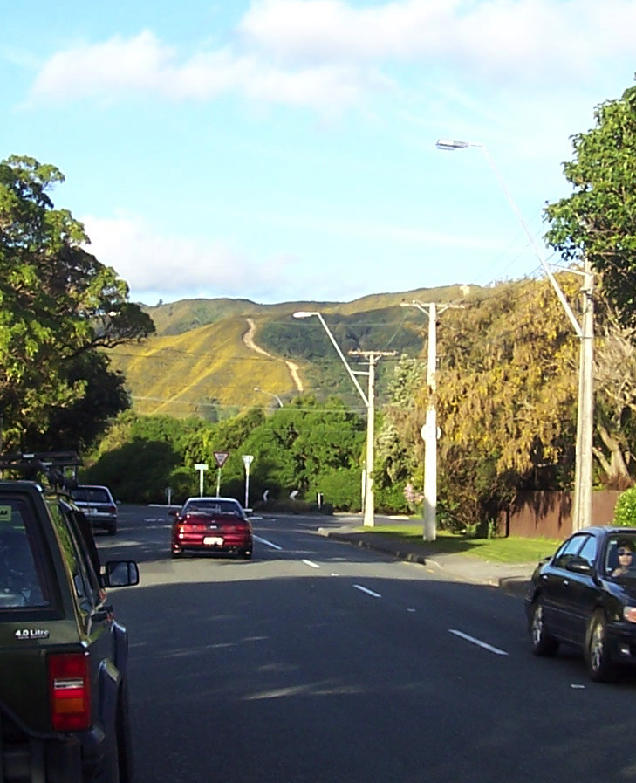
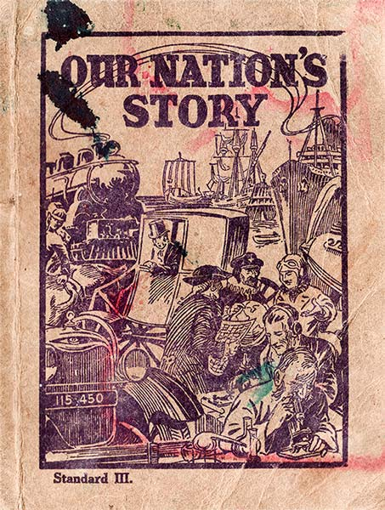
The land is a text: We need to free the teaching of history from textbook authors & ‘official’ Knowledge

Slide 21
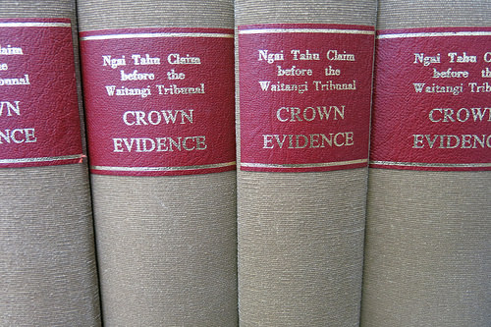
Other Briefs of evidence presented:
Replies to Pauline Cleaver: Deputy Secretary for Education
Joint brief of evidence with Bevan Holloway (Paraparaumu College): Ideological capture?
Joint brief with Jessie Moss (NZEI): Te Marautanga now a carbon copy (translation) of the NZC?
PPTA presentations by Alicia Poroa, Jane Jarman & Bevan Holloway should also be explored by PPTA Māori teachers.

Slide 22
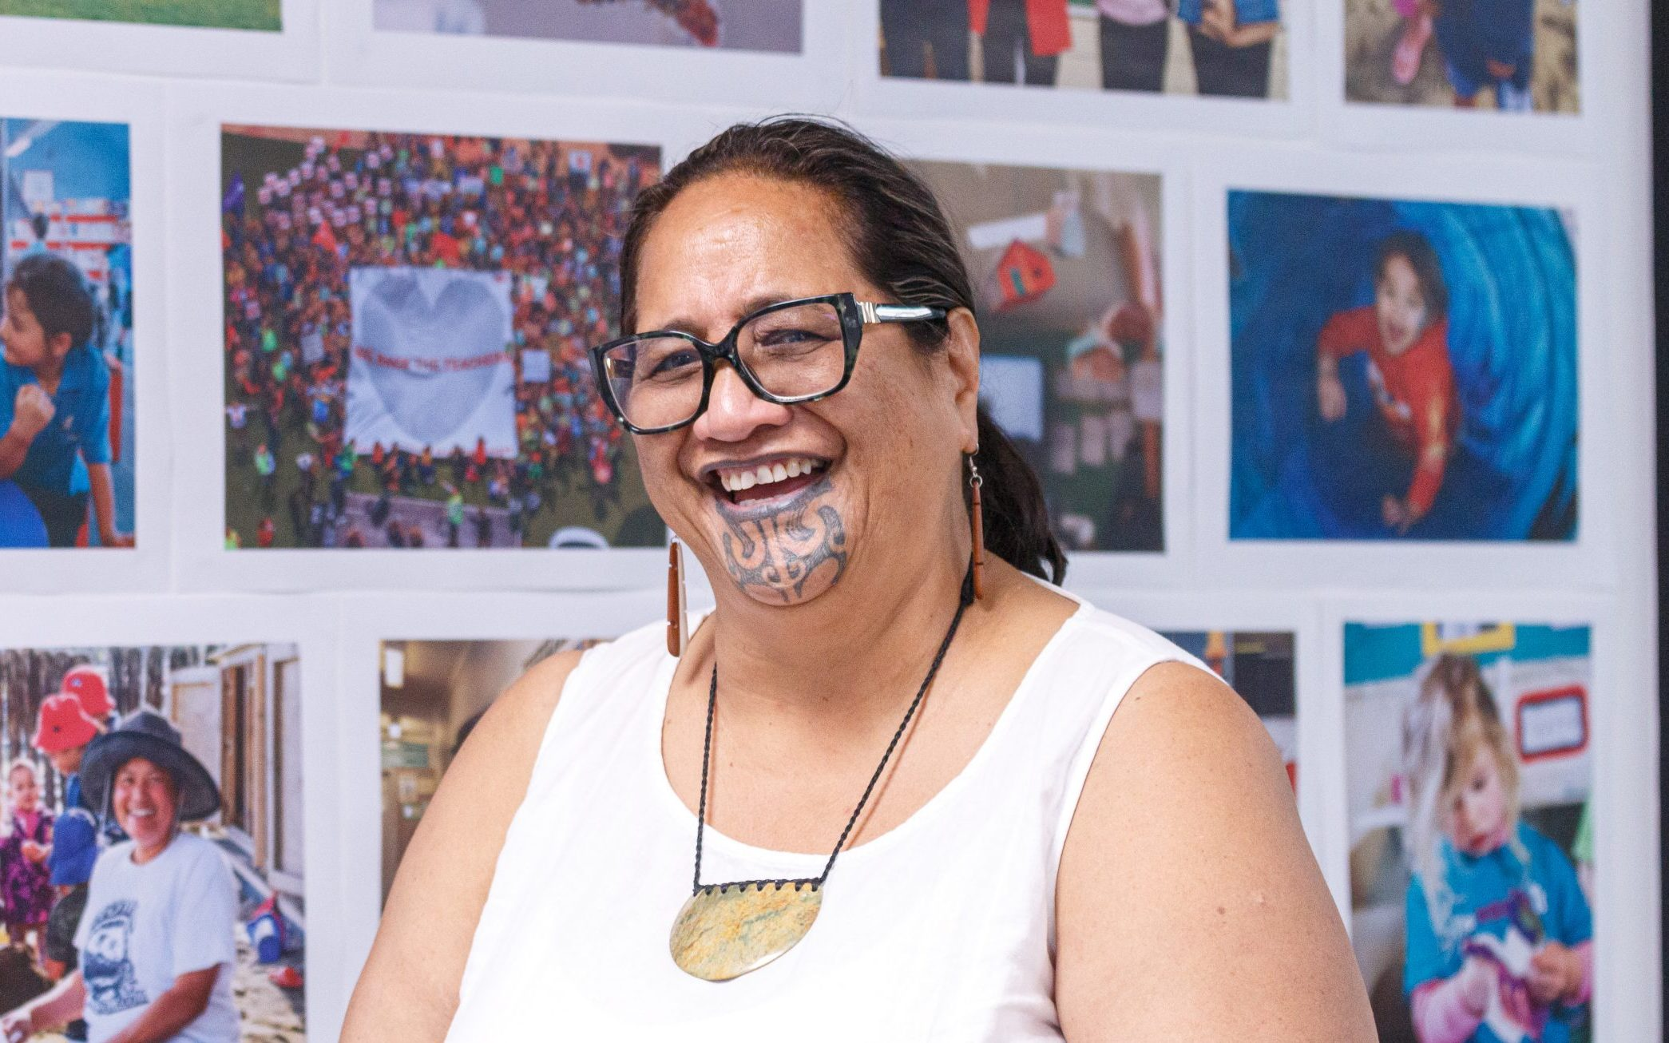
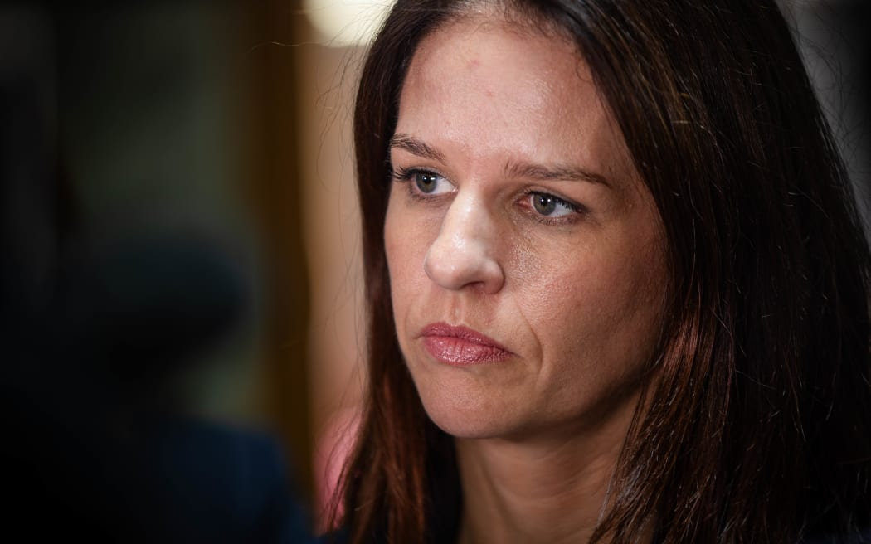
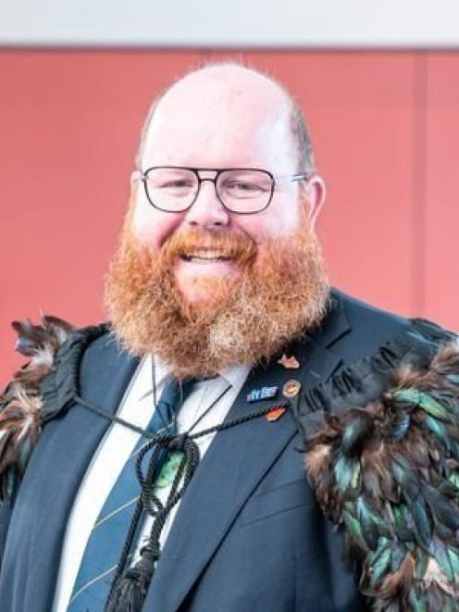
5. The Tribunal Reports
Phase 1: Hūtia te Rito o te Harakeke, kei Hea te Kōmako e Kō? (Waitangi Tribunal, Phase 1 report): https://waitangitribunal.govt.nz/mi/news/tribunal-releases-report-on-proposed-changes-to-the-education-and-training-act
Phase 2: TBC (due July?)

Slide 23

Pātai?

Slide 24
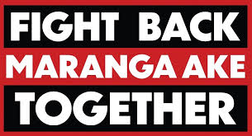
Some key references
Batchelor, J. (2023). A school Resource on the Treaty: Truth and error weaved together. Sop Co Governance – Grooming in Schools. https://stopcogovernance.kiwi/school-propaganda/
Bolstad, R., Bright, N., Palmer, G., Durie , K., and Barnes, A. (2024). Teaching and learning about the histories of Aotearoa New Zealand: School leaders and kaiako experiences with early curriculum implementation. New Zealand Council for Educational Research. https://www.nzcer.org.nz/research/publications/teaching-learning-histories-aotearoa-new-zealand
Childs, R. (2021). Roger Childs: School curriculum histories submission. Hobson’s Pledge. https://www.hobsonspledge.nz/roger_childs_school_curriclum_histories_submission
Childs, R. (2023). New Zealand’s history curriculum: Education or indoctrination? Tross publishing.
Olsen-Reeder, V. (2026). Why the word ‘tribe’ makes some Māori uneasy. Spinoff, March 9, 2025. https://thespinoff.co.nz/atea/09-03-2026/why-the-word-tribe-makes-some-maori-uneasy
Free Speech Union (2025). Academics of New Zealand unite against a culture of fear. Free Speech Union. https://www.fsu.nz/membershippages/academics
Partridge, R. (2021). Unbalanced compulsory NZ History curriculum lacks humanity. The New Zealand Initiative: Reports & Media , March 27, 2021. https://www.nzinitiative.org.nz/reports-and-media/opinion/unbalanced-compulsory-nz-history-curriculum-lacks-humanity/
Kierstad, J. (2022). Interview with Paul Moon: The Treaty of Waitangi; Cannibalism; The school curriculum; Academic freedom. Free Kiwis Podcast (August 10, 2022). 34.16 to 52.36. https://www.youtube.com/watch?v=bQ95sOy__c0
MacManus, J. (2025). Inside the weirdest trial of the year: Jim Grenon, Julian Batchelor and TVNZ. The Spinoff: Media (December 19, 2025). https://thespinoff.co.nz/media/19-12-2025/inside-the-weirdest-trial-of-the-year-jim-grenon-julian-batchelor-and-tvnz?brid=h98F3SsAHk7IdGKu4zmksg
Moon, P. (2021a), New History Curriculum Off to a Worrying Start. Newsroom (October 15, 2021). https://www.newsroom.co.nz/new-history-off-to-a-worrying-start
Moon, P. (2021b). More on our unsatisfactory history curriculum – Interview with Sean Plunket. The Platform. https://www.democracyaction.org.nz/more_on_our_highly_unsatisfactory_new_nz_history_curriculum
Rata, E. (2022). Elizabeth Rata: The Curriculum, intelligence, and democracy. The Democracy Project. https://democracyproject.nz/2022/11/21/elizabeth-rata-the-curriculum-intelligence-and-democracy/
Rata, E., (2025). Ngāi Tahu ambitions for the South Island. Bassett, Brash & Hide. https://www.bassettbrashandhide.com/post/elizabeth-rata-ngai-tahu-ambitions-for-the-south-island
Stanford, E. (2024). ERO reports confirms need for clearer curriculum. Beehive (New Zealand Government), April 4, 2024. https://www.beehive.govt.nz/release/ero-report-confirms-need-clearer-curriculum

