Slide 1
Poia te wānanga
Poia te ao mārama
Swing poi into existence
Swing poi into the world of enlightenment
Notes:
Mukarau Poia te Wānanga Poia Te Ao Marama Muka (Raupō) play on words to mean many threads, that bring the Poi to existence. Like those who come to discuss and share with you. Swing Poi into the consciousness of awareness. Swing Poi to the world of enlightenment that allows space for ALL to engage and enjoy

Slide 2
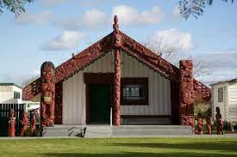
Ko wai au?
Ko Pūtauaki te maunga
Ko Rangitaiki te awa
Ko Ngāti Awa te Iwi
Ko Mataatua te waka
Ko Uiraroa te Marae
Ko Ngai Tamawera te hapū
Ko Ruaroa te tangata
Ko Hākaiatua te taniwha.
Ko Reweti Elliott ahau.

Slide 3
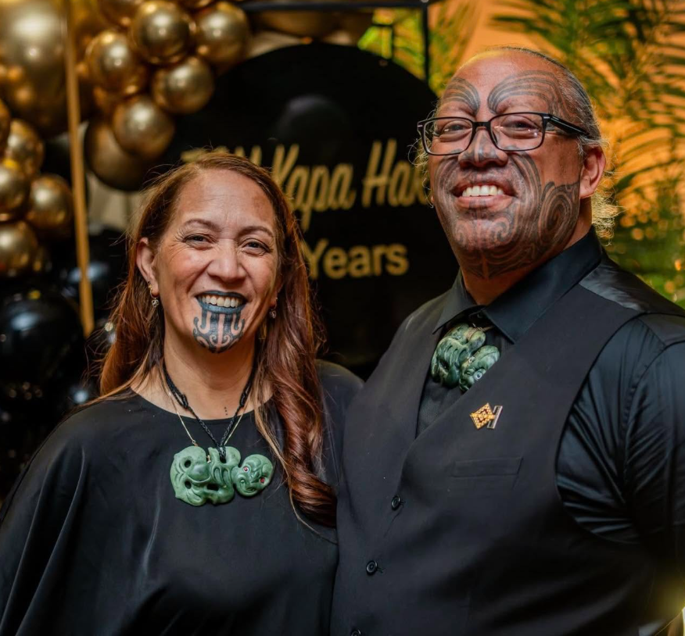
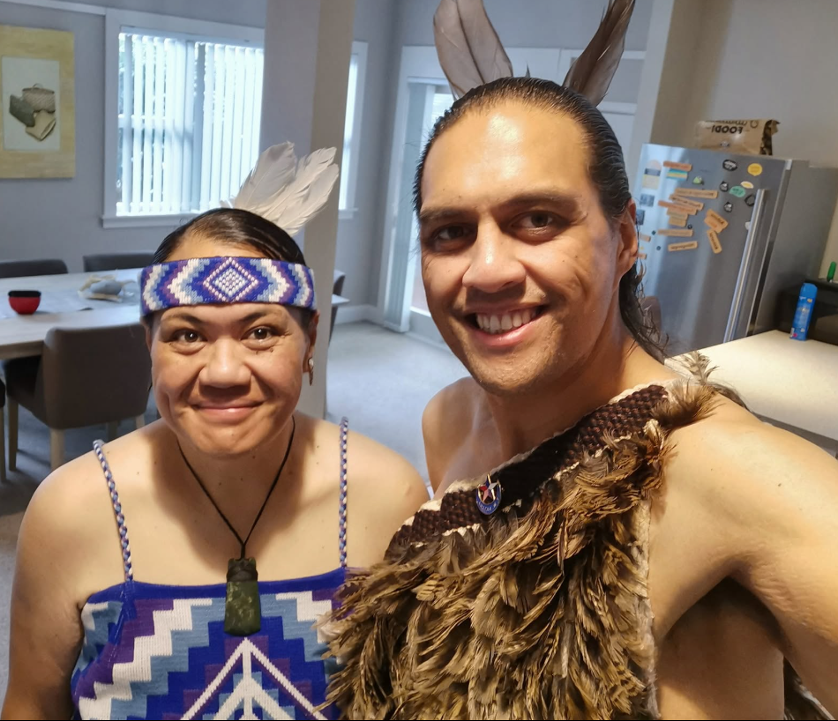
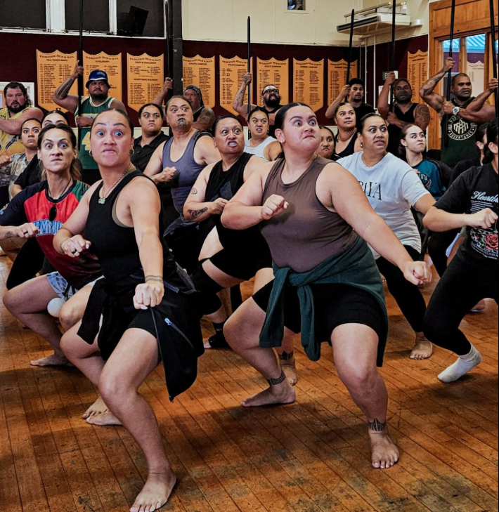
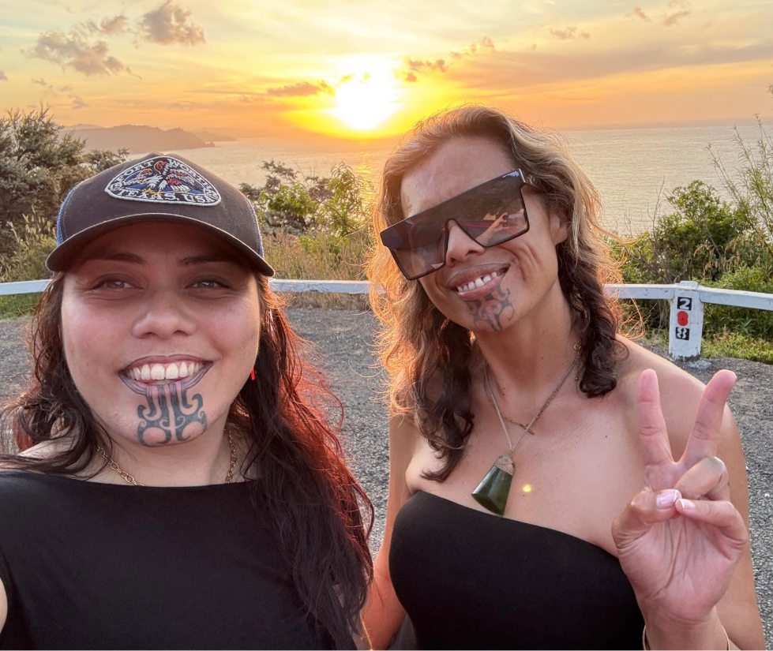
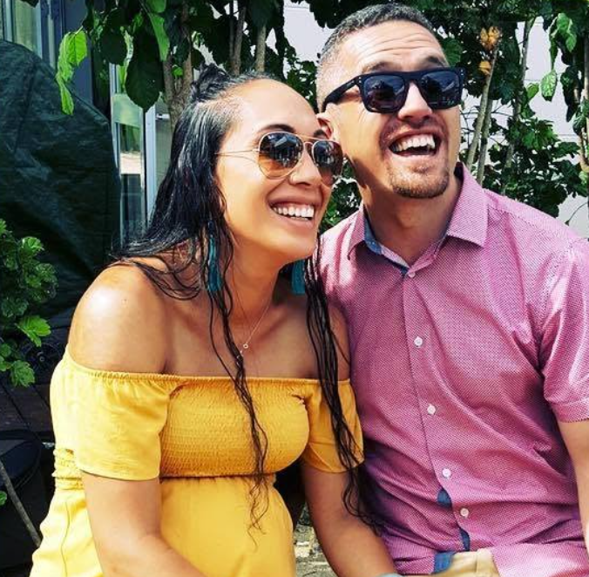
Aku mahi
Notes:
So your most probably sitting there wondering to yourself,
Who am I in the haka world and what experience have I had in Haka.
My answer is always, You may not know me as an individual
But you most probably have seen my work.
Te Pou o Mangatawhiri 2006-2026
Te Iti Kahurangi 2015-2025
Tutarakauika ki Rangataua 2014-2026
Te Tini o Awa 2024-2026
Te Koko Tangiwai

Slide 4
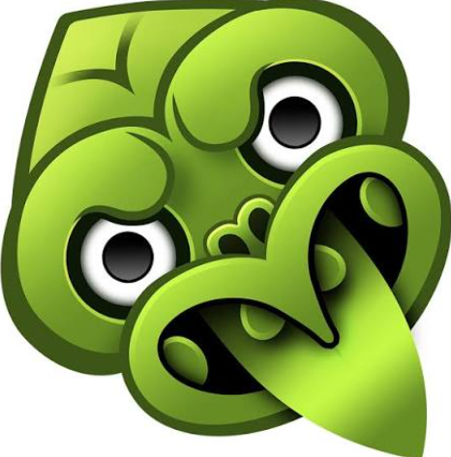
Whakapapa

Slide 5
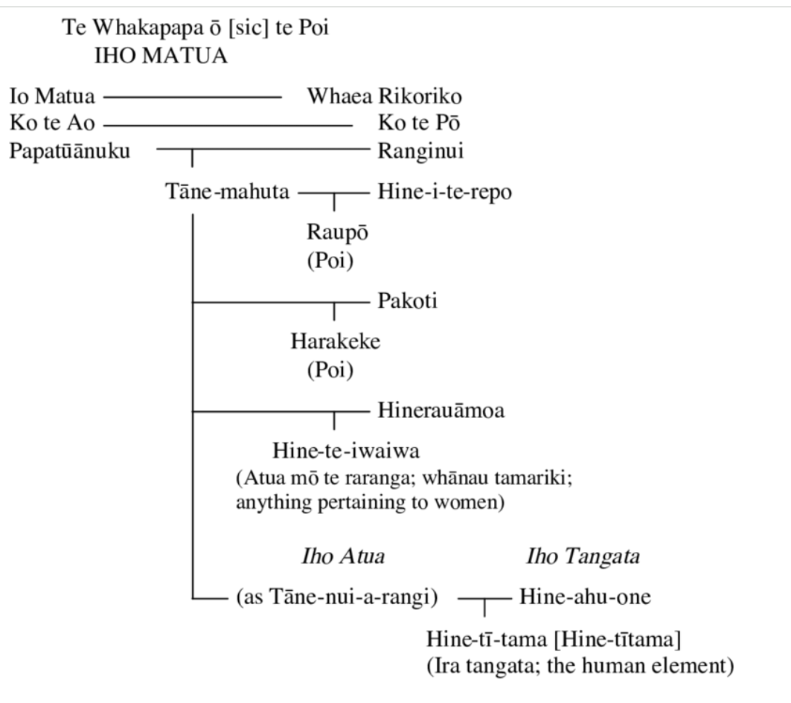
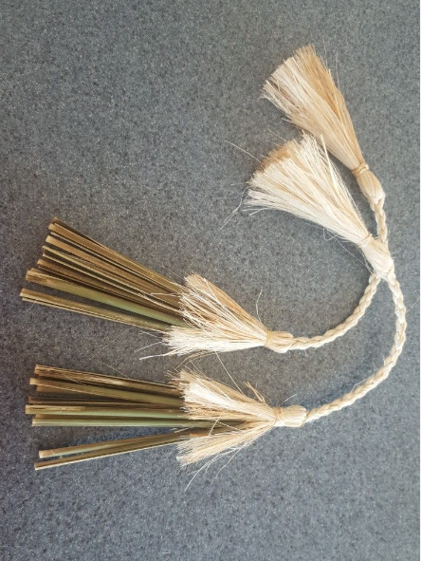
I ahu mai te poi Ihea?
Notes:
Whaea Rikoriko | the feminine energy source - the first glistening light when there was only darkness
Hine I te huhi
Tāne (God of the forests and birds) separated his father and mother he set about providing means for his mother to be protected and cared for. One of those means was the great forest of Tāne and repo plays an extremely important part in Te Waonui a Tāne (forest mythology). In this account, Tāne created the repo as the kidneys for Papatūānuku, acting as a natural cleansing mechanism for her body. These were named Ngā Whatukuhu o Papatūānuku, the kidneys of Earth Mother.

Slide 6
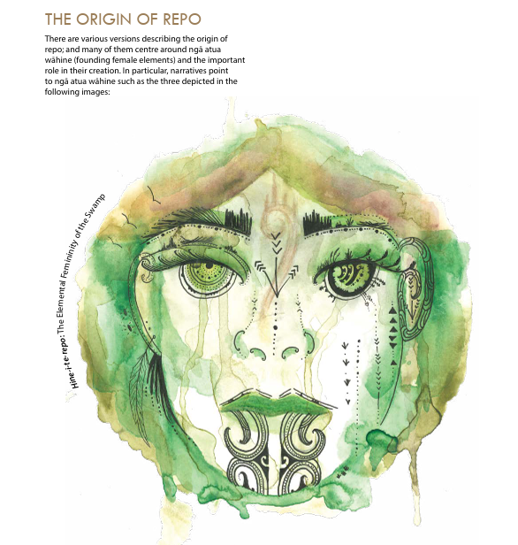
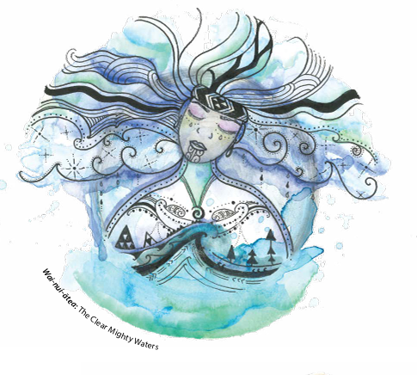
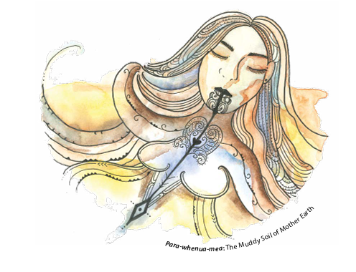

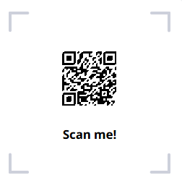
I ahu mai te poi Ihea?
Notes:
In a version from the Waikato region (North Island), Tangaroa (God of the oceans) had three wives:
• Hine-i-te-huhi – the union with Tangaroa descend repo
• Hine-Moana – the union with Tangaroa descend roto and awa
• Ikatere – the union with Tangaroa descend ika (fish)
A version from Te Waipounamu (South Island) notes that Hine-i-te-huhi and Hine-i-te-repo are the personified versions of swamps. Hine-tū-repo one of the wives of Māui (Polynesian demigod), was ravished by Tuna or Puhi, personified form of the eel.
In a version from the Waikato region (North Island), Tangaroa (God of the oceans) had three wives: • Hine-i-te-huhi – the union with Tangaroa descend repo • Hine-Moana – the union with Tangaroa descend roto and awa • Ikatere – the union with Tangaroa descend ika (fish)4

Slide 7
Taha Wairua

Slide 8
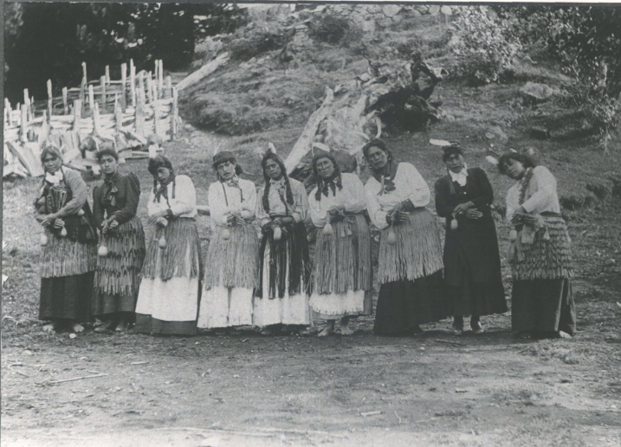
Taranaki
Notes:
Ko Te poi he taonga i tukuna iho e kui e koro ma. Hei Kinaki atu, ki roto ki nga mahi a Rehia.
Ki etahi o tatou, ko tona tino kaupapa ko te whakangahau i te iwi
Engari ki roto o Taranaki whanui he rereke te kaupapa i whakaritea iho mo taua taonga ra
Poi is a practice handed down by our ancestors
For some of us, it is a form of entertainment
But in Taranaki it carries other particular significances

Slide 9
Taranaki
“Hei aha ra te manu, Ko taku ringa te manu, Hei aha ra te manu, Ko taku poi te manu” What is the bird? The bird is my hand, What is the bird? The bird is my poi”
Notes:
The korero originated from a love ditty, something used to enamour women. Heoi ko te karakia tuturu nei “He aha ra te manu, Ko te Pitore te manu, He aha ra te manu, ko te kaarewa te manu”
What is the bird? It is a wood robin, what is the manu? It is the bush hawk? He tauira i kapohia ake, hei haangai ki nga āhuatanga o te wa.
Poi was a source where the people of Taranaki were able to express or make their statements of resistance, a sort of right to exercise their authority over themselves and their lands.
Poi served to achieve this by communicating to other hapu, about kaupapa that was happening at that time.
That is the importance of poi, its to convey its message beyond just our whenua but take our message to the world.

Slide 10
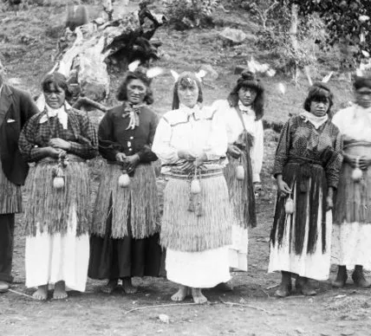
Poi Groups
““Ma wai hei tiki te motu, te ao e riro mai ai, ma taku poi e haere te whenua, ma haku rongo e tipi te whenua”
Notes:
In times past they would create Poi Groups or teams, and each had its own name, like Paopao ki te rangi, Te Morehu, Te Puapua and so fourth. They would gather and consider how to express their issues, to clarify and share among the other teams. Today we have devices that is accessible at the snap of a finger, but in those times, we had to figure a way to express our selves and this is the role that poi played specifically in Taranaki, Parihaka.
Poi was their Radio, TV, Internet, Facebook and many other platforms that we have today.
Today Poi is used as a format, where only woman perform it, its alluring, its entertainment, its enegetic, but in those days poi was the messenger,
Don’t think that the Poi message was limited to just Taranaki or Aotearoa,
“Ma wai hei tiki te motu, te ao e riro mai ai, ma taku poi e haere te whenua, ma haku rongo e tipi te whenua” Who will have influence over the land, indeed the world? My Poi will travel the land, news of my deeds will traverse the oceans.
The importance of poi, is to convey its message beyond just our whenua but take our message to the world.

Slide 11
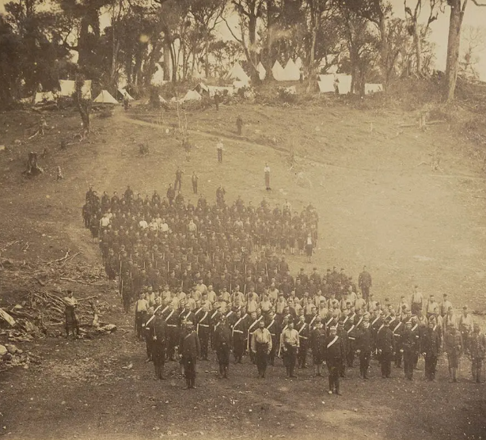
Paopao ki Rangi
“Hei aha ra te manu, Ko taku ringa te manu, Hei aha ra te manu, Ko taku poi te manu” What is the bird? The bird is my hand, What is the bird? The bird is my poi”
Notes:
The drum has many significances, It is said to resemble the sound of the footsteps of the colonial soldiers when they were approaching Parihaka. Taranaki used it to motivate themselves rather than feel powerless but stare the forces in the eyes.
It resembled the heartbeat of the people, who were left behind once the men had been taken away.
Go over the ringa Being shackled, being restricted in movement.

Slide 12
Ngā Āhai

Slide 13
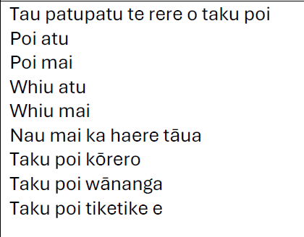
Karakia

Slide 14
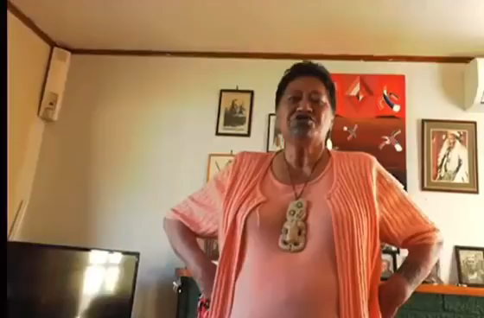
Ngā Ahai o te poi
Taupeka
Taokurukuru
Poi Purutia
Poi Porotia
Porotiti
Tirairaka
Makea Whakarunga
Makea Whakararo
Taupatupatu
Tauparepare

Slide 15
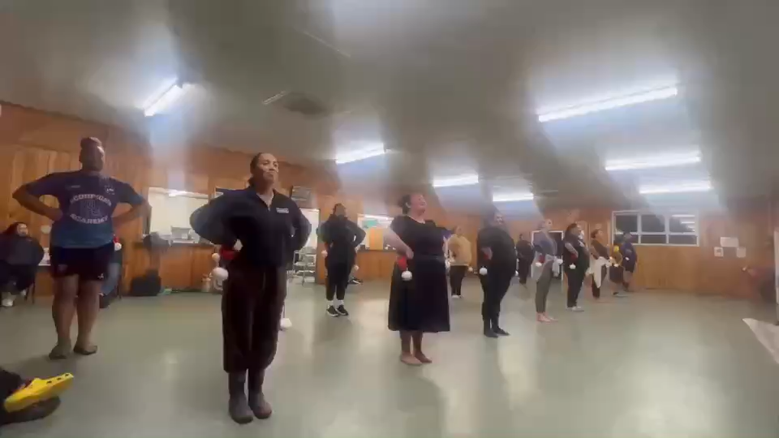
Poi Drills.
Notes:
Do poi drills, but don’t drill just any action, drill the actions that are in the poi.
While the ladies are running through their drills, that’s when you got your cleaner out to sweep through the lines, looking at levels,
Placement of poi, body movement, toe points and overall execution.

Slide 16

Types of Poi

Slide 17
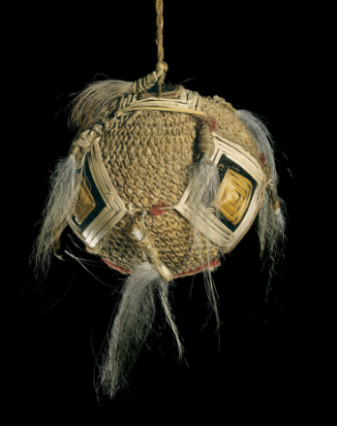
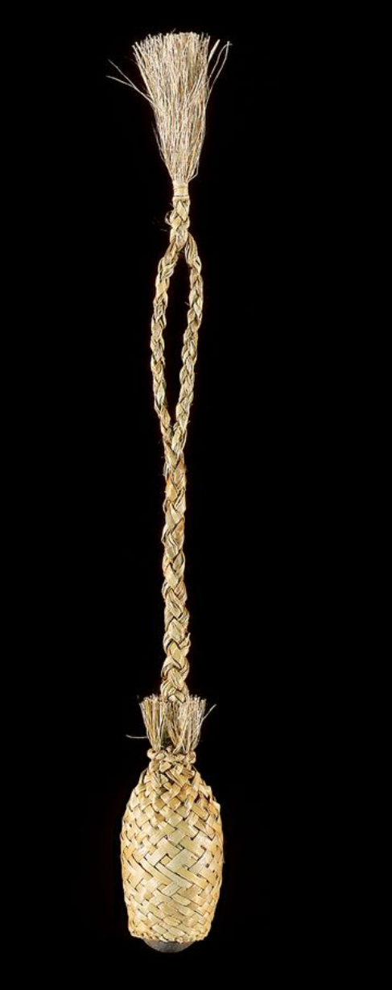
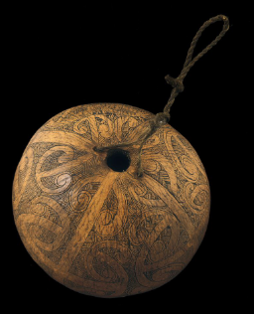
Types of Poi
Poi
Poi Piu
Poi Patu
Poi Taniko
Poi Waeroa
Poi Kokau
Poi Atua
Poi Raupo
Poi Harakeke
Poi Rakau
Poi Hue
Poi Ika
Notes:
Made from a hollowed hue or gourd, the poi āwhiowhio is an example of one of these treasures that was almost lost to colonisation. This taonga is sacred to Hine-Pū-Te-Hue, an atua or deity of peace. When swung, these gourd-based poi produce a variety of calming sounds that emulate birds such as the kererū or native wood pigeon with calls ranging from chattering to whistling. When used by skilled players, these soothing sounds can be used to coax and attract birds for entertainment or hunting. Another taonga in the realm of poi is the poi piu, or the ipu kōrero as they are more commonly known by practitioners. Ipu kōrero are another example of a kind of poi within taonga pūoro that almost disappeared. These taonga are woven from the curled and dried leaves of harakeke (New Zealand flax) and occupy the space between the poi raupō and a rattle, with oral narratives strongly linking them to the practice of storytelling and traditional chants or mōteatea.

Slide 18
Poi āwhiowhio Poi Hue
Notes:
Made from a hollowed hue or gourd, the poi āwhiowhio is an example of one of these treasures that was almost lost to colonisation. This taonga is sacred to Hine-Pū-Te-Hue, an atua or deity of peace. When swung, these gourd-based poi produce a variety of calming sounds that emulate birds such as the kererū or native wood pigeon with calls ranging from chattering to whistling. When used by skilled players, these soothing sounds can be used to coax and attract birds for entertainment or hunting.

Slide 19
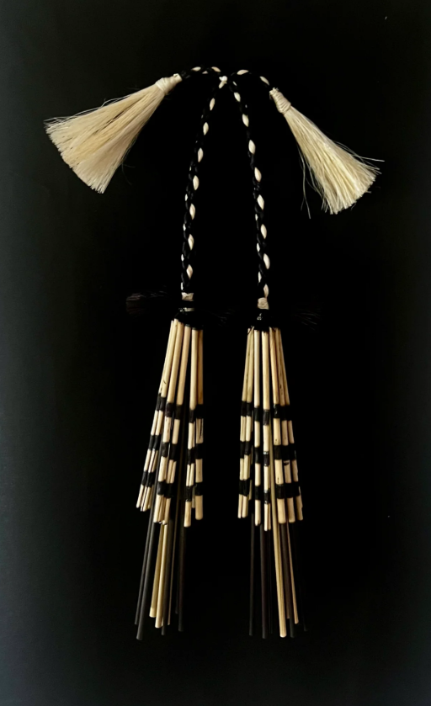
Poi Piu
Ipu Kōrero
Notes:
taonga in the realm of poi is the poi piu, or the ipu kōrero as they are more commonly known by practitioners. Ipu kōrero are another example of a kind of poi within taonga pūoro that almost disappeared. These taonga are woven from the curled and dried leaves of harakeke (New Zealand flax) and occupy the space between the poi raupō and a rattle, with oral narratives strongly linking them to the practice of storytelling and traditional chants or mōteatea.ed to coax and attract birds for entertainment or hunting.

Slide 20
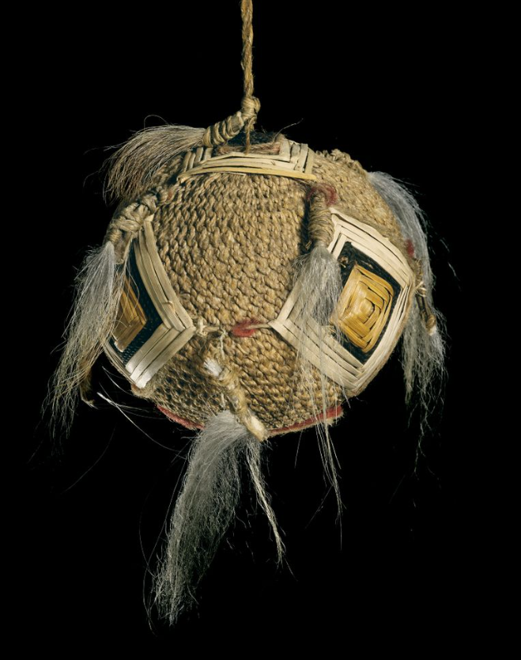
Poi Awe
Notes:
Poi awe are named for the tufts of white dog hair that adorn them. These poi are woven from fine muka cord using a knotless netting technique. The completed ball is adorned with woven diamond-like patterns known as papakirango, or karu atua. The meaning of these patterns can vary by iwi or tribe, but they are commonly associated with mourning, atua (deities), or whenua (land). These special poi were used ritually including during funerals as part of the spiritual grieving process. Although these poi are rare today, they are undergoing a revival process due to the research of dedicated makers and researchers

Slide 21
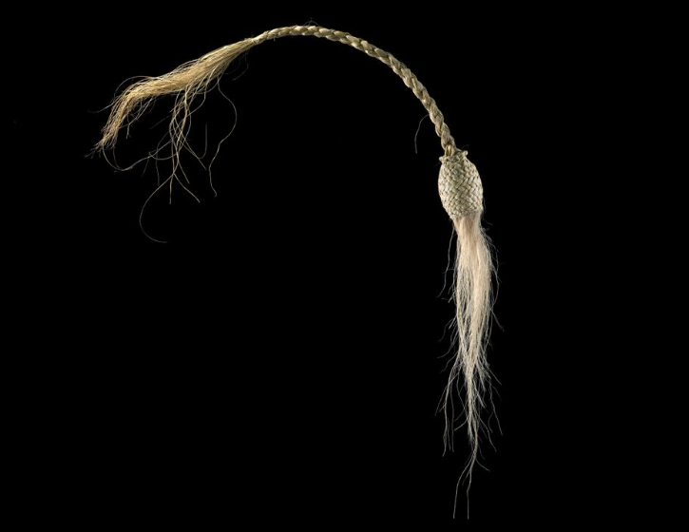
Types of Poi
Notes:
Poi patu generally refers to a specific type of poi made from dried and curled strands of harakeke (flax) rather than soft, stuffed balls. It can also refer to a traditional Māori tag game (Poi Patu or Poi Toa) played with longer, weighted poi where players gently tag each other below the hips. [1, 2, 3, 4, 5]

Slide 22
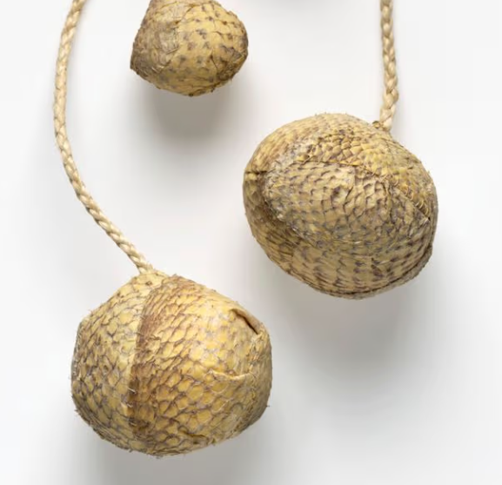
Types of Poi
Notes:
Poi ika are a contemporary adaptation of the traditional Māori poi. Pioneered in 2019 by renowned weaver Tangimoe Clay from nearby Ōpōtiki, these unique poi are crafted using the tanned skin of the terakihi (fish), with whītau (muka/flax fiber) braided for the handles and stitching.

Slide 23
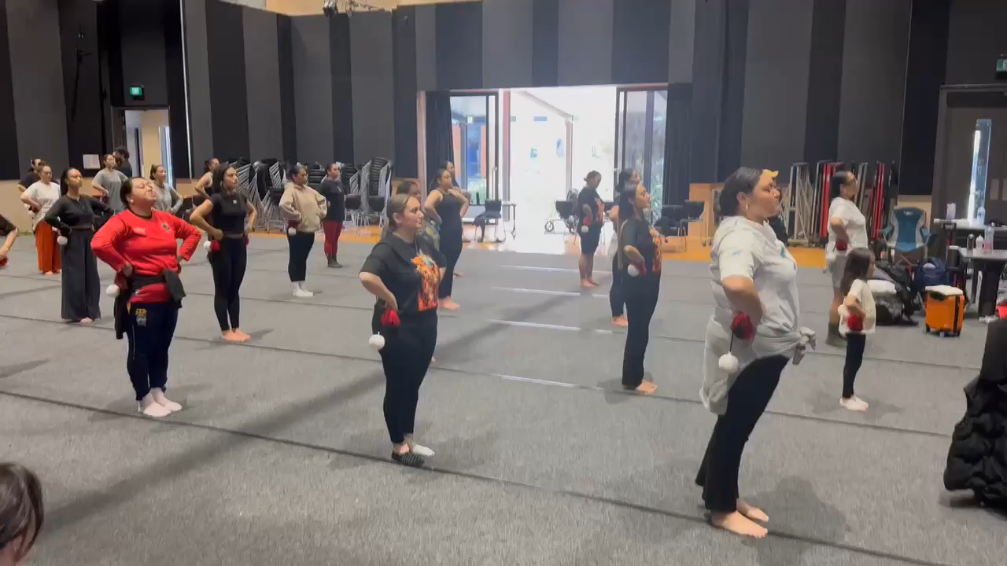
Teaching Poi
Notes:
Explain and demonstrate what you want
Think of
Placement
Levels
Timing
How you tell your story
What is your signature? Your style?
Confidence? Like any mahi that we are introduced to, poi needs time to marinade.

Slide 24
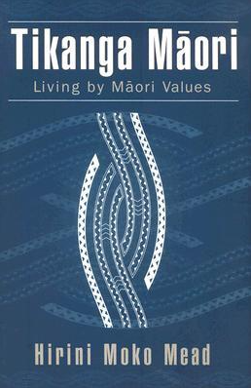
Mau ki ngā tikanga!
Notes:
Tikanga is much more than customs or traditions. It is the foundation of who we are as Māori.
It provides guidance on how we treat one another, how we care for our environment, and how we uphold values such as mana, whanaungatanga, manaakitanga, and kaitiakitanga. These principles shape not only our actions but also our identity.
When we teach our rangatahi through tikanga, we are giving them more than knowledge we are giving them a sense of belonging.
Many of our young people are searching for identity and purpose. By embedding tikanga into our teaching, we help them understand where they come from, who they are, and the strengths they carry from their ancestors.
Retaining tikanga also strengthens cultural confidence. When rangatahi see their culture respected and practised, they are more likely to feel proud of their heritage and more willing to participate, lead, and contribute within their whānau and communities. This confidence often carries over into education, employment, and other areas of life.
As educators, mentors, and role models, we have a responsibility to ensure tikanga is not lost. Every pōwhiri, every karakia, every waiata, every kōrero, and every opportunity to practise respect, humility, and collective responsibility keeps our culture alive.
These are not simply activities they are lessons that teach values and create meaningful connections.
In a world that is constantly changing, tikanga provides stability. It reminds our rangatahi that while they can embrace new opportunities and technologies, they do not have to leave their identity behind. Instead, they can walk confidently in both te ao Māori and the wider world.
Retaining tikanga is about preserving the wisdom of our tūpuna while preparing the next generation for the future. If we invest in teaching tikanga today, we are investing in strong, resilient, and culturally grounded leaders for tomorrow.
Nā reira, let us continue to uphold, practise, and pass on our tikanga so that our rangatahi can thrive with pride in who they are and where they come from.

Slide 25
Kupu
Whakamutunga
Tau patupatu te rere o taku poi
Poi atu
Poi mai
Whiu atu
Whiu mai
Nau mai ka haere tāua
Taku poi kōrero
Taku poi wānanga
Taku poi tiketike e
E rere whakawaho e poi e
Hārō to haere ki ngā pito o Mataatua
Rōnaki to haere
Naki atu
Naki mai
Naki naki rautihi tapu o te Tai Rāwhiti
Tihirau mai tawhiti
Pukanakana ana
Whāterotero ana
Koutu atu
Koutu mai
i ngā puke tapu o te Te Whakatōhea
Makeo
Makeo whakarunga
Makeo whakararo
Ka tuohu nei
Hāngai te titiro
Piu atu
Piu mai
Mauao kei runga
Tirikawa kei raro
Uhi tai uhi tai e..
Rere whakauta
E koro Putauaki
Taku mana
Taku ihi
Taku wanawana
Ka tau taku poi
Ki tōku whenua tauri kura
Taku mana motuhake
E ko Ngāti Awa
Notes:
As Mukarau reminds us, poi is a powerful expression of our culture, identity, and storytelling. We should encourage people to get out there, be inspired, and embrace the beauty of poi without fear of making mistakes. However, with that inspiration comes responsibility. It is important that poi is taught properly, with respect for its history, tikanga, and cultural significance. By learning and teaching it correctly, we honour those who came before us while ensuring future generations can carry this taonga forward with confidence, authenticity, and pride.

