Slide 1

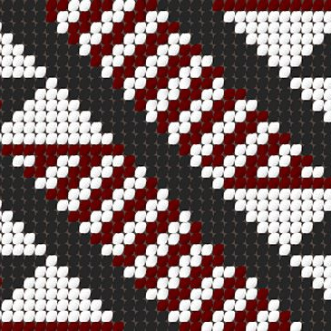
Tāniko: The Art of Māori Weaving
Exploring Tradition, Technique, and Identity in Aotearoa

Slide 2

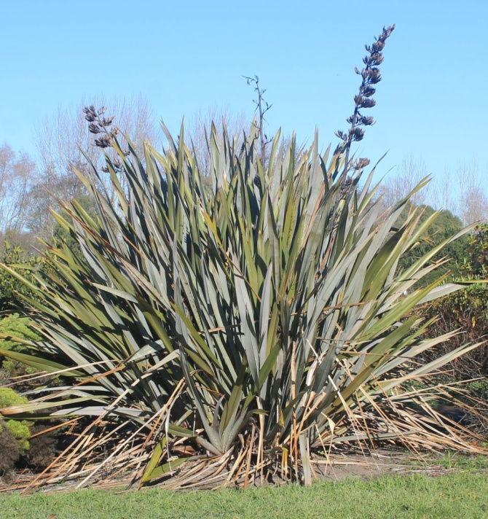
Learning Objectives
Today we will explore the cultural significance and history of Tāniko weaving.
We will learn to identify traditional materials like Mukaharakeke and understand the fundamental weaving structure.
By the end of the lesson, you will apply these skills to create your own geometric pattern for a small pūkoro (pouch).

Slide 3
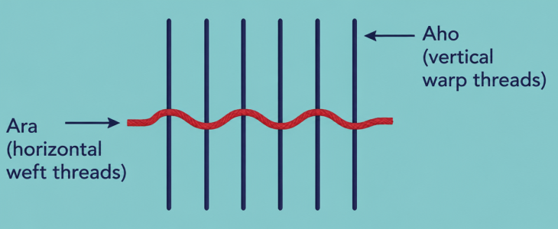
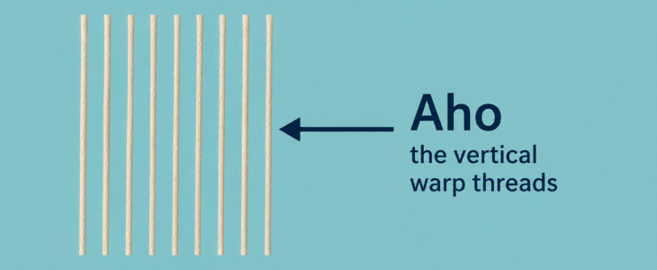
Key Vocabulary
Ara
The horizontal weft threads (twine). These move across the Aho to create patterns.
Aho
The vertical warp threads. These are the structural foundation of the weaving.

Slide 4
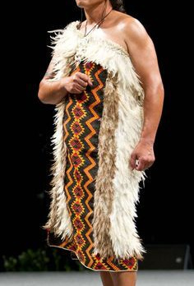
A Living Connection
Why do we weave?
Imagine wearing a garment that tells the story of your ancestors. Tāniko is more than just decoration; it is a way of recording history, status, and whakapapa (genealogy).
Historically, it was used to adorn the borders of fine cloaks (kākahu) and headbands (tīpare).
🔑
Key point
Tāniko is a unique Māori finger-weaving technique that does not use a loom.

Slide 5
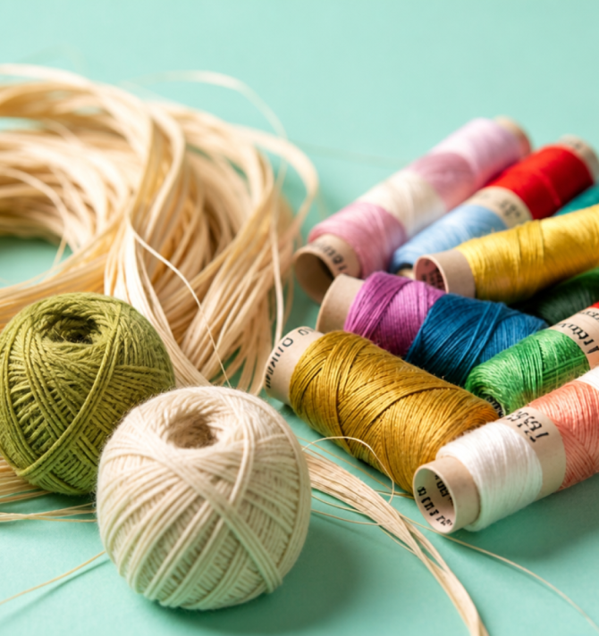
Materials: From Bush to Bench
TRADITIONAL VS. MODERN
Historically, weavers used muka—the prepared fibre of the harakeke (flax) plant.
Today, while many still use muka for ceremonial pieces, we can use modern alternatives for practice, such as cotton twine, wool, or embroidery thread.
🧠
Remember
Harakeke must be harvested according to tikanga (protocols) to ensure the plant continues to thrive.

Slide 6
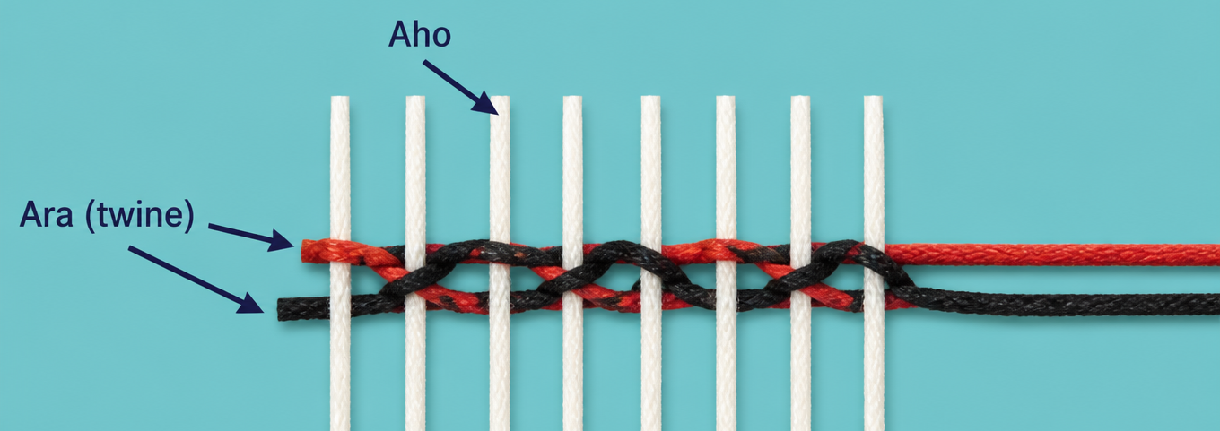
The Structural Foundation
Tāniko is created by twisting horizontal threads (Ara) around fixed vertical threads (Aho). By using two or more colours of Ara, you can hide one colour behind the Aho while showing the other on the front. A full twist, puts the same colour back on top of your pattern. A half twist puts the second colour on top of your pattern. "Pop Outs" (which is when the bottom colour pops through between two Aho,) is due to a drop in Ara tension. To remedy this, tighten the bottom Ara until the second colour disappears below.

Slide 7
Check Your Knowledge
Answers on the next slide...
Which term refers to the vertical warp threads in Tāniko weaving?
1.
Aho
2.
Pūkoro
3.
Ara
4.
Muka

Slide 8
Check Your Knowledge
✅​
Which term refers to the vertical warp threads in Tāniko weaving?
1.
Aho
👍​
2.
Pūkou
3.
Ara
4.
Muka

Slide 9
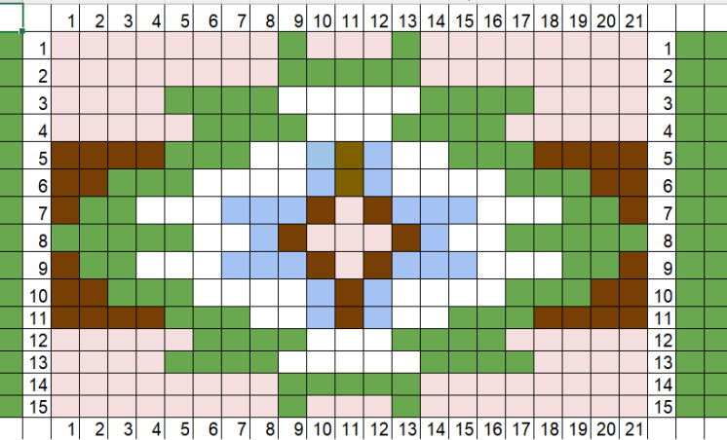
Geometric Patterns
DESIGN
Traditional patterns use triangles and diamonds to represent the natural world.
Aramoana (Path of the Sea) uses zig-zags, while Poutama (Stairway to Heaven) uses stepped designs.
🔍
Example
Try sketching a simple 'Niho Taniwha' (Taniwha Teeth) pattern—a row of triangles—using a grid.

Slide 10
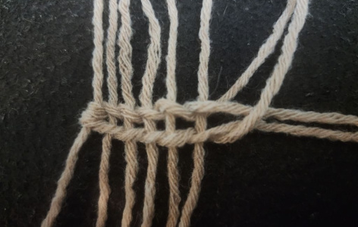
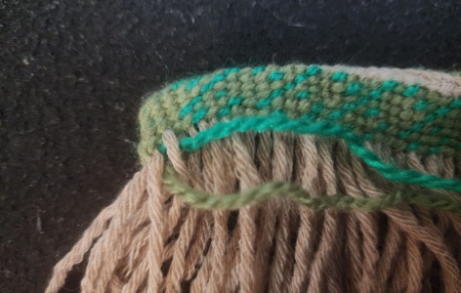
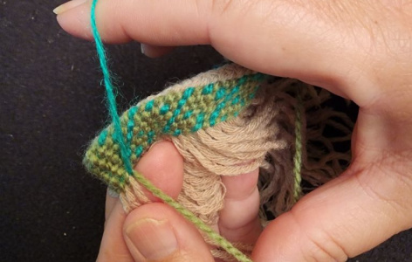
Step-by-Step: Starting Your Pūkoro
Prepare the Aho
Cut even lengths of your main thread and using a whatu plait, secure them to a center "Spine"
Introduce the Ara
Take two different coloured threads, tie a thumb knot in one end. These are your Ara (weft).
The Twist
Twist the two Ara threads around each Aho, bringing the desired colour to the front.

Slide 11
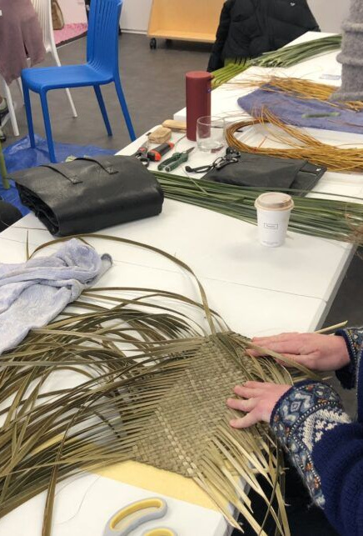
Tikanga and Protocols
Weaving is a sacred task. Traditional tikanga (rules) include:
No eating over the weaving.
Keeping the workspace clean and focused.
Returning scraps of harakeke to the earth (Papatūānuku).
The weaver is a vessel for the knowledge of the ancestors. — Erenora Puketapu-Hetet

Slide 12
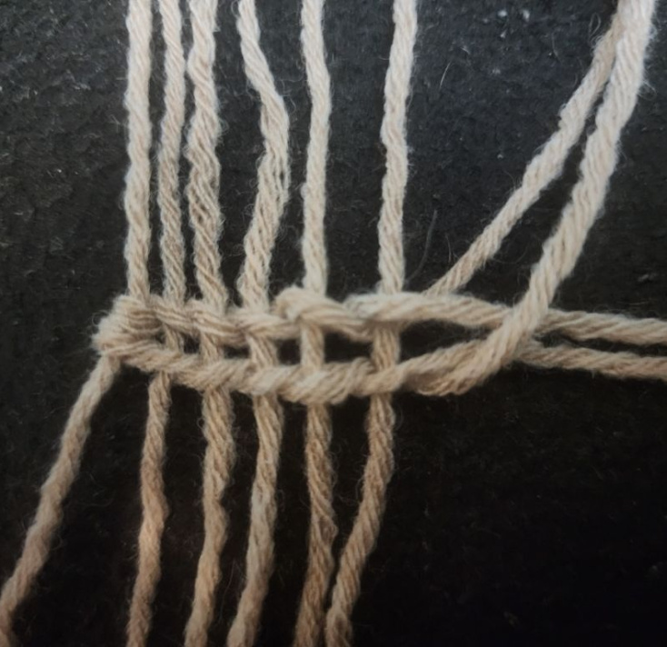
Practical Practice: Creating Your Pouch
Your Task
Begin weaving with a Whatu of the two short strands to create a spine. Use the two green tones of threads to create a simple Patiki (diamond) pattern on one side of the pukoro and purapura whetu (stars) on the other side.
CHALLENGE
Can you maintain even tension so the edges don't pull inwards?

Slide 13
Terminology Match
1.
Muka
a)
Cultural protocols and correct practice
2.
Ara
b)
Horizontal weft or twine threads
3.
Aho
c)
Prepared flax fibre
4.
Tikanga
d)
Vertical warp threads

Slide 14
Terminology Match
✅​
1.
Muka
c)
Prepared flax fibre
2.
Ara
b)
Horizontal weft or twine threads
3.
Aho
d)
Vertical warp threads
4.
Tikanga
a)
Cultural protocols and correct practice

Slide 15

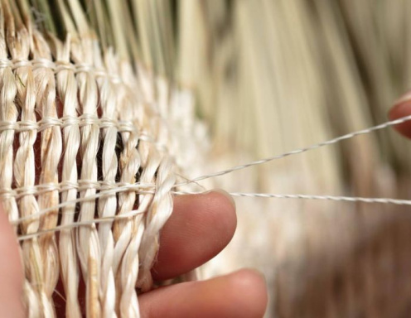
Reflecting on Tradition
Why do you think it is important to follow tikanga (like not eating near the work) when practicing traditional Māori arts today?

Slide 16
Reflecting on Tradition
✅​
You might have said...
It shows respect for the ancestors who developed the technique.
It helps the weaver maintain focus and mana in their work.
It preserves the spiritual connection between maker and materials.

Slide 17
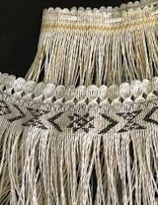
Finishing Your Weave
FINAL STEPS
Once you have reached the desired height for your pūkoro, it is time to secure the threads so your hard work doesn't unravel.
The Final Row
Complete your pattern row and ensure the tension is firm across all Aho threads.
Casting Off
Turn your Pukoro inside out, then cast off one Aho at a time, Use a decorative 'whatu' (twine) finish or a simple fold-over technique to lock the vertical threads in place.

Slide 18
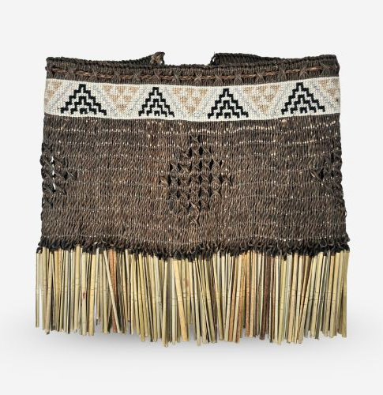
Securing the Edges
Secure your finish to maintain tension and preserve your Niho Taniwha or Patiki patterns.
Selvedge Edge: Pull your final Ara row tight to lock the pattern.
Hiding Ends: Use a darning needle to weave loose ends back into the piece.
⚠️
Aata haere (Take Care)
Keep Aho threads long enough to braid into the top edge of your Pukoro.

Slide 19

The Journey Continues
You have taken your first steps into the world of Te Whare Pora (The House of Weaving).
Continue to practice your tension and patterns. In our next session, we will look at how to finish the edges and join your weaving into a functional pouch.

