Slide 1



Slide 2
Kei Hea Tātau e Ahu Ana?
Which way in education?
The question is not simply where education is going, but whose direction it follows?

Slide 3
Qualification systems are never neutral
They shape
• what counts as knowledge
• whose success is recognised
• whose language is legitimised
• whose futures are enabled
"Qualification frameworks embody the histories, knowledges, biases, omissions and values of their designers."

Slide 4
Cabinet acknowledged that the (then) proposed reforms were likely to have their greatest impact on learners already experiencing inequity, including ākonga Māori

Slide 5
Some Tensions
Coherence
Consistency
Standardisation
National assurance
Equity for all learners and honour Māori aspirations
Local aspirations, identity,languages, cultures and knowledge systems
Diverse ways knowledge is held and valued
Tino rangatiratanga

Slide 6
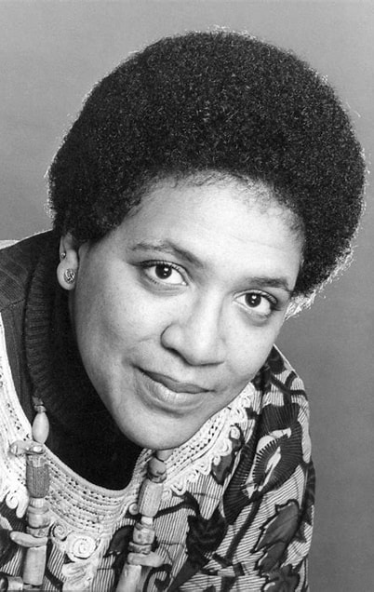
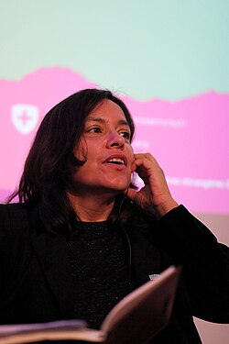

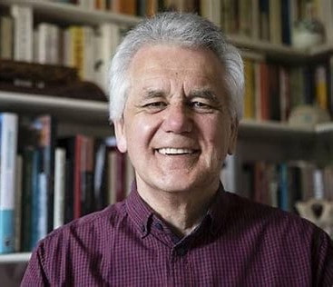
These are not theoretical debates. They shape the everyday experiences of Māori

Slide 7
Do these reforms strengthen the conditions for Māori to flourish?

Slide 8
Whakawhiti Kōrero
Policy documents tell us what reform intends.
Research tells us what has happened before.
But neither can tell us what these changes may mean in your kura, classrooms, and communities.

Slide 9
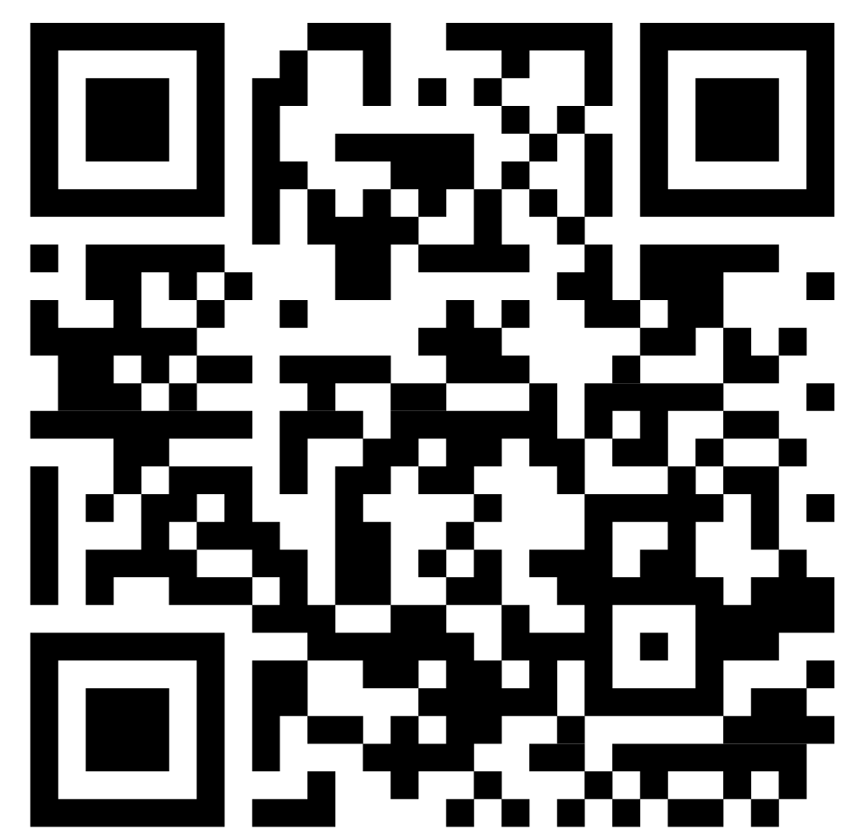
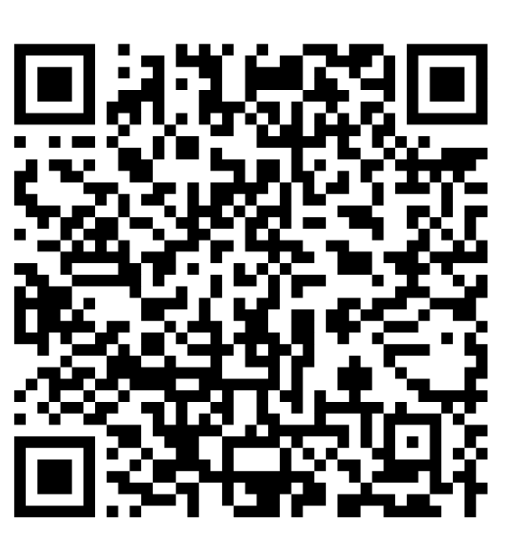
Information Sheet Consent Form

Slide 10
Prompts
What does a successful schooling experience and NCEA pathway look like for Māori, and how well do current NCEA reforms align with Māori aspirations, values, and understandings of the purpose of schooling?
How effective or successful do you think the reforms will be at achieving the aspirations of your kura, community and the wider sector?
What do you think is the problem this reforms are trying to solve, and is replacing NCEA the right response? Why or why not?
What implications might these changes have for the responsibilities carried by kaiako Māori and leaders?
How do you see Te Tiriti, mātauranga Māori and mana motuhake reflected in these changes?
What do you think you, or your kura will start, stop, and keep as a result of these changes?

Slide 11
Kei hea tātau e ahu ana?

