Slide 1
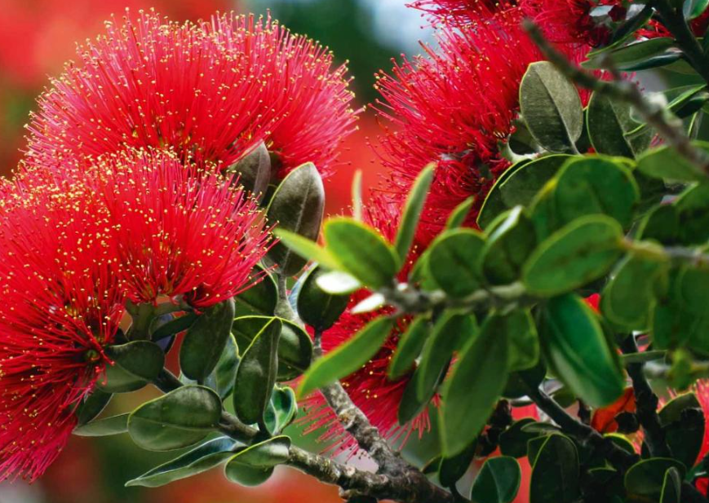
Te Ao Rongoā
Katrina & Rhodesia Rameka-Dewes

Slide 2
Whare Tapa Whā
Sir Mason Durie
Taha Tinana
Taha Hinengaro
Taha Wairua
Taha Whānau

Slide 3
Whakatau Hinengaro
Bob Bickerton - Matariki
https://sounz.org.nz/works/26066?locale=en

Slide 4
Whare Tapa Whā
Sir Mason Durie
Taha Tinana
Taha Hinengaro
Taha Wairua
Taha Whānau
Check in…

Slide 5
What is Rongoā

Slide 6
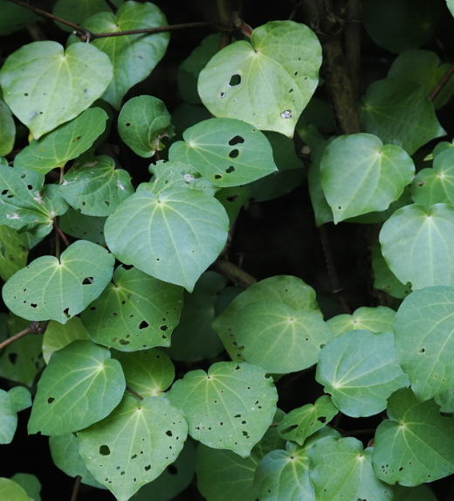
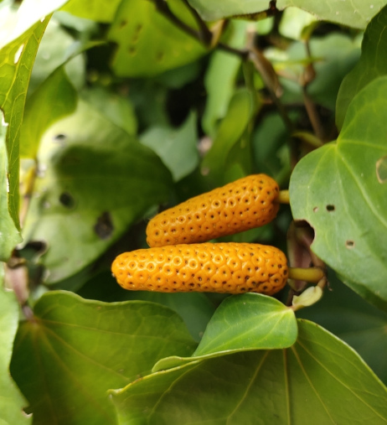
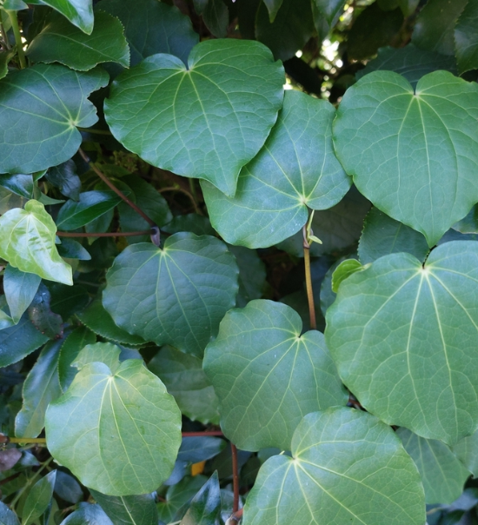
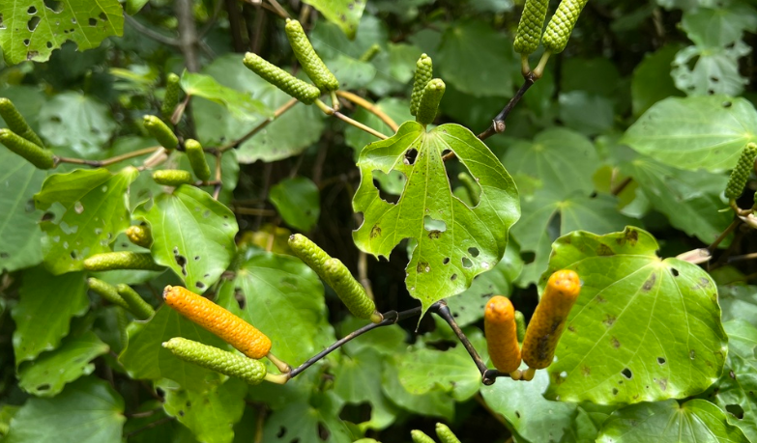
Male & Female Heart-shaped
Kawakawa looper moth North & South Island
Berries ripen between January Peppery taste
and February

Slide 7
Pani Kawakawa …

Slide 8
Analgesic (Pain killer)
Anti-inflammatory (counteracts inflammation in the body)
Antimicrobial (fights bacteria and fungi)

Slide 9
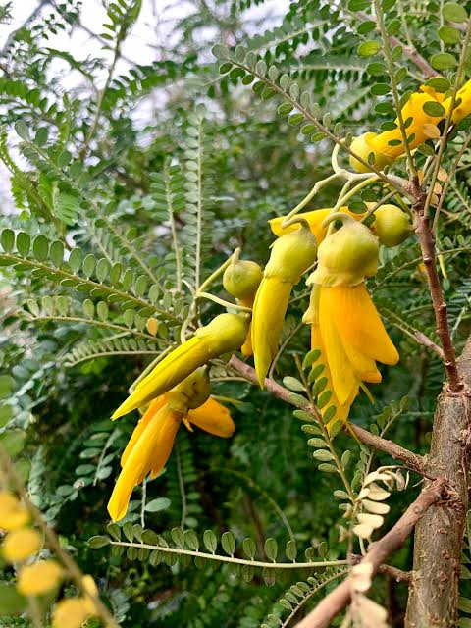
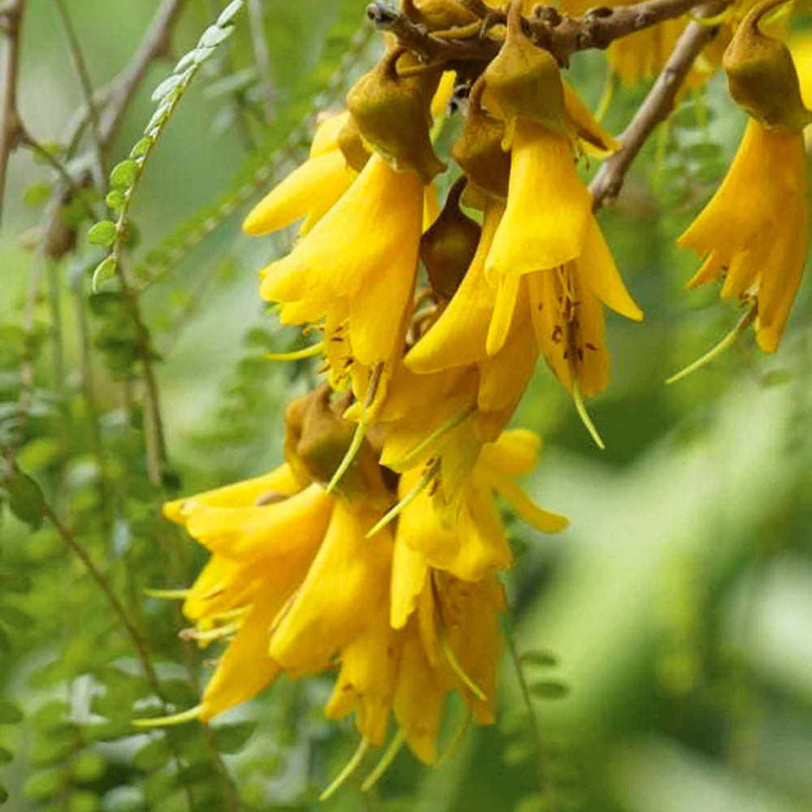
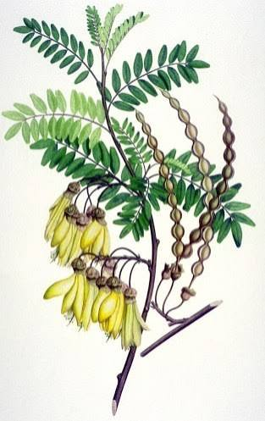
Famous for its brilliant yellow, tubular 4 petals.
Entire plant is poisonous, seed contain TOXIN cytisine
Blooms in July & November, north island flowers are larger
Known as the bone mender

Slide 10
Hinu Kōwhai …

Slide 11
Topical antiseptic and anti-inflammatory
Bark and leaves used for broken limbs & muscular pain
Not to be taken orally
Flowers signal when to plant the kumara and gather kina just like the
Pōhutukawa

Slide 12
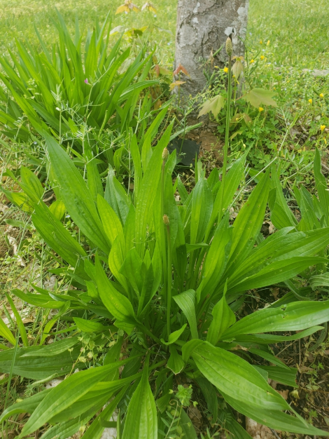
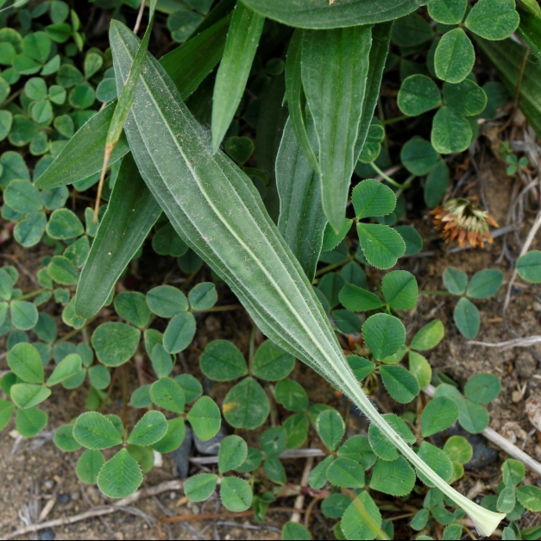
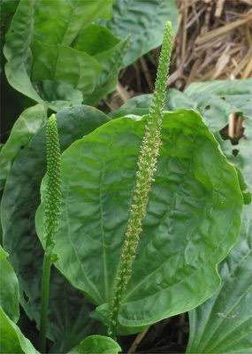
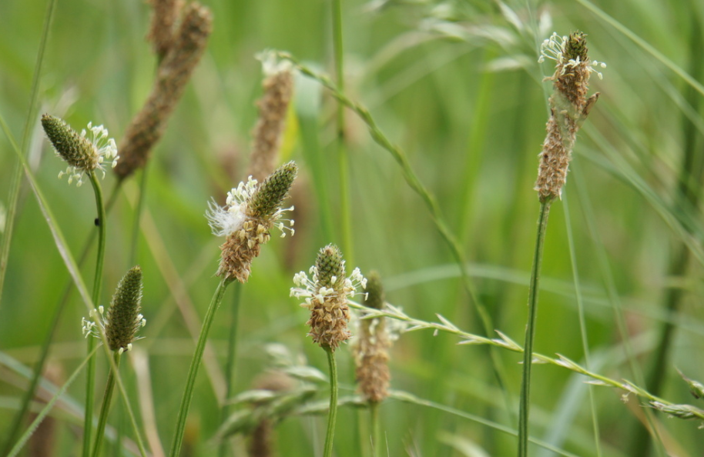
Broadleaf & Narrow leaf Fibres
Vertical veins Mistaken as a weed
Nature's First Aid Kit Found in the lawn

Slide 13
Pani Kopakopa…

Slide 14
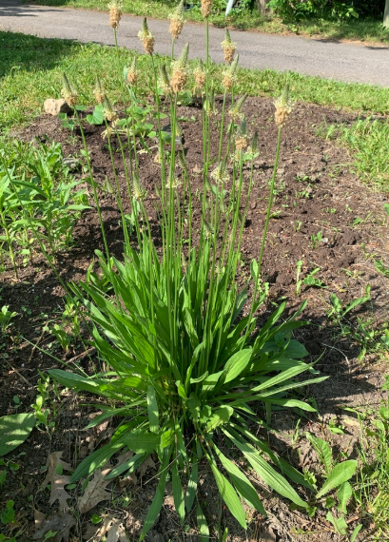
Anti-inflammatory (counteracts inflammation in the body)
Antimicrobial (kills microorganisms like bacteria and fungi)
Soothes insect bites, burns, rashes, and minor wounds, and help to draw out splinters and toxins.

Slide 15
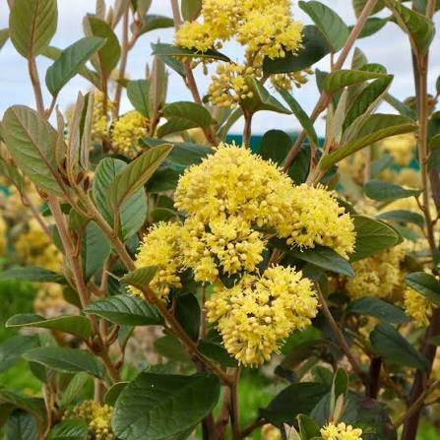
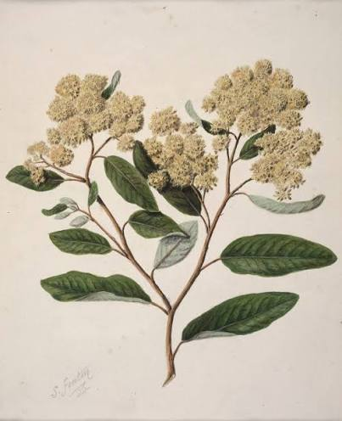
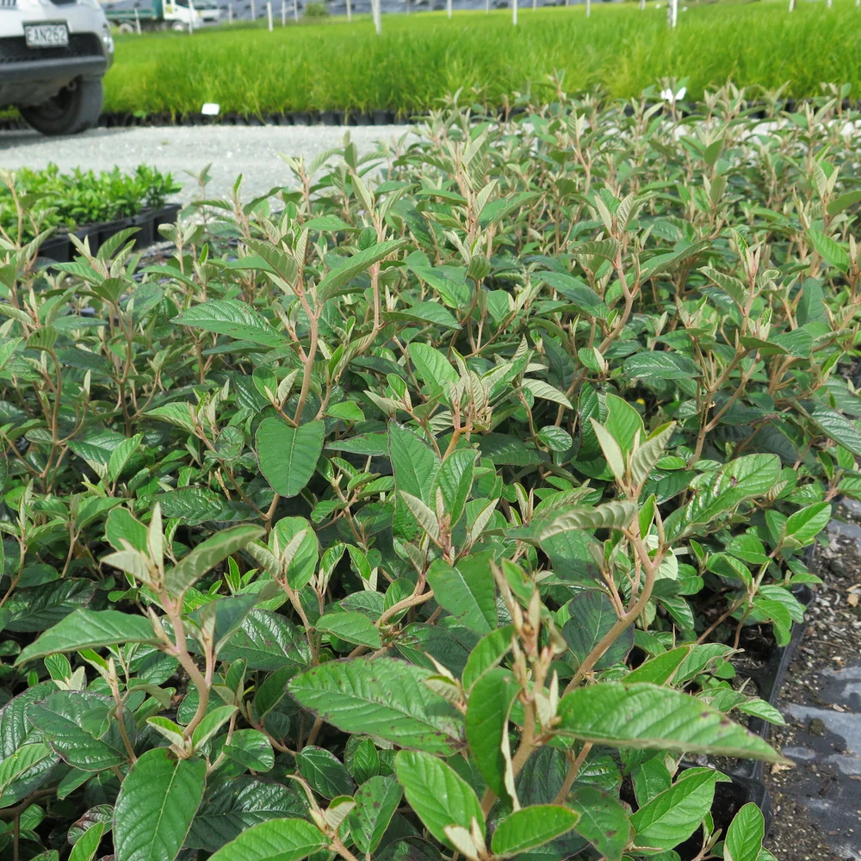
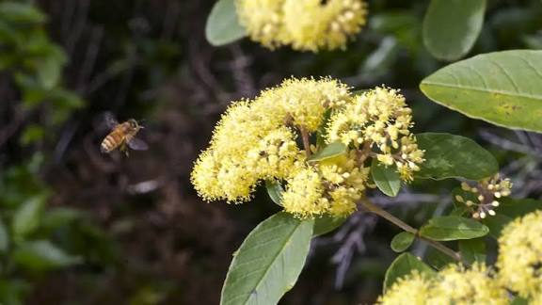
Golden yellow cluster of flowers Widely known as Gumdiggers soap
Strong-tasting plant, used moderately
Grown in the north island, can be grown in the south island
Not to be taken if pregnant, breastfeeding, low blood pressure & heart condition

Slide 16
Wairākau …

Slide 17
Anti-inflammatory (counteracts inflammation in the body)
Respiratory and lung support
Clears chest congestion and soothes coughs
Typically used as topical for irritated skin conditions

Slide 18

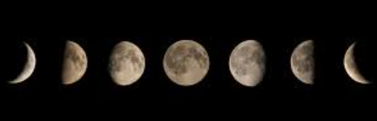
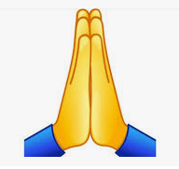

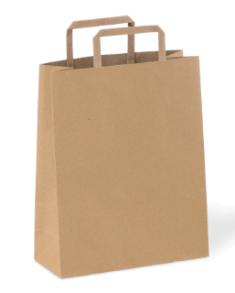
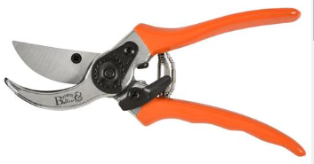
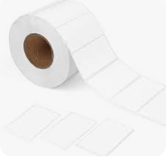
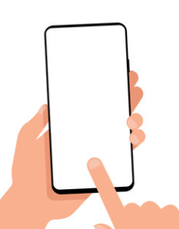
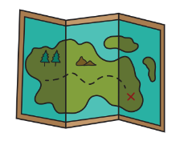
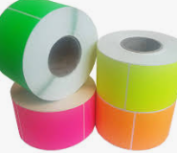
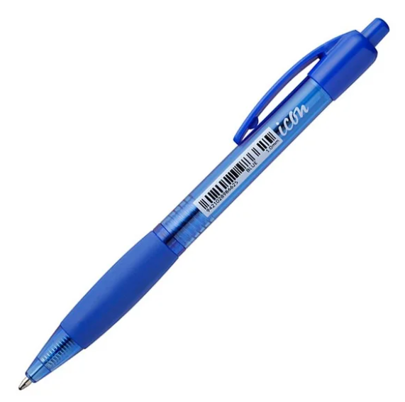
Hauhake

Slide 19
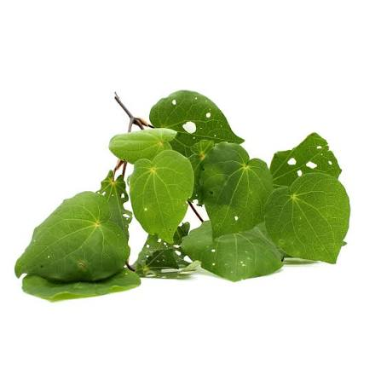
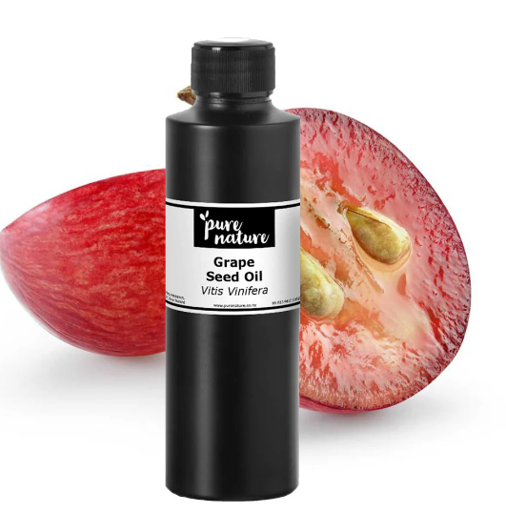
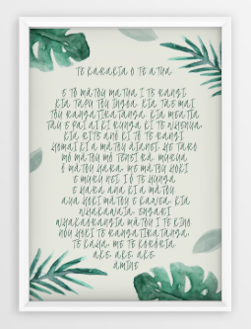
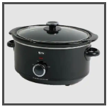
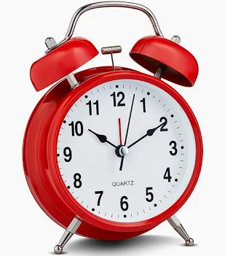
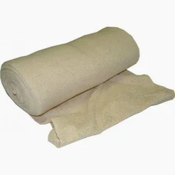
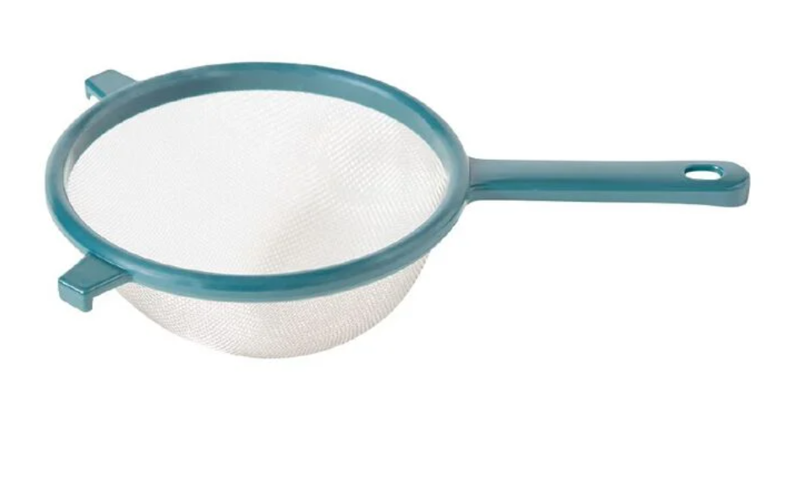
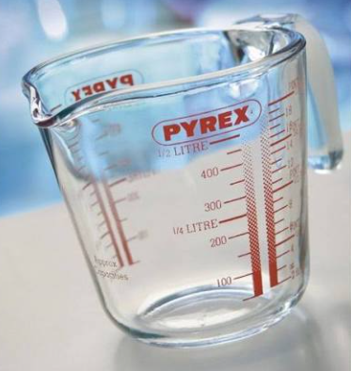
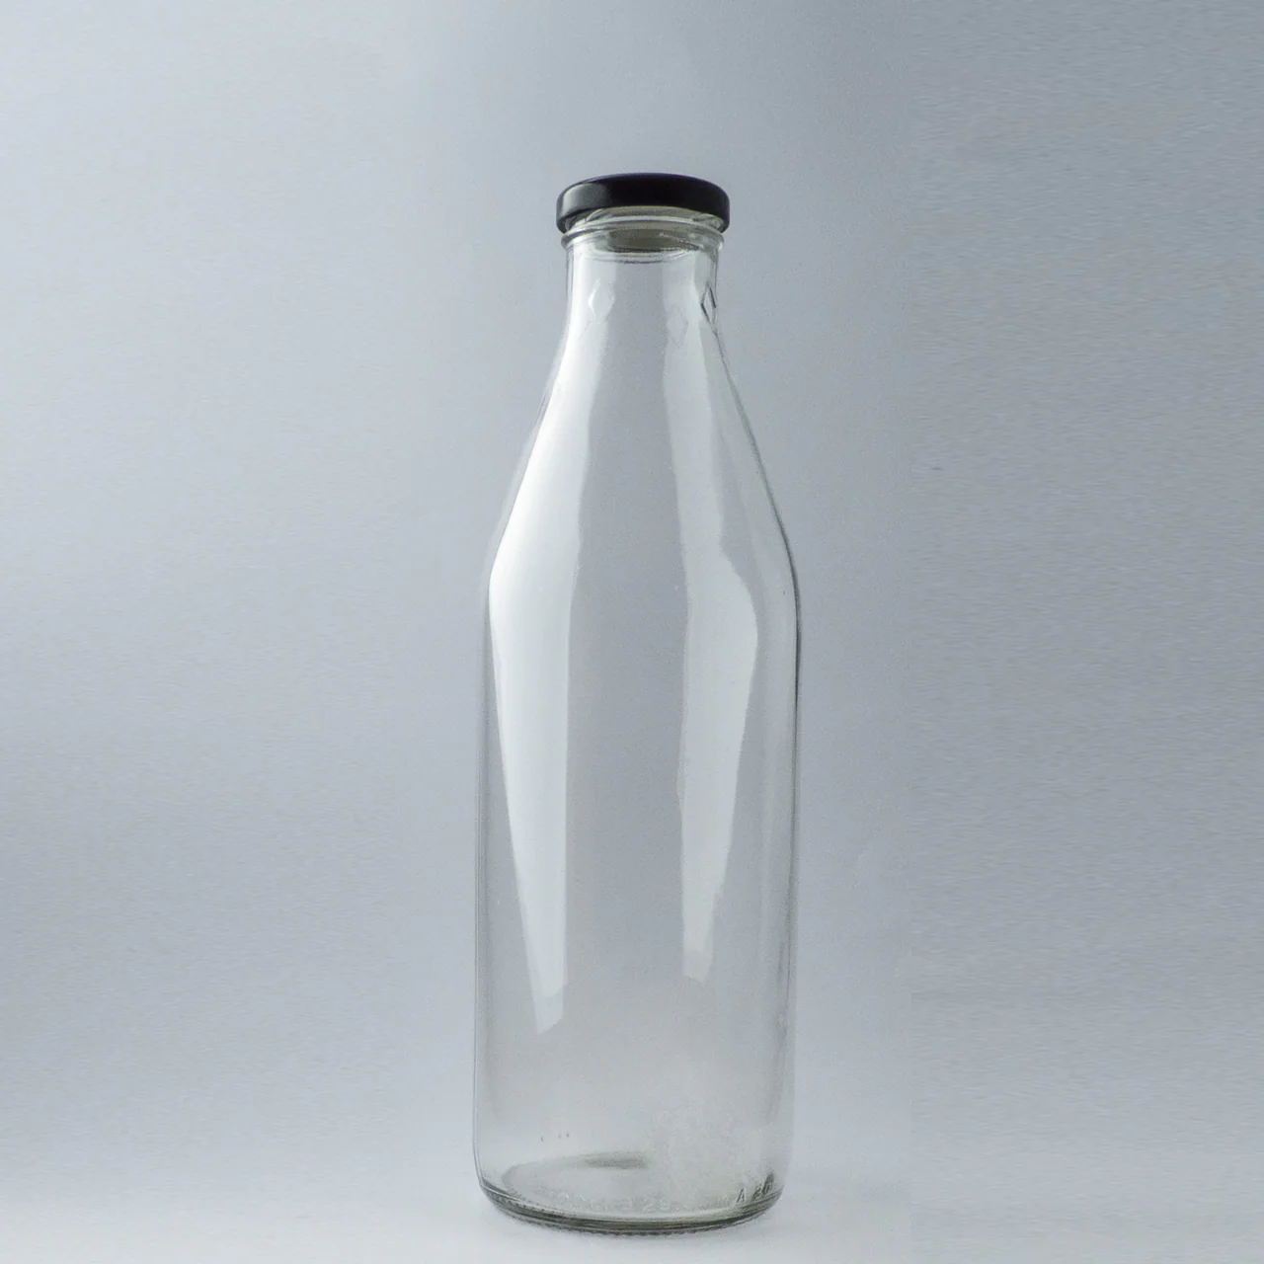
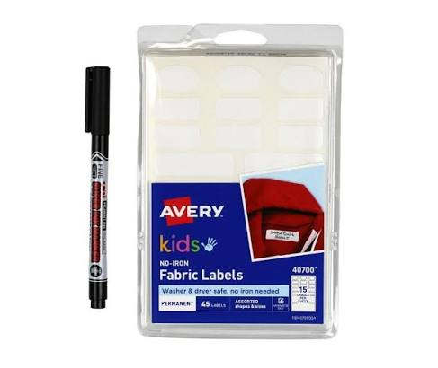
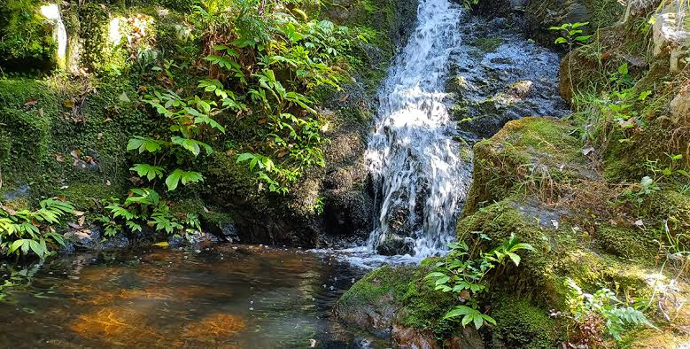
HOW TO MAKE A HINU

Slide 20
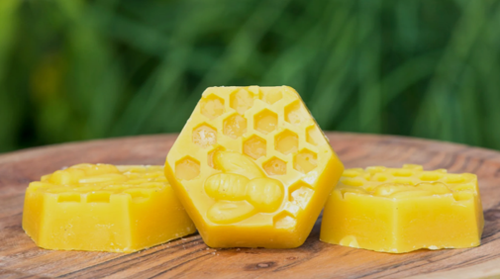
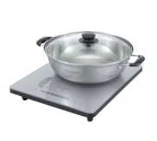
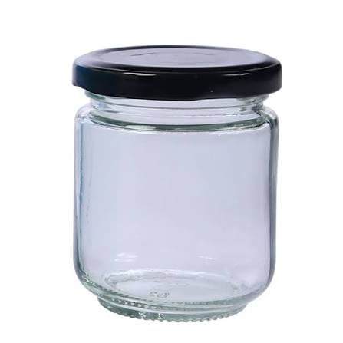

HOW TO MAKE A PANI

Slide 21
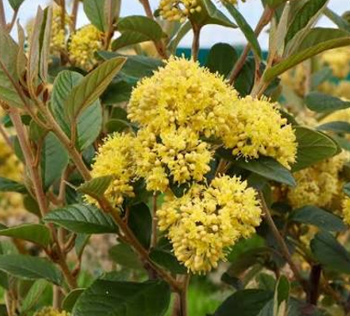

HOW TO MAKE A WAIRĀKAU

Slide 22



Slide 23



Slide 24



Slide 25
Open kōrero ...

Slide 26
PRIZE ROUND…

Slide 27
I have beautiful golden yellow
clusters of flowers and I am also
known as Gumdigger's soap
WHO AM I?

Slide 28
I have heart shaped leaves
and a peppery taste
What is my name?

Slide 29
I come in two shapes broadleaf
& narrow leaf. People mistake
me for a weed all the time.
Who am I ?

Slide 30
I am bright yellow, have 4
petals and every
part of me is TOXIC.
Who am I?

Slide 31
What is the name of the
hauora model we used in the
beginning of our workshop?

Slide 32
For the last and final round
What is her name
What is my name
AND where do we live?

Slide 33
Tāne te Māramatanga
Tāne te Pūkenga
Tāne te Hinengaro
Whakarongo mai,
whakarongo mai
I tohia koe e Io te urutapu i te orongo
Nāu i tiki ngā kete e toru o te Wānanga
Nāu i whakamana te tangata
Whakamārama mai,
Whakamārama mai,
Nāu i poupou te Mārama te pō
Ko koe te matua o te ngahere
Ko koe te hā o te ora
Ko koe te āhua o te tangata
Ko koe ko au
Ko au ko koe

