Slide 1
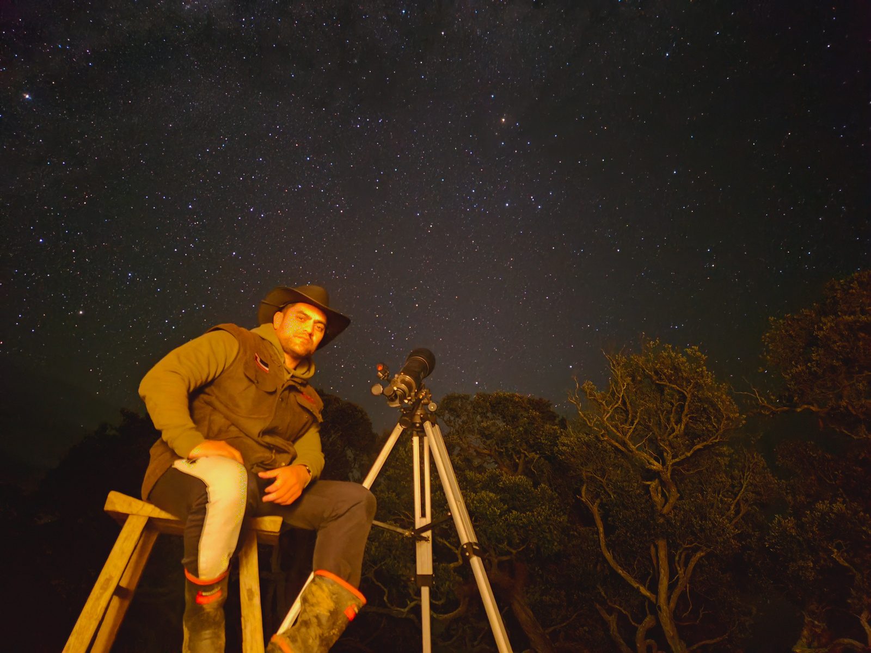
JADE KAMETA
Ngāti Pikiao
Ngāti Whakaue
Te Whanau a Apanui
Te Whakatōhea
Ngati Porou

Slide 2
From Observation to Transformation
Our tupuna didn't simply observe. They followed a cycle:
1. Observed
6. Observe Again
2. Reflect
5. Learnt
3. Connect
4. Respond

Slide 3
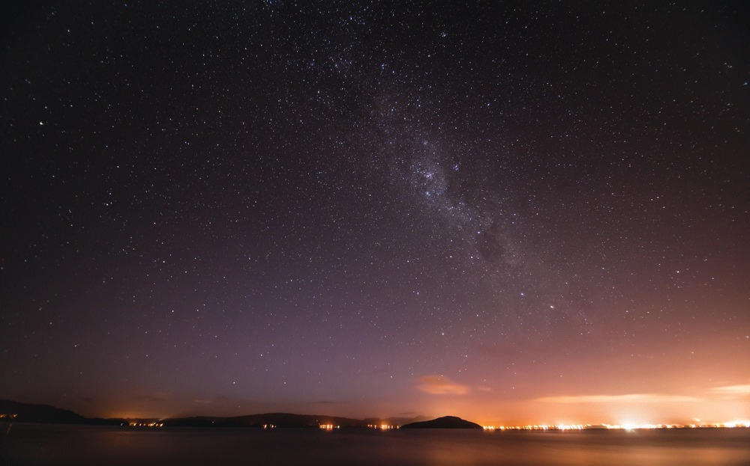
http://www.ngapatakakorerootearawa.org
email: patai@ngapatakakorerootearawa.org
TUIA KI TE RANGI TUIA KI TE WHENUA TUIA KI TE MOANA TUIA KI TE HERENGA TANGATA KA RONGO TE PO KA RONGO TE AO

Slide 4
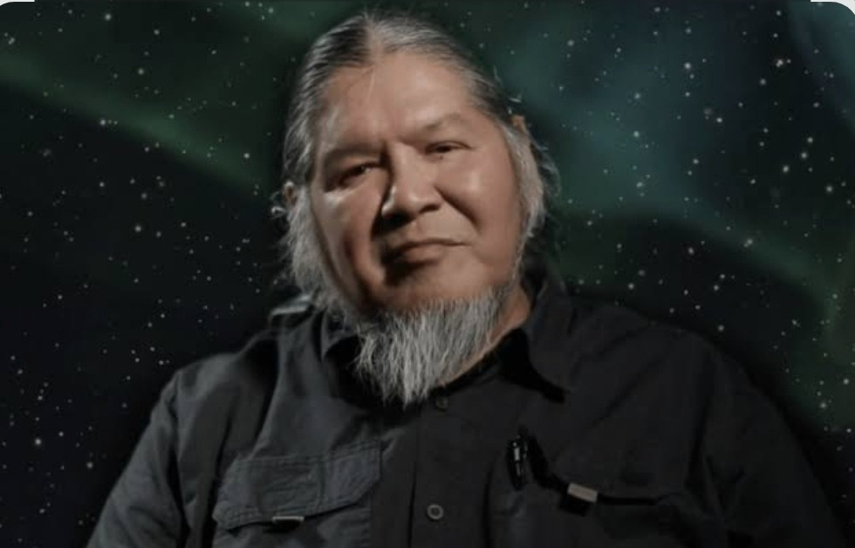
"In our world alternate realities exist, even when we dream, we dream of multiple realities"
Wilfred Buck

Slide 5
“Korekau he mea hangatia, ahunoa rānei i roto i tēnei ao, ahakoa matangaro ka kitea te mauri”
Tūkaki Waititi
Nothing in this world is meant to exist in isolation, and just because you can't see certain things, doesn't mean they don't exist.

Slide 6
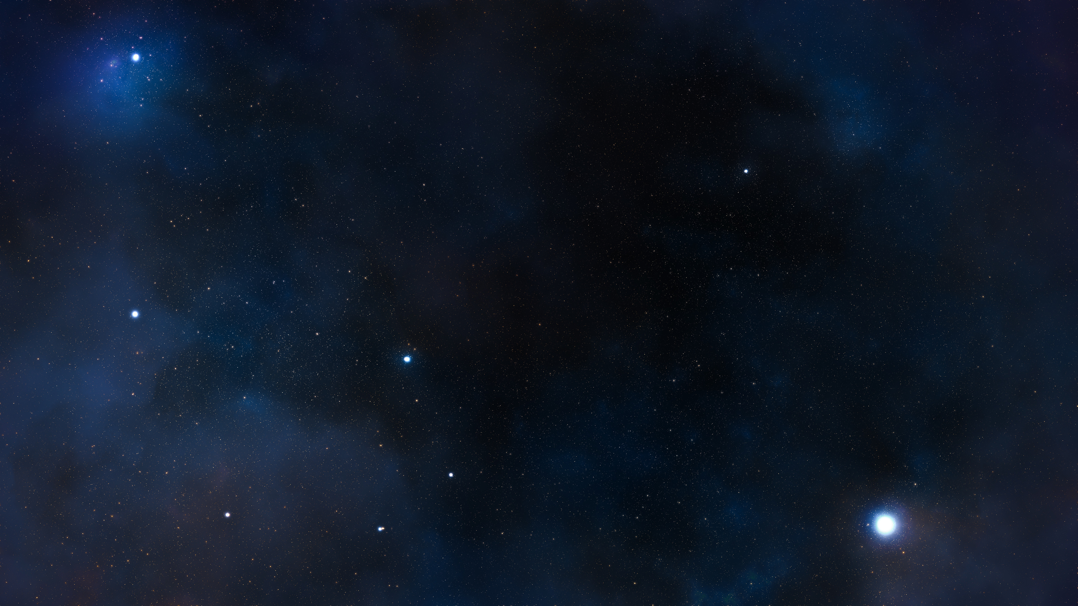
Ngā Kaupeka o Te Tau
· “There are so many different cycles within the cycles of the world and maramataka has helped me connect with the tohu”
Davina Merepeka Thomson

Slide 7
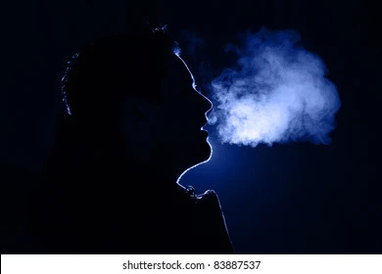
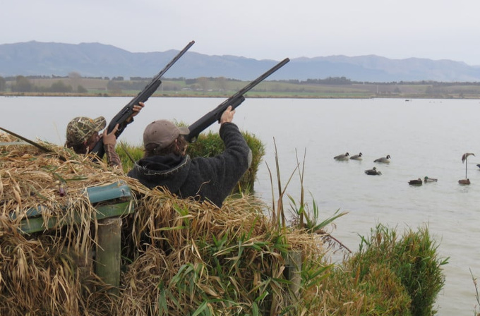
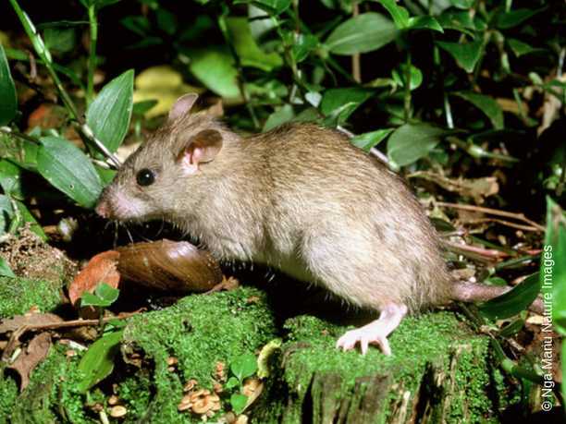
Wero i te ninihi
    Hakihuritua (Te Arawa)
    Te Ngāhuru ma rua o Hakiharatua (Dr Rangi Matamua)
    Haratua
    Maramarima
    Mei
    May
Shutterstock. (n.d.). Colored outline of man exhaling warm breath in cold air [Stock photo].
Adams, R. (2024). It’s game on for the 2024 game bird hunting season [Photograph]. Fish & Game New Zealand.
Ngā Manu Nature Images. (n.d.). Ship rat (Rattus rattus) on forest floor [Photograph].

Slide 8
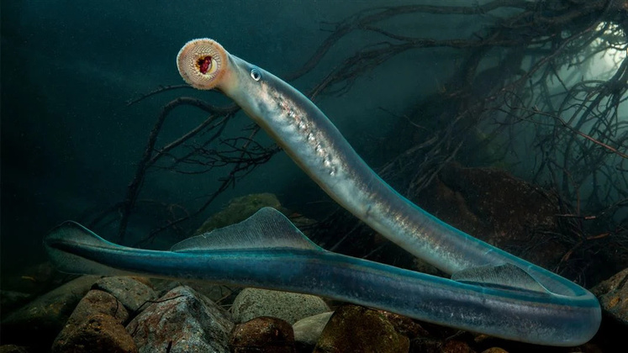
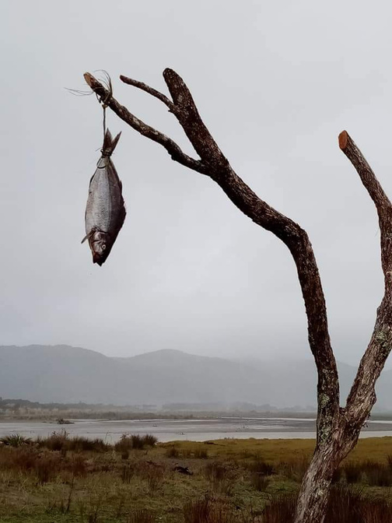
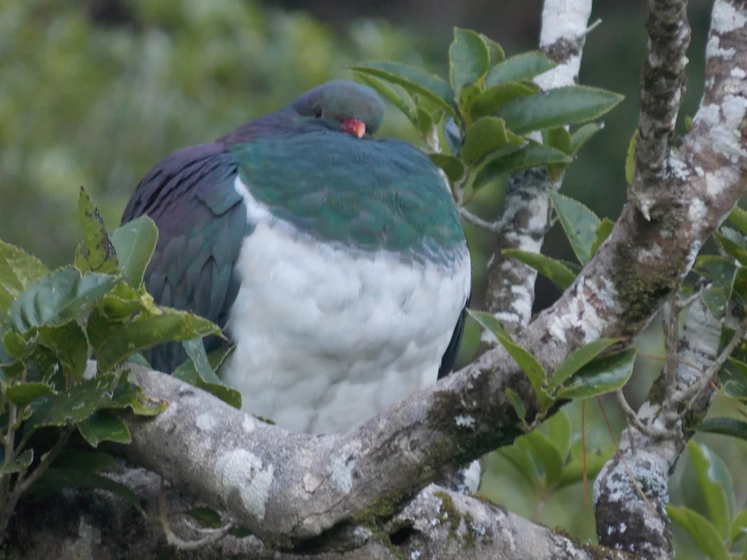
WERO I TE KOKOTA
  Te Tahi o Pipiri
  Mātahi o te tau
  Pipiri
  Maramaono
  Huamata (Ringatū)
  Aonui (Ngāti Kahungunu)
  Hune
  June
  Honohonoi (Te Arawa)
  Hōngongoi
  Hongonui
  Te Rua o Takurua (Dr Rangi Matamua)
  Maramawhitu
  Maruaroa
  Hūrae
  July
Morris, R. (n.d.). Lamprey (kanakana/piharau) underwater [Photograph].
Jade’s phone
Butler, S. (2022, August 14). Kererū [Photograph]. Medium.

Slide 9
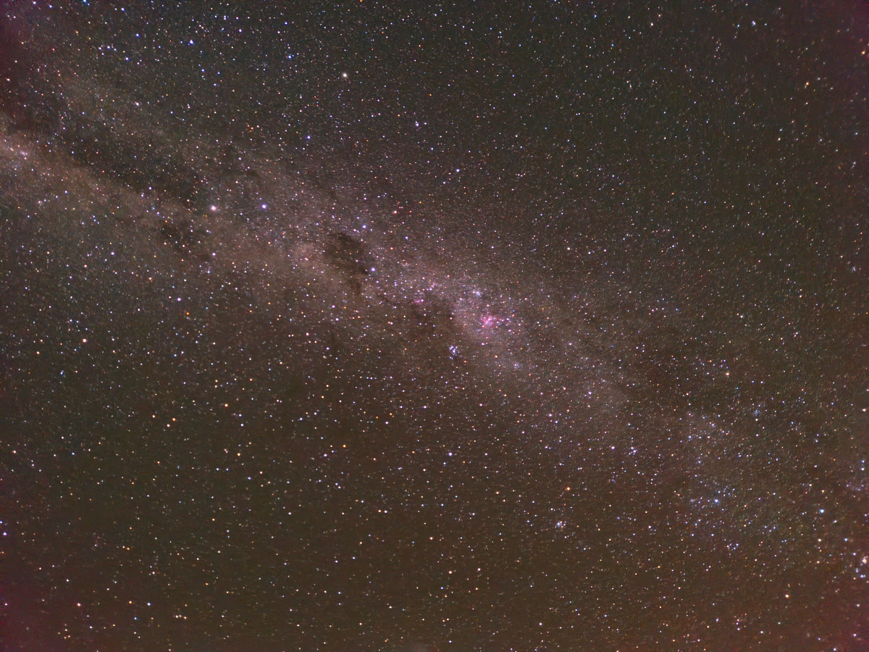
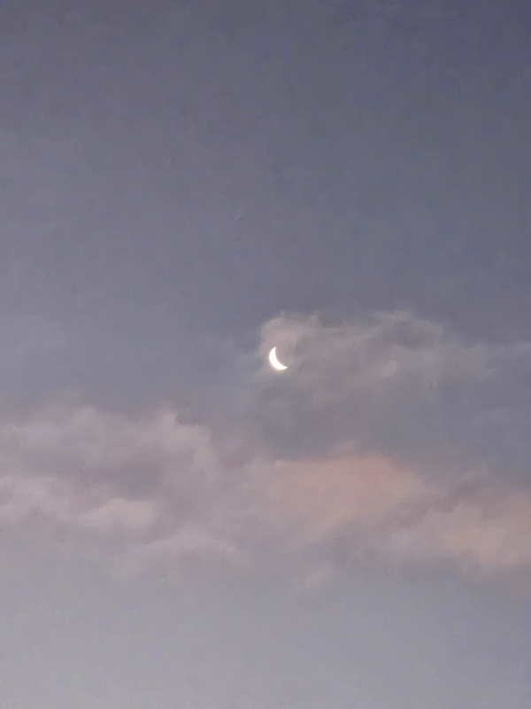
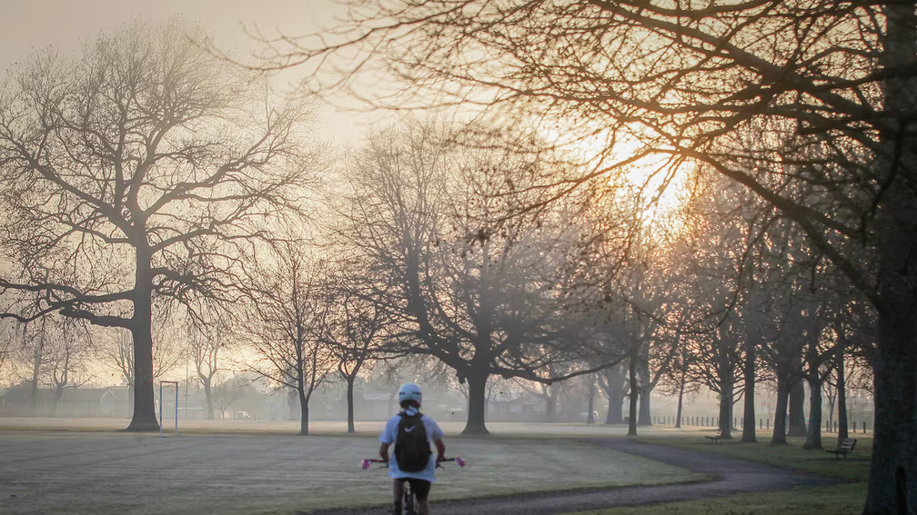
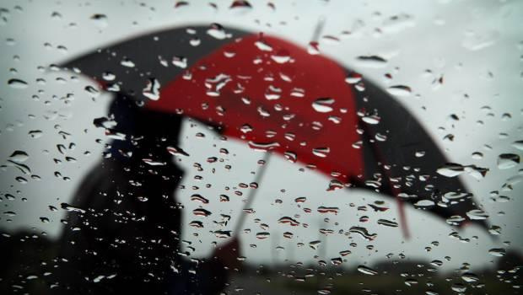
WERO I TE AHURU
    Honohonoi (Te Arawa)
    Te Rua o Takurua (Dr Rangi Matamua)
    Hōngongoi
    Hongonui
    Maruaroa
    Maramawhitu
    Hūrae
    July
Jade’s phone
Jade’s phone
Rotorua Daily Post. (2022, July 6). Cold and frosty Rotorua weather in June included -8C frost [Photograph].
Unknown. (n.d.). Person holding umbrella on rainy day [Photograph].

Slide 10
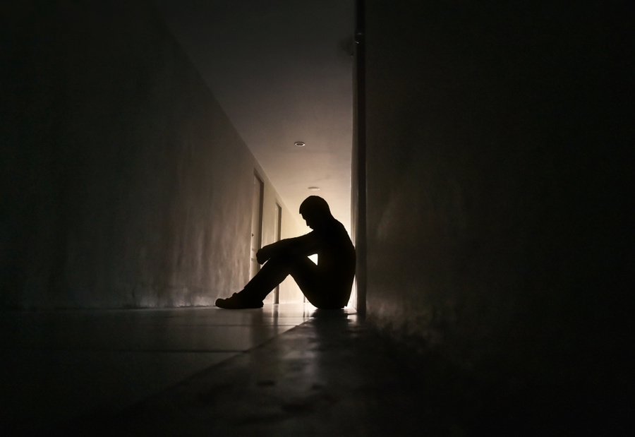
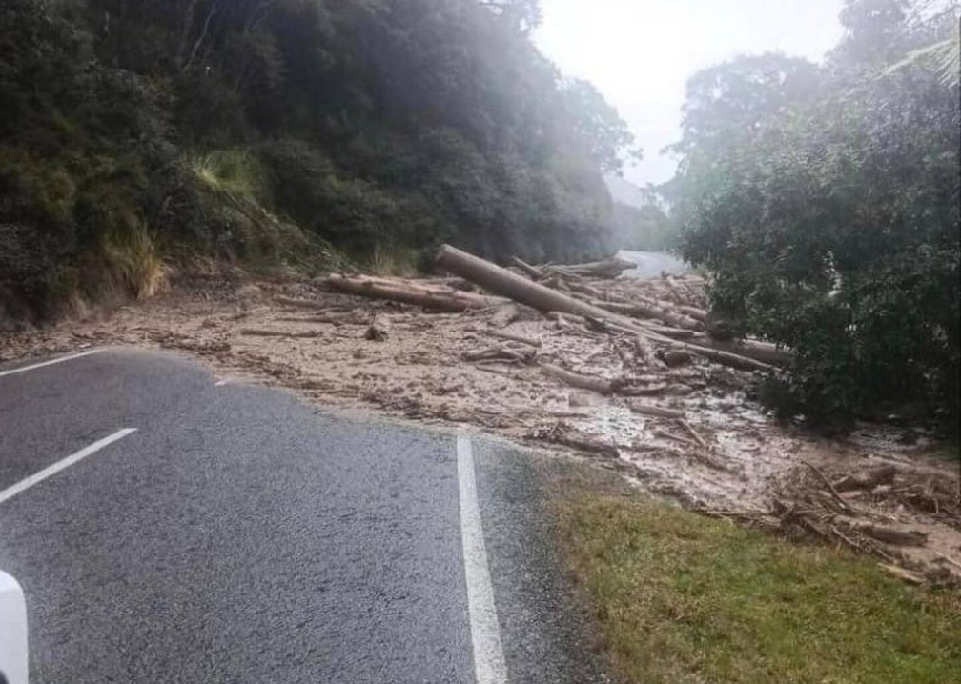
Wero i te ao mārie
    Honohonoi (Te Arawa)
    Te Rua o Takurua (Dr Rangi Matamua)
    Hōngongoi
    Hongonui
    Maruaroa
    Maramawhitu
    Hūrae
    July
    Hereturikōka (Te Arawa)
    Te Toru Here o Pipiri (Dr Rangi Matamua)
    Ākuhata
    Maramawaru
    August
Unknown. (n.d.). Silhouette of depressed man sitting in dark hallway [Photograph].
NZ Herald. (2023, March 1). Logging debris and landslide block Gisborne road during heavy rain

Slide 11
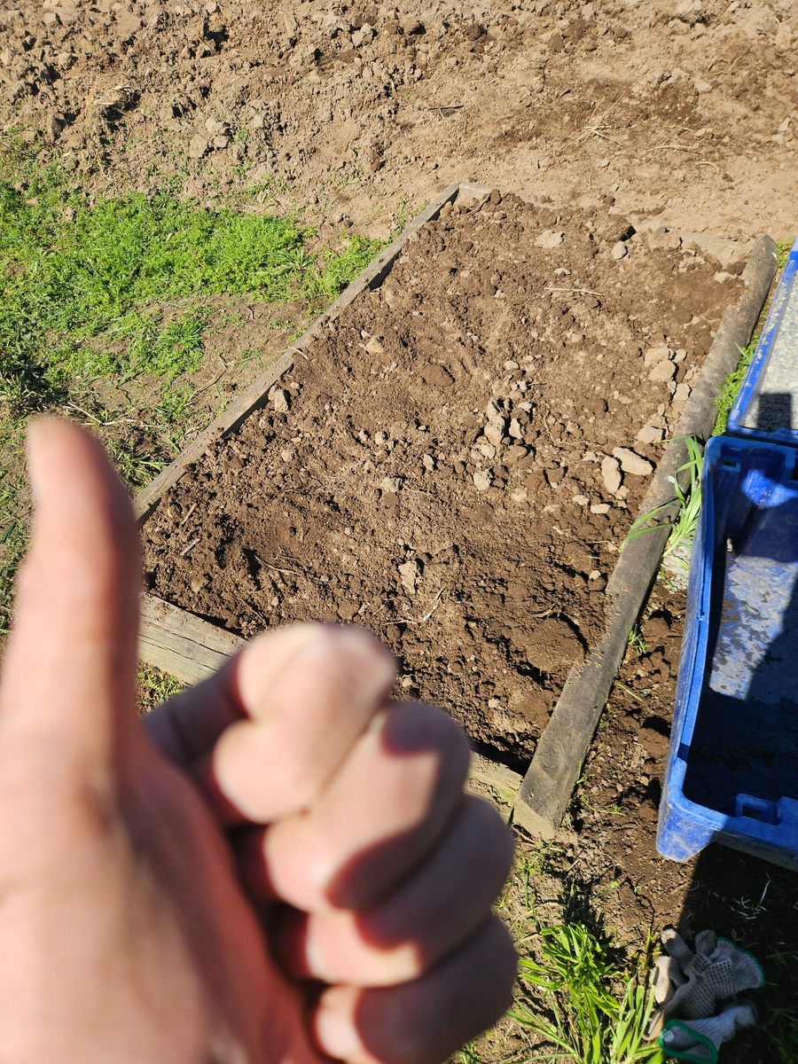
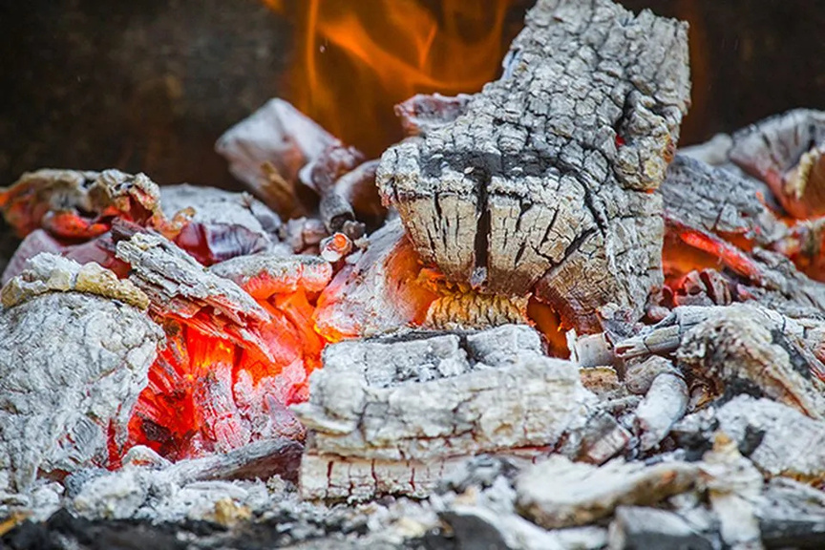
Wero i te whakatakapungarehu
    Hereturikōka (Te Arawa)
    Te Toru Here o Pipiri (Dr Rangi Matamua)
    Ākuhata
    Maramawaru
    August
    Mahuru (Te Arawa)
    Te Whā o Mahuru(Dr Rangi Matamua)
    Whakaahu
    Maramaiwa
    Hepetema
    September
This Old House. (n.d.). 8 uses for wood ash at home and in the garden [Photograph].
Jade’s phone

Slide 12
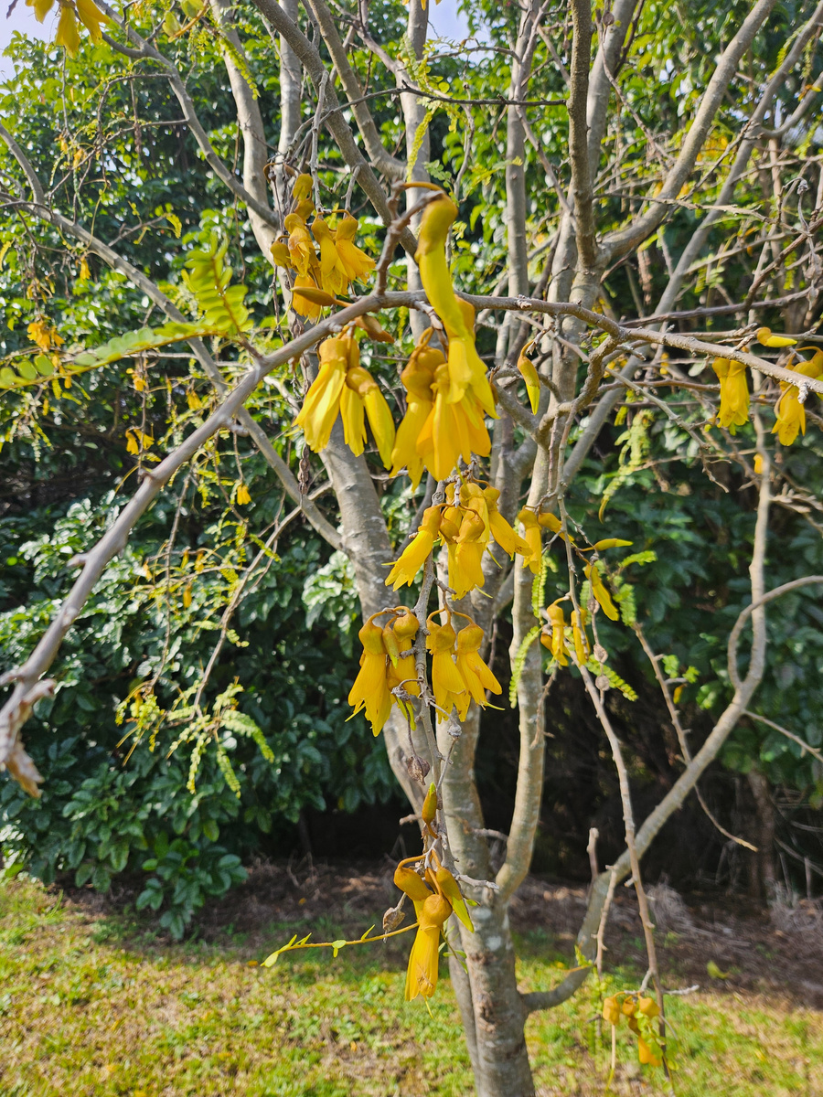
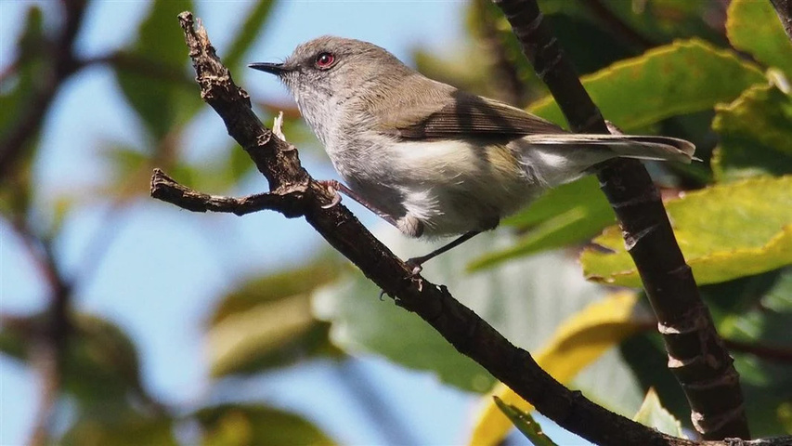
Matiti Kura
    Whiringānuku (Te Arawa)
    Te Rima o Kōpū
    Whiringa-ā-nuku
    Hiringa-ā-nuku
    Maramatekau
    Oketopa
    October
    Mahuru (Te Arawa)
    Te Whā o Mahuru(Dr Rangi Matamua)
    Whakaahu
    Maramaiwa
    Hepetema
    September
Hamilton, M. (n.d.). Grey warbler (riroriro) perched on a branch [Photograph].
Jade’s phone

Slide 13
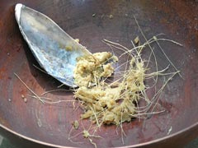
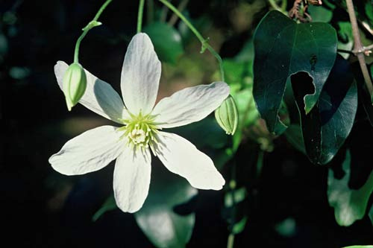
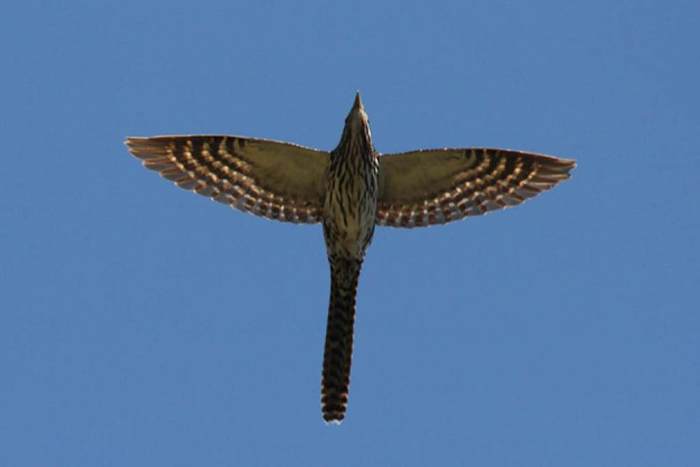
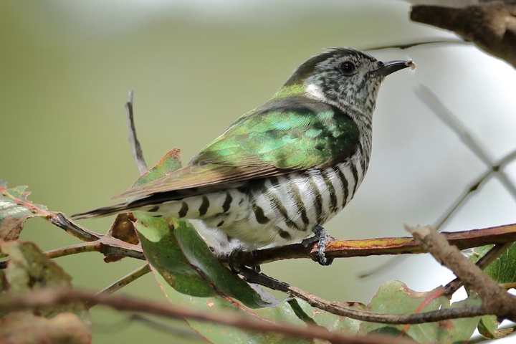
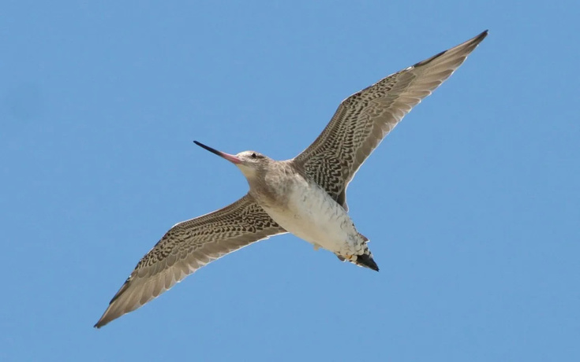
Matiti Hana
    Whiringa-ā-rangi (Te Arawa)
    Te Ono a Whitiānaunau (Dr Rangi Matamua
    Maramamātahi
    Uru-tautahi (Ngāti Kahungunu)
    Noema
    November
Christchurch City Libraries. (n.d.). Tī kōuka – The cabbage tree. Christchurch City Libraries.
Te Ara – The Encyclopedia of New Zealand. (n.d.). Puawānanga flower [Photograph].
Canopy Tours. (n.d.). New Zealand native birds – Long-tailed cuckoo returns to Canopy Tours [Photograph].
NZ Birds Online. (n.d.). Shining cuckoo / pīpīwharauroa (Chrysococcyx lucidus) [Photograph].
Radio New Zealand. (2015, October 26). Endurance champ takes Bird of the Year [Photograph].

Slide 14
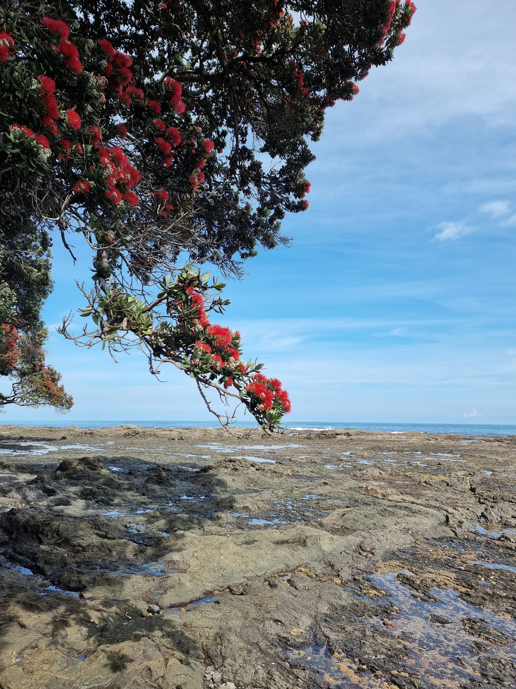
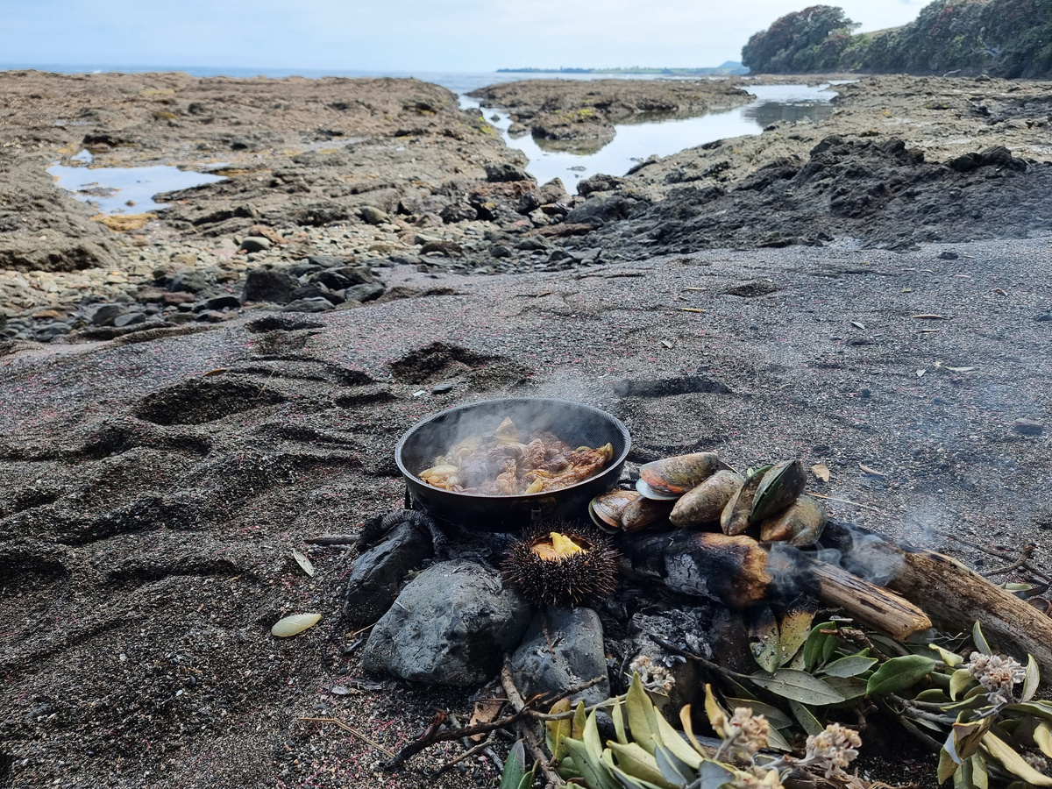
Matiti Muramura
    Hakihea (Te Arawa)
    Te Whitu o Hakihea (Dr Rangi Matamua)
    Akaaka-nui (Ngāti Kahungunu)
    Maramamārua
    Tīhema
    December

Slide 15
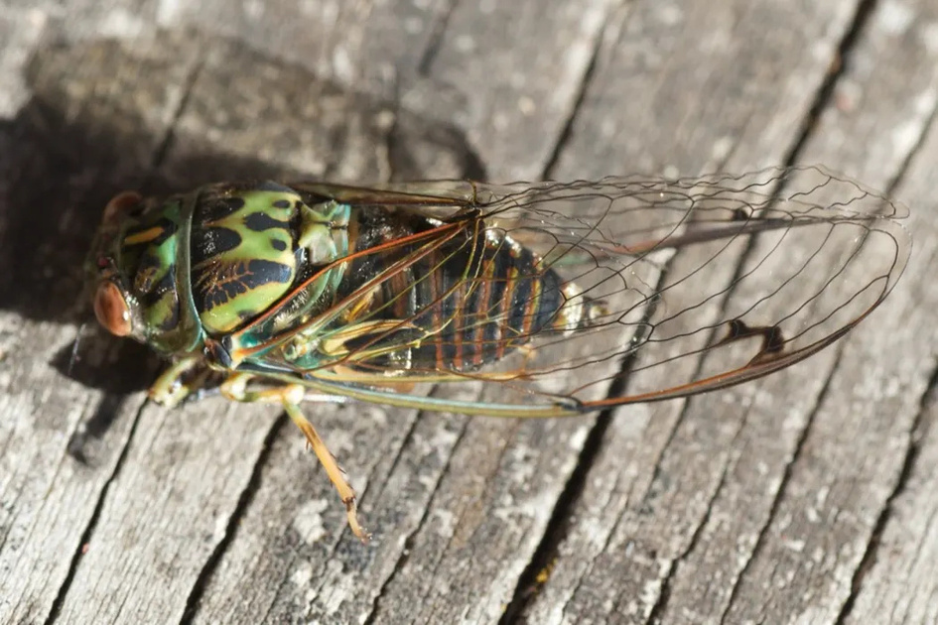
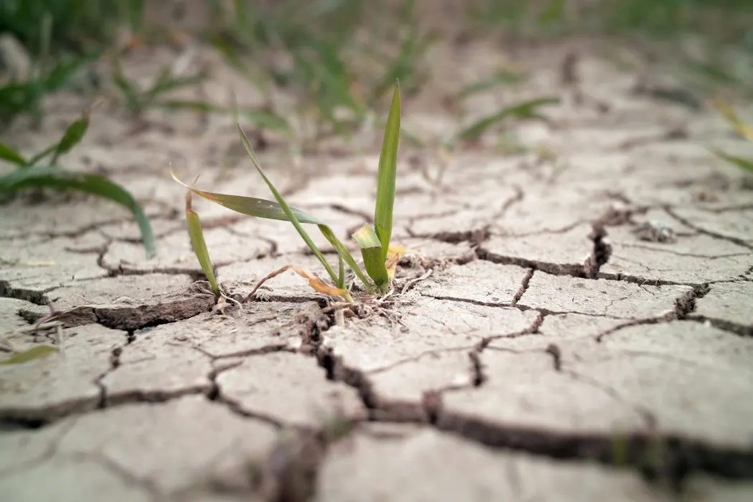
Matiti Kaiwai
    Kohitātea (Te Arawa)
    Te Waru o Rehua (Dr Rangi Matamua)
    Te Waru i kata ai a Rehua (Rereata Makiha)
    Kaitātea
    Ahuahu-mataora (Ngāti Kahungunu)
    Hānuere
    January
Radio New Zealand. (2018, January 19). Critter of the week: NZ cicadas – kihikihi and tatarakihi [Photograph]. RNZ.
Radio New Zealand. (2020, February 6). Farmers, wildlife and residents alike face water shortages as regions dry up fast [Photograph]. RNZ.

Slide 16
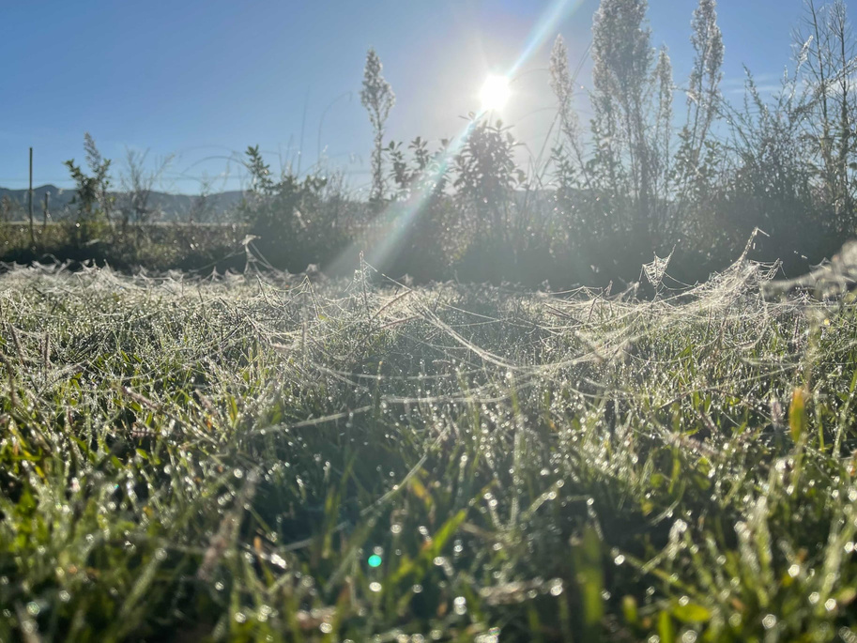
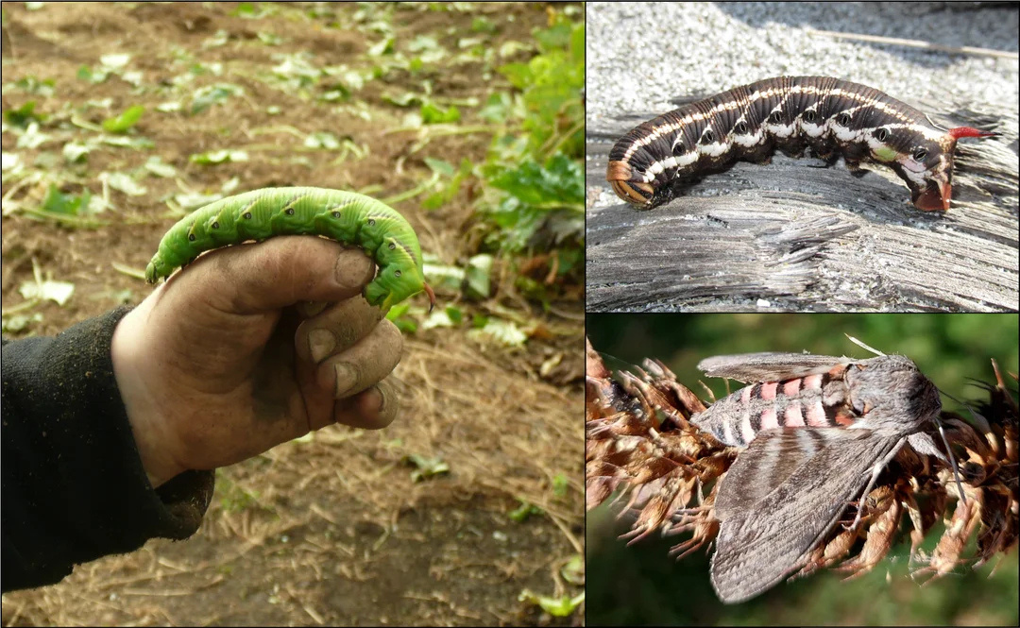
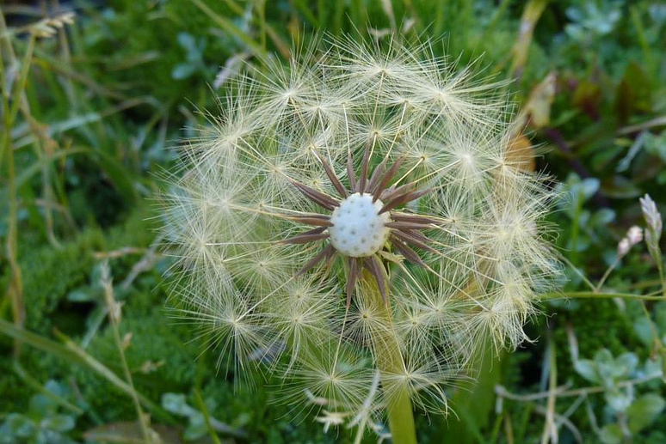
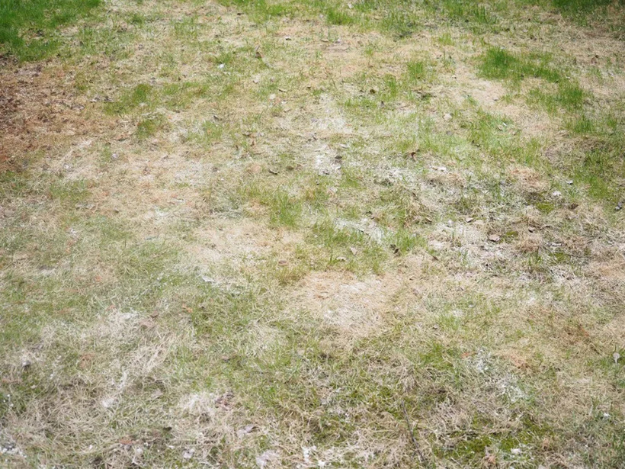
Matiti Raurehu
    Huetānguru (Te Arawa)
    Te Iwa o Ruhi
    Huitanguru
    Pēpuere
    February
Te Urewera. (2022, April 28). Pūna werewere – dew-covered spiderwebs glistening in the morning light [Photograph]. Facebook.
New Zealand Plant Names Database. (n.d.). tohetakla/tawao/tohetake [Photograph]. NZ Flora.
Science Learning Hub – Pokapū Akoranga Pūtaiao. (n.d.). Anuhe (caterpillars) and adult moths [Photograph]. Science Learning Hub.
Gardening Know How. (n.d.). Powdery mildew on grass: What causes lawn mildew [Photograph].

Slide 17
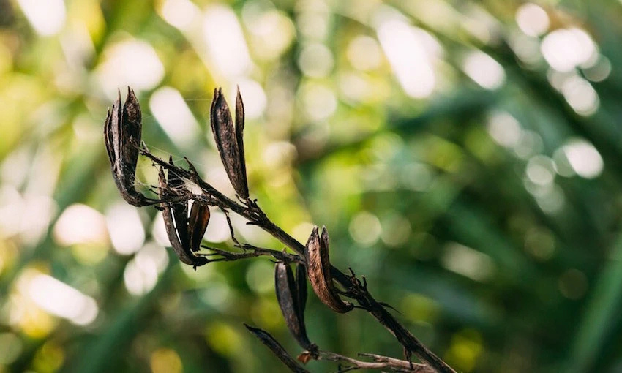
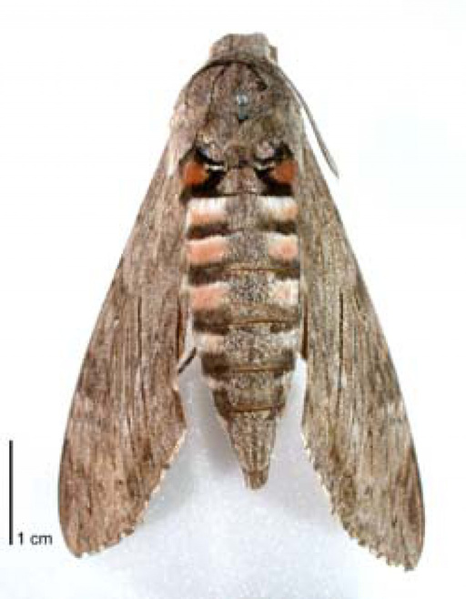
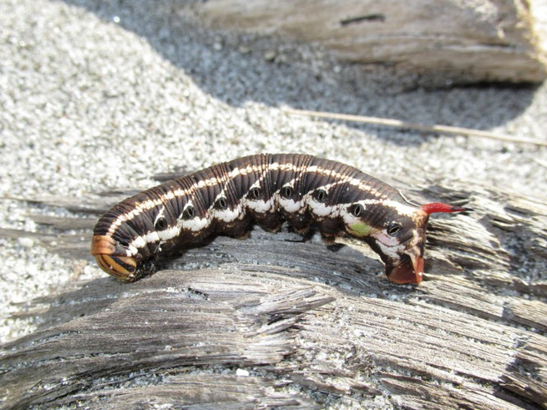
Matiti Rautapata
    Poutūterangi
    Te Ngāhuru o Poutūterangi (Dr Rangi Matamua)
    Putoki-o-tau (Ngāti Kahungunu)
    Maramatoru
    Māehe
    March
The Spinoff. (2020, March 3). Learning to live by the maramataka – Poutūterangi [Photograph of harakeke seed pods]. The Spinoff.
Landcare Research. (n.d.). Kūmara moth caterpillar and adult [Photographs]. Manaaki Whenua – Landcare Research.

Slide 18
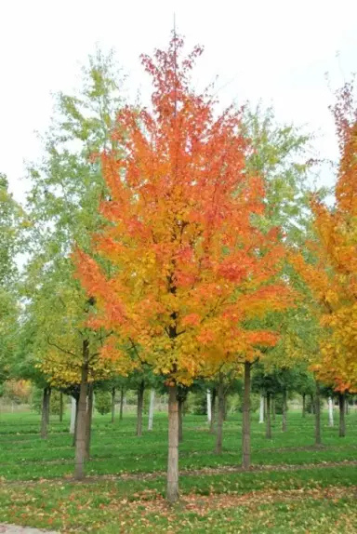
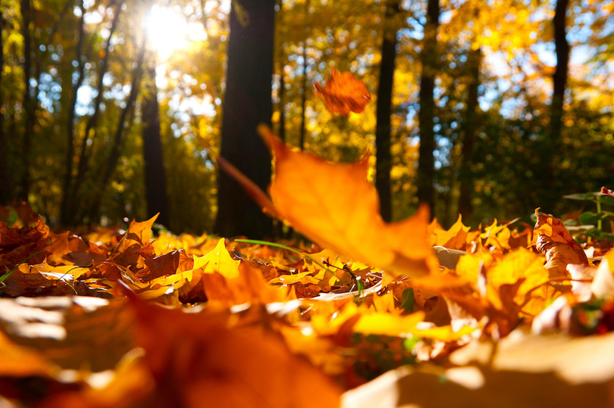
Matiti Rauangina
    Paengawhāwhā
    Ngāhuru mā tahi o Paengawhāwhā (Dr Rangi Matamua)
    Kaipō
    Tīkākā-muturangi (Ngāti Kahungunu)
    Āerira
    April
MyNativeForest. (n.d.). Fund native trees – individual plans [Photograph].
MyNativeForest. (n.d.). Fund native trees – individual plans [Photograph].

Slide 19
Ngā Mata o Te Marama
“Ngā taka o te marama, or the repeating cycles of the moon was recognised by our tūpuna and how it impacts our taiao and how it sits as a time marker when it’s best to do certain things, that to me is the brilliance of maramataka” Rereata Makiha

Slide 20
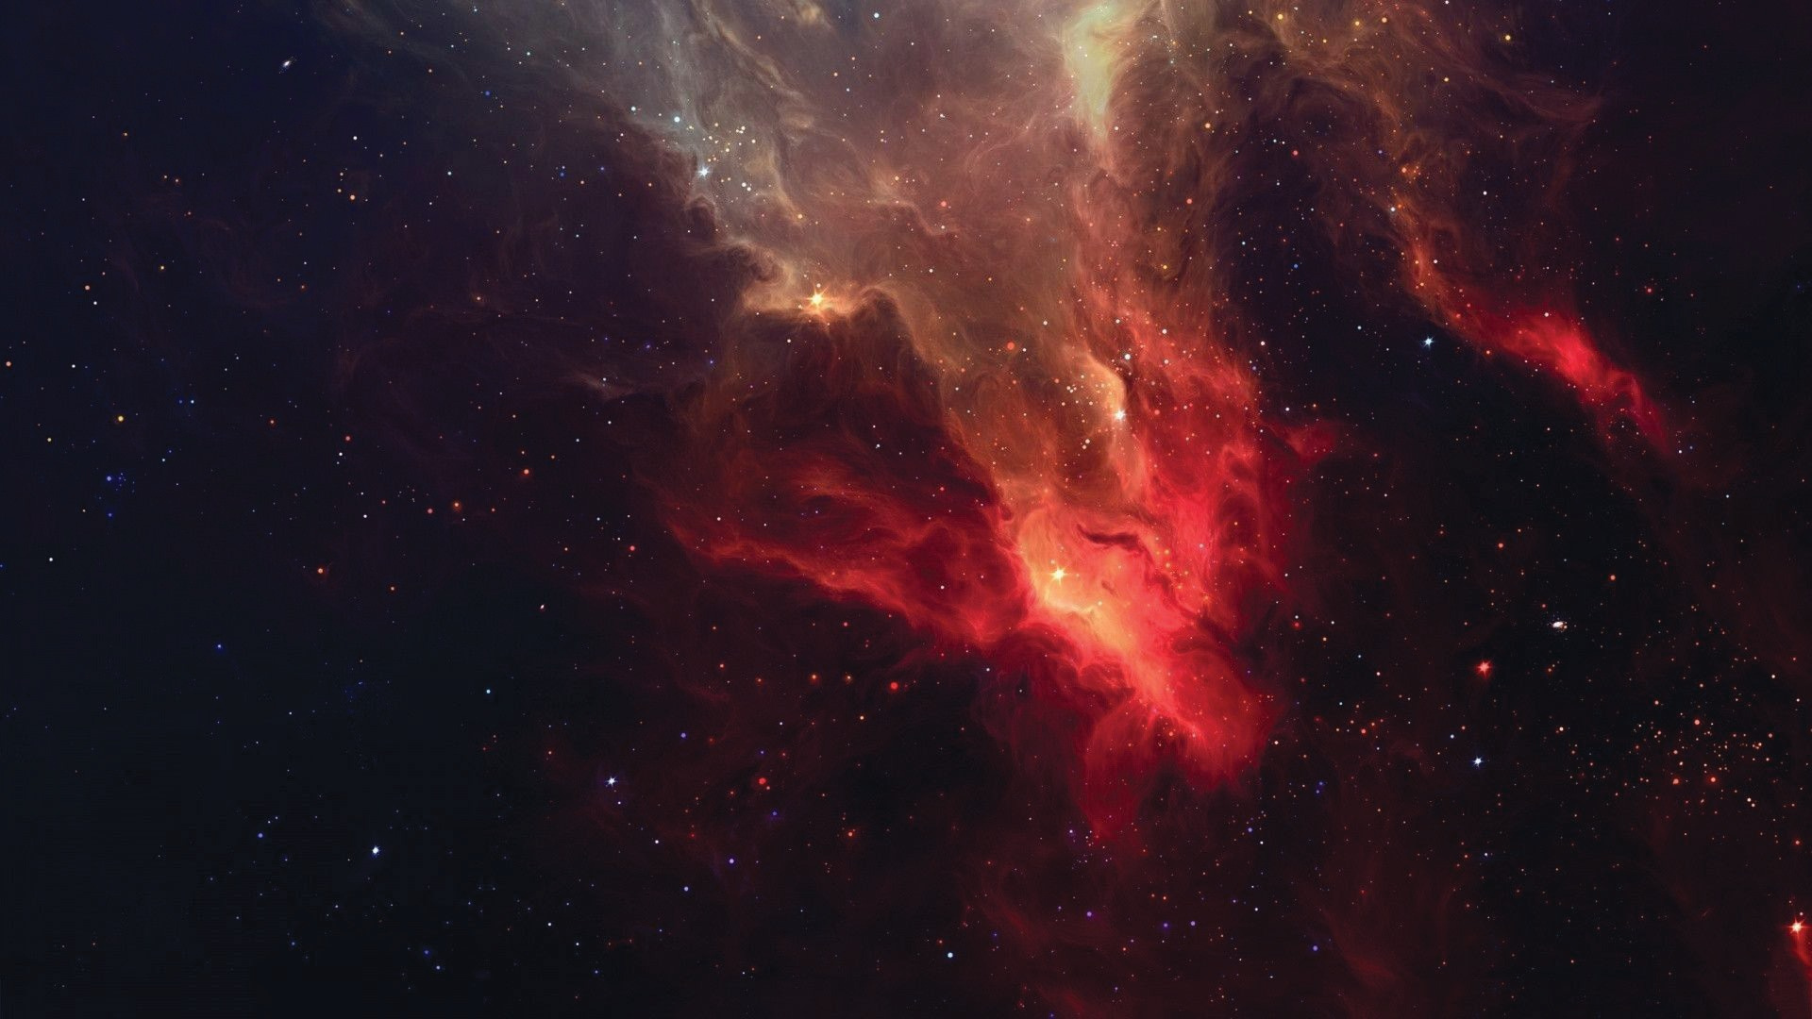




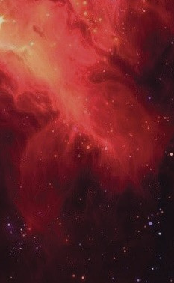

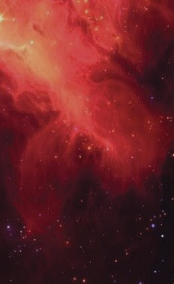



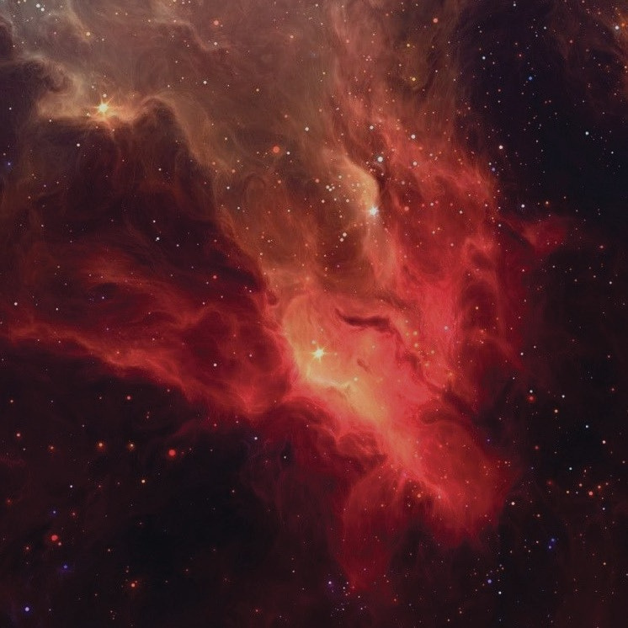

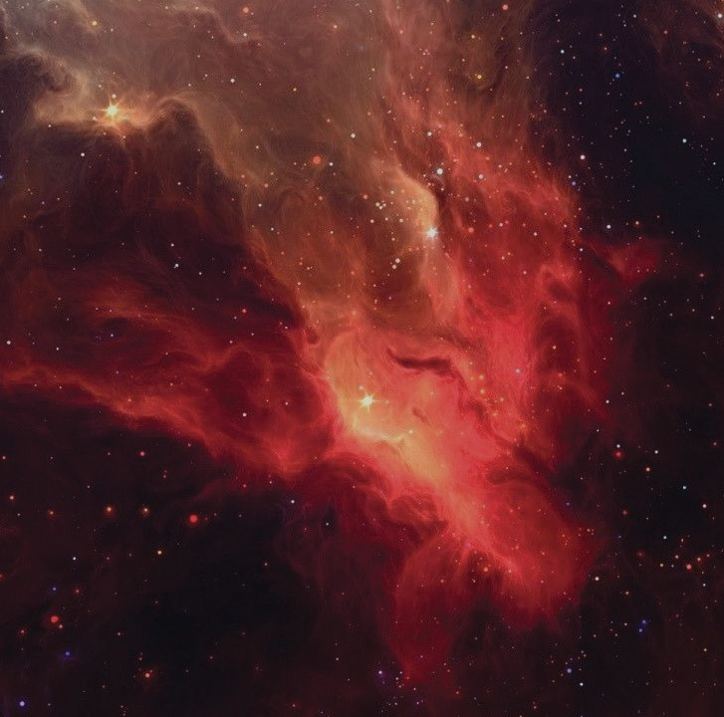
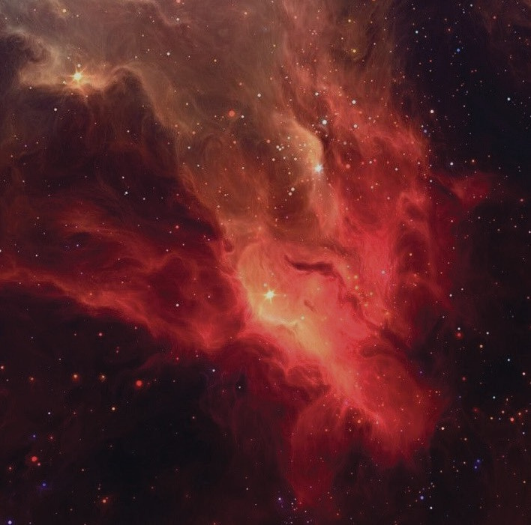





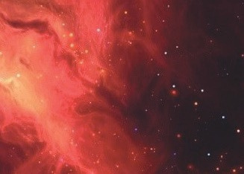
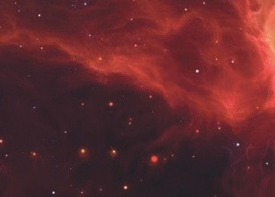











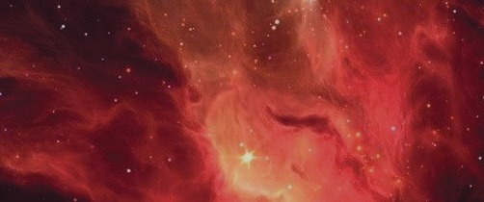
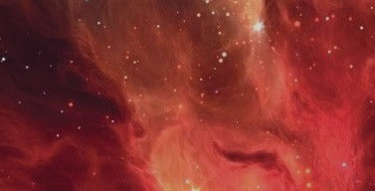

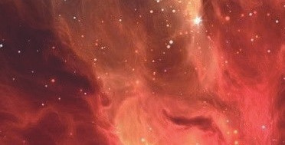














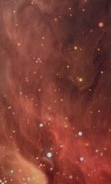














ŌTURUTURU
RĀKAUNUI
ŌHOTUROA
TAKIRAU
RAKAUMĀTOHI
OIKE
ATUAHAEHAE
Te Arawa Maramataka
MĀWHARU
MĀURE
KOREKORE-TE-
WHIWHIA
How to read this Maramataka
ARIMATANUI
K OREKORE-T E-
1. The Maramataka for Te Arawa begins at
NGA NG ANA
Whirowhiti.
HUNA
KOREKORE-PIRI-
2. Read the Maramataka in a clockwise direction,
KI-NGA-TANGAROA
starting from Whirowhiti at the bottom; the lowest energy of each month.
TAMATEAWHAKAPAU
TANGAROA-Ā-MUA
3. There are 4 main phases in the Maramataka:
TAMATEAAIO
TANGAROA-Ā-ROTO
Whirowhiti, Tamatea, Rākaunui and Tangaroa.
TAMATEAANGANA
TANGAROA-Ā-KIOKIO
4. There are 32 marama on the Maramataka.
However due to seasonal changes, some months have less marama. For example: Four marama are interchangeable. In Te Arawa they are: ‘Mutuwhenua & Tāpikiora, Māure & Māwharu.’ During Te Wā o Hine Raumati – Māure and Māwharu are present because they represent abundance in planting and harvesting kai. Mutuwhenua and Tāpikiora are not present during Te Wā o Hine Raumati. They will reappear during the Te Wā o Hine Takurua. Mutuwhenua is an extention of Ōmutu, where activity on the land ceases. Tāpikiora is a very special marama and brings balance to the Maramataka.
TAMATEATUATAHI
ŌTĀNE
ŌKOROTĀTEA
ŌRO NGONU I
ŌUENUKU
ŌRONGOMAURI
HOATA
WHIROWHITI
M UTUWHENUA
ŌMUTU
ŌTIREA
TĀPIKIORA
5. Our traditional kōrero tells us, that the āhua and
energy of each marama are influenced by one or several Atua Māori.
http://www.ngapatakakorerootearawa.org
|
email: patai@ngapatakakorerootearawa.org

Slide 21



TE MARAMATAKA O TE ARAWA2025-26
Te Ngao Energy Key
Te Ngao Makoa - Lowest Energy Te Ngao Ōrite - Moderate Energy Te Ngao Matawhāwhati - Unpredictable Energy
Te Ngao Hua - Productive Energy Te Ngao Rawa - Highest Energy Te Ngao Memeha - Waning Energy
MARAMA
NGĀO
27
TAHI-Ō-PIPIRI
HONOHONOĪ
HERETURIKŌKĀ
MĀHURU
WHIRINGĀNUKU
WHIRINGĀRANGI
20
HAKIHEA
KOHITĀTEA
19
HUETĀNGURU
POUTŪTERANGI
PAENGAWHĀWHA
HAKIHURITUA
TAHI-Ō-PIPIRI
WHIROWHITI ŌTIREA HOATA ŌUENUKU ŌKOROTĀTEA TAMATEATUATAHI TAMATEAANGANA TAMATEAAIO TAMATEWHAKAPAU HUNA ARIMATANUI MĀURE MĀWHARU ATUAHAEHAE ŌHOTUROA ŌTURUTURU RĀKAUNUI RĀKAUMĀTOHI TAKIRAU OIKE
KOREKORE-
TE-WHIWHIA
KOREKORE-
TE-NGANGANA
KOREKORE-PIRI-
KI-NGĀ-TANGAROA
TANGAROA-Ā-MUA TANGAROA-Ā-ROTO TANGAROA-Ā- KIOKIO ŌTĀNE ŌRONGONUI ŌRONGOMAURI ŌMUTU MUTUWHENUA TĀPIKIORA
25
25
23
22
22
20
18
19
17
17
28
26
26
24
23
23
21
21
20
19
20
18
18
29
27
27
25
24
24
22
22
21
20
21
19
19
30
28
28
26
25
25
23
23
22
21
22
20
20
31
29
29
27
26
26
24
24
23
22
23
21
21
1 JUNE
30
30
28
27
27
25
25
24
23
24
22
22
2
1 JULY
31
29
28
28
26
26
25
24
25
23
23
3
2
1 AUGUST
30
29
29
27
27
26
25
26
24
24
4
3
2
31
30
30
28
28
27
26
27
25
25
5
4
3
1 SEPTEMBER
1 OCTOBER
31
29
29
28
27
28
26
26
6
5
4
2
2
1 NOVEMBER
30
30
29
28
29
27
27
7
6
5
3
3
2
1 DECEMBER
31
30
28
6
4
8
7
6
5
4
3
2
1 JANUARY 2026
31
1 MARCH
30
29
28
9
8
7
6
5
4
3
2
1 FEBRUARY
2
31
30
29
10
9
8
7
6
5
4
3
2
3
1 APRIL
1 MAY
30
11
10
9
8
7
6
5
4
3
4
2
2
31
12
11
10
9
8
7
6
5
4
5
3
3
1 JUNE
13
12
11
10
9
8
7
6
5
6
4
4
2
14
13
12
11
10
9
8
7
6
7
5
5
3
15
14
13
12
11
10
9
8
7
8
6
6
4
16
15
14
13
12
11
10
9
8
9
7
7
5
17 MATARIKI
16
15
14
13
12
11
10
9
10
8
8
6
18 MATARIKI
17
16
15
14
13
12
11
10
11
9
9
7
19 MATARIKI
18
17
16
15
14
13
12
11
12
10
10
8
20 MATARIKI
19
18
17
16
15
14
13
12
13
11
11
9
21 MATARIKI
20
19
18
17
16
15
14
13
14
12
12
10
22 MATARIKI
21
20
19
18
17
16
15
14
15
13
13
11
23 MATARIKI
22
21
20
19
18
17
16
15
16
14
14
12
24
23
22
21
20
19
18
17
16
17
15
15
13
24
21
19
18
17
18
16
16
14
19

Slide 22




Slide 23




Slide 24




Slide 25




Slide 26




Slide 27


Kalei Nu’uhiva
“Be the app, be more like your kupuna” (Nu’uhiva, 2021)
“When covid started, more people wanted to grow their gardens and become self-sufficient. This has helped maramataka grow.”
(Nu’uhiva, 2021)
“We can create systems change by getting the message out there to as many people as possible because it is sometimes the community who will force the changes in those powerful people.
(Nu’uhiva, 2021).
“If the environment is healthy then we are healthy; when the environment is unwell then we are unwell” (Nu’uhiva, 2021). “
“Using the tools that our ancestors put together is a true way of returning ourselves to a pono (balanced) state of being, in terms of our relationship with our environment.” (Nu’uhiva, 2021).
· “Maramataka is a nice way to reconnect with your ancestors if you feel disconnected at all. All you have to do is feel the wind and that is your kupuna.” (Nu’uhiva, 2021).

Slide 28

· “Maramataka is something you have to live and breathe; it is the ability to have a conversation with the environment” (Waititi, 2021).
“All our traditional practices come from our ability to have a conversation with the environment.”
(Waititi, 2021).
“We have integrated maramataka into Te Hāhi Ringatū and Kapa haka”
(Waititi, 2021)
“These ‘ture’ for the moki still exist today, and if you look at it, you can transfer it into the way we look after each other, treat each other with respect”
(Waititi, 2021).
Your paragraph text
“If mātauranga Māōri is a dollar, science is one cent of that dollar, and we have to make up all the other parts of the dollar to give the full mātauranga Māori experience, and to be able to make informed decisions”
(Waititi, 2021).
Rawiri Waititi
“Matauranga Māori will always be difficult to articulate academically because of our two different worldviews” (Waititi, 2021).

Slide 29

“The key to mātauranga Māori is practice; it can’t be just studied then go back to living someone else’s values and understanding of the world” (Matamua, 2021).
“I’m excited about the next generation and what they’ll bring to this space”
(Matamua, 2021).
“The issue is that we live in a cycle that is going at 100 miles per hour” (Matamua, 2021).
“We are taking time off at the most productive period of the year and working hard during a time when we all get the flu. And the issue compounds” (Matamua, 2021).
·“The greatest coloniser of the Māori people is Pākeha time” (Matamua, 2021).
“When you impose on someone else’s timekeeping system it completely changes the way they interact with their environment, it completely changes the way they understand their culture, identity, and way of being, even their language changes” (Matamua, 2021).
Dr Rangi Matamua
“As indigenous peoples, we are not made to live like that, we are put on this earth, we are a product of the earth, we are meant to synch with the earth, if we don’t, it will have dire consequences.”
(Matamua, 2021).
· “We have adopted a time system driven by religion and commerce, things that have no association to our environment or to who we are as a people, the environmental factors that feed into who we are”
(Matamua, 2021).

Slide 30


“Nothing in this world is meant to exist in isolation; this is how we have to work today, with whakapapa”
(Makiha, 2021).
“Maramataka doesn’t work until you understand the whakapapa, tohu o te rangi, whenua, moana” (Makiha, 2021).
“I think our priority is wai and kai, for ourselves and rest life on Papatuanuku, this is also a response to climate change”
(Makiha, 2021).
Your paragraph text
“It only works until you understand and believe our tūpuna mātauranga that has been denied us for over 180 years in the education system that values pākeha science but denies our tūpuna knowledge”
(Makiha, 2021).
Rikki Solomon
“Pākeha science work to keep the nitrogen out of the waterways to restore them, where our tūpuna would work with all the trees and flowers that fruit within all those matiti phases to ensure that all those animals and creatures that live in and around those waterways have kai throughout all the phases”
(Makiha, 2021).

Slide 31

“Maramataka tells us when and what atua are more present at each time”
(Solomon, 2021).
· “If you learn about atua Māori and their pūrākau you’re also learning about emotions” (Solomon, 2021).
“Pākeha continue to show data, insights, and facts but it has never made a difference, and if we continue to be that way, we will continue to have the same problem” (Solomon, 2021).
· “What we’ve found in ‘Mahi ā Atua’ is that when we share our pūrākau with our whānau in distress they are able to navigate their journey themselves” (Solomon, 2021).
“When we first investigated this, we found that the highest was a connecting to WHRO, atua of darkness, mischief, and associated with bad and negativity etc” (Solomon, 2021).
“Maramataka connects us back to the taiao and it tells us when to perform certain rituals that are always associated with the taiao” (Solomon, 2021).
Rikki Solomon
· “We don’t have to talk about whakamōmōri, but it applies to that”
(Solomon, 2021).

Slide 32

“We need to recalibrate ourselves to our own timekeeping system, not the pākehā tick-tock time but maramataka time ‘te wā”
(Freeland, 2021).
“In terms of our Te Ao Māori systems, it sees things in a holistic way as appose to the western breaking down of knowledge into parts”
(Freeland, 2021).
“If we are going to look at tāne we need to also look at wahine. Because we see that in the relationship with Ranginui and Papatuanuku” (Freeland, 2021).
“Through our observations, what we have seen is the longer the rahui has gone on here in Tāmaki we are starting to see the manifestation of anxiety, rahui fatigue), because of people’s conditioning to tick tock time” (Freeland, 2021).
Johnnie Freeland
“By anchoring ourselves to maramataka helps us cope better because we are more in tune with the rhythms of the environment”
(Freeland, 2021)
.
“We need to know those spaces, cycles, and patterns (i.e., not just rangi, whenua, moana, but ourselves as tane & wahine) because it’s really important to the connection to our whakapapa. The solutions sit in our whakapapa”
(Freeland, 2021).

Slide 33

“Maramataka is enculturated through our DNA” (Te Hurihanganui, 2021).
“Maramataka is pinned down to your local environment, rangatiratanga, self-determined by determining your space”
(Te Hurihanganui, 2021).
“Maramataka has always been there, we just need to change the lens to which we see the world” (Te Hurihanganui, 2021).
“If we say we are one symbiotic relationship with the environment, over the past 40 plus years our environment has taken to a pākeha environment” (Te Hurihanganui, 2021).
Paora Te Hurihanganui

Slide 34

“Through observations, we have noticed in our bronze factory that certain days are better than others for poring”
(Kiel, 2021).
“Our ‘pōhutu’ usually go off for about 20 minutes, but during the Tamatea phase, they go off for over an hour”
(Kiel, 2021).
Your paragraph text
“Using the maramataka, tāne whaiora of the Pūwhakamua rehabilitation program we have been able to understand themselves more. Understand their triggers and behaviours. They’ve also been able to understand Tū and Rongo” (Kiel, 2021).
“I a koe i te pō uriuri i te pō tangotango, ko te whakaaro e rere ana i roto i a koe, ko koe anake” (Kiel, 2021).
Eraia Kiel

Slide 35

“Maramataka has given us an opportunity to take observations and act on those observations as opposed to its Monday today, and I need to be doing this and that today” (Warbrick, 2021).
“A lot of people are keen to learn about maramataka but we need to be careful that we don’t create maramataka prescriptive programs that people stop observing” (Warbrick, 2021).
·“When a health initiative or program is developed, very rarely is the environment considered when developing these initiatives.” (Warbrick, 2021).
Your paragraph text
“So, we can’t just do health by just focusing on physical activity and not worry about hinengaro” (Warbrick, 2021).
Dr Isaac Warbrick
“We can’t do health without worrying about the environment.” (Warbrick, 2021).

Slide 36

“Through our mahi with Tuhi Stationary, we’ve found that Māori are hungry to reclaim what is theirs, to understand it and apply it”
(Tibble, 2021)
“Maramataka continues to change daily, and your learning will change”
(Tibble, 2021).
“Learn to look up and out and take notice of those tohu around you”
(Tibble, 2021).
“Don’t just subscribe to one single learning point i.e., a book” (Tibble, 2021).
“Using maramataka as a strategy to understand and manage our feelings movements” (Tibble, 2021).
Mihi Tibble
“When you begin to look at time from a Te Ao Māori perspective it teaches us to look deeper and wider” (Tibble, 2021).

Slide 37

“Maramataka is about using yourself and your surroundings.”
(Clarke, 2021)
“When I was born my mother had just lost her mother and when I was born my brothers were out looking at the stars so my mother named me Whetū Mārama in remembrance of my grandmother, this is where my passion comes from”
(Clarke, 2021).
Your paragraph text
· “You must know within yourself what times to do certain things”
(Clarke, 2021).
“And you can find that through research, wānanga and being a haututu” (Clarke, 2021).
Lilliana Clarke

Slide 38

“As rongoa practitioners, it is so important to have an understanding of maramataka”
(Thompson, 2021).
“I have helped many other wahine with their hapūtanga, and what is interesting is everyone is different” (Thompson, 2021).
Your paragraph text
“When I harvest rongoa, I make use it’s the right cycle for that plant and the right phase of the marama, and the right cycle of the wahine” (Thompson, 2021).
“There are so many different cycles within the cycles of the world and maramataka has helped me connect with the tohu” (Thompson, 2021).
Davina Thompson
· “Maramataka teaches us to honour the atua when we enter their spaces” (Thompson, 2021).

Slide 39

“The maramataka has enhanced my connection with the whenua and has brought absolute results in terms of understanding the kai that we grow, the people with whom we share our knowledge, and the people with whom we mahi with”
(Kiripātea, 2021).
· “Our people were scientific thinkers but also logical thinkers”
(Kiripātea, 2021).
Your paragraph text
“Never turn your back on the sun because the sun provides that energy for your tipu; if you get in between the tipu and the sun you are blocking that energy”
(Kiripātea, 2021).
· “We have become so colonised that we forgot a lot of things of what our old people said”
(Kiripātea, 2021).
Te Rangikaheke Kiripatea

Slide 40

“Te take kua ū au ki ngā ahuatanga a Hina, ko te whakariterite i tōku ao, ki te ao o ngā atua Māori” (Rupapera, 2021).
“I roto i tēra ko te whai wāhi ki te āta whakangungu i ahau anō, i tōku ngao me tōku mauri ki ngā ahuatanga o taiao, ki ahau ko te oranga tonutanga tēra,” (Rupapera, 2021).
Your paragraph text
“I roto i ngā mahi tūpuna ka whai pūkenga, ka whai huarahi anō ki te tino whakaū i ahau anō, ko te mahi maara, kaitiaki taiao.” (Rupapera, 2021).
Harina Rupapera

Slide 41

“Be intentional about sharing matauranga Māori while you’re working; what is interesting was the kids joining in with work because of the maramataka” (Raharuhi, 2021).
“Health Families Rotorua wanted to do something in the food system. We Māori already know we have the worst health stats. So, we thought, let’s turn the volume down on that but turn the volume up on something that increases our opportunity to participate and engage in something that will change those stats.”
(Raharuhi, 2021).
Your paragraph text
Mapihi Raharuhi
· “Maramataka became an opportunity to not only talk about nutrition or health, but a vehicle to talk about our connection to the taiao, our whakapapa and our Reo” (Raharuhi, 2021).

Slide 42

“First thing I did was learn the phases and understand how my mauri interacted with the mauri of the maramataka” (Galvin, 2021).
“I had a very tough upbringing which left me with massive bouts of depression” (Galvin, 2021).
Your paragraph text
“Weaving for me is a form of active meditation. It’s helped me through the korekore phases when I know I struggle” (Galvin, 2021).
“I have spent years on finding better ways to get through the korekore phases. (Galvin, 2021).
Anahera Galvin
· Maramataka is what led me into other Māori practices like rongoa, karakia and weaving”
(Galvin, 2021).

Slide 43

“We embedded maramataka observations and trends into our policies”
(Hancock, 2021).
“Individual observations from the trustees informed the policy” (Hancock, 2021).
Your paragraph text
“Knowing when to push hard on the productive days and when to slow down on less productive days”
(Hancock, 2021).
· “During the first week when we went into hibernation my baby got sick and I was at home to take care of her; during that time there were also bugs going around” (Hancock, 2021).
Kerri-Anne Hancock

Slide 44

· “Ko te hononga o te taiao, me te hononga o te tangata ki te taiao , ka whaia e mātau ki tā te atua, ko ngā atua au e kōrero na”
(Curtis, 2021).
“He ao ataahua tēnei, he ao tino Māori tēnei, he ao whakawhanake tēnei”
(Curtis, 2021).
“Hei ia ata ka noho te kura ki te wānanga i te maramataka Māori, mā reira ka hono atu ki tō mātau kaupapa o te rā” (Curtis, 2021)
Your paragraph text
“Kei te whai mātau i te taiao, kaore i te tohutohu ki te taiao” (Curtis, 2021).
Tukiterangi Curtis
· “I tipu ai te whakaaro ko te maramataka i roto i ahau me taku tirohanga whānui ki te taiao” (Curtis, 2021).

Slide 45

“The first thing was done as staff, we had to immerse ourselves in maramataka; we were lucky to have journals where we had to take observations” (Kiel, R, 2021).
“We started teaching our kids ngā mata o te marama (phases of the marama)” (Kiel, R, 2021).
Your paragraph text
· “Utilising the maramataka as it should be, not just a tick box, and you will get some amazing results, I’ve been noticing it already” (Kiel, 2021)
Rahera Kiel

Slide 46
Here are the four key findings of Te Hekenga a Rongo:
1. Increased Interest but Challenges in Practice:
• While more people are interested in maramataka, there is still a gap between knowledge and practice. People want quick and easy ways to learn maramataka, but true understanding requires active participation and alignment with natural cycles.
2. Health and Environmental Reconnection:
• Practicing maramataka helps individuals reconnect with the environment, leading to health benefits, self-discovery, and a deeper sense of identity.
3. Revitalization Efforts:
• Initiatives to normalize maramataka are growing, and resources are being developed to make it accessible. However, there are concerns about the commodification of maramataka knowledge and the risk of it being misused or diluted.
4. Barriers of Systemic Racism:
• Experts note that maramataka is often devalued within Western scientific frameworks, creating a barrier to its widespread adoption and practice.

Slide 47


