Slide 1
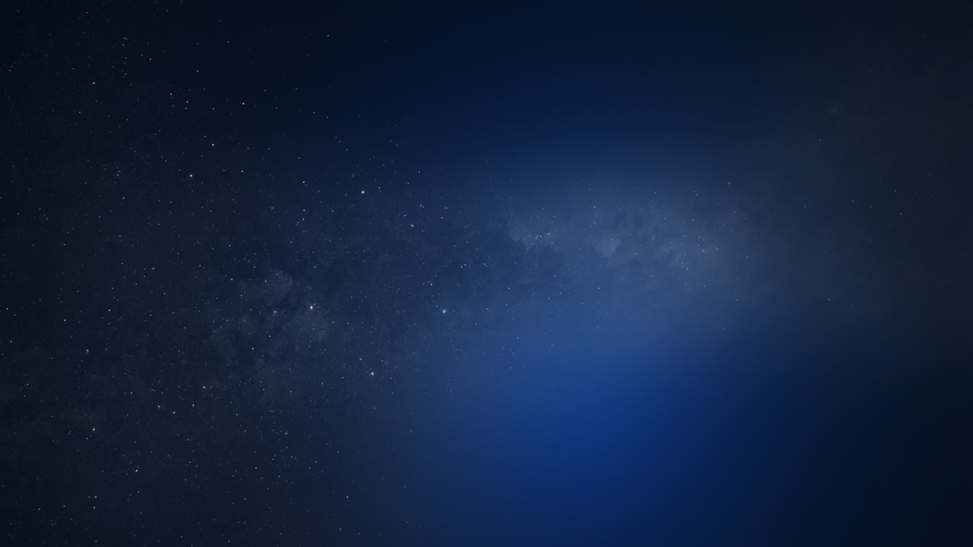
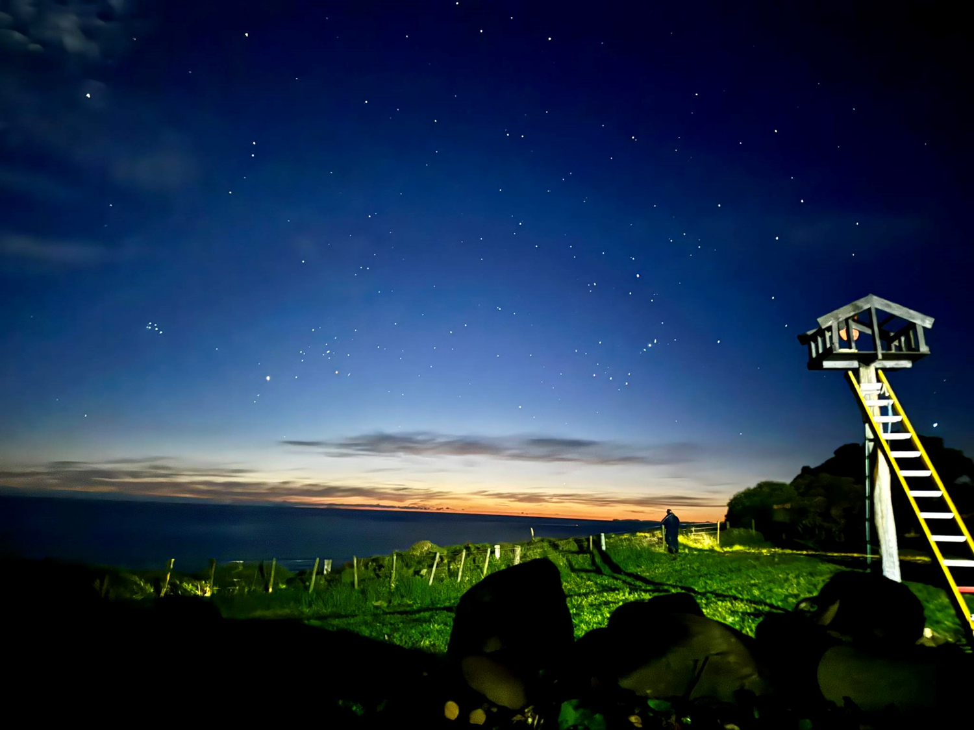
Te Uetāngahu a Tānenuiārangi
Reconnecting Education Through the Stars
PPTA Māori Teachers’ Conference 2026
Sudima, Rotorua,
Notes:
Pause before speaking. Let the image hold the room. Then begin softly:
Before there were classrooms, there were the stars.
Acknowledge Matariki, Puanga, Pūanga, Autahi

Slide 2
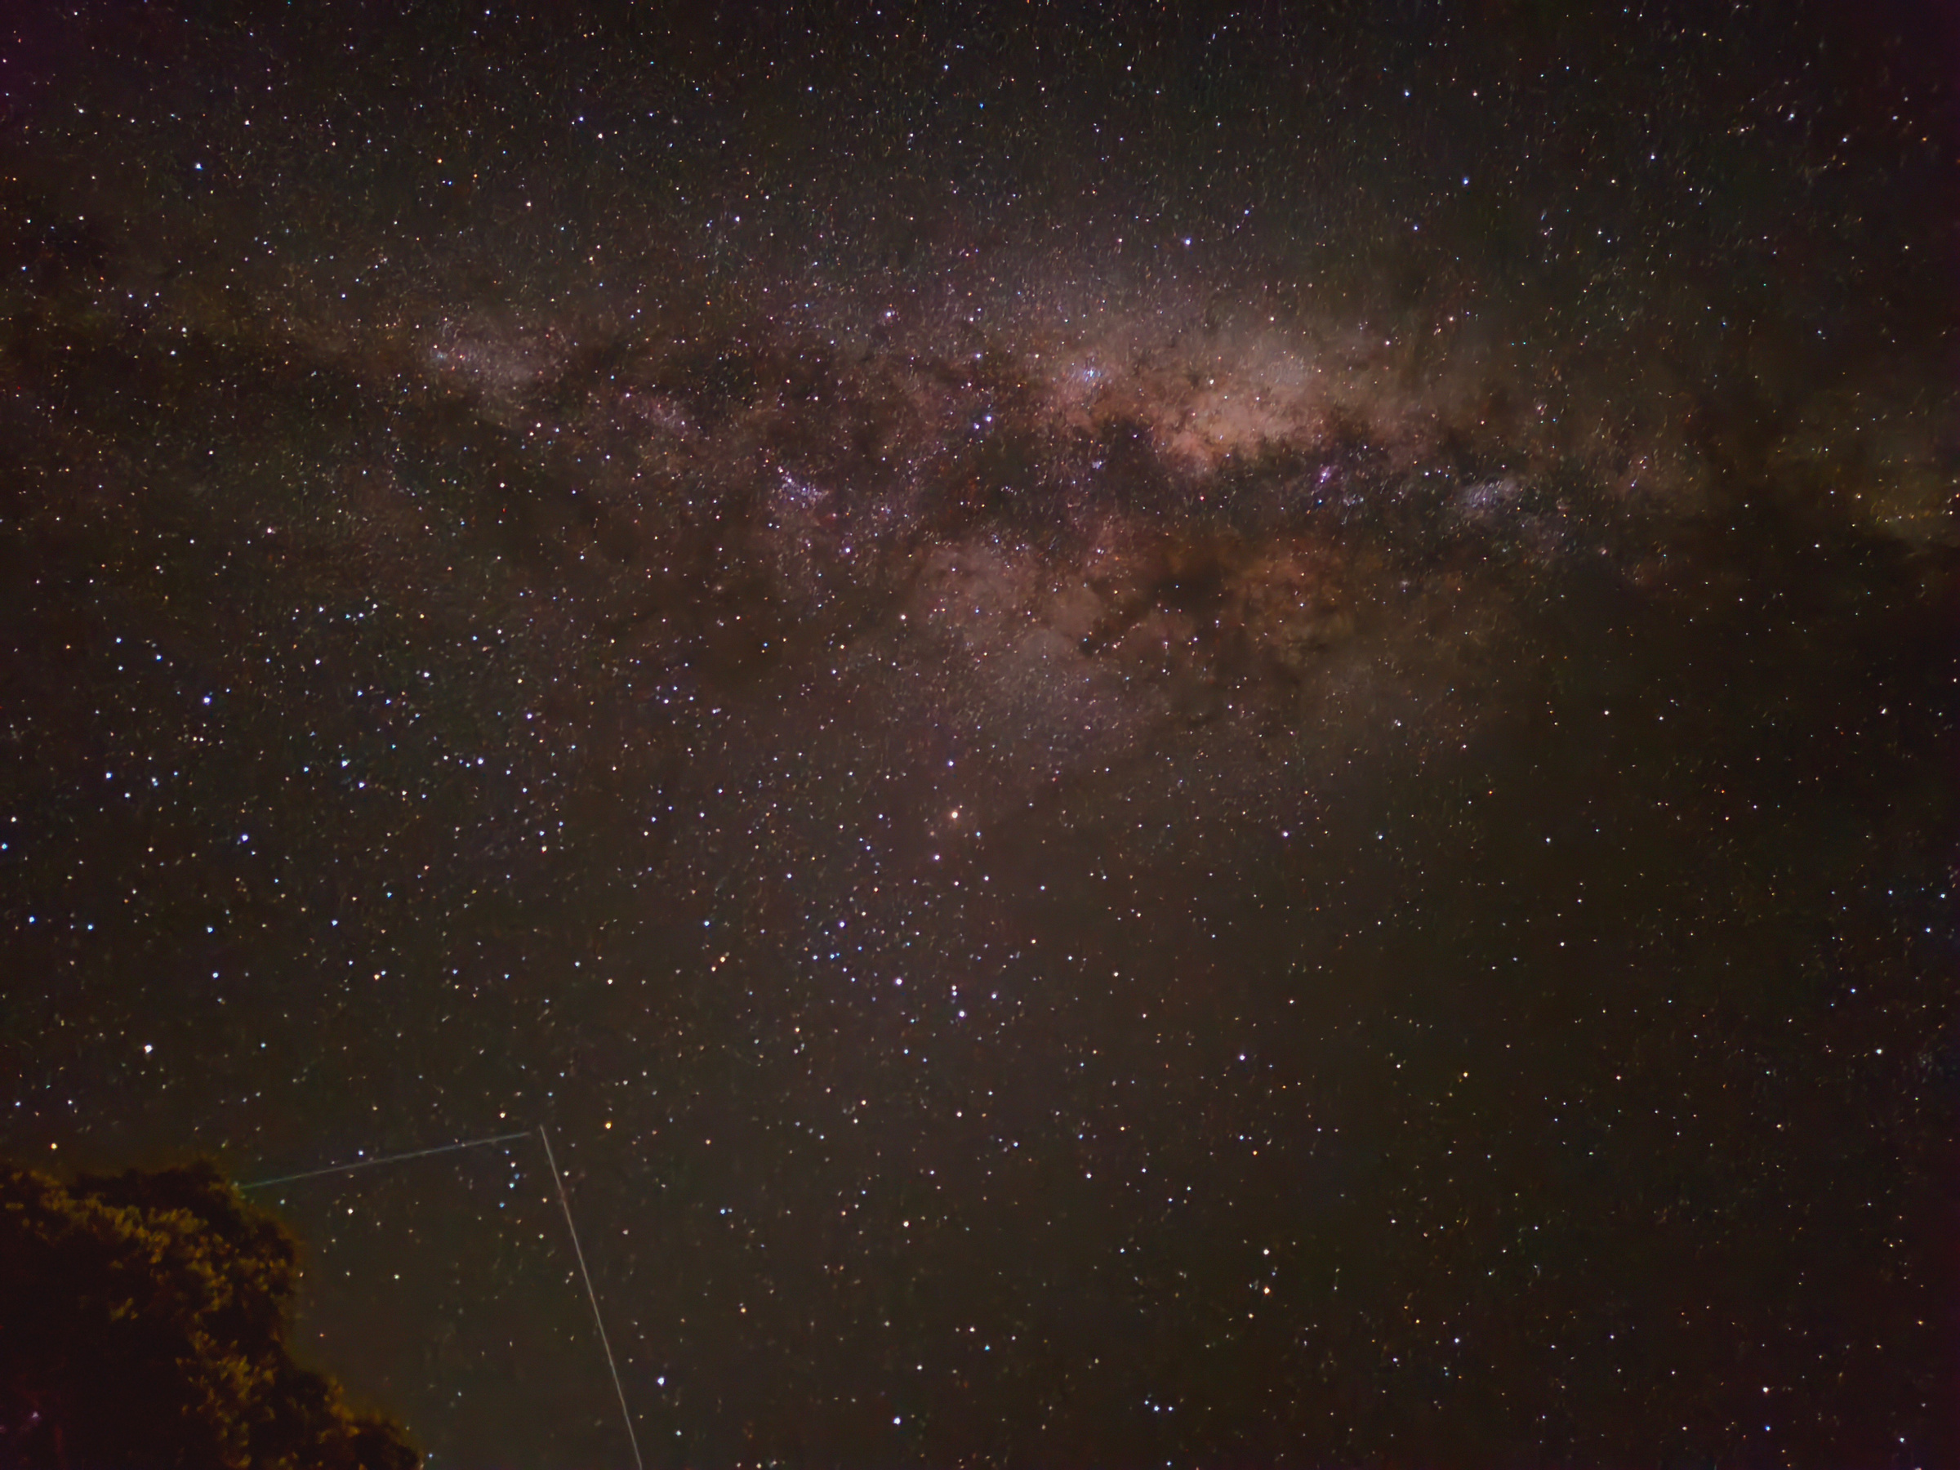
“When was the last time you truly looked at the stars?”
Notes:
When was the last time you truly looked at the stars?
When was the last time you stood outside...
...not to check the weather...
...not to find your car...
...not because you were in a hurry...
...but simply to look at the stars?
(Pause again.)
As teachers, we're constantly asking our students to look down.
Look at your books.
Look at your screens.
Look at the board.
But today, I'd like to invite us to do something different.
I'd like us to look up.
(Pause.)
Because for our tūpuna, looking up wasn't simply an act of curiosity.
It was an act of learning.
"Who taught you to look at the stars?"

Slide 3
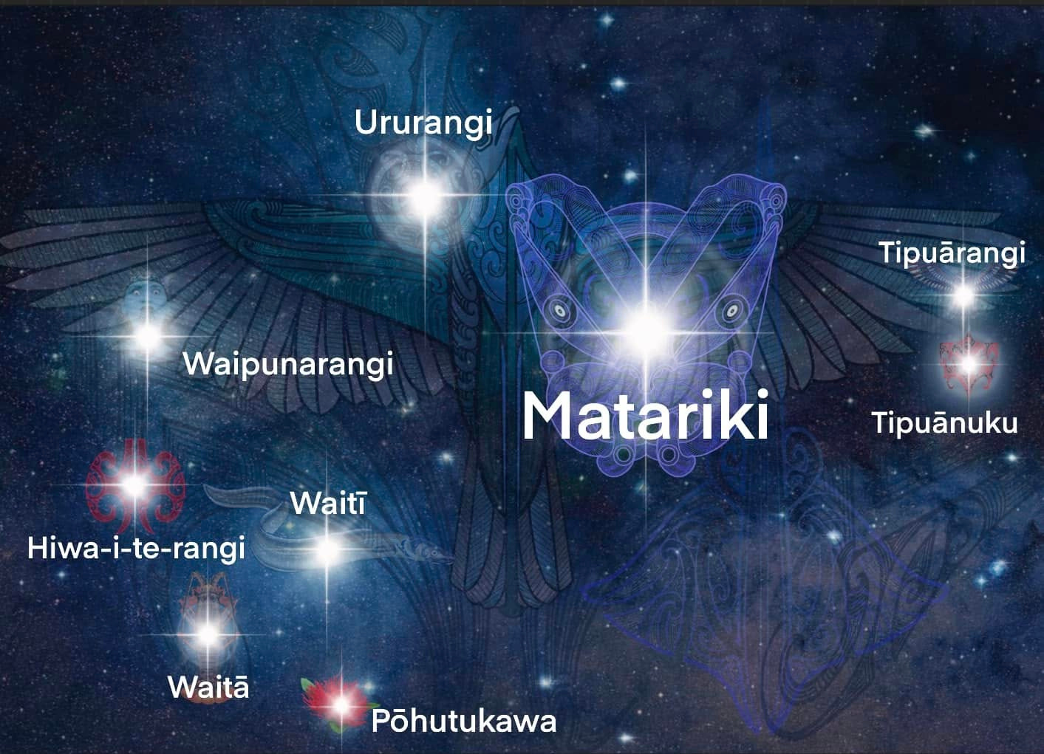

Slide 4
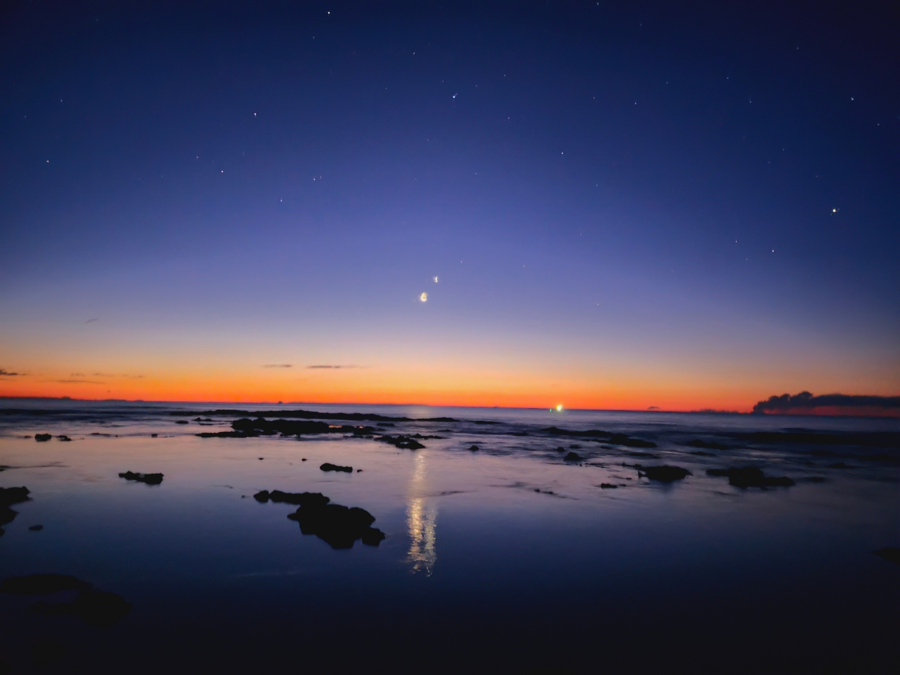
Before there were classrooms.
“Before there were classrooms, there were teachers”.
Notes:
Speaker Notes
(Allow the audience to read the slide.)
We often think education began when someone built the first classroom.
We imagine knowledge began when somebody wrote the first book.
We celebrate the invention of universities.
(Pause.)
But our ancestors had no classrooms.
(Pause.)
They had no projectors.
No textbooks.
No internet.
No assessment schedules.
(Smile.)
Yet somehow...
(Pause.)
They crossed Te Moana-nui-a-Kiwa.
(Click to next image if using animation.)
They memorised thousands of years of whakapapa.
(Pause.)
They understood tides.
Winds.
Seasons.
Astronomy.
Ecology.
Food systems.
Healing.
Leadership.
Governance.
(Pause.)
So the question isn't...
How did they learn?
(Pause.)
The better question is...
Who were their teachers?

Slide 5
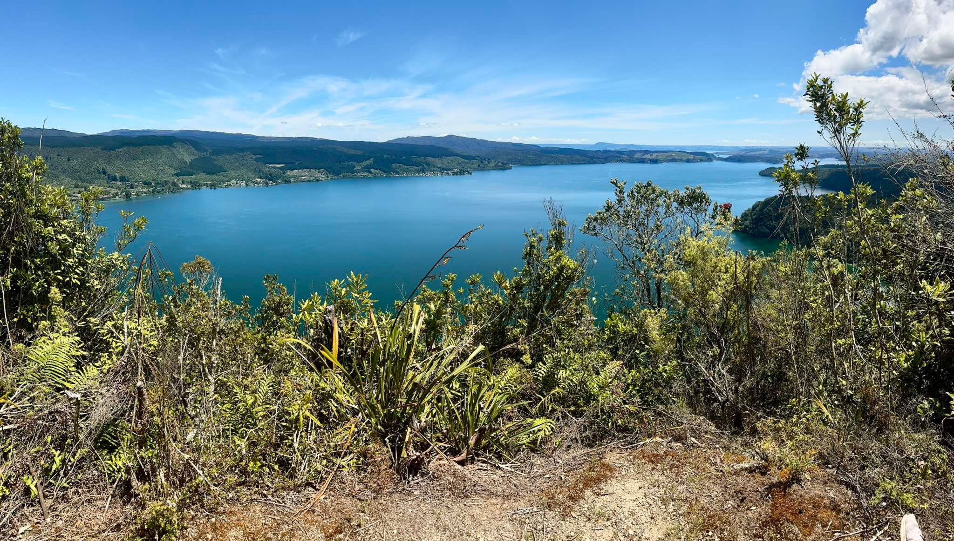

Slide 6
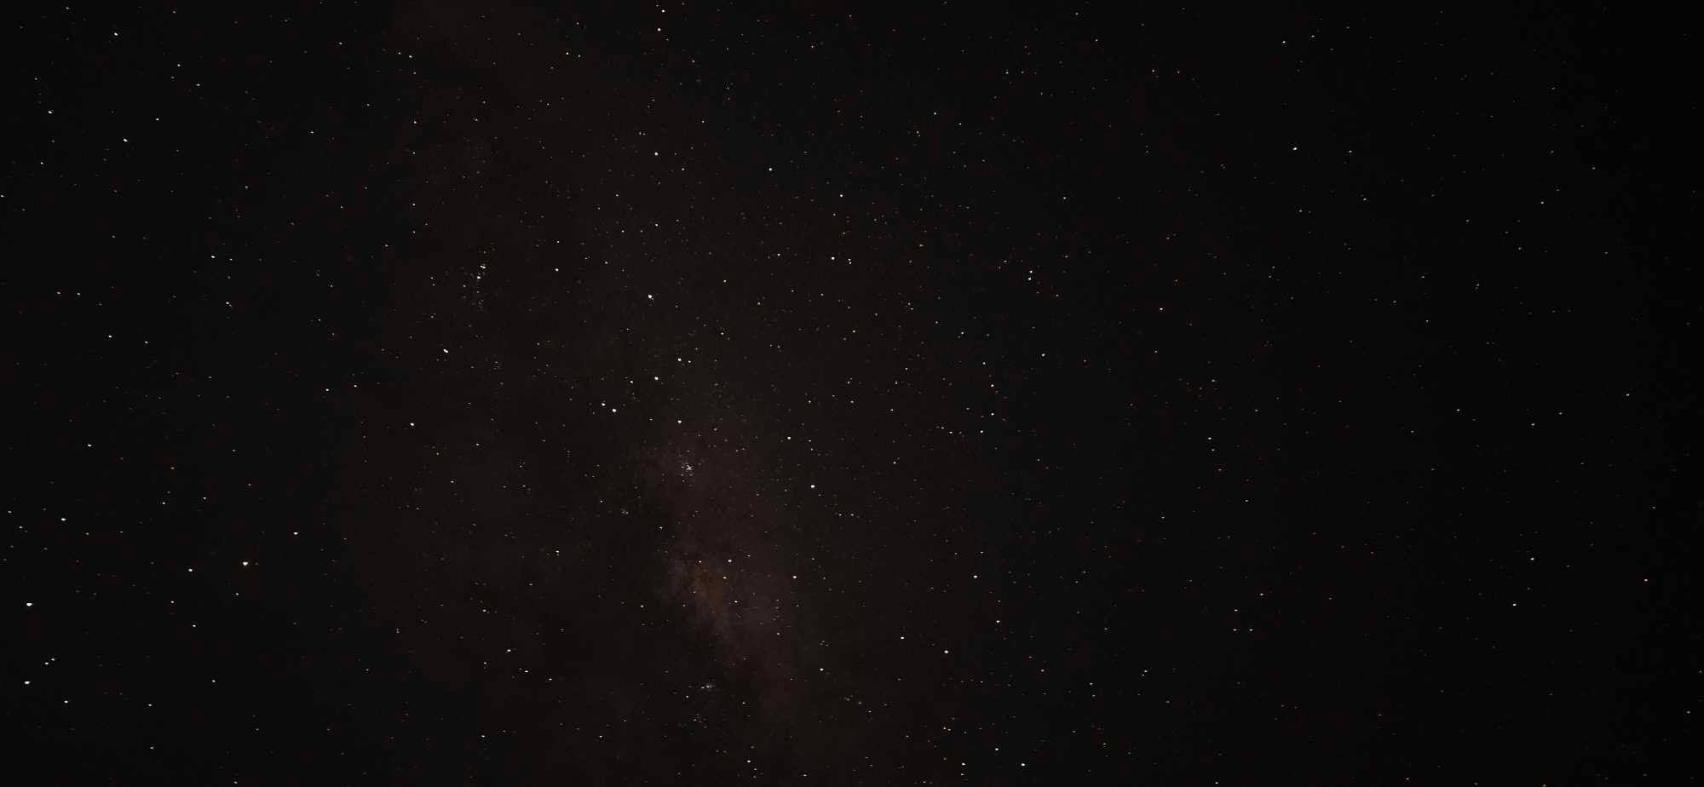
Whare Wānanga
Notes:
Before there were classrooms...
before there were schools...
before there were books...
before there were exams...
our tūpuna were already learning.
(Pause.)
Their classroom wasn't built from timber or concrete.
It wasn't surrounded by four walls.
It had no ceiling.
No bell.
No timetable.
(Pause.)
Their classroom was Te Taiao.
Continue.
Every day...
the world around them became their teacher.
The stars taught navigation.
The moon revealed rhythm.
The tides guided movement.
The birds signalled seasonal change.
The winds carried messages.
The rivers revealed health.
The forests offered food, medicine, and shelter.
Every part of creation carried knowledge.
Introduce the central idea
Slow down.
Our tūpuna didn't separate learning from life.
(Pause.)
Learning happened while gathering kai.
While fishing.
While travelling.
While observing the stars.
While listening to the stories of kaumātua.
Education wasn't somewhere you went.
It was a way of living.
Connect to today
Now bring the audience in.
Imagine if our learners understood that learning doesn't stop when they leave the classroom.
Imagine if they recognised that every walk, every season, every sunrise, every night sky still has something to teach them.
That's the philosophy I want to explore with you today.
Audience Reflection
Ask:
If Te Taiao was our first classroom...
(Pause.)
What might it still be teaching us today?

Slide 7
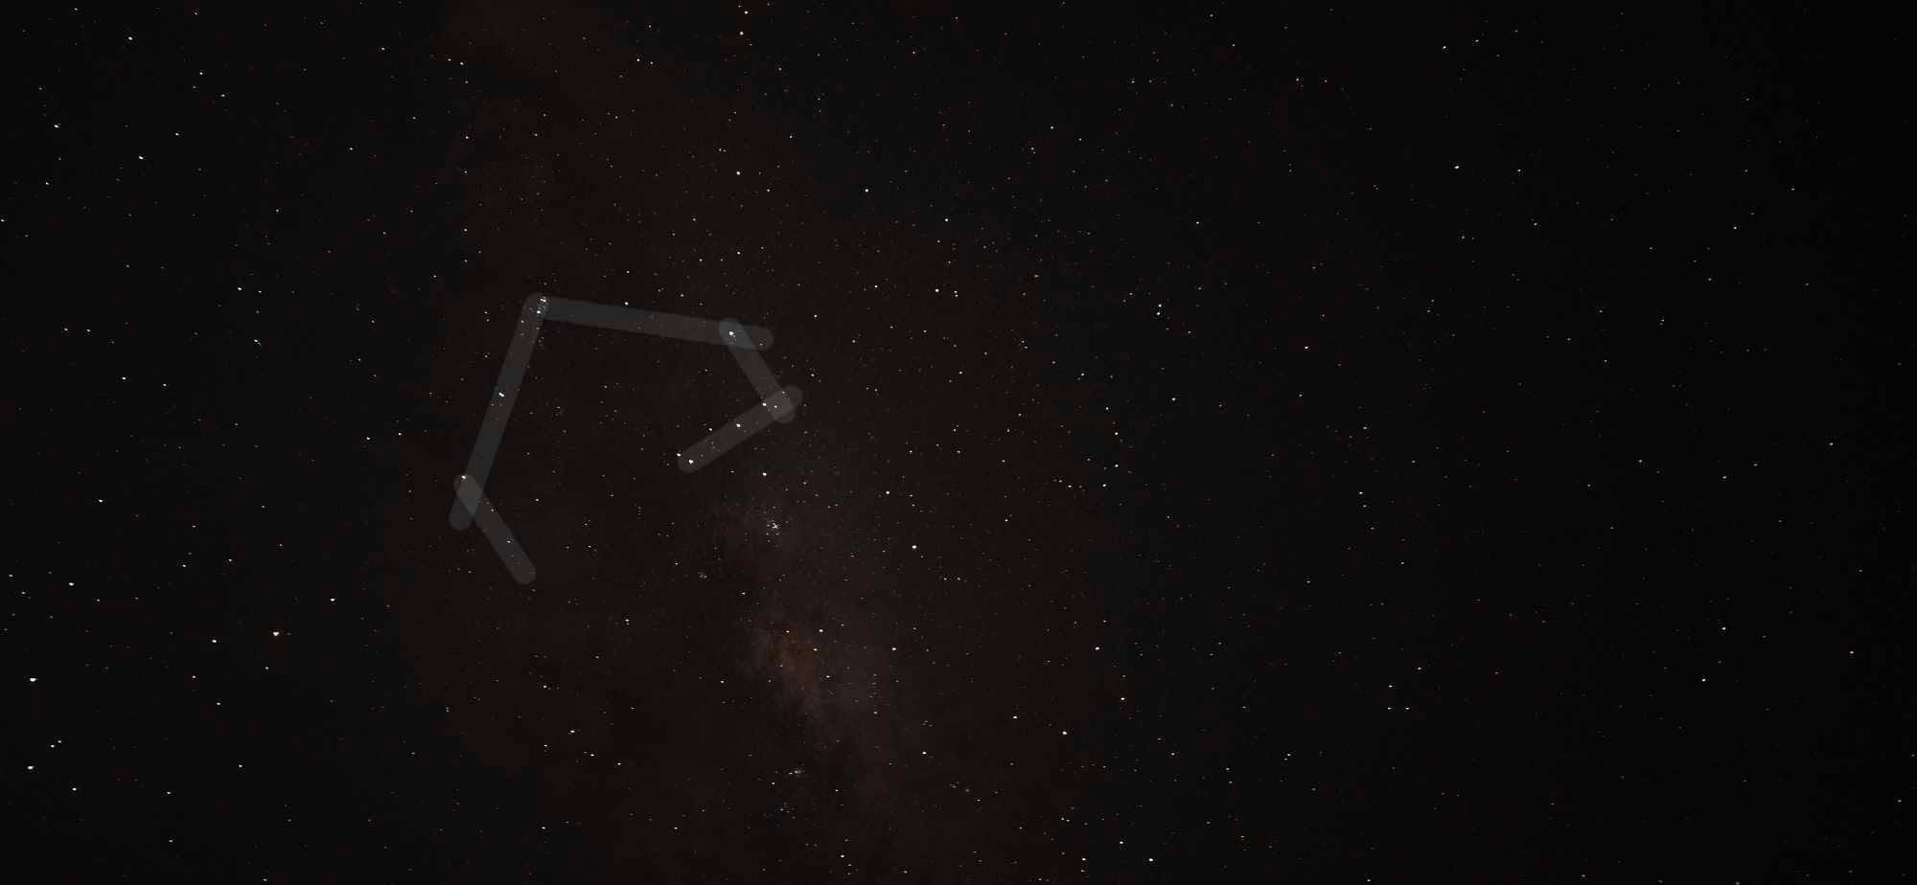
Whare Wānanga
Notes:
Before there were classrooms...
before there were schools...
before there were books...
before there were exams...
our tūpuna were already learning.
(Pause.)
Their classroom wasn't built from timber or concrete.
It wasn't surrounded by four walls.
It had no ceiling.
No bell.
No timetable.
(Pause.)
Their classroom was Te Taiao.
Continue.
Every day...
the world around them became their teacher.
The stars taught navigation.
The moon revealed rhythm.
The tides guided movement.
The birds signalled seasonal change.
The winds carried messages.
The rivers revealed health.
The forests offered food, medicine, and shelter.
Every part of creation carried knowledge.
Introduce the central idea
Slow down.
Our tūpuna didn't separate learning from life.
(Pause.)
Learning happened while gathering kai.
While fishing.
While travelling.
While observing the stars.
While listening to the stories of kaumātua.
Education wasn't somewhere you went.
It was a way of living.
Connect to today
Now bring the audience in.
Imagine if our learners understood that learning doesn't stop when they leave the classroom.
Imagine if they recognised that every walk, every season, every sunrise, every night sky still has something to teach them.
That's the philosophy I want to explore with you today.
Audience Reflection
Ask:
If Te Taiao was our first classroom...
(Pause.)
What might it still be teaching us today?

Slide 8
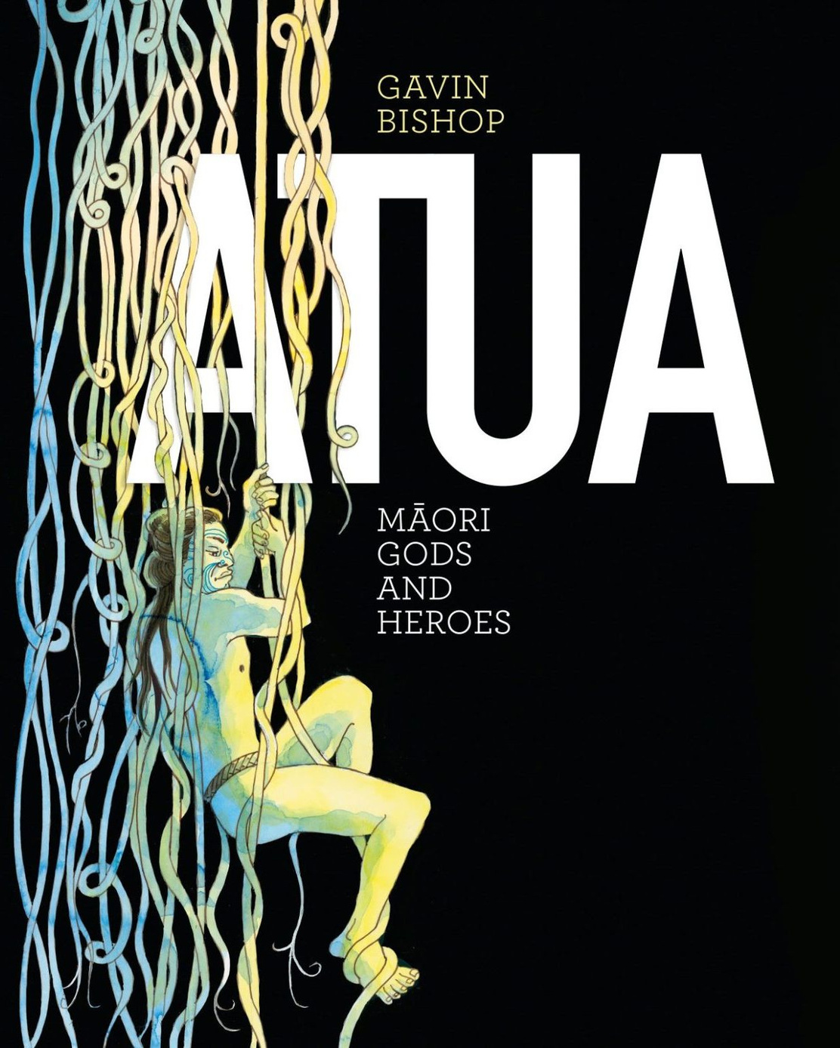
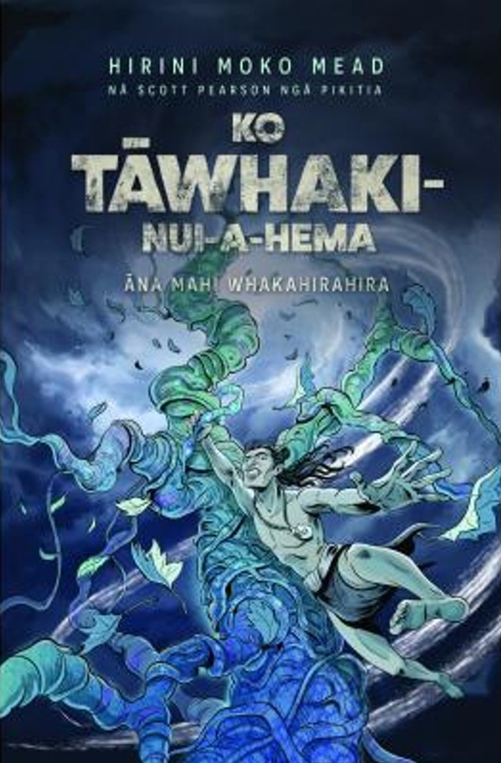
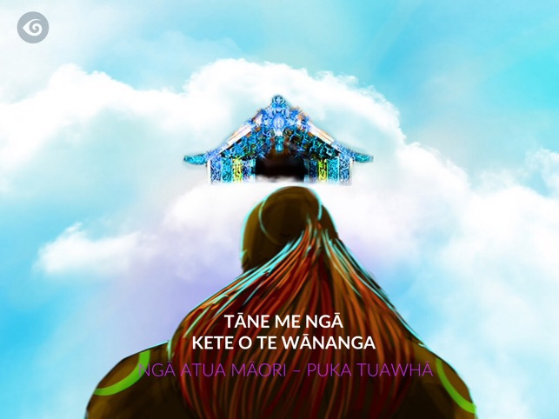
Whare Wānanga
Kiwa Digital. (2014). Tāne me ngā kete o te wānanga: Ngā Atua Māori – Book Four [Mobile application software]. Available on Apple App Store and Google Play Store.
Bishop, G. (2021). Atua: Māori gods and heroes. Penguin Random House New Zealand.
Mead, H. M. (2020). Ko Tāwhaki-nui-a-Hema: Āna mahi whakahirahira (S. Pearson, Illus.). Huia Publishers.
Notes:
Before there were classrooms...
before there were schools...
before there were books...
before there were exams...
our tūpuna were already learning.
(Pause.)
Their classroom wasn't built from timber or concrete.
It wasn't surrounded by four walls.
It had no ceiling.
No bell.
No timetable.
(Pause.)
Their classroom was Te Taiao.
Continue.
Every day...
the world around them became their teacher.
The stars taught navigation.
The moon revealed rhythm.
The tides guided movement.
The birds signalled seasonal change.
The winds carried messages.
The rivers revealed health.
The forests offered food, medicine, and shelter.
Every part of creation carried knowledge.
Introduce the central idea
Slow down.
Our tūpuna didn't separate learning from life.
(Pause.)
Learning happened while gathering kai.
While fishing.
While travelling.
While observing the stars.
While listening to the stories of kaumātua.
Education wasn't somewhere you went.
It was a way of living.
Connect to today
Now bring the audience in.
Imagine if our learners understood that learning doesn't stop when they leave the classroom.
Imagine if they recognised that every walk, every season, every sunrise, every night sky still has something to teach them.
That's the philosophy I want to explore with you today.
Audience Reflection
Ask:
If Te Taiao was our first classroom...
(Pause.)
What might it still be teaching us today?

Slide 9
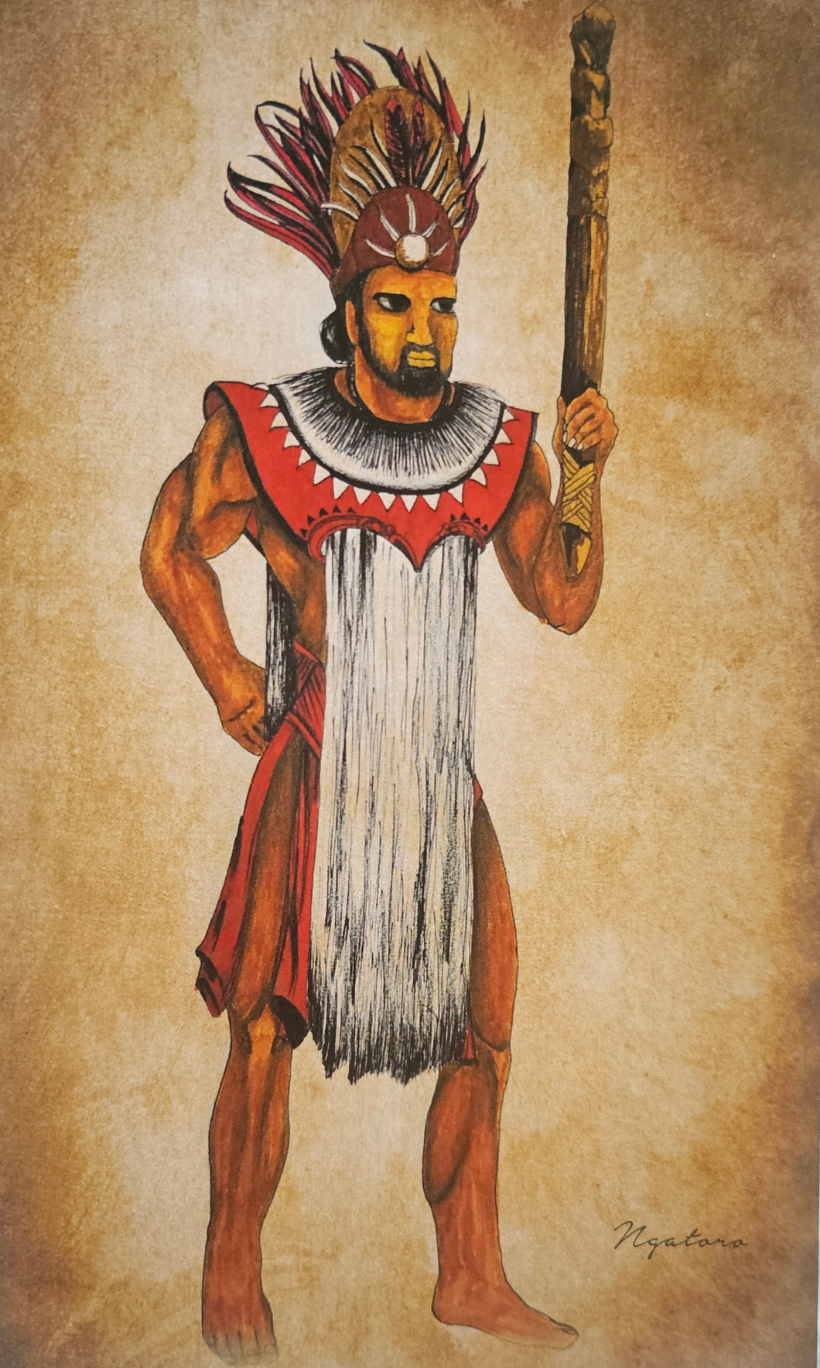
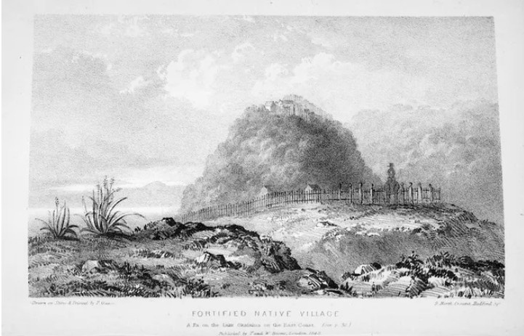
Ngā Tū Whare a Maninihau
Image: Joseph Jenner Merrett (1842), Fortified Native Village: Te Koutu Pā on Lake Ōkataina. National Library of New Zealand.
Source: E Oho, Raimona Inia
Notes:
Ngatoroirangi

Slide 10
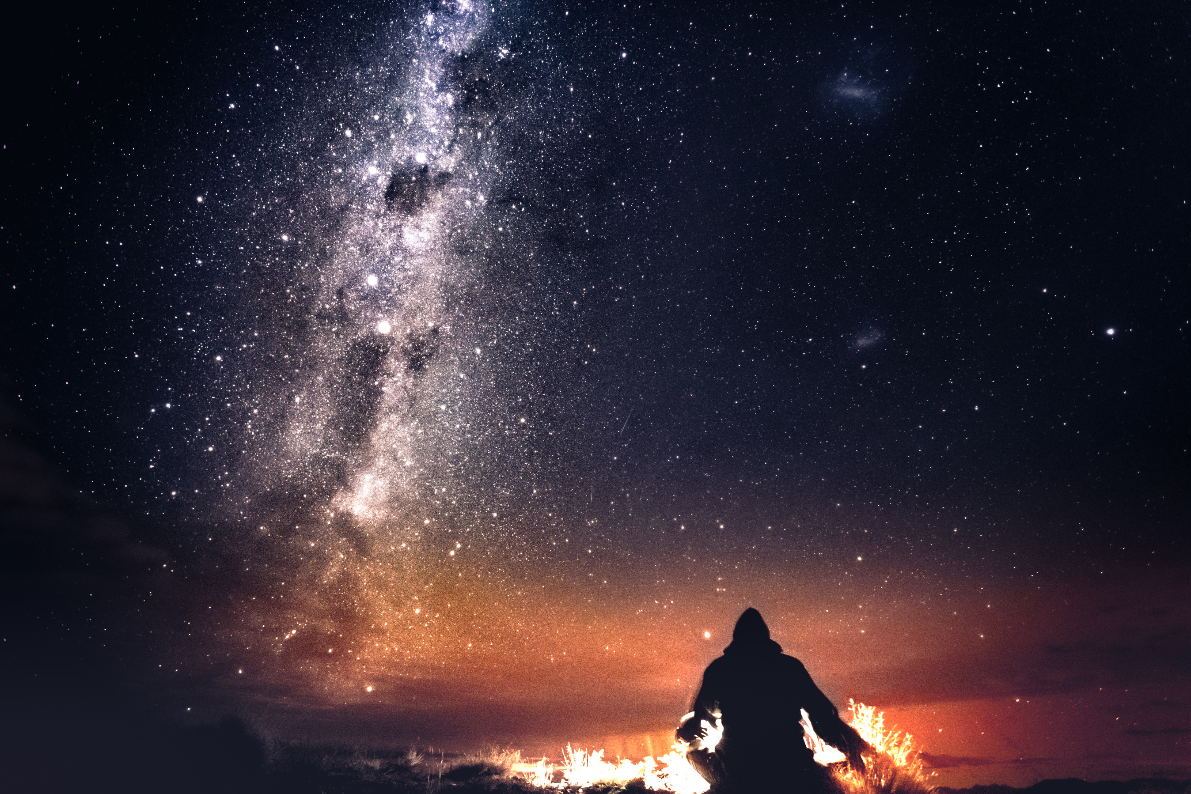
Tirotiro Whetu
“Our tūpuna started by paying attention.
Notes:
Speaker Notes
(Pause.)
Today, we often begin learning by asking questions.
We Google.
We search.
We expect answers immediately.
(Smile.)
But our tūpuna began somewhere different.
(Pause.)
They watched.
(Pause.)
They listened.
(Pause.)
They waited.
Continue...
They noticed that certain birds returned at certain times of the year.
They noticed the changing position of stars.
They noticed the rhythm of the moon.
They noticed the flowering of particular plants.
They noticed the behaviour of fish.
They noticed the winds.
(Pause.)
One observation meant very little.
Hundreds of observations became knowledge.
Thousands of observations, shared across generations, became mātauranga.
Introduce an important distinction
This is a beautiful place to explain something that sits at the heart of your research.
You might say:
Mātauranga Māori was never based on a single observation.
It was built through generations of careful watching, testing, remembering, and passing knowledge on.
It wasn't guesswork.
It was disciplined observation over centuries.
That is a powerful statement because it challenges the misconception that mātauranga Māori is simply belief. It affirms it as a rigorous knowledge system grounded in long-term observation and lived experience.
Connect it to teachers
Then bring it back to the audience.
As teachers...
(Pause.)
Perhaps one of the greatest gifts we can give our learners...
isn't another answer.
(Pause.)
Perhaps it's teaching them...
how to notice.
Audience Reflection
Ask:
What would happen if our classrooms valued observation as much as information?
Let that question sit.
Transition to Slide 7
Finish with:
Observation was only the beginning.
(Pause.)
Our tūpuna also understood something that many education systems are only beginning to rediscover.
(Pause.)
Everything is connected.
(Click.)
That leads beautifully into Slide 7, where you begin introducing whakapapa as the organising principle of knowledge, showing that stars, rivers, forests, people, seasons, and wellbeing were never separate subjects, but part of one living system.
A whakaaro to strengthen the keynote
I think this is also the perfect place to introduce a distinction between seeing and observing.
You could say:
"We all see the stars. But not everyone observes them."
That simple contrast is memorable and applies far beyond astronomy. It captures the essence of mātauranga Māori, teaching, and inquiry. Seeing is passive. Observing is intentional. Observation, repeated with care and shared across generations, becomes knowledge. That single idea can become a thread you return to throughout the rest of your keynote.
The position of the stars.
The phases of the moon.
The movement of clouds.
The colour of the sky at sunrise and sunset.
The flowering of trees.
The behaviour of birds.
The tides.
The condition of waterways.
Changes in the landscape over time.
Question for teachers:
What are your students really seeing every day?
2. Whakarongo - Listening
The environment speaks.
Our tūpuna listened to:
Birdsong.
The silence when birds disappeared.
The strength of the wind.
The sound of the ocean.
The flow of rivers.
The first insects of the evening.
Frogs calling after rain.
Leaves moving through the forest.
Sometimes the absence of sound told its own story.
Question
What is Te Taiao saying today?
3. Hongi - Smelling
Smell often tells us something before we can see it.
Our tūpuna recognised:
Rain approaching.
Salt carried inland by strong winds.
The scent of flowering plants.
Damp soils.
Rot and decay.
Healthy forests.
Fresh water.
The sea.
Smell became an environmental indicator.
4. Pā - Touch
Knowledge also comes through touch.
Feeling:
Soil moisture.
The warmth of rocks.
Water temperature.
The direction of the wind.
Humidity.
Tree bark.
The texture of leaves.
The movement of currents.
Touch connects us physically to place.
5. Whakamātau - Experience
Observation isn't passive.
It is tested.
Our tūpuna:
Went fishing.
Grew kai.
Navigated oceans.
Harvested plants.
Built waka.
Lit fires.
Observed outcomes.
Knowledge developed through repeated experience.
6. Wānanga - Reflection
Observation becomes wisdom through reflection.
Questions included:
What happened?
Why did it happen?
Has this happened before?
What does this mean?
What should we do differently next time?
Reflection transformed observation into mātauranga.
7. Whakapapa - Making Connections
This is perhaps the most important sense of all.
Our tūpuna connected observations.
Noticing that:
When a certain star rises...
Certain fish arrive.
Certain birds begin nesting.
Particular plants flower.
Winds change.
Water temperatures shift.
One observation means little on its own.
Many observations connected through whakapapa become understanding.

Slide 11
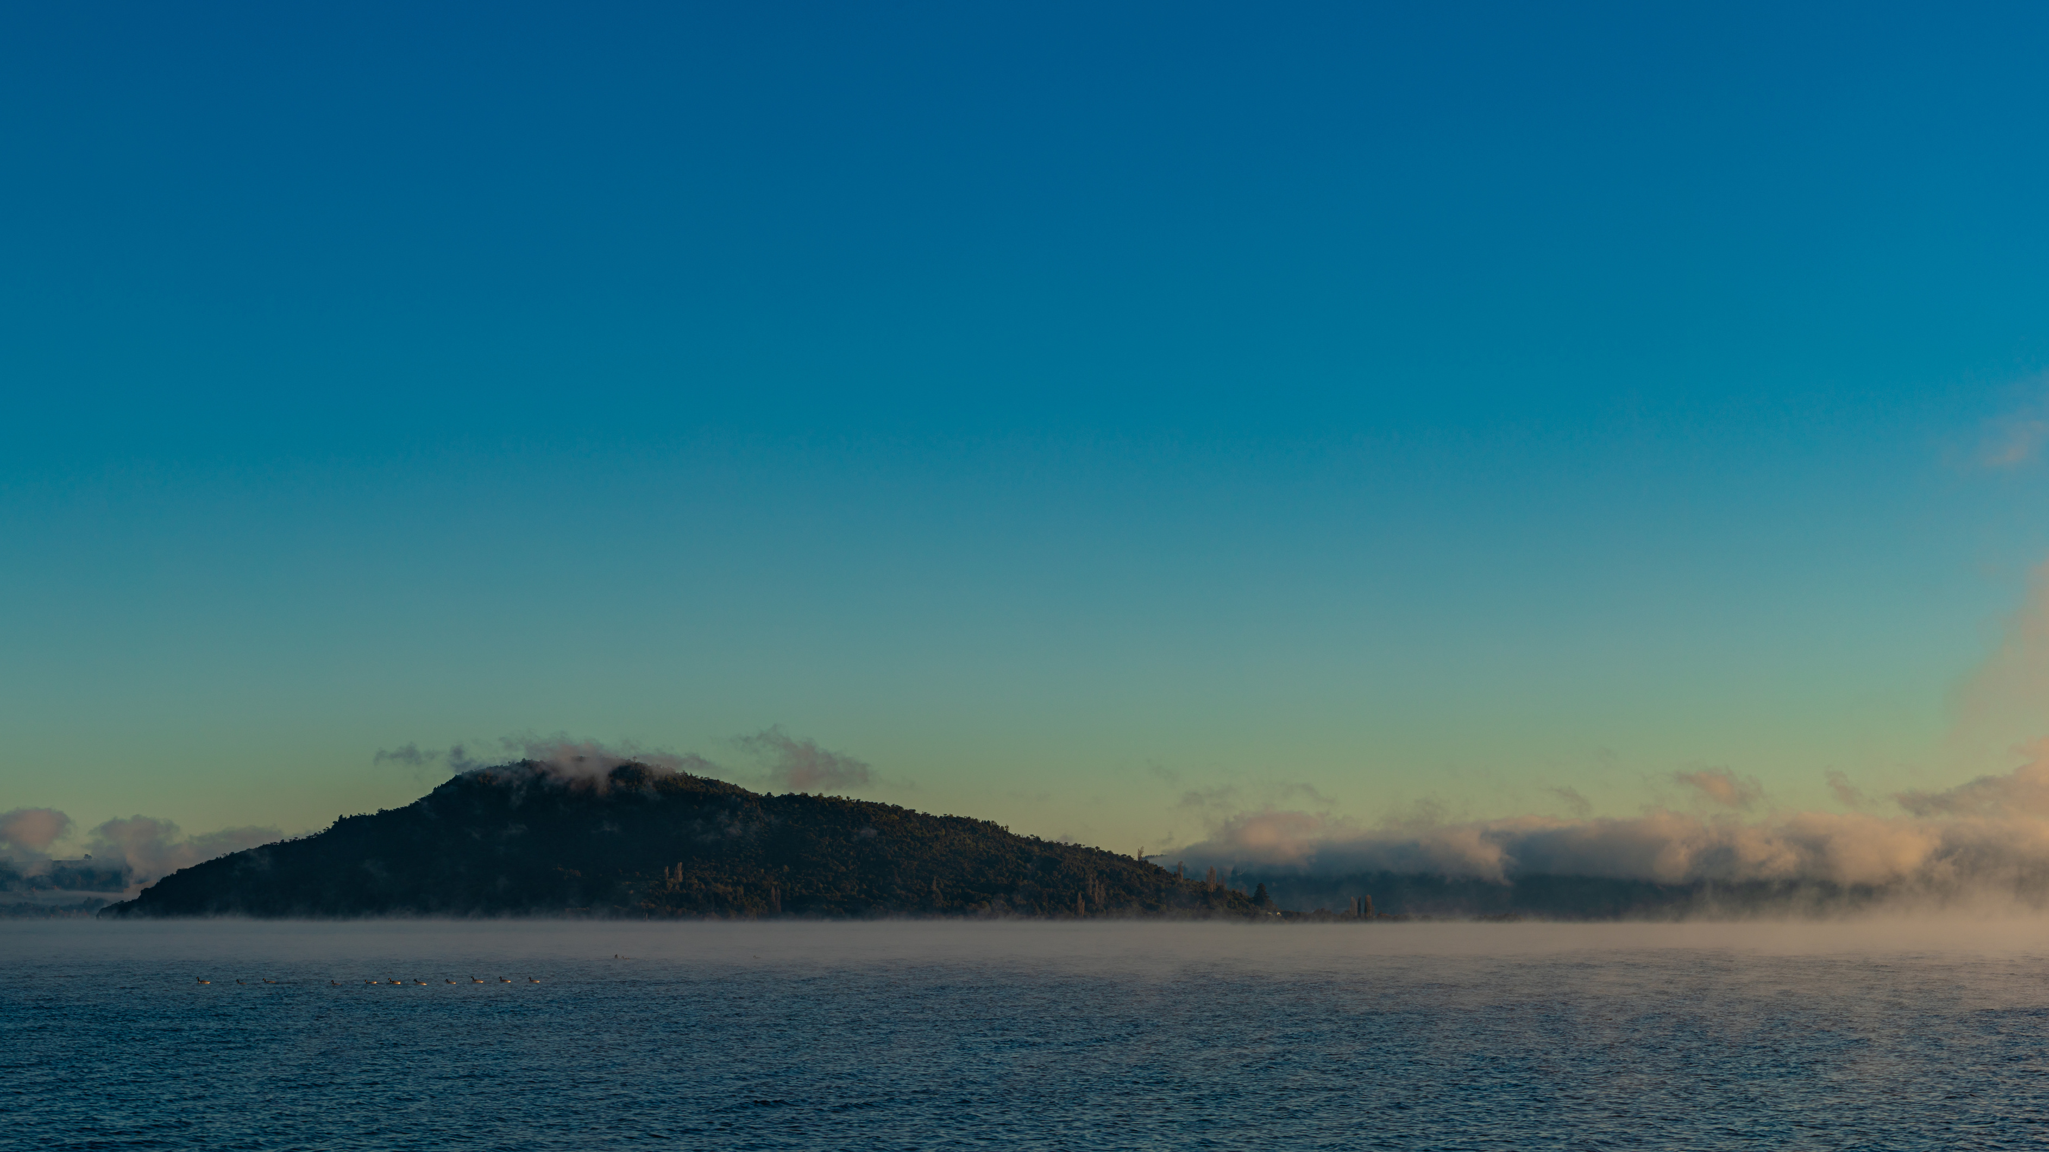
Whakapapa
“Our tūpuna didn't observe isolated events.
They observed patterns.”
Notes:
Whakapapa is not simply about where we come from.
It helps us understand how everything belongs together.
hen many people hear the word whakapapa...
they immediately think about genealogy.
Our parents.
Our grandparents.
Our ancestors.
And they would be absolutely right.
(Pause.)
But whakapapa is much bigger than that.
(Pause.)
Whakapapa is the way we understand relationships.
Not just between people...
but between all living things.
Continue...
The stars have whakapapa.
The moon has whakapapa.
The rivers have whakapapa.
The forests have whakapapa.
The birds have whakapapa.
Our food has whakapapa.
Our health has whakapapa.
Our learning has whakapapa.
Because nothing exists alone.
ntroduce a beautiful idea
This is where I'd introduce one of the key messages of your keynote.
In many education systems...
knowledge is divided into subjects.
Science.
English.
Mathematics.
Health.
Geography.
History.
(Pause.)
In te ao Māori...
knowledge begins with relationships.
Connect it back to teachers
Ask:
What if our curriculum didn't begin with subjects...
(Pause.)
What if it began with relationships?
Relationships with:
whenua
wai
ngā whetū
whakapapa
community
one another
Introduce your systems thinking
Now you can naturally connect to your own work.
Much of my work in systems innovation begins with a very simple question.
What relationships are we not seeing?
Because whenever we overlook relationships...
we often create unintended consequences.
Our tūpuna understood that if one part of the system changed...
everything else responded.
That understanding wasn't called "systems thinking."
It was simply a way of living through whakapapa.
A Moment of Reflection
Invite the audience to pause.
Think about one learner in your classroom.
(Pause.)
Can you understand that learner...
without understanding their whakapapa?
Their whānau?
Their whenua?
Their language?
Their dreams?
Their challenges?
(Pause.)
Probably not.
Because we learn in relationship.
A Powerful Quote for the Slide
I think this would become one of the memorable lines of your keynote:
Whakapapa doesn't simply tell us where we come from.
Whakapapa reminds us that nothing stands alone.

Slide 12
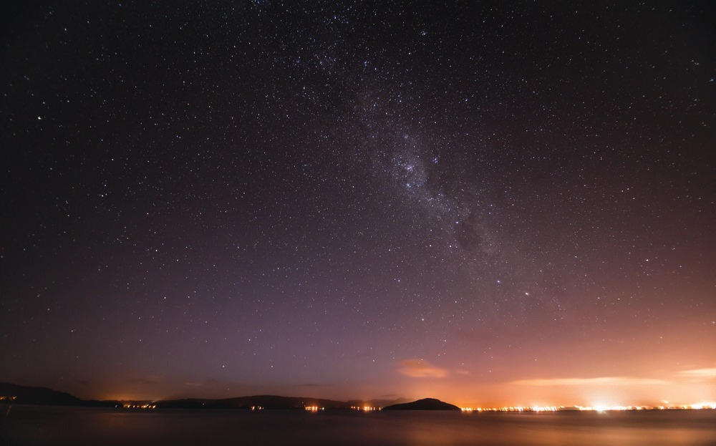
http://www.ngapatakakorerootearawa.org
email: patai@ngapatakakorerootearawa.org
TUIA KI TE RANGI TUIA KI TE WHENUA TUIA KI TE MOANA TUIA KI TE HERENGA TANGATA KA RONGO TE PO KA RONGO TE AO

Slide 13
Rongo
Sight
Hearing
Touch
Taste
Smell
Intuition

Slide 14
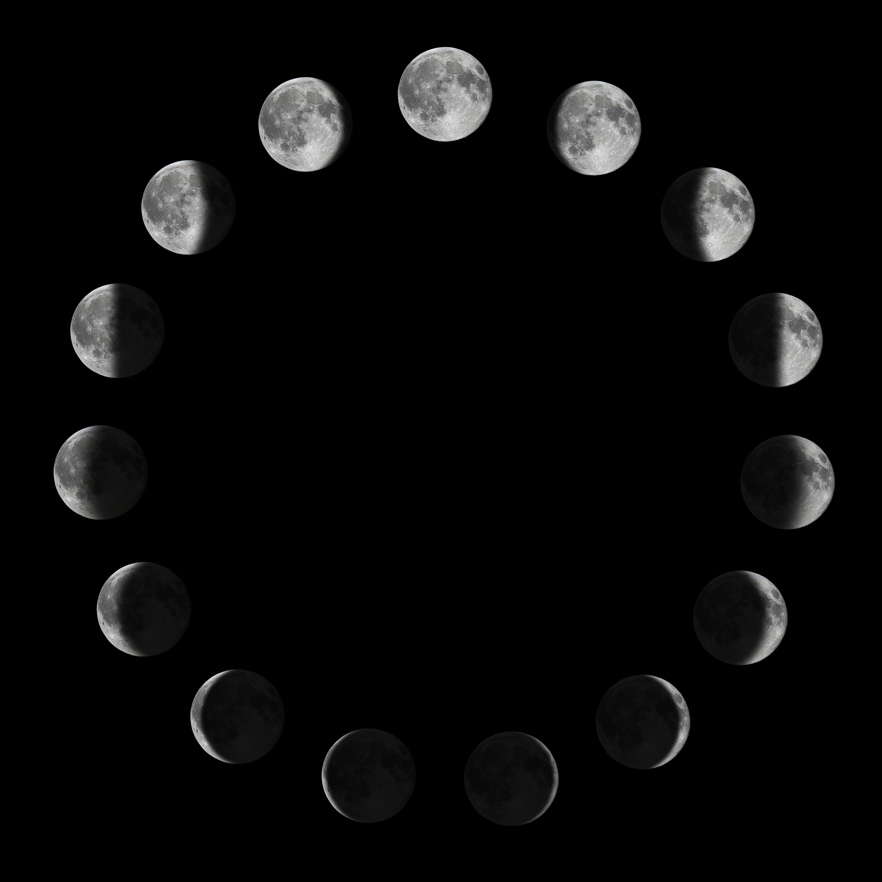
Maramataka
Notes:
Imagine looking at the night sky...
(Pause.)
...for one night.
You wouldn't learn very much.
(Pause.)
Imagine watching it every night...
for a year.
You'd begin to notice patterns.
(Pause.)
Imagine watching those same patterns...
over fifty years.
(Pause.)
Then imagine your grandparents...
and their grandparents...
and their grandparents...
all observing those same patterns.
(Pause.)
That's how mātauranga grows.
Continue...
Our tūpuna weren't simply asking,
"What happened today?"
They were asking,
"What happens every year?"
"What changes?"
"What stays the same?"
"What happens before?"
"What happens after?"
"What relationships exist?"

Slide 15
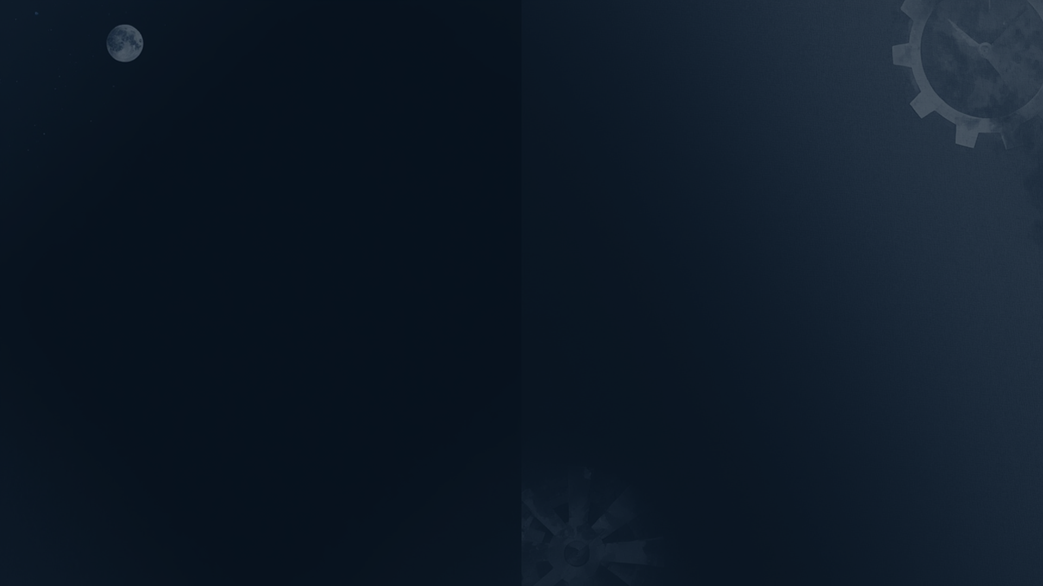
Wā vs Time
Wā
Time
Cyclical and relational
Linear and measured
Connected to natural rhythms
Disconnected from nature
Past, present, and future coexist
Past is behind, future ahead
Time is lived and felt
Time is counted and scheduled
Guided by Maramataka
Guided by clocks and calendars

Slide 16
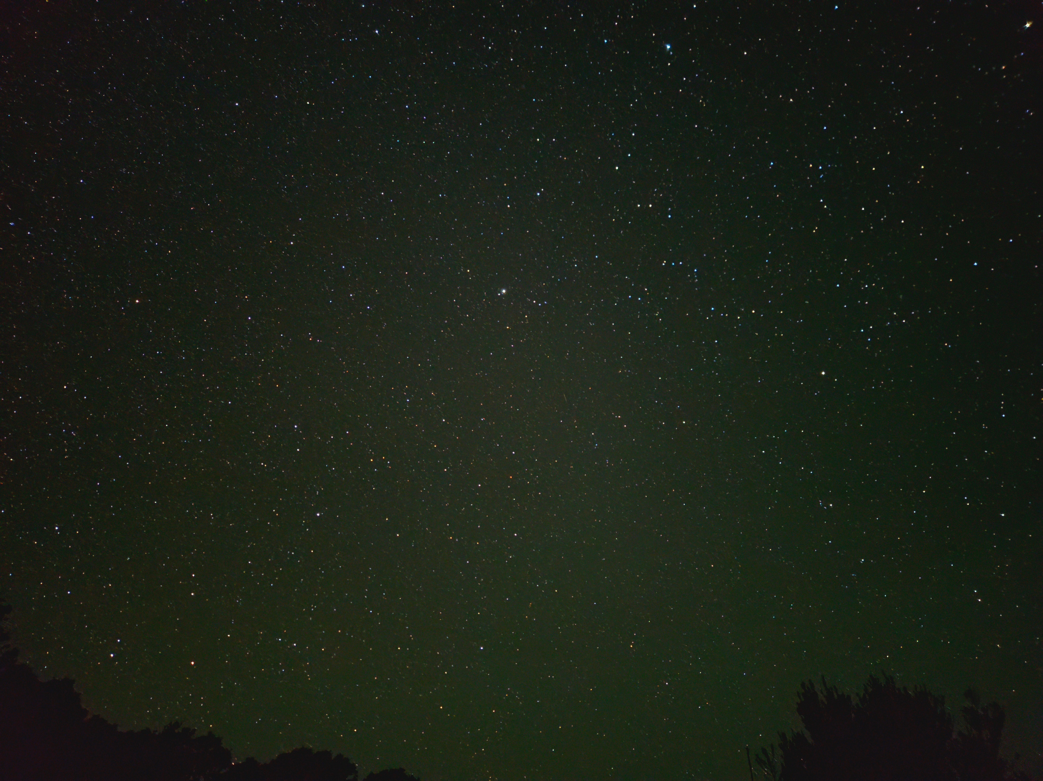
Tātai Ara Whetū
“Our tūpuna didn't simply look at the sky.
They learnt to read it.”
Notes:
Every culture has looked at the stars.
(Pause.)
But not every culture learned to read them in the same way.
Continue.
For our tūpuna...
the sky wasn't decoration.
It wasn't entertainment.
It wasn't simply beautiful.
(Pause.)
It was communicating.
Every rising star...
had something to say.
Every setting star...
had something to say.
Every phase of the moon...
had something to say.
Every changing season...
had something to say.
(Pause.)
The question wasn't,
"Can we see the stars?"
The question was,
"What are they telling us?"
Introduce Tātai Arorangi
Now introduce the kaupapa.
This is where we begin to understand Tātai Arorangi.
Tātai Arorangi is far more than identifying stars or memorising constellations.
It is a way of reading relationships between the heavens, the whenua, the waters, and the lives of our people.
It teaches us to observe, interpret, and respond with care.
A Practical Example
Bring it to life with an example that everyone knows.
Think about Matariki.
Many people see Matariki as a celebration.
And it is.
But before it became a celebration...
it was an observation.
The appearance of Matariki wasn't the event.
It was a sign.
A tohu.
It invited our tūpuna to observe:
the brightness of the stars
the clarity of the sky
the winds
the soil
the waterways
the abundance of kai
Only then would decisions be made.
The stars didn't provide all the answers.
They invited deeper observation.
That distinction is important.
Connect to Teaching
Turn to the audience.
Great teachers do exactly the same.
They don't simply deliver information.
They observe.
They notice.
They recognise patterns.
They respond to what they see.
Perhaps our greatest teachers have always been readers of signs.
Audience Reflection
Ask:
What is your classroom telling you...
that no assessment data can?
(Pause.)
What are your learners communicating...
without using words?
(Pause.)
Observation and interpretation are just as important in teaching as they are in Tātai Arorangi.
A Powerful Quote
This could appear on the slide after your kōrero, or be spoken slowly.
I absolutely love this distinction because it avoids portraying the stars as deterministic. Instead, it honours the role of Tātai Arorangi as a knowledge system that supports thoughtful observation and decision-making.
The stars did not tell our tūpuna what to do.
They reminded them what to pay attention to.

Slide 17
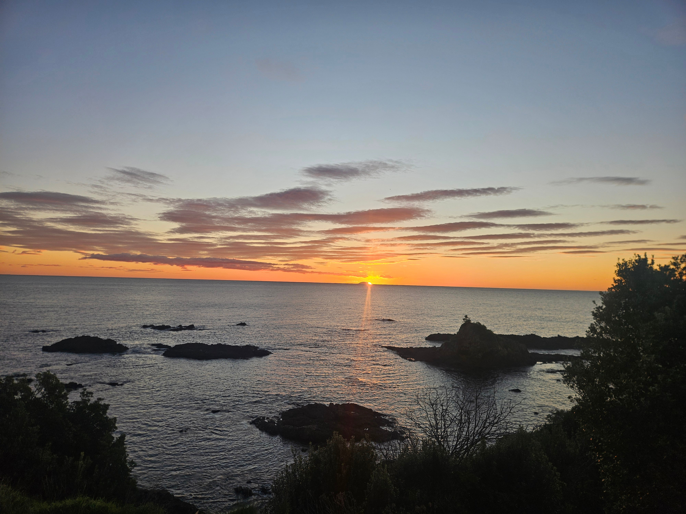
Tohu
Learning to Read the Living World
“Korekau he mea hangatia, ahunoa rānei i roto i tēnei ao, ahakoa matangaro ka kitea te mauri”
Tūkaki Waititi
Nothing in this world is meant to exist in isolation, and just because you can't see certain things, doesn't mean they don't exist.
Notes:
(Pause.)
One of the biggest misunderstandings about mātauranga Māori...
is the idea that our tūpuna made decisions based on a single sign.
(Pause.)
They didn't.
(Pause.)
If one star appeared...
they didn't immediately decide to plant.
(Smile.)
Instead...
they kept observing.
Continue...
They asked:
What is the moon doing?
What direction is the wind coming from?
What are the birds doing?
Are the tuna moving?
Have the kōwhai flowered?
What is happening in the rivers?
How does the soil feel?
What is the temperature?
What are the clouds telling us?
(Pause.)
Every tohu added another piece to the picture.
Introduce a beautiful analogy
I think this will resonate strongly with teachers.
Think of each tohu as one page in a book.
One page tells you very little.
But when you read every page together...
the whole story begins to emerge.
That's how our tūpuna read Te Taiao.
Connect to your research
This is a perfect place to introduce your doctoral work.
One of the questions driving my research is:
How might we once again learn to read these tohu together?
Not to replace science.
Not to replace data.
But to stand alongside it.
To enrich our understanding.
To help us make wiser decisions for our people and our environment.
Link to Teaching
Now bring it back to education.
Our learners also leave us tohu every day.
Not only through tests.
But through:
their attendance
their laughter
their silence
their body language
their relationships
their curiosity
their confidence
Great teachers don't rely on one piece of evidence.
They read the whole learner.
Audience Reflection
Ask:
When you think about your own classroom...
(Pause.)
What are the tohu your learners are giving you today?
(Pause.)
And which tohu might you be missing?
One of the strongest messages of the keynote
This is where I'd slow down and say:
Tohu don't tell us what will happen.
(Pause.)
They invite us to pay closer attention.
(Pause.)
Wisdom comes from how we respond.
I think this distinction is incredibly important. It keeps the keynote grounded and avoids suggesting that tohu are deterministic or predictive in a simplistic sense.
Visual Animation
As you speak, each tohu appears one by one around the central circle.
⭐ Ngā Whetū
↓
🌙 Te Marama
↓
🌬 Ngā Hau
↓
🐦 Ngā Manu
↓
🌳 Ngā Rākau
↓
🌊 Ngā Tai
↓
🐟 Ngā Ika
↓
☁️ Ngā Kapua
↓
💧 Ngā Wai
Until the audience sees a complete web of relationships.
Transition to Slide 11
Finish with:
But there is something even more remarkable.
(Pause.)
Our tūpuna didn't simply observe these tohu.
(Pause.)
They did so...
over generations.
(Pause.)
Knowledge wasn't created in a lifetime.
It was inherited, tested, refined, and gifted forward.
(Click.)

Slide 18

Mātauranga
“One observation creates curiosity.
Generations of observation create mātauranga.”
Notes:
isual
A stunning image showing three generations.
Perhaps:
A kaumātua
A parent
A mokopuna
Standing together beneath Matariki.
Or sitting beside an awa.
The image should communicate the passing of knowledge between generations.
Slide Text
One observation creates curiosity.
Generations of observation create mātauranga.
Speaker Notes
(Pause.)
Imagine I observed Matariki this morning.
(Pause.)
I've learnt something.
(Pause.)
Imagine I observed Matariki...
every winter...
for forty years.
I've learnt much more.
(Pause.)
Now imagine...
my parents observed it.
(Pause.)
Their parents observed it.
(Pause.)
Their parents observed it.
(Pause.)
Now we're not talking about one person's experience.
We're talking about centuries of careful observation.
Continue...
This is one of the things I admire most about mātauranga Māori.
It wasn't created overnight.
It wasn't based on one opinion.
It wasn't based on one season.
It grew through generations of observation...
discussion...
testing...
reflection...
and refinement.
Challenge a common misconception
This is where I'd slow down.
Sometimes people ask...
"Is mātauranga Māori evidence-based?"
(Smile.)
I think that's the wrong question.
(Pause.)
The better question is...
"What counts as evidence?"
Continue...
For our tūpuna...
Evidence included:
repeated observations
lived experience
environmental indicators
successful harvests
navigation
community memory
oral histories
whakapapa
collective validation over generations
A key distinction
Then say:
Mātauranga Māori wasn't preserved because it was ancient.
(Pause.)
It was preserved because it worked.
(Pause.)
And when it no longer reflected what people observed...
it evolved.
That is why mātauranga Māori remains a living knowledge system.
Bring in your doctoral research
This is a natural place to share why your research matters.
One of the reasons I'm undertaking my doctoral research is because I believe these observations still have something to teach us.
Not simply about the past.
But about:
education
health
environmental stewardship
climate adaptation
wellbeing
decision-making
The question isn't whether mātauranga Māori belongs in the future.
The question is:
How do we continue observing, testing, and contributing to it ourselves?
Connect to Teachers
Now make it personal.
Every teacher in this room contributes to mātauranga.
(Pause.)
Every day you observe.
You adapt.
You try something new.
You reflect.
You learn.
(Pause.)
You're adding another chapter to the story of education.
Audience Reflection
Ask:
What knowledge are we creating today...
that our mokopuna will inherit?
(Pause.)
Will it still serve them in fifty years?
(Pause.)
In one hundred years?
Powerful Closing Quote
I'd finish this slide with:
Our tūpuna didn't inherit finished knowledge.
(Pause.)
They inherited the responsibility to keep learning.
(Pause.)
That responsibility now belongs to us.

Slide 19
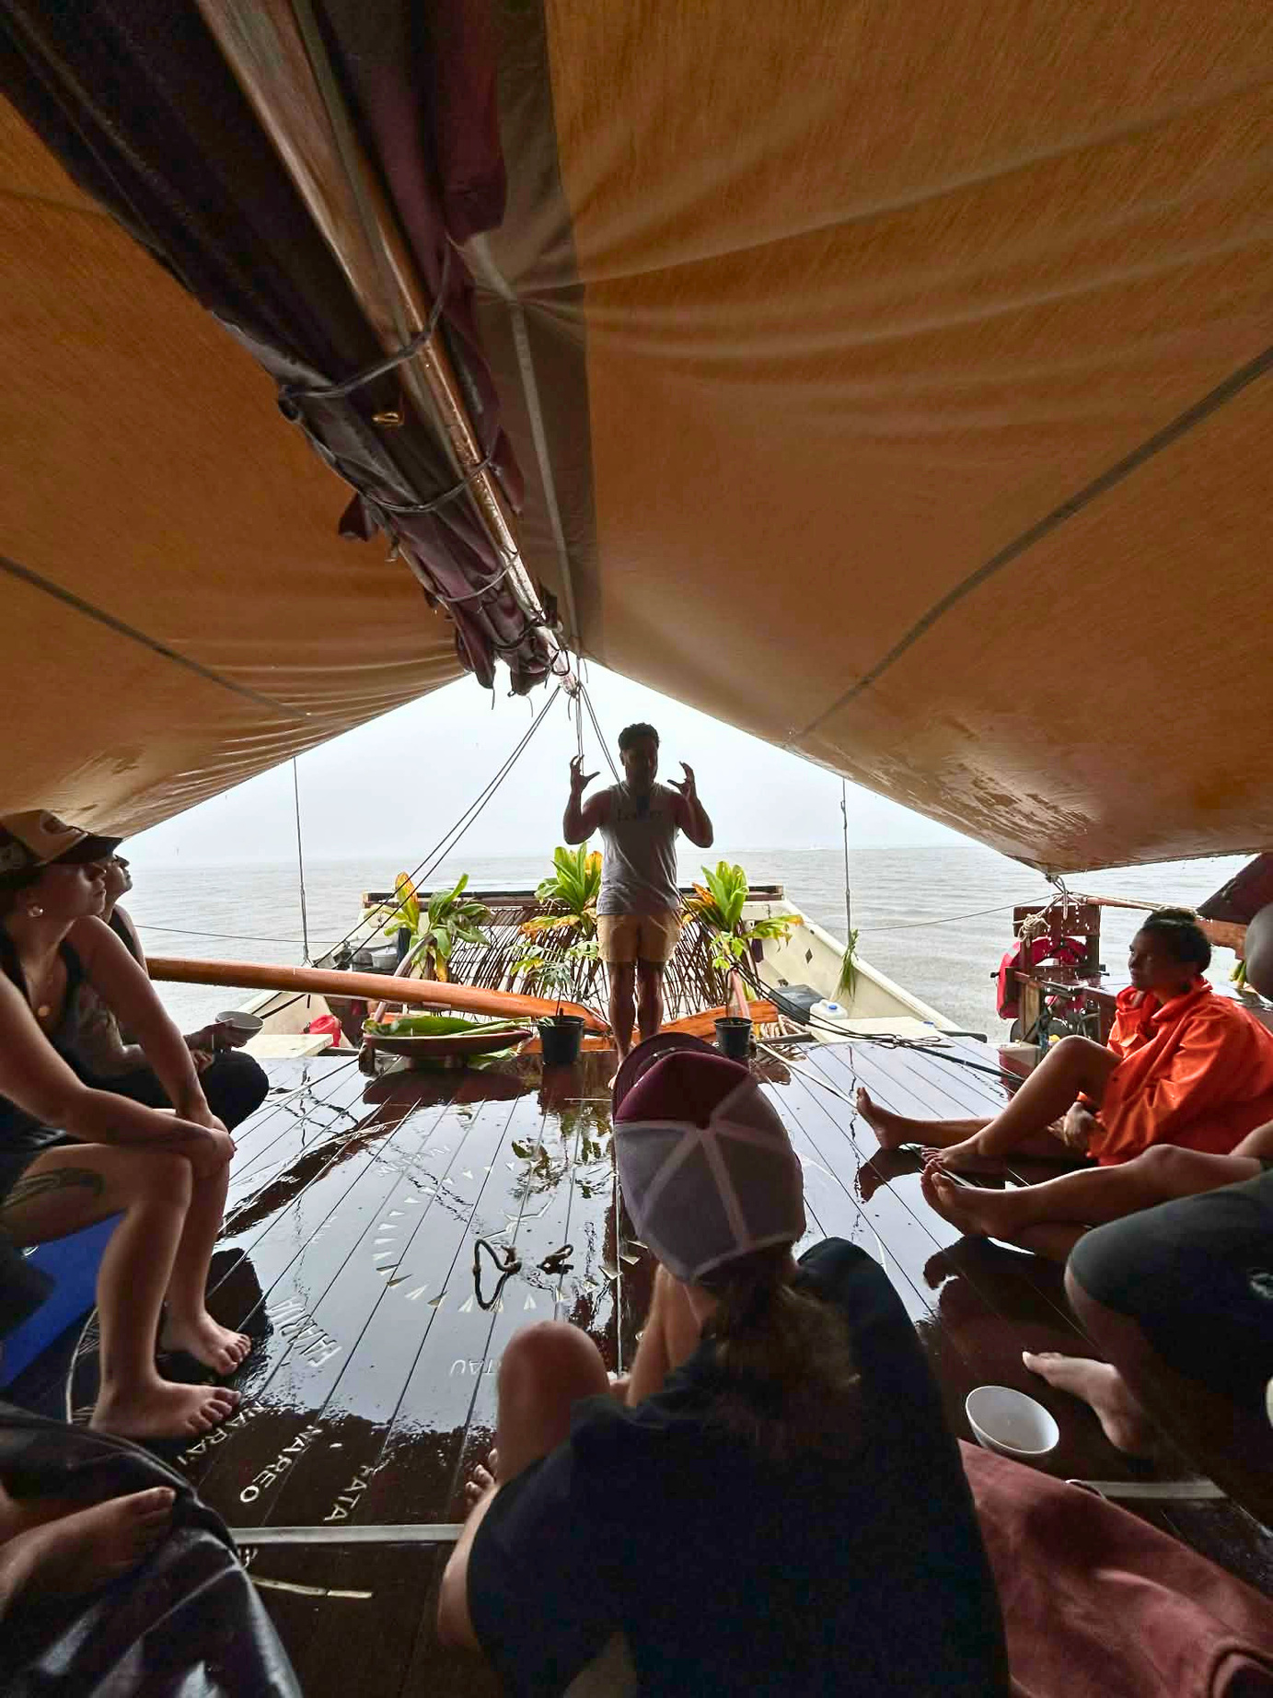
The Purpose of Knowledge
“Knowledge was never collected to know more.
Knowledge was gathered so people could live well”.
Notes:
Speaker Notes
(Pause.)
Sometimes we think education is about gaining more knowledge.
More facts.
More qualifications.
More information.
(Pause.)
But if we look to our tūpuna...
knowledge had a much deeper purpose.
Continue.
They didn't study the stars because they loved astronomy.
(Smile.)
They studied the stars because they wanted to know:
When should we plant?
When should we fish?
When should we travel?
When should we gather?
When should we rest?
How do we keep our people safe?
How do we care for our whenua?
Knowledge was always connected to life.
Introduce the concept of oranga
This is a beautiful place to introduce oranga.
Every observation...
Every tohu...
Every decision...
Ultimately came back to one question.
How do we enhance the oranga of our people and our environment?
A powerful distinction
This could become one of the memorable moments of your keynote.
In many education systems...
success is measured by what we know.
(Pause.)
In te ao Māori...
success is measured by
how we live.
(Pause.)
Knowledge finds its true value in the way it shapes our relationships, our decisions, and our responsibilities.
Link to teachers
Turn to the audience.
As teachers...
our role isn't simply to fill minds.
(Pause.)
Our role is to help shape people.
People who know who they are.
People who know where they belong.
People who understand their responsibilities to others and to the world around them.
Bring in your own mahi
This is a natural point to connect your work.
Whether I'm working in education...
or public health...
or environmental wellbeing...
or systems innovation...
I keep coming back to the same question.
Does this improve the oranga of our people and our taiao?
If the answer is no...
then perhaps we need to rethink what success looks like.
Audience Reflection
Ask:
Imagine one of your students standing before you in twenty years' time.
(Pause.)
Would you rather they remembered every fact you taught them...
or that they became someone who cared deeply for people, place, and future generations?
A Quote for the Slide
I would end with this.
The highest purpose of knowledge is not achievement.
It is responsibility.
Or, if you want a more Māori framing:
Ko te tino hua o te mātauranga ko te oranga o te tangata me te taiao.
The highest expression of knowledge is the wellbeing of people and the natural world.

Slide 20
Te Uetāngahu a Tānenuiārangi
“Knowledge is never simply received.
It is sought with purpose, humility, and responsibility.”
Notes:
use.)
Every culture has stories about knowledge.
(Pause.)
This is ours.
Continue...
Our tūpuna tell us that Tānenuiārangi journeyed through the heavens in search of knowledge.
(Pause.)
But I don't think this story is only about climbing into the sky.
(Pause.)
I think it's telling us something much deeper.
Ask the audience:
Why didn't knowledge simply come to Tāne?
(Pause.)
Why did he have to climb?
(Pause.)
Why did he have to struggle?
(Pause.)
Why was knowledge something that had to be earned?
The Deeper Meaning
Continue.
Because knowledge changes us.
Knowledge requires commitment.
Knowledge requires discipline.
Knowledge requires humility.
Knowledge carries responsibility.
(Pause.)
The journey wasn't simply upwards.
It was inward.
A Challenge to Teachers
Turn towards the audience.
As educators...
perhaps one of our greatest responsibilities isn't simply transferring knowledge.
(Pause.)
Perhaps it is preparing our learners for the journey required to seek it.
Link to Modern Education
This is where your keynote becomes contemporary.
We often ask...
How do we improve education?
(Pause.)
Maybe another question is...
How do we help our learners become worthy carriers of knowledge?
Introduce Ngā Kete o te Wānanga
Don't explain everything yet.
Simply reveal the image.
Three kete.
Pause.
Say:
From this journey came Ngā Kete o te Wānanga.
Not simply baskets.
But responsibilities.
(Pause.)
We'll return to them shortly.
Leave the audience curious.
One of the strongest ideas in the keynote
Slow right down.
Tāne did not climb for himself.
(Pause.)
He climbed for everyone who would come after him.
(Pause.)
That includes us.
(Pause.)
And that includes every learner sitting in our classrooms today.
Audience Reflection
Ask:
What mountains are our learners climbing today?
(Pause.)
And are we helping them climb...
or simply measuring how high they've already climbed?
Powerful Quote
I think this could become one of the defining moments of your keynote.
Education is not the transfer of knowledge.
Education is the preparation of people to carry knowledge wisely.

Slide 21
Ngā Kete o te wānanga
Te Kete Aronui
Te Kete Tuauri
Te Kete Tuatea
Notes:
(Pause.)
We often ask...
"What was inside each kete?"
(Pause.)
And that's an important question.
(Pause.)
But today...
I'd like us to ask another one.
(Pause.)
Why were there three?
Continue.
If knowledge was simply information...
one kete would have been enough.
(Pause.)
Instead...
our tūpuna tell us there were three.
Why?
Because knowledge has many dimensions.
No single kete could hold everything.
No single person could know everything.
No single discipline could explain everything.
Introduce a contemporary comparison
This is where you connect with teachers.
Think about our schools today.
We have:
Science
Mathematics
English
Technology
Health
The Arts
Social Sciences
(Pause.)
Each subject holds valuable knowledge.
But life...
doesn't happen in subjects.
Life happens where they intersect.
Connect to systems thinking
This is where your systems lens shines.
Healthy ecosystems don't exist in silos.
Healthy communities don't exist in silos.
Healthy education doesn't exist in silos.
Neither did Ngā Kete o te Wānanga.
The kete remind us that knowledge is interconnected.
A powerful moment
I'd slow down here.
The challenge isn't deciding which kete is most important.
(Pause.)
The challenge is learning how to weave them together.
Bring in your own journey
This is where you can briefly speak about yourself.
Much of my own journey has been learning to weave together:
mātauranga Māori
public health
education
environmental stewardship
systems thinking
Indigenous astronomy
Not because they're separate.
Because they already belong together.
Audience Reflection
Ask:
What kete are your students carrying?
(Pause.)
More importantly...
What kete are we helping them weave together?
A memorable quote
This could become one of the signature lines of the keynote.
Wisdom isn't found in one kete.
Wisdom is found in the weaving between them.
Visual Animation
Three kete appear separately.
Pause.
Then a woven harakeke pattern slowly appears between them.
Finally, the three kete become connected by the weave.
No arrows.
No hierarchy.
Just relationship.
Transition
Finish with:
But there is something even more remarkable.
(Pause.)
Tāne didn't keep the kete.
(Pause.)
He brought them back.
(Pause.)
Knowledge was never meant to be owned.
It was always meant to be shared.
(Click.)

Slide 22
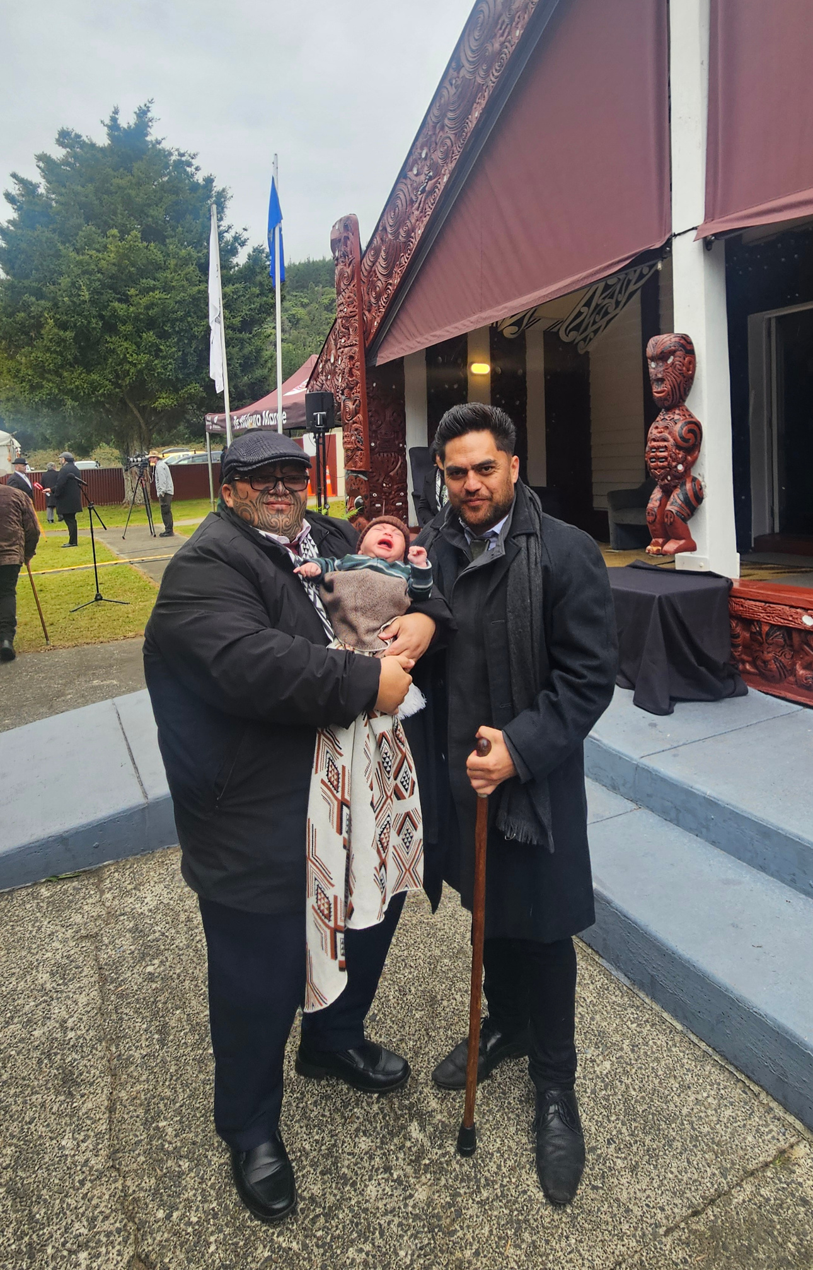
Kōrero Tuku Iho
Notes:
(Pause.)
One of the things I love most about this pūrākau...
(Pause.)
...is that Tāne didn't climb for himself.
(Pause.)
He climbed...
so others could benefit.
Continue.
Imagine if he had kept the kete.
(Smile.)
Imagine if he had said,
"This knowledge belongs to me."
(Pause.)
The story would end there.
Instead...
he returned.
He shared.
He gifted.
He trusted others to continue the journey.
Connect to teachers
Turn towards the audience.
Isn't that exactly what teachers do?
(Pause.)
Every day...
you climb.
You learn.
You prepare.
You reflect.
You solve problems.
You grow.
(Pause.)
Then you return to your classrooms...
and you gift that knowledge to others.
Introduce the idea of stewardship
This is a beautiful place to introduce kaitiakitanga of knowledge.
In te ao Māori...
knowledge isn't property.
It's a taonga.
And taonga carry responsibilities.
Not ownership.
Responsibility.
We are not owners of mātauranga.
We are its caretakers for a time.
Connect to your own mahi
You can speak personally here.
One of the reasons I continue researching Tātai Arorangi...
isn't simply to understand more.
It's because I believe this knowledge has something to offer our tamariki...
our schools...
our communities...
and our future.
Like Tāne...
I don't want to keep it.
I want to share it.
Audience Reflection
Ask:
Think about one teacher...
who changed your life.
(Pause.)
They probably didn't give you all the answers.
(Pause.)
They gave you something much more valuable.
They helped you become someone who could keep learning.
A Powerful Distinction
This is one of those lines I think people will write down.
Information can be owned.
Wisdom must be shared.
Another Memorable Quote
Or perhaps even stronger:
The value of knowledge is measured...
by the lives it transforms.
Animation
One woven kete appears.
↓
Hands receive it.
↓
Hands pass it on.
↓
A child receives it.
↓
That child grows into an adult.
↓
They pass another kete to the next generation.
The audience sees knowledge flowing through generations.
Connect to the Conference
This is also a lovely moment to acknowledge why everyone is gathered.
You could say:
As I look around this room...
I see hundreds of Tānenuiārangi.
People who climb every day...
not for themselves...
but for the generations who follow.
That connects the pūrākau directly to the lived experience of Māori teachers and honours the kaupapa of the conference.

Slide 23
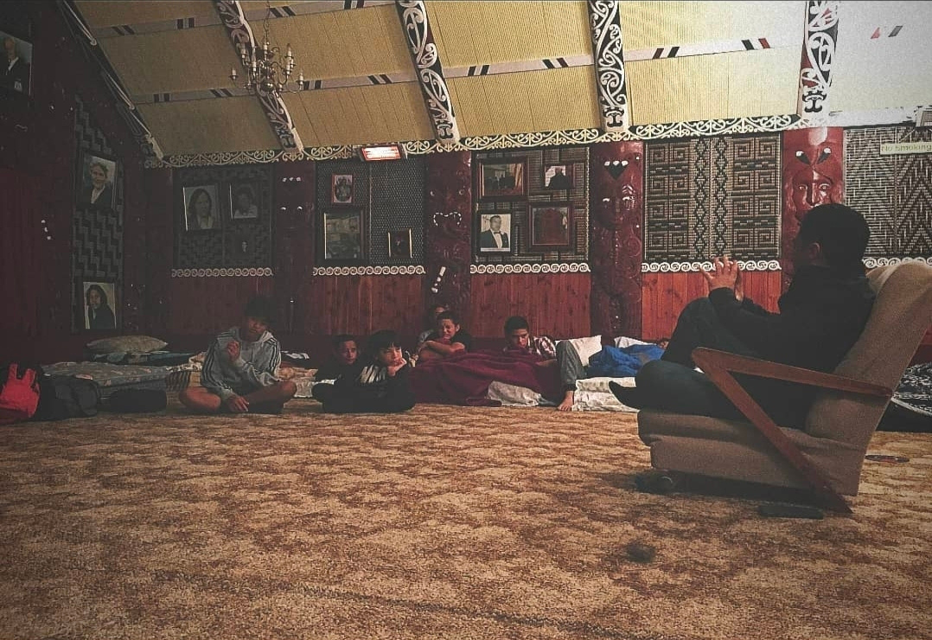
Knowledge Carries Responsibility
Notes:
What kind of generating are we raising??
Knowledge Carries Responsibility
Ehara te mātauranga i te mana anake.
He kawenga hoki.
Knowledge is not only a privilege. It is also a responsibility.
Visual
A silhouette of a kaiako walking hand in hand with a student at sunrise.
Or
A teacher standing with students looking towards the horizon.
The emphasis is not on teaching.
The emphasis is on walking together.
Slide Text
The purpose of knowledge
is not to elevate ourselves.
It is to uplift others.
Speaker Notes
(Pause.)
One of the most beautiful lessons I take from the journey of Tānenuiārangi...
(Pause.)
...is that the story doesn't end when he receives the kete.
(Pause.)
That's actually where the story begins.
Continue.
Receiving knowledge isn't the reward.
It's the beginning of responsibility.
(Pause.)
Knowledge asks something of us.
It asks...
How will you use what you've learnt?
Who will benefit?
Who might be left behind?
What legacy will you leave?
Bring it into Te Ao Māori
In te ao Māori...
knowledge has always carried obligations.
If we receive mātauranga...
we are expected to care for it.
Live it.
Test it.
Share it wisely.
Protect it.
Grow it.
Pass it forward.
Bring it back to educators
Now look around the room.
That's exactly what every one of you does.
(Pause.)
You don't simply teach mathematics.
You shape confidence.
You don't simply teach science.
You shape curiosity.
You don't simply teach history.
You shape identity.
You don't simply teach te reo Māori.
You help carry the language of our ancestors into the future.
(Pause.)
Your influence reaches far beyond your classroom.
Connect to your own mahi
This is a lovely place to share your own motivation.
Whether I'm working alongside iwi...
researching Tātai Arorangi...
supporting systems change...
or speaking with teachers...
I keep asking myself one question:
How will this knowledge make life better for the next generation?
Because if it doesn't improve the oranga of our people and our taiao...
then I still have more to learn.
Audience Reflection
Invite a quiet moment.
Think about the person who first believed in you.
(Pause.)
A teacher.
A kaumātua.
A kuia.
A parent.
An aunty.
An uncle.
(Pause.)
What responsibility did their belief place upon your life?
(Pause.)
Now ask yourself...
Whose future are you shaping today?
A Powerful Quote
I think this is one of the strongest lines in the entire keynote.
Knowledge is not measured by what we know.
It is measured by how we serve.
Animation
Reveal the flow one stage at a time.
Seek Knowledge
↓
Receive Knowledge
↓
Understand Knowledge
↓
Live Knowledge
↓
Share Knowledge
↓
Leave the World Better
The final step should appear on its own after a pause.
Leave the World Better
That becomes the emotional takeaway from this section.
Link to Education
This is a beautiful point to introduce a whakataukī that many educators will recognise:
Nāu te rourou, nāku te rourou, ka ora ai te iwi.
You could reflect:
Education has never been the responsibility of one teacher.
It has always been the collective work of whānau, hapū, iwi, schools, and communities.
Every one of us carries part of the ket

Slide 24
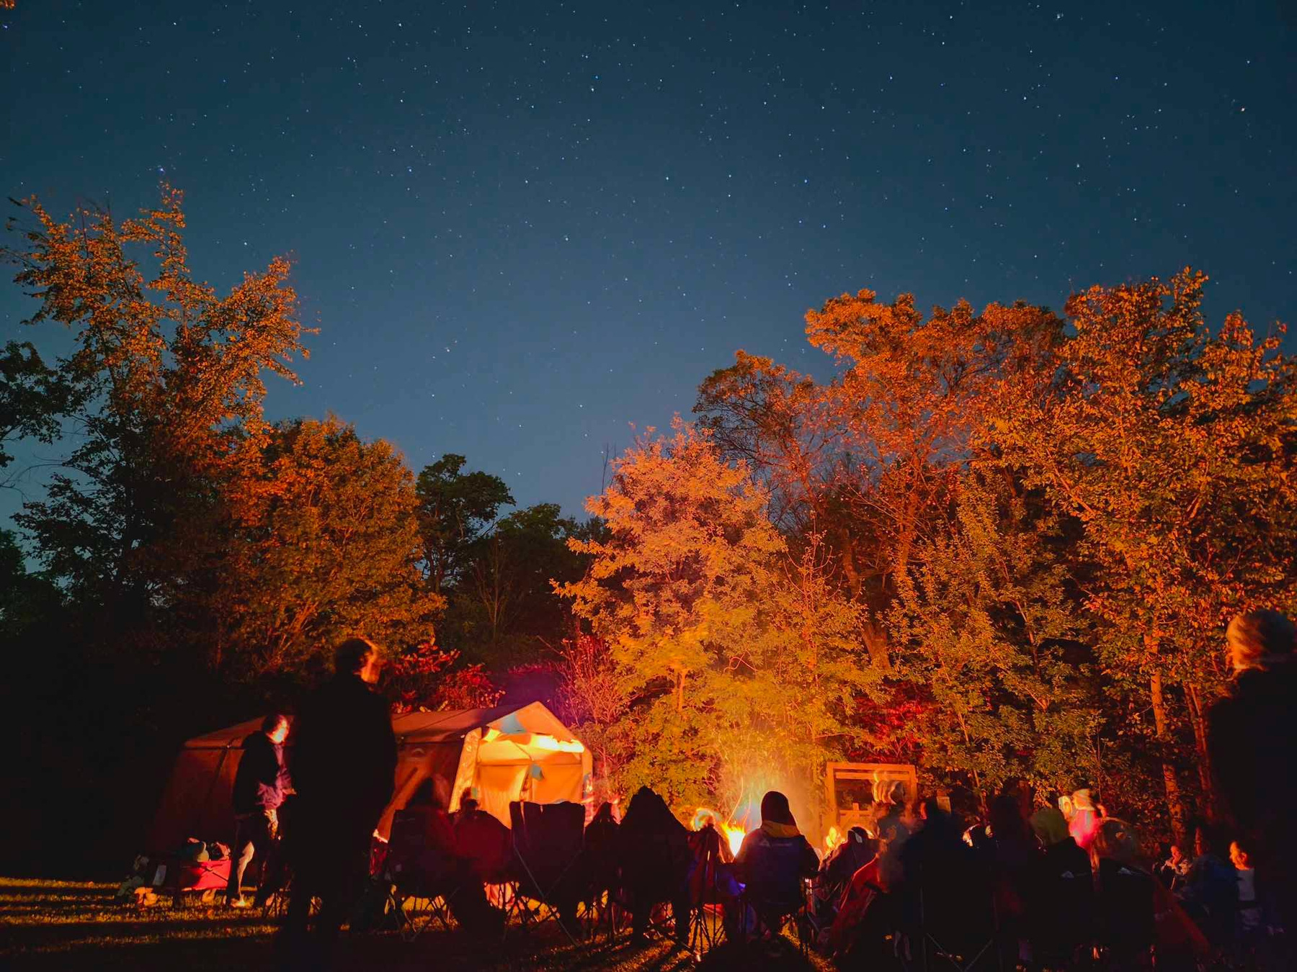
Reimagining Education
What if we taught the way our tūpuna learnt?
Notes:
Visual
A split-screen image.
Left side
A conventional classroom:
Rows of desks
Whiteboard
Students looking down at books
Right side
A class outside:
Students beside an awa
Looking at the stars
Working in a māra
Listening to a kaumātua
Observing manu
The contrast should invite curiosity rather than judgement.
Slide Text
Education isn't confined to classrooms.
Education happens wherever relationships with people, place, and knowledge are nurtured.
Speaker Notes
(Pause.)
I'd like us to imagine something.
(Pause.)
Imagine if we could begin again.
(Pause.)
If we were designing education for Aotearoa today...
using everything we've learnt from our tūpuna...
what might it look like?
Continue.
Would learning happen only inside four walls?
(Pause.)
Would every lesson begin with a worksheet?
(Pause.)
Would we separate knowledge into subjects?
(Pause.)
Or...
would we reconnect learning with place?
Paint a Vision
Imagine...
Science begins beside an awa.
Mathematics begins through celestial navigation.
Health begins by understanding our relationship with Te Taiao.
History begins with local whakapapa.
Geography begins by walking the whenua.
Language begins through kōrero with kaumātua.
Astronomy begins by standing beneath the night sky.
(Pause.)
Education becomes something we experience...
not simply something we consume.
Bring in Maramataka
This is where your expertise naturally comes in.
Imagine every kura understanding the rhythms of their own environment.
Not every school using the same maramataka.
But every school learning to observe:
their own whenua
their own skies
their own seasons
their own tohu
Because every place teaches differently.
Link to Systems Thinking
One of the things systems thinking teaches us...
is that changing one part of the system changes everything else.
Our tūpuna already understood this.
When we reconnect learners with Te Taiao...
we don't just improve environmental understanding.
We strengthen identity.
We strengthen belonging.
We strengthen wellbeing.
We strengthen relationships.
Everything begins to move together.
Bring it back to teachers
Look around the room.
The future of education doesn't depend on a new curriculum alone.
(Pause.)
It depends on teachers who are courageous enough...
to reconnect learning with life.
Audience Reflection
Ask:
If you could change one thing about the way your students learn...
(Pause.)
What would it be?
(Pause.)
And what is one small step you could take when you return to your kura?
Powerful Quote
This is one I'd have on the screen by itself.
The classroom is not a place.
It is a relationship.
(Pause.)
Because whenever curiosity, connection, and purpose come together...
learning begins.
Animation
The slide begins with the traditional classroom.
As you speak, it gently fades into:
a ngahere
an awa
a māra kai
the night sky
a marae
students walking with kaumātua
The audience literally watches the walls disappear.
Why this slide matters
This is the first slide where your audience begins to think:
"I could actually do this."
You've spent the first part inspiring them.
Now you're empowering them.

Slide 25
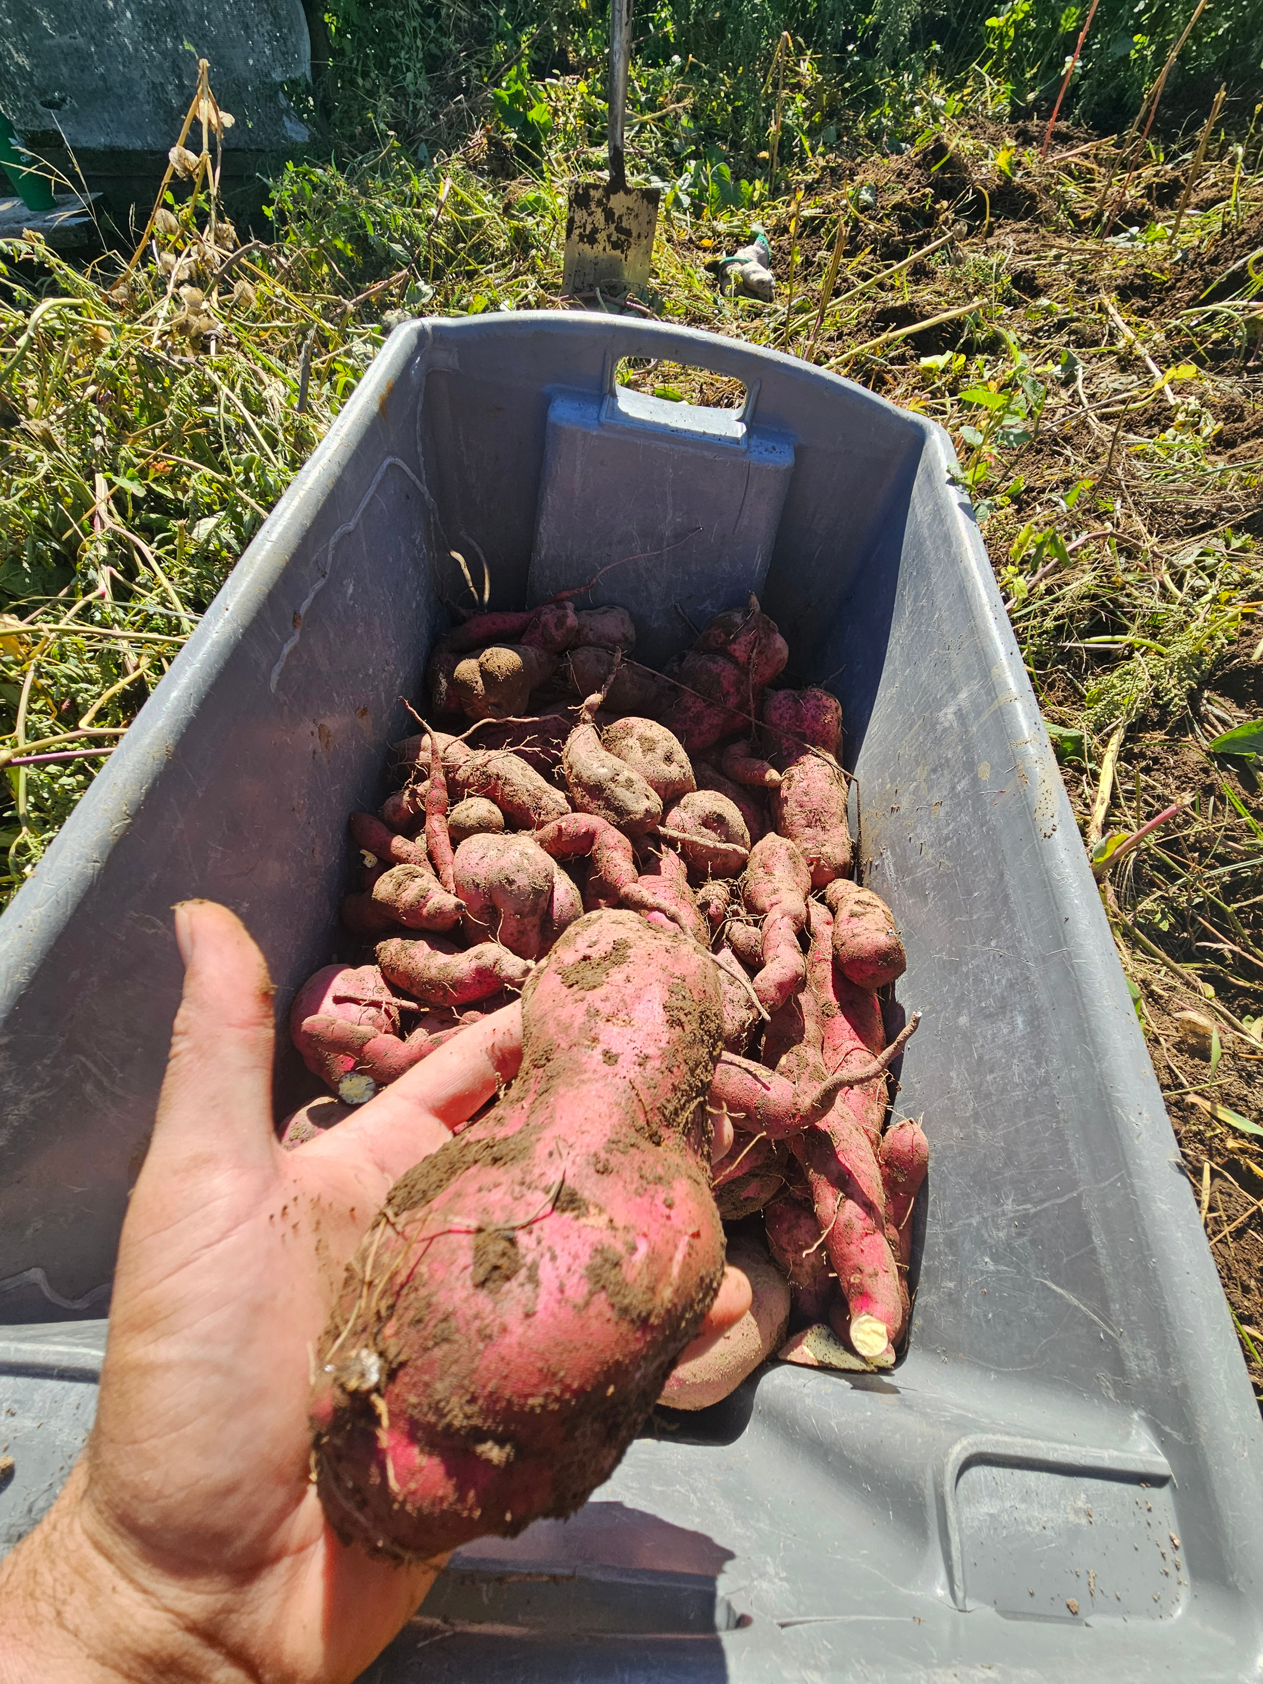
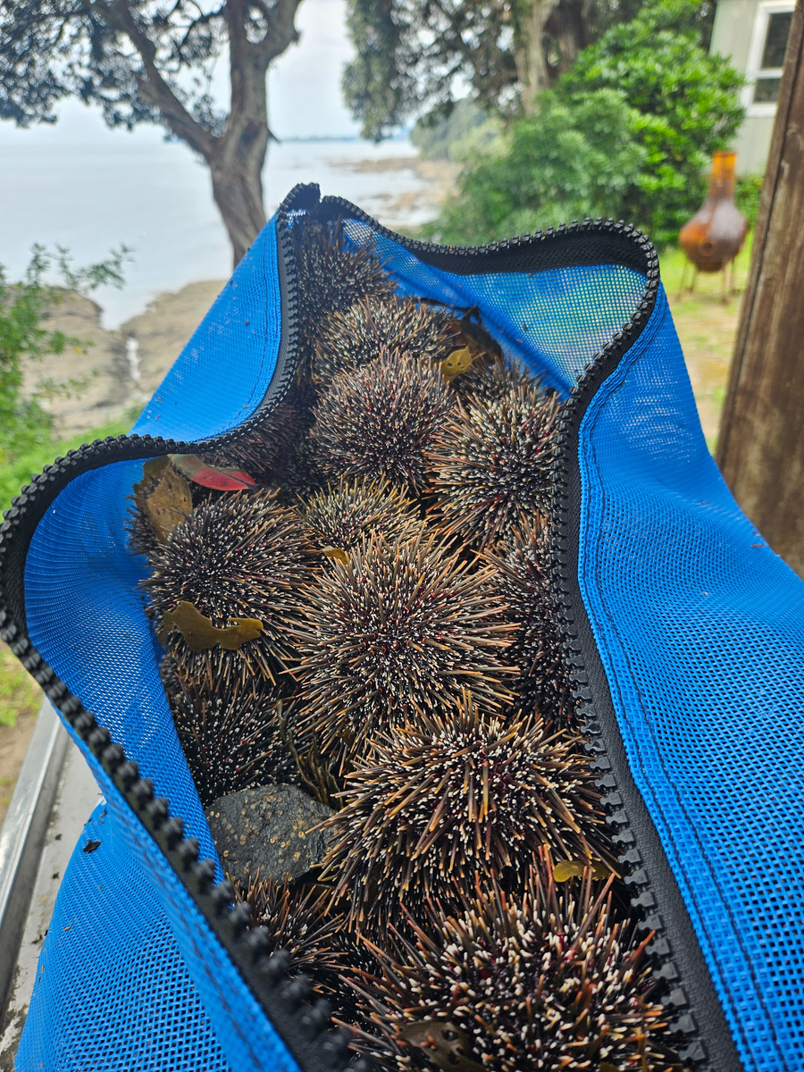
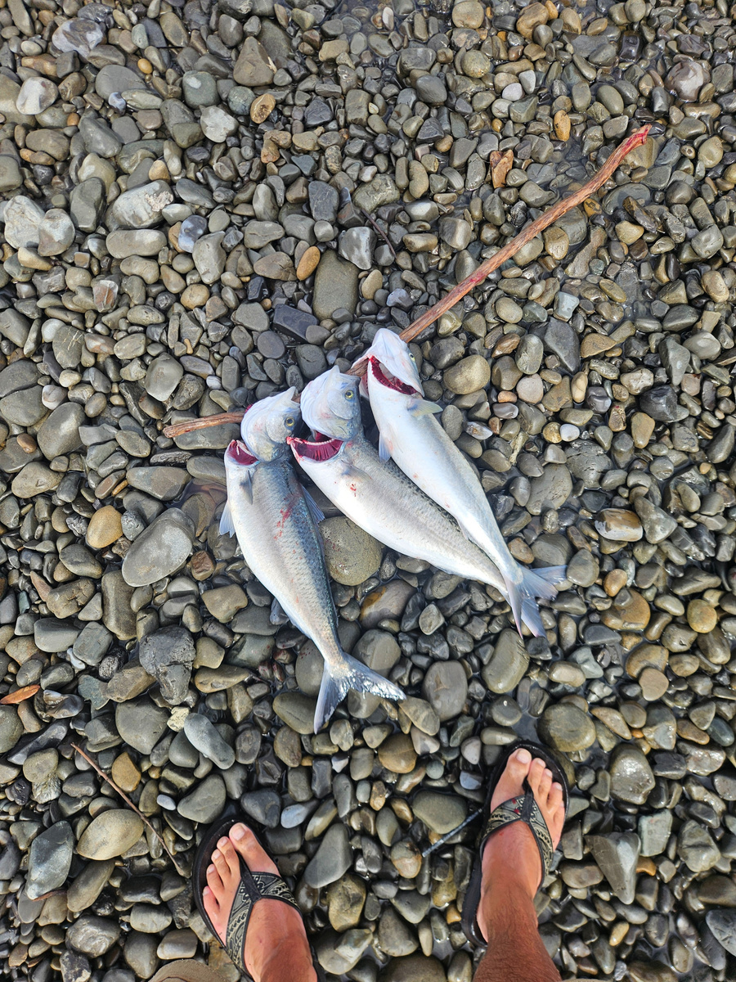
Mātauranga Māori
“It's not something we preserve.
It's something we practise.”
Notes:
Speaker Notes
(Pause.)
People sometimes ask me...
"How do we bring mātauranga Māori back?"
(Smile.)
And I always respond...
(Pause.)
It never left.
Continue.
It's still here.
In our marae.
In our kōrero.
In our waiata.
In our whakapapa.
In our reo.
In our whānau.
In our taiao.
In our communities.
(Pause.)
Sometimes...
we simply forget to notice it.
Bring in your own journey
One of the greatest privileges of my life has been walking alongside iwi, hapū, schools, communities, and organisations across Aotearoa.
Not to teach them mātauranga Māori.
But to create spaces where people reconnect with knowledge they already carry.
(Pause.)
I've learnt that my role isn't to provide answers.
It's to ask better questions.
To create opportunities for observation.
To encourage curiosity.
To help people reconnect.
Share a Story
Rather than listing projects, tell one story.
For example:
I remember standing with a group of tamariki during a maramataka session.
We weren't inside a classroom.
We weren't reading a textbook.
We were simply standing quietly.
Looking.
Listening.
Feeling the wind.
Watching the birds.
Noticing the moon.
One of the tamariki looked up and said,
"I've never noticed that before."
(Pause.)
That moment reminded me that education begins with noticing.
Not with knowing.
Connect to Teachers
Turn to the audience.
Every one of you has the opportunity to create moments like that.
Not because you know everything.
But because you're willing to slow down...
and help your learners notice what has always been there.
The Big Insight
Slow down.
Mātauranga Māori isn't fragile.
(Pause.)
It doesn't need rescuing.
(Pause.)
It needs to be lived.
It needs to be practised.
It needs to be shared.
It needs to keep growing.
Just as it always has.
Audience Reflection
Ask:
Where is mātauranga Māori already alive in your community?
(Pause.)
Who are the knowledge holders?
What stories are waiting to be heard?
What places are waiting to become classrooms?
A Powerful Quote
I think this should appear on the screen on its own.
The future of mātauranga Māori
does not depend on remembering the past.
It depends on living it today.
Animation
Begin with a single photograph.
As you speak, other images gently fade in:
Wānanga
Marae
Kura
Whānau
Kaumātua
Tamariki outdoors
Community planting
Looking at the stars
The audience sees that mātauranga Māori is alive in many places and many forms.

Slide 26
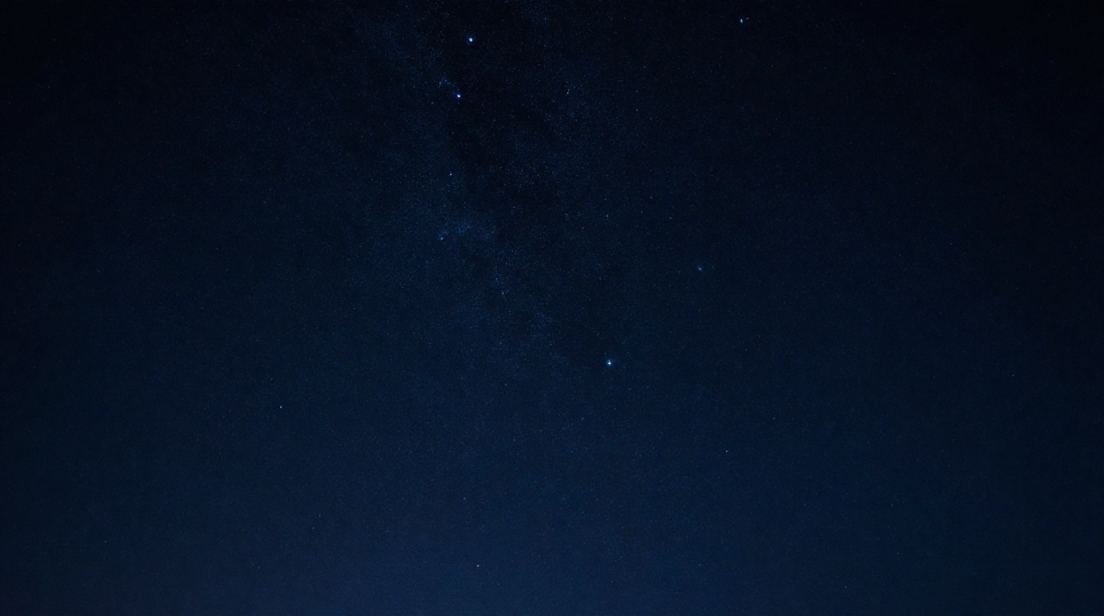
From Observation to Transformation
Our tupuna didn't simply observe. They followed a cycle:
1. Observed
6. Observe Again
2. Reflect
5. Learnt
3. Connect
4. Respond
Notes:
Introduce your framework
This is where you can say:
Over the years, whether I've been working with iwi, schools, communities, or through Healthy Families East Cape, I've found myself returning to this same cycle.
1. Observe
What is happening?
2. Reflect
Why is it happening?
3. Connect
How is it connected to everything else?
4. Respond
What action is needed?
5. Grow
What have we learnt?
Then...
begin observing again.
Connect to Teaching
Turn to the audience.
Imagine using this cycle with your learners.
Instead of asking,
"What's the right answer?"
Ask,
"What are you noticing?"
Instead of saying,
"Here's today's lesson."
Ask,
"What is Te Taiao teaching us today?"
Instead of memorising facts...
students begin investigating relationships.
Connect to your own mahi
Now bring in your real-world examples.
This cycle has shaped much of my own mahi.
Whether we're:
embedding maramataka in schools
supporting Kia Tū
strengthening Taurikura
working alongside iwi
improving public health
or undertaking doctoral research
We always begin the same way.
Not with solutions.
With observation.
A Strong Systems Thinking Message
Systems don't change because someone writes a new strategy.
Systems change...
when people begin seeing the system differently.
Our tūpuna understood this long before we gave it the name "systems thinking."
Audience Reflection
Ask:
Think about one challenge in your kura.
(Pause.)
What would happen if...
instead of solving it immediately...
you spent one month simply observing it?
What patterns might begin to emerge?
Memorable Quote
This could appear on screen by itself.
Observation creates awareness.
Awareness creates understanding.
Understanding creates transformation.
Animation
The circular framework appears one stage at a time.
Observe
↓
Reflect
↓
Connect
↓
Respond
↓
Grow
↓
Back to Observe
The final arrow returning to "Observe" is important because it reinforces that learning is ongoing.
Why this slide matters
This is the first slide where your audience can immediately apply what you've shared.
It gives them a practical, memorable framework that they can use with learners, staff, whānau, and communities.
It also subtly introduces systems thinking without using technical language.

Slide 27
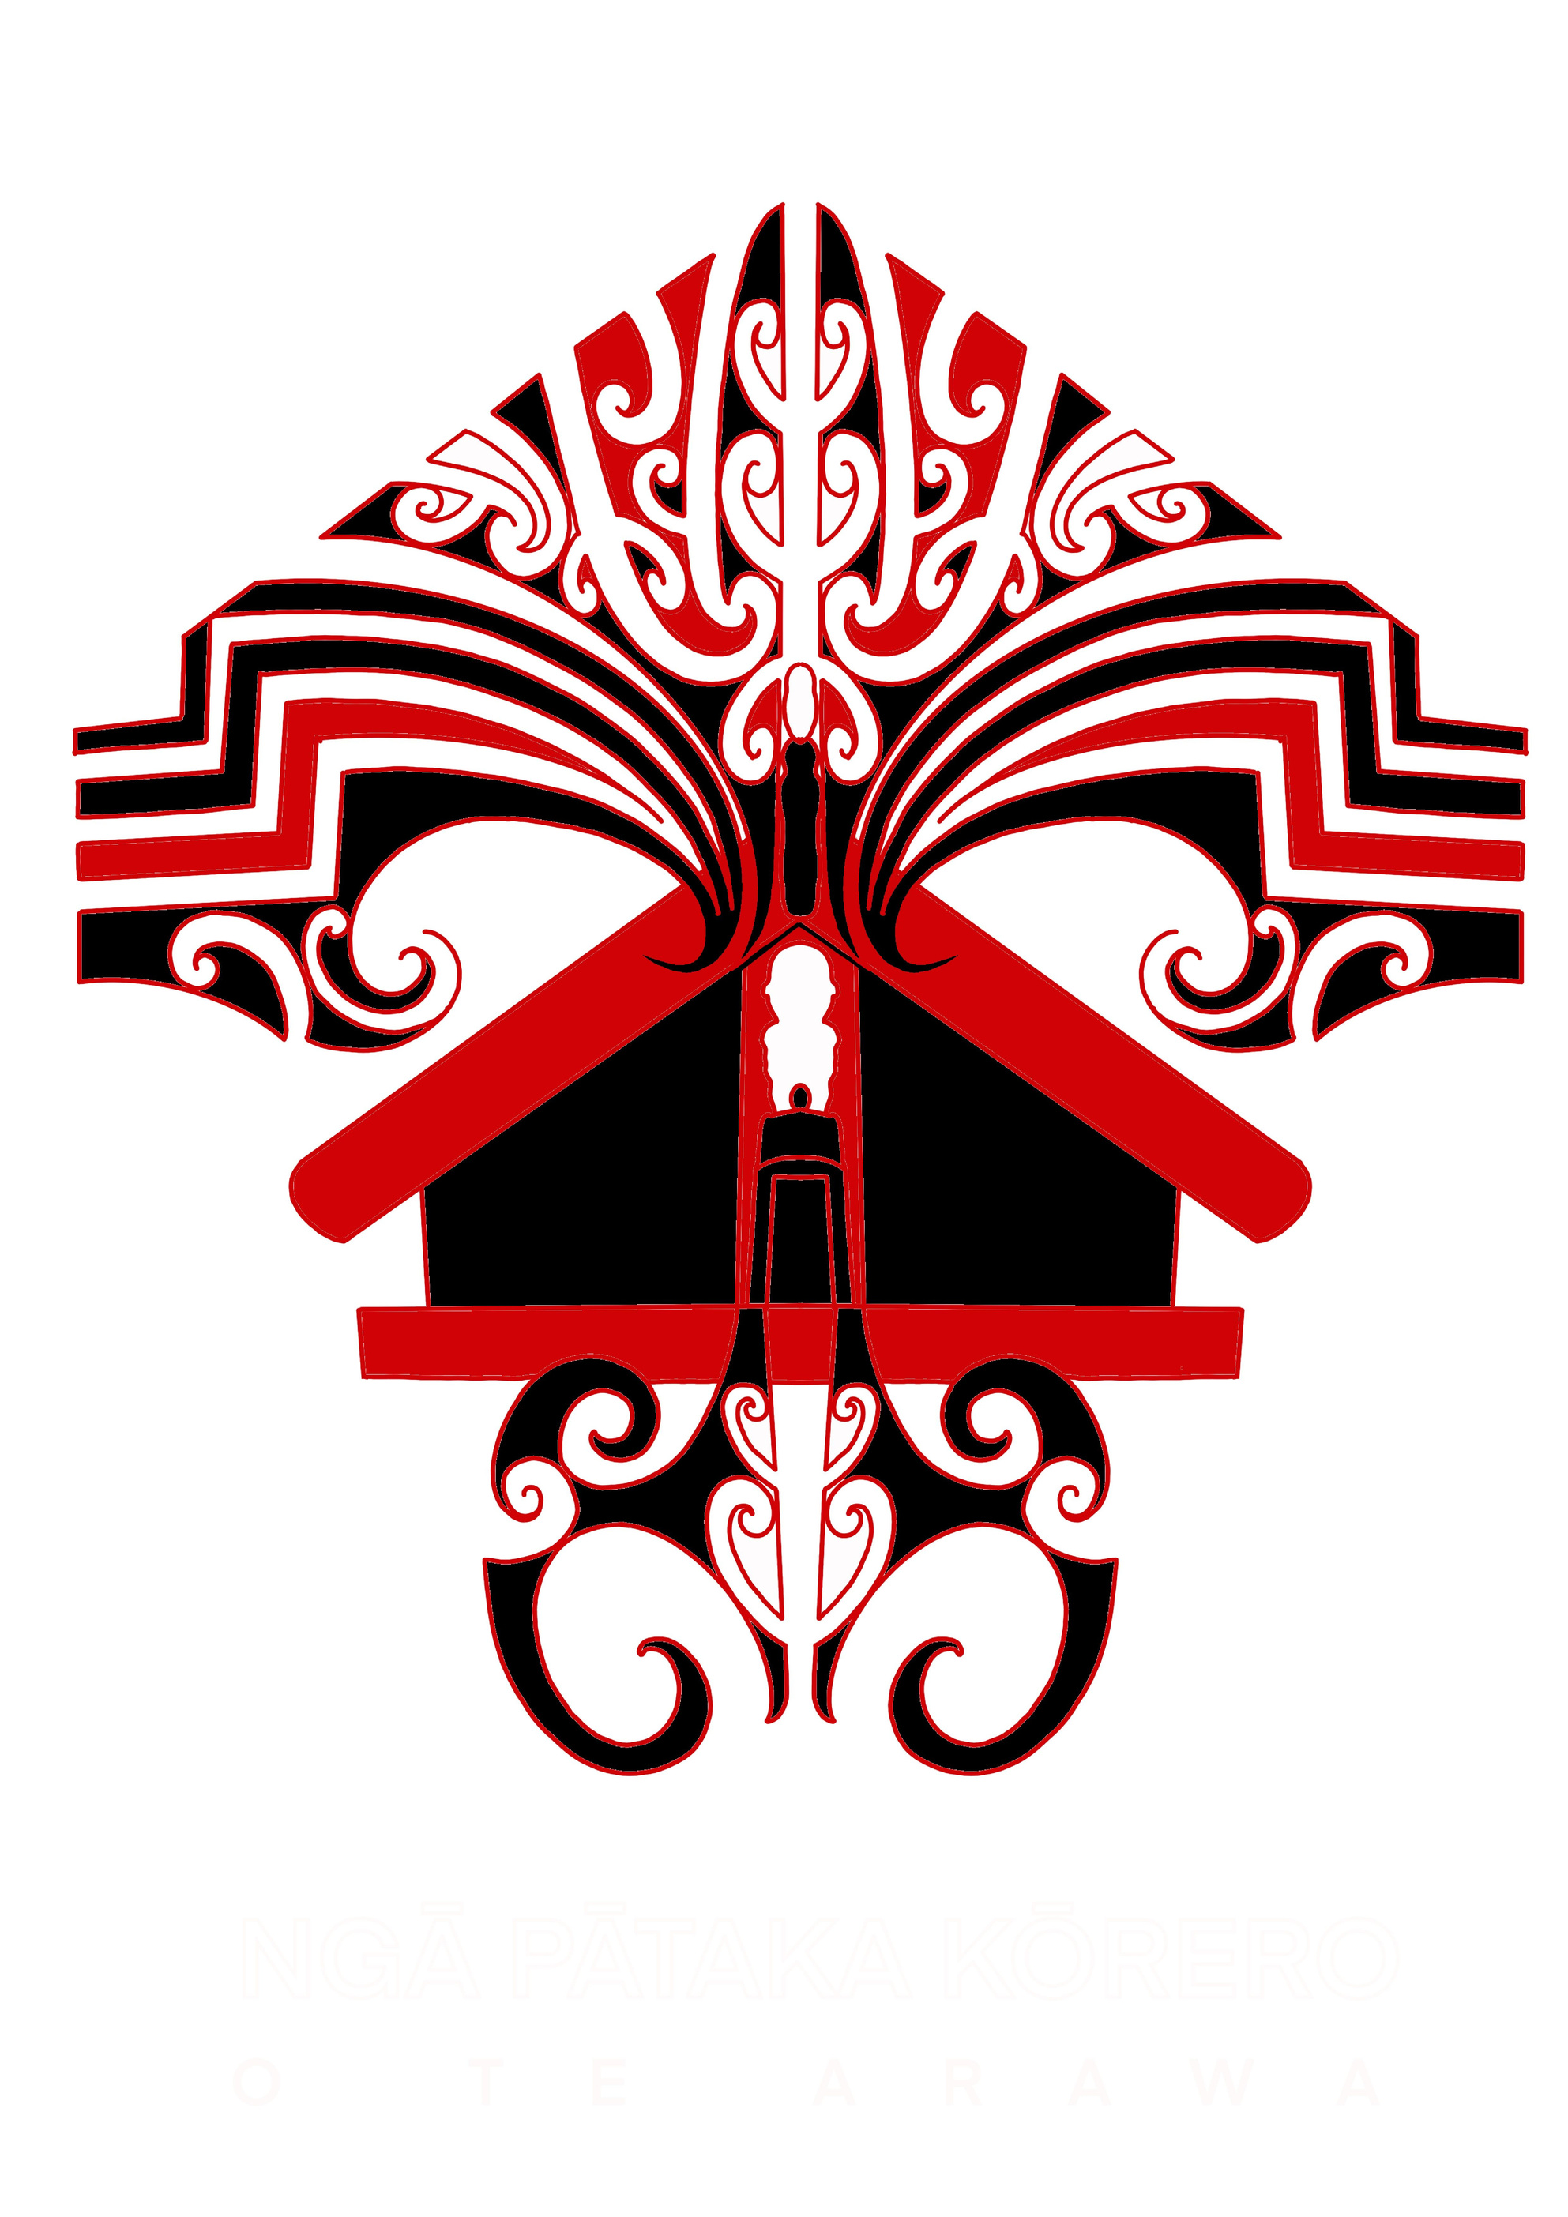
Ngā Pātaka Kōrero o Te Arawa
Every community carries a library.
Sometimes it is written.
Most often, it is remembered.
Notes:
One of the greatest privileges in my life...
has been serving alongside Ngā Pātaka Kōrero o Te Arawa.
(Pause.)
People sometimes think archives are about preserving the past.
(Pause.)
I don't.
(Pause.)
I believe they're about preparing the future.
Continue.
Every kōrero...
every whakapapa...
every waiata...
every pūrākau...
every place name...
every memory...
is another strand in our collective kete.
Connect to your keynote
Earlier today we spoke about Tānenuiārangi bringing back the kete of knowledge.
(Pause.)
Our responsibility today is different.
We don't need to climb the heavens.
We need to ensure those kete remain alive.
Not locked away.
Not forgotten.
Lived.
Shared.
Added to.
Connect to teachers
Every kura has its own pātaka.
Not necessarily a building.
(Pause.)
Its people.
Its stories.
Its local knowledge.
Its relationships.
Its kaumātua.
Its reo.
(Pause.)
One of the greatest gifts we can give our learners is helping them discover those treasures.
Bring in Tātai Arorangi
This is where your keynote comes back together beautifully.
When I study Tātai Arorangi...
I'm not simply studying stars.
I'm listening to generations of observation.
Generations of careful noticing.
Generations of kōrero handed from one person to another.
That is exactly what Ngā Pātaka Kōrero seeks to honour.
Audience Reflection
Ask:
Who are the living libraries in your community?
(Pause.)
Have your learners met them?
(Pause.)
What stories might disappear if we don't create space for them to be shared?

Slide 28
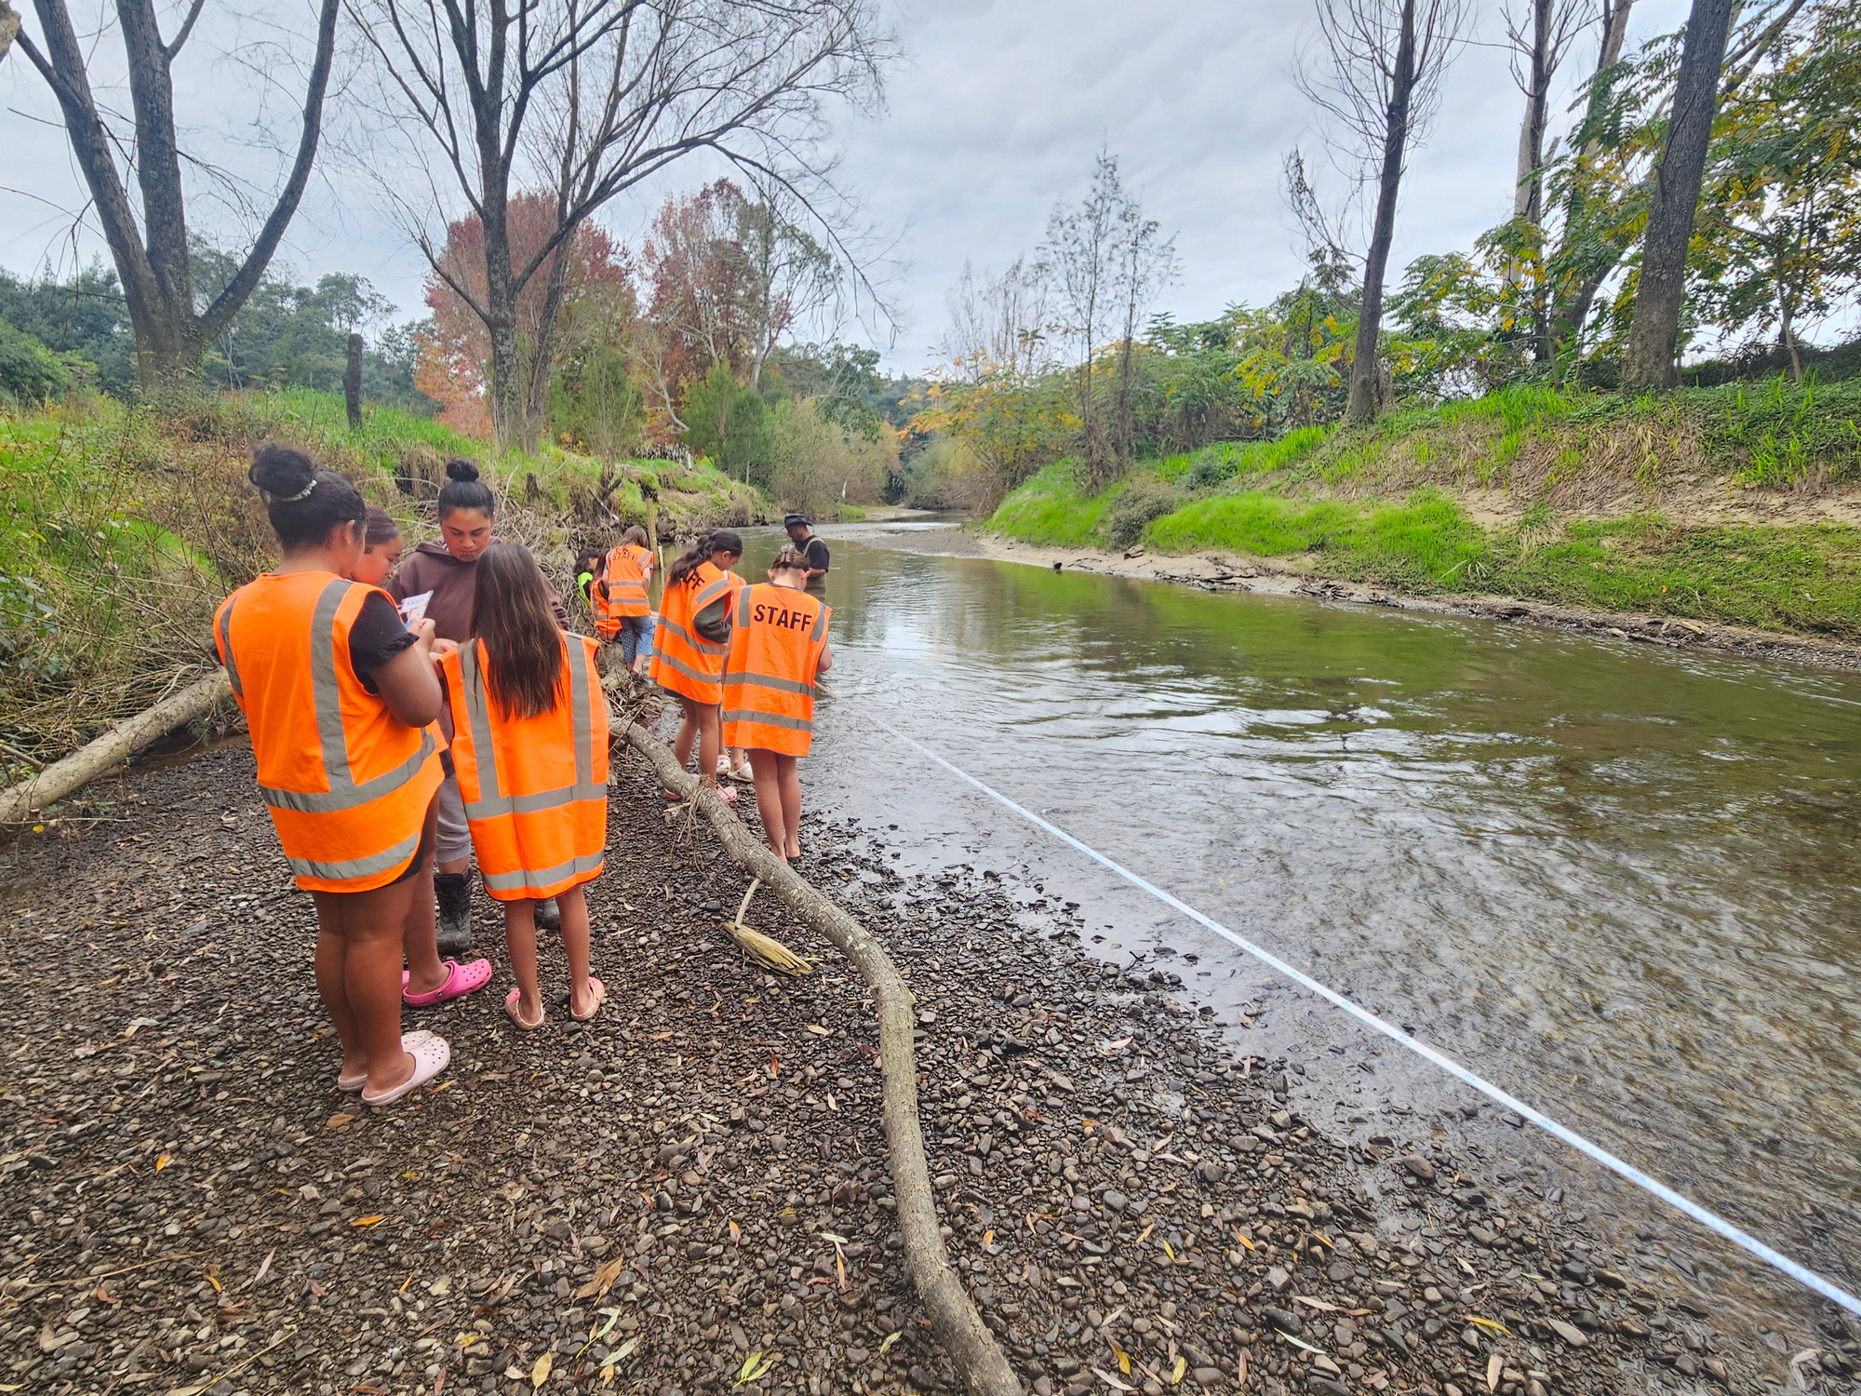
The Tuna Became the Teacher
Sometimes our greatest teachers...
don't stand at the front of the classroom.
Notes:
Speaker Notes
(Pause.)
I'd like to tell you a story.
(Pause.)
It's a story about tuna.
But really...
it's a story about education.
Continue.
When many people hear about Kia Tū...
they think it's an environmental project.
Or perhaps they think it's about restoring tuna.
(Smile.)
But I don't think that's what Kia Tū is really about.
The Story
Kia Tū is about restoring relationships.
Relationships between:
tamariki and awa
schools and communities
teachers and kaumātua
mātauranga Māori and learning
people and Te Taiao
(Pause.)
The tuna simply became our teacher.
Connect to Observation
Remember when we spoke about observation?
That's exactly where Kia Tū begins.
Not with answers.
With curiosity.
Students ask:
Where are the tuna?
Why are they here?
Why aren't they here?
What has changed?
What is the awa telling us?
Show Integrated Learning
Then explain:
Without realising it...
students are learning:
science
ecology
history
geography
mathematics
te reo Māori
whakapapa
oral history
systems thinking
Not because we've divided learning into subjects.
Because the tuna connects them all.
Connect to Maramataka
They begin noticing:
the moon...
the rainfall...
the water temperature...
the seasons...
the migration...
the birds...
the insects...
the plants...
(Pause.)
Everything starts connecting.
The Big Realisation
Slow down.
We didn't take education to the awa.
(Pause.)
The awa reminded us what education had always been.
Connect to Teachers
Look around the room.
Imagine if every kura had its own tuna.
(Smile.)
Not necessarily an eel.
(Laughter.)
But something local...
something meaningful...
something that could connect every subject...
every learner...
every teacher...
and every whānau.
That's place-based education.
Audience Reflection
Ask:
What's the "tuna" in your community?
(Pause.)
What species...
what story...
what river...
what mountain...
what place...
could become the centre of learning?
Powerful Quote
I'd reveal this after a pause.
The best learning doesn't happen when we teach about life.
It happens when life becomes the teacher.

Slide 29
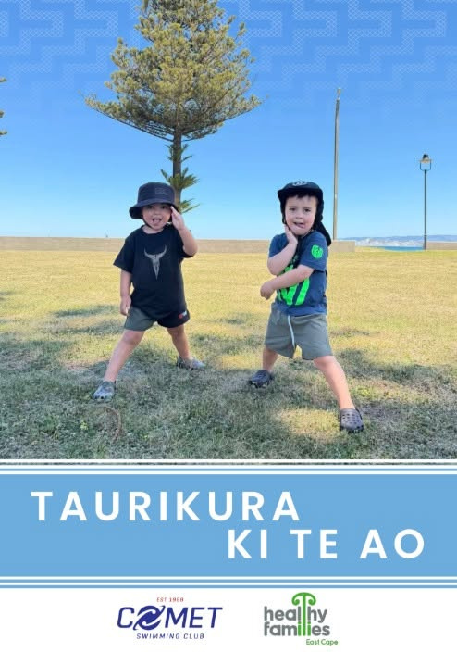
Taurikura
Water Doesn't Just Keep Us Safe. It Teaches Us Who We Are.
Water doesn't simply teach us how to swim.
It teaches us confidence, connection, and responsibility.
Notes:
Pause.)
I'd like you to think back to your own childhood.
(Pause.)
How many of your happiest memories happened around water?
At the beach.
In the river.
At the lake.
Fishing with your whānau.
Gathering kai.
Swimming with cousins.
(Pause.)
For Māori...
wai has never simply been a resource.
Wai is whakapapa.
Wai is identity.
Wai is life.
Introduce Taurikura
When we began Taurikura...
our goal wasn't simply to teach tamariki to swim.
(Pause.)
Our goal was much deeper.
We wanted tamariki to feel that they belonged in the water.
To understand Tangaroa.
To respect wai.
To build confidence.
To strengthen whānau.
To reconnect culture and learning
Connect back to Tātai Arorangi
Just as our tūpuna looked to the stars...
they also looked to the tides.
The moon.
The currents.
The winds.
The changing seasons.
Water was never separate from the sky.
Everything was connected.
Link to Education
Through Taurikura...
children weren't only learning a life skill.
They were learning:
observation
courage
teamwork
whakapapa
environmental stewardship
cultural identity
confidence
(Pause.)
That's education.
Connect to Teachers
Turn to the audience.
Sometimes we think education happens because of the content we teach.
(Pause.)
I've come to believe...
education happens because of the relationships we create.
Education isn't measured only by what learners know.
It's measured by who they become.

Slide 30
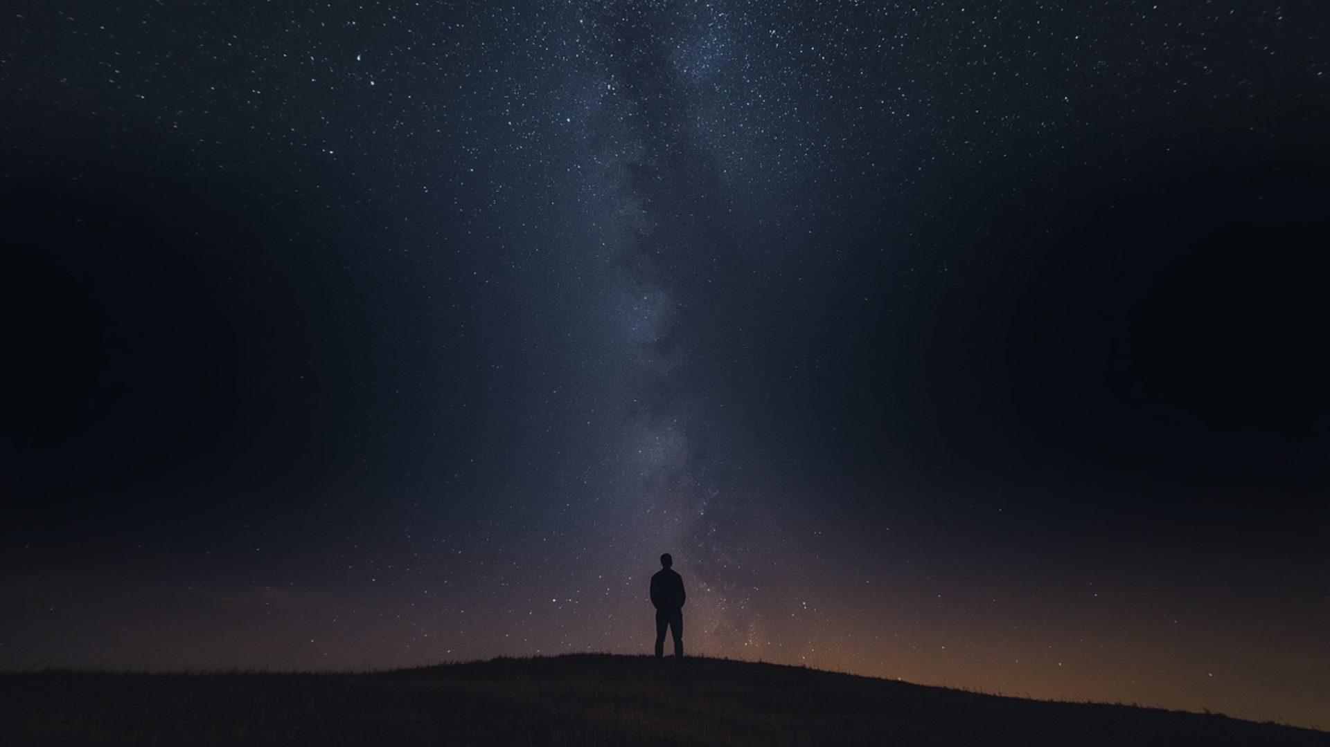
Tātai Arorangi & Hauora: Exploring How Māori Celestial Knowledge Informs Health, Wellbeing, and Environmental Relationships

Slide 31
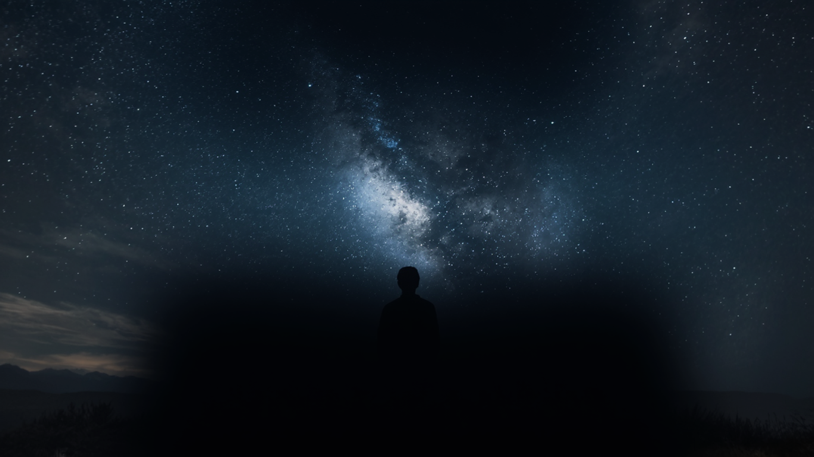
Looking Up... Looking Within
"The stars do not simply tell us where we are.
They remind us who we are."
Notes:
Visual
A single silhouette standing beneath Matariki or the Milky Way.
No distractions.
No labels.
Just one person.
One sky.
One relationship.
The audience should almost feel like they're standing there themselves.
Slide Text
The stars do not simply tell us where we are.
They remind us who we are.
Speaker Notes
(Pause.)
We've spent a lot of time this morning talking about stars.
(Smile.)
But this keynote has never really been about stars.
(Pause.)
It's been about people.
Continue.
Our tūpuna didn't study the night sky because they wanted to become astronomers.
They studied the sky because it helped them understand:
where they belonged
when to act
how to care for one another
how to care for the whenua
how to live well
The stars became a mirror.
They reflected our responsibilities back to us.
Bring it back to identity
One of the greatest gifts Tātai Arorangi offers...
is identity.
When we know our stories...
our whenua...
our whakapapa...
our local skies...
we begin to understand our place in the world.
And when people know where they belong...
they often begin to thrive.
Connect to education
Imagine if every learner could answer these questions:
Ko wai au?
Nō hea au?
He aha taku hononga ki tēnei whenua?
He aha aku kawenga ki ngā whakatipuranga kei te haere mai?
Those are not just cultural questions.
They are educational questions.
They are wellbeing questions.
They are leadership questions.

Slide 32
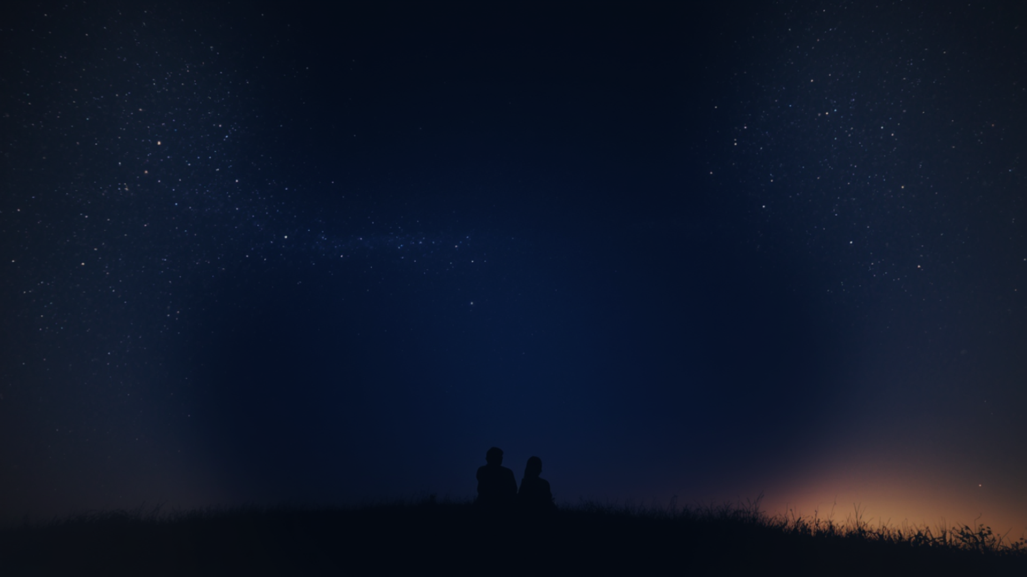
The stars never stopped teaching.
We simply stopped looking.
The greatest gift we can give our tamariki...
...is not more answers.
It is a deeper sense of belonging.
Notes:
Speaker Notes
(Long pause.)
Do you remember...
the very first slide this morning?
(Pause.)
The stars.
(Pause.)
They're still here.
(Pause.)
Exactly where they have always been.
Continue.
Ranginui never stopped speaking.
Te Marama never stopped moving.
Matariki never stopped rising.
The tides never stopped flowing.
The birds never stopped singing.
The seasons never stopped turning.
(Pause.)
Te Taiao never stopped teaching.
Slow down.
The question has never been...
"Are the lessons still there?"
(Pause.)
The question has always been...
"Are we paying attention?"
Bring the audience into the story
Every morning...
our learners arrive carrying questions.
(Pause.)
Every day...
Te Taiao is offering lessons.
(Pause.)
Every season...
our communities are changing.
(Pause.)
Perhaps education isn't about creating something entirely new.
(Pause.)
Perhaps...
it's about remembering how to notice again.
Bring it back to the teachers
Look around the room.
You don't need permission to begin.
(Pause.)
You don't need to know every moon phase.
(Pause.)
You don't need to become an expert in Tātai Arorangi overnight.
(Pause.)
Tomorrow morning...
you could simply take your learners outside.
(Pause.)
Look up.
Listen.
Observe.
Wonder together.
The Big Challenge
This is where I'd challenge them gently.
If every kaiako in this room...
helped just one learner...
fall in love with their whenua...
their sky...
their whakapapa...
their language...
their people...
(Pause.)
Imagine Aotearoa in fifty years.
Audience Reflection
Invite silence.
I'd like everyone...
to think of one thing.
(Pause.)
When you return to your kura...
on Monday morning...
(Pause.)
What's one thing you'll help your learners notice...
that they may never have noticed before?
(Long pause.)
The greatest gift we can give our tamariki...
(Pause.)
Click.
...is not more answers.
(Pause.)
Click.
It is a deeper sense of belonging.

Slide 33
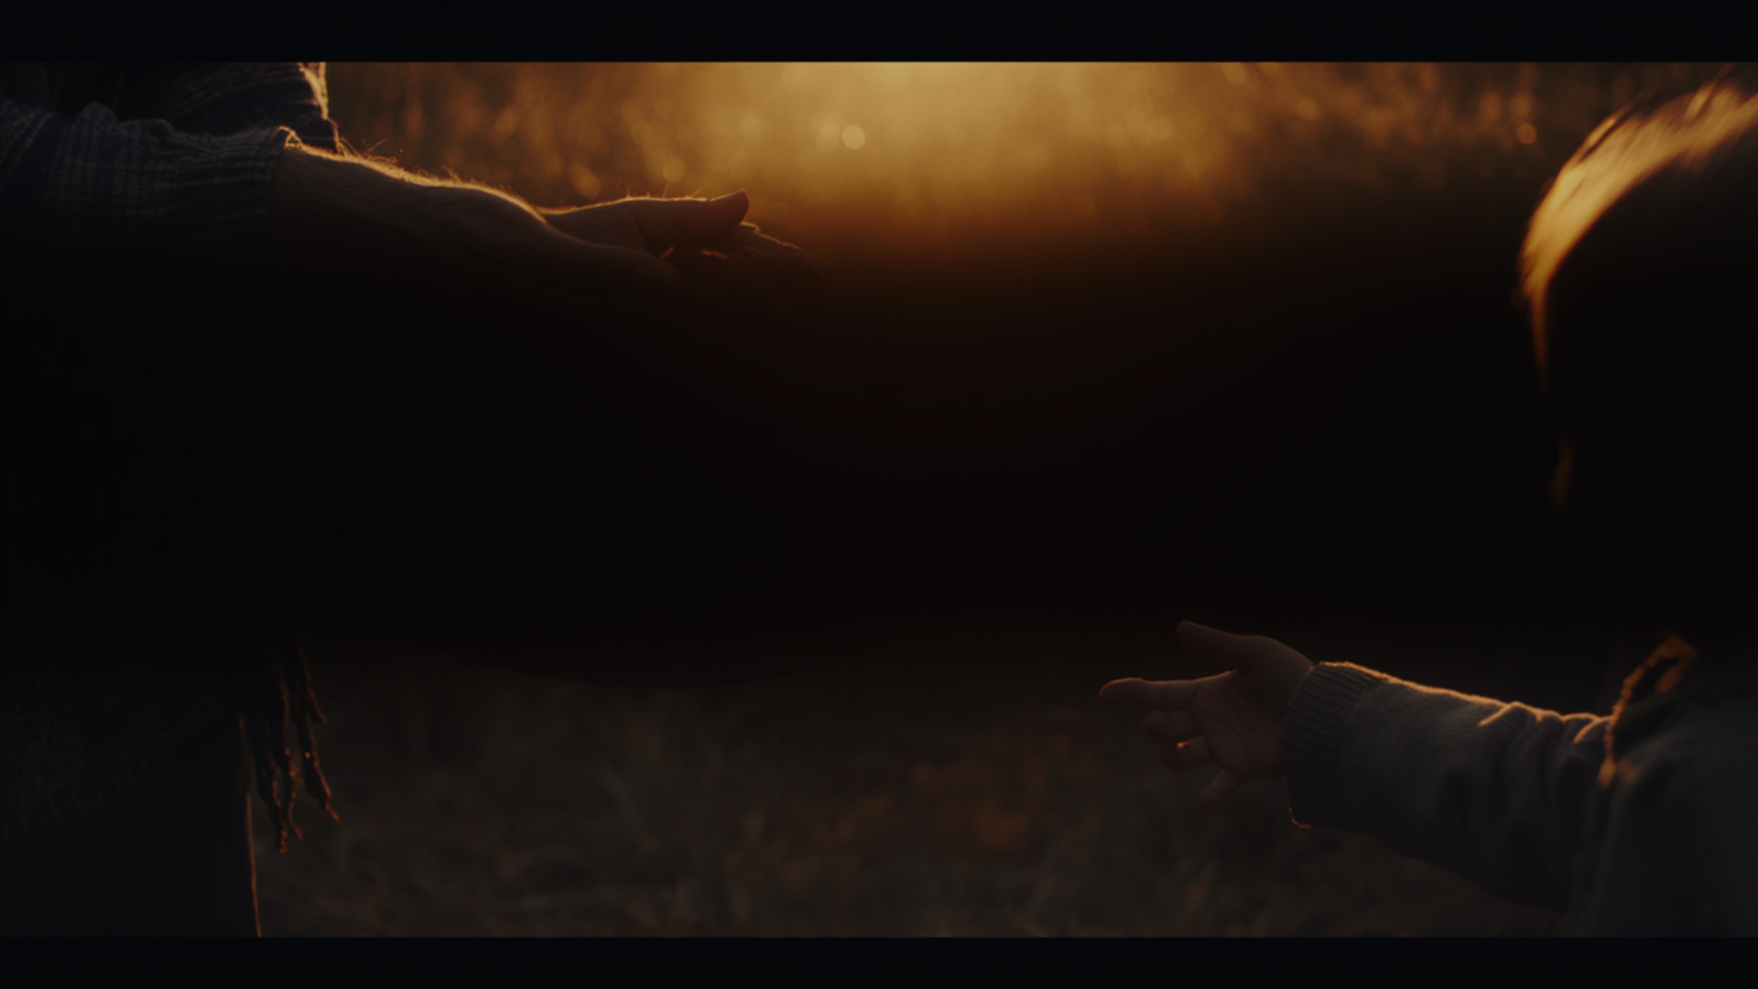
“Legacy is not only about what we leave behind. It is what we awaken in others.”
Notes:
Speaker Notes
(Long pause.)
Every one of us stands in a very special place.
(Pause.)
Behind us...
stand our tīpuna.
(Pause.)
In front of us...
stand our mokopuna.
(Pause.)
And right here...
stands us.
Continue.
We didn't create the kete.
(Pause.)
We inherited it.
(Pause.)
We won't carry it forever.
(Pause.)
One day...
we'll hand it on.
Bring it back to education
Every lesson...
Every conversation...
Every relationship...
Every act of kindness...
Every challenge...
Every expectation...
(Pause.)
Becomes part of someone else's inheritance.
A personal story
I'd become very personal here.
As I've continued my own journey...
working with iwi...
communities...
schools...
and now through my doctoral research...
I've come to realise something.
(Pause.)
My greatest contribution won't be a thesis.
(Pause.)
It won't be a publication.
(Pause.)
It won't even be this presentation.
(Pause.)
It will be the people whose lives I've had the privilege to walk alongside.
Honour the audience
Turn to them.
The same is true for every one of you.
(Pause.)
Your legacy won't be measured by how many years you taught.
(Pause.)
It will be measured by the people who leave your classroom believing...
"I matter."
"I belong."
"I can make a difference."
The Big Reflection
Ask:
Imagine your mokopuna...
or perhaps someone else's mokopuna...
standing here...
one hundred years from now.
(Pause.)
What story will they tell...
about the generation that came before them?
(Long pause.)
Will they say...
"They protected our language."
"They cared for our rivers."
"They honoured our stories."
"They looked after one another."
"They helped us remember who we are."

Slide 34
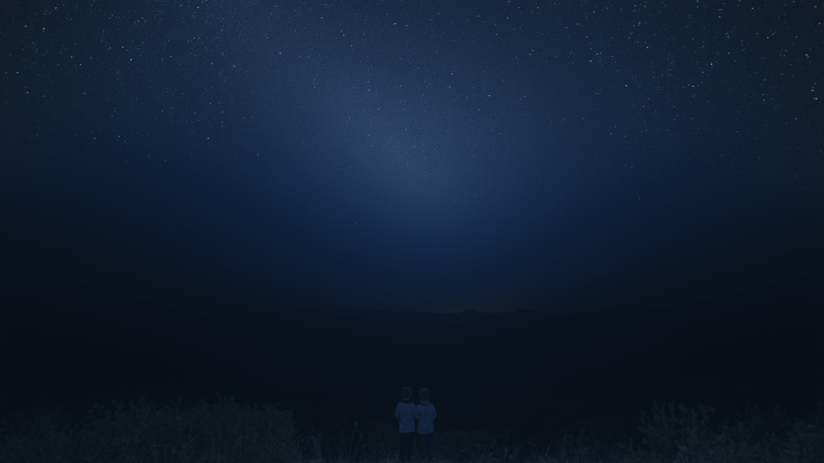
Imagine an Aotearoa where...
“Every child knows who they are.”
“Every child knows where they belong.”
“Every child knows the stories of their whenua.”
“Every child understands that they are part of Te Taiao, not separate from it.”
“Every child leaves school knowing they have a responsibility to future generations.”
Notes:
(Long pause.)
I'd like to finish by asking you to imagine.
(Pause.)
Not a new curriculum.
Not another education strategy.
(Pause.)
A different future.
Continue.
Imagine an Aotearoa where every child can stand on their own whenua...
and tell you the stories of that place.
(Pause.)
Imagine every learner recognising Matariki...
not because they memorised it for an assessment...
but because they have watched it rise with their whānau.
(Pause.)
Imagine every kura working alongside mana whenua...
where local knowledge is not an "extra" but the foundation of learning.
(Pause.)
Imagine tamariki leaving school not only with qualifications...
but with identity...
purpose...
confidence...
and a deep sense of belonging.
Connect back to your keynote
If that sounds ambitious...
remember where we began.
Our tūpuna already showed us that education can be relational.
That it can be place-based.
That it can prepare people not just for work...
but for life.
Honour the audience
Look around the room.
I don't believe that vision begins in Parliament.
(Pause.)
I believe it begins in rooms like this.
With kaiako who are courageous enough to teach differently.
With leaders who are willing to listen.
With communities who are ready to walk together.
(Pause.)
And with every one of us choosing to look up again.
Audience Reflection
Ask one final reflective question.
If this is the future we want...
(Pause.)
What part of that future will begin in your classroom next week?
(Pause.)
Because every great transformation begins somewhere.
Why not here?
Why not now?
The future of education will not be built by policy alone.
(Click.)
It will be built through relationships.

Slide 35
From Observation to Transformation
1. Observed
6. Observe again
2. Reflect
5. Learn
3. Connect
4. Respond
Notes:
Introduce your framework
This is where you can say:
Over the years, whether I've been working with iwi, schools, communities, or through Healthy Families East Cape, I've found myself returning to this same cycle.
1. Observe
What is happening?
2. Reflect
Why is it happening?
3. Connect
How is it connected to everything else?
4. Respond
What action is needed?
5. Grow
What have we learnt?
Then...
begin observing again.
Connect to Teaching
Turn to the audience.
Imagine using this cycle with your learners.
Instead of asking,
"What's the right answer?"
Ask,
"What are you noticing?"
Instead of saying,
"Here's today's lesson."
Ask,
"What is Te Taiao teaching us today?"
Instead of memorising facts...
students begin investigating relationships.
Connect to your own mahi
Now bring in your real-world examples.
This cycle has shaped much of my own mahi.
Whether we're:
embedding maramataka in schools
supporting Kia Tū
strengthening Taurikura
working alongside iwi
improving public health
or undertaking doctoral research
We always begin the same way.
Not with solutions.
With observation.
A Strong Systems Thinking Message
Systems don't change because someone writes a new strategy.
Systems change...
when people begin seeing the system differently.
Our tūpuna understood this long before we gave it the name "systems thinking."
Audience Reflection
Ask:
Think about one challenge in your kura.
(Pause.)
What would happen if...
instead of solving it immediately...
you spent one month simply observing it?
What patterns might begin to emerge?
Memorable Quote
This could appear on screen by itself.
Observation creates awareness.
Awareness creates understanding.
Understanding creates transformation.
Animation
The circular framework appears one stage at a time.
Observe
↓
Reflect
↓
Connect
↓
Respond
↓
Grow
↓
Back to Observe
The final arrow returning to "Observe" is important because it reinforces that learning is ongoing.
Why this slide matters
This is the first slide where your audience can immediately apply what you've shared.
It gives them a practical, memorable framework that they can use with learners, staff, whānau, and communities.
It also subtly introduces systems thinking without using technical language.

Slide 36
Look Up One More Time
Notes:
When was the last time you truly looked at the stars?
When was the last time you stood outside...
...not to check the weather...
...not to find your car...
...not because you were in a hurry...
...but simply to look at the stars?
(Pause again.)
As teachers, we're constantly asking our students to look down.
Look at your books.
Look at your screens.
Look at the board.
But today, I'd like to invite us to do something different.
I'd like us to look up.
(Pause.)
Because for our tūpuna, looking up wasn't simply an act of curiosity.
It was an act of learning.
"Who taught you to look at the stars?"

Slide 37
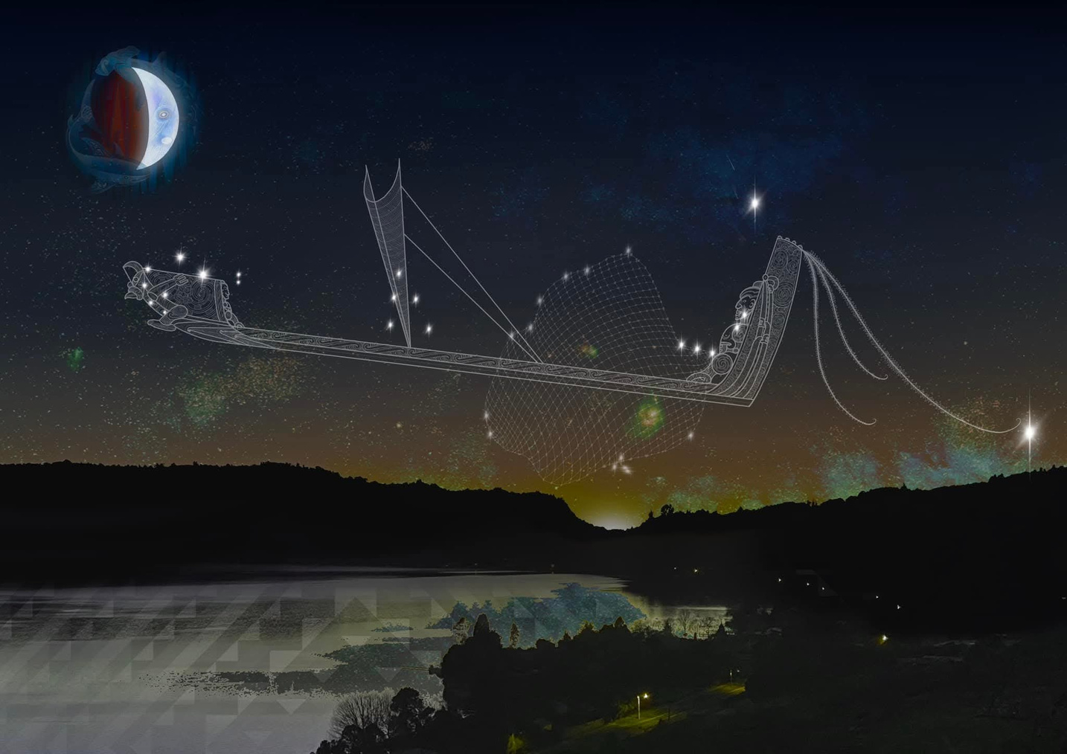
"Pūai karihia e Matariki e te uetāngahu a Tanenuiarangi"
Irirangi Tiakiawa

Slide 38
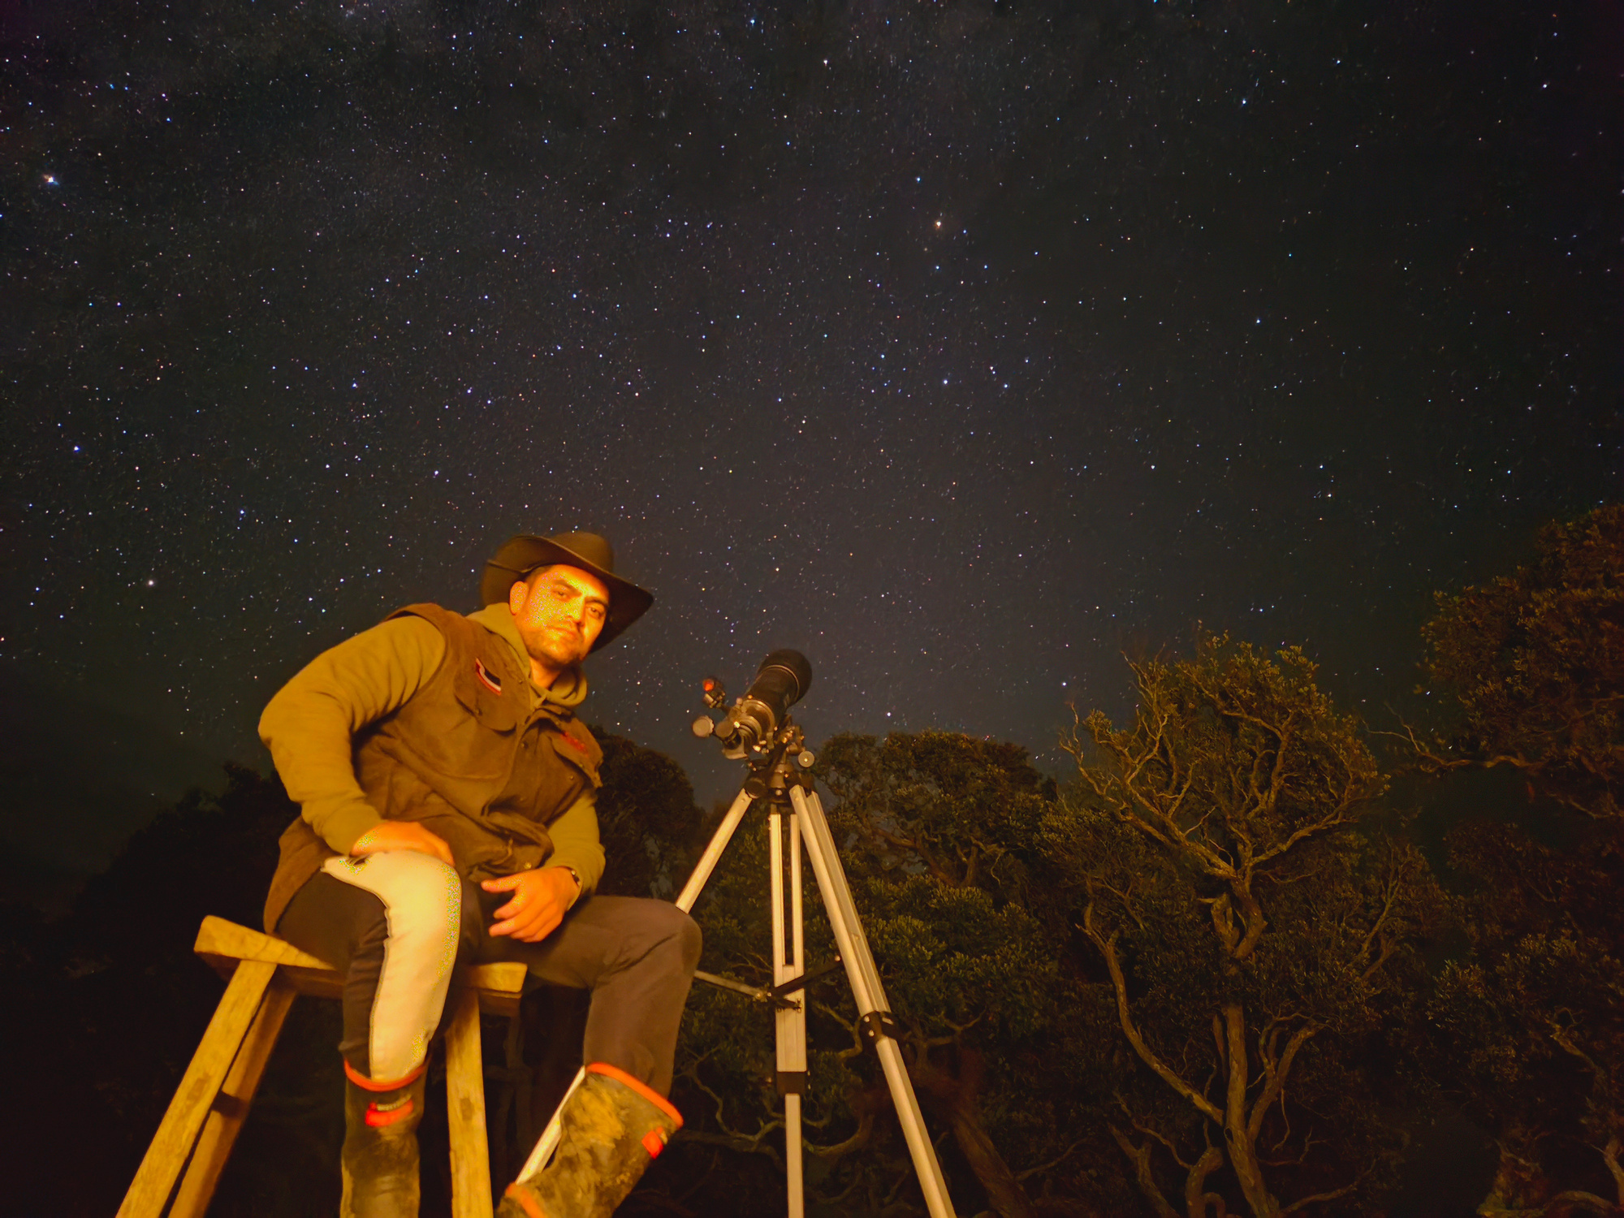
Te Uetāngahu a Tānenuiārangi
Reclaiming a Māori Philosophy of Education
Jade Kameta
Ngāti Pikiao, Ngāti Whakaue (Te Arawa), Te Whakatōhea, Te Whānau-ā-Apanui, Ngāti Porou
Māori Systems Strategist, Healthy Families East Cape
Doctoral Researcher, AUT
Maramataka & Tātai Arorangi Practitioner

