Slide 1
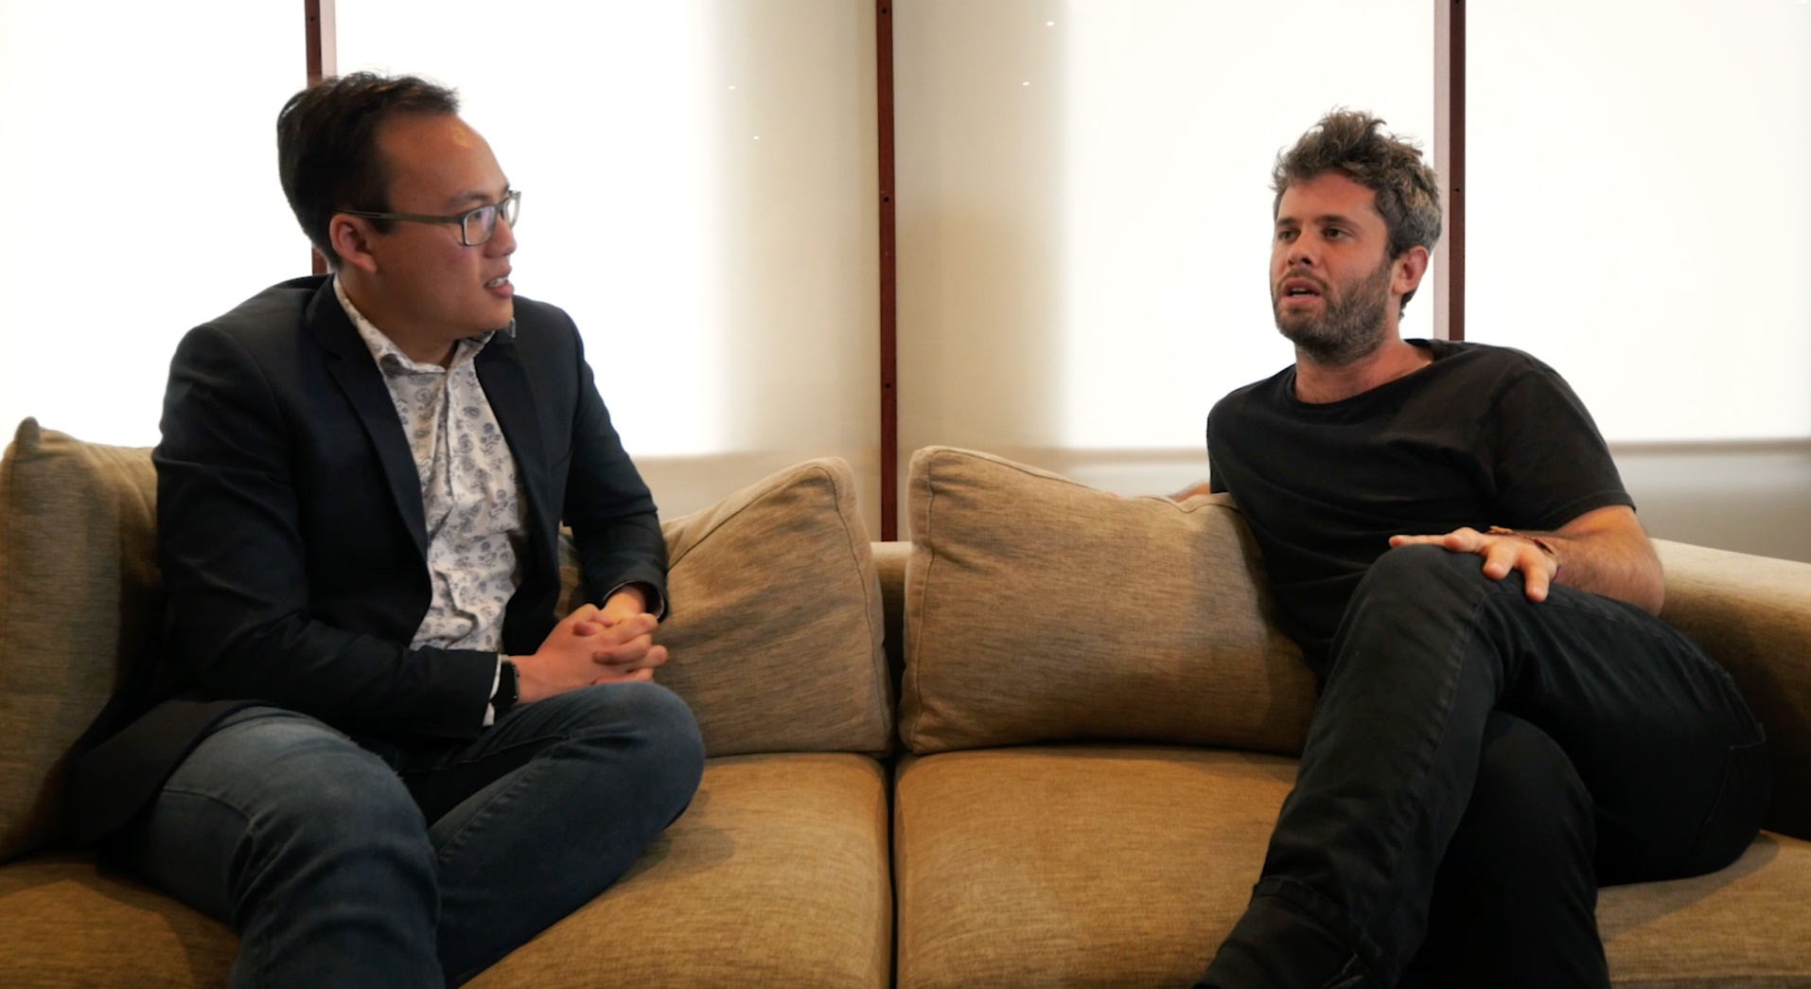
Appraisal

Slide 2
In groups share current appraisal requirements in your school
Notes:
Groups of 3
Talk about current appraisal
Does this match the high trust model envisaged by Minister and Secretary for Education

Slide 3
Share
Examples of :
Good practice
Poor practice
Schools that have improved practice since the Accord announcements
Notes:
Groups of 3
Talk about current appraisal
Does this match the high trust model envisaged by Minister and Secretary for Education

Slide 4
What is currently required of schools?
A policy which establishes there is a performance management system that is operational, reasonable and consistent.

Slide 5
Secretary of Education (1996)
Written performance expectations, development objectives and specifications of support required
An observation of teaching each year
Two opportunities for discussion
Self-appraisal
An annual summary report that states whether or not the appraisee meets the standards or ngā paerewa.
Notes:
Current advice from MoE
Discussion of what this could mean

Slide 6
No requirement that it include :
An inquiry is undertaken by teachers
Reports from the professional development teachers do
A portfolio of evidence compiled by teachers
Any specific mode of professional development
Notes:
Acknowledge evidence cited (not necessarily recorded)

Slide 7
Four processes
Competence
Attestation
Performance appraisal
Re-certification

Slide 8
1. Competence
Totally different process
STCA 3.3

Slide 9
2. Attestation
Annual
Moving up salary scale
Assured that the teacher concerned is meeting the required standards.
Achieved in different ways: discussion with the teacher, observations, appraisal.

Slide 10
3. Performance appraisal
Annual
As required by Secretary of Education

Slide 11
4. Re-certification
Once every three years
Meet the Standards of the Teaching Profession

Slide 12
Certification
Schools need to keep a record for each teacher to indicate that they have been appraised and have participated in some form of PLD

Slide 13
The record for each teacher needs only to indicate that the teacher has been:
Observed and received feedback from their appraiser
Involved in two annual appraisal conversations
Involved in professional learning
Affirmed by their appraiser, in their professional judgement, as meeting the Teaching Council standards (the evidence for this would be from their normal day to day professional interactions with the teacher).
Notes:
Acknowledge evidence cited (not necessarily recorded)

Slide 14
Appraisal gone wrong
What are some of the things you can do if your school has onerous appraisal processes?

Slide 15
Shedding the compliance burden
PPTA has a guide to assist branches and employers review their current performance management system with the goal of eliminating unnecessary workload from the process

Slide 16
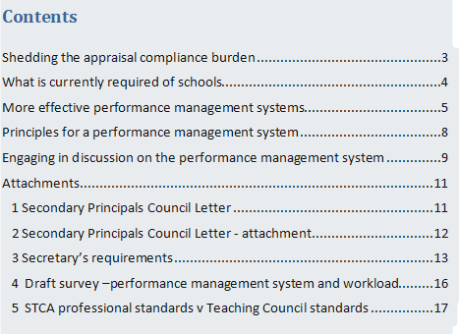

Slide 17
Appraisal
Where to now?

