Slide 1
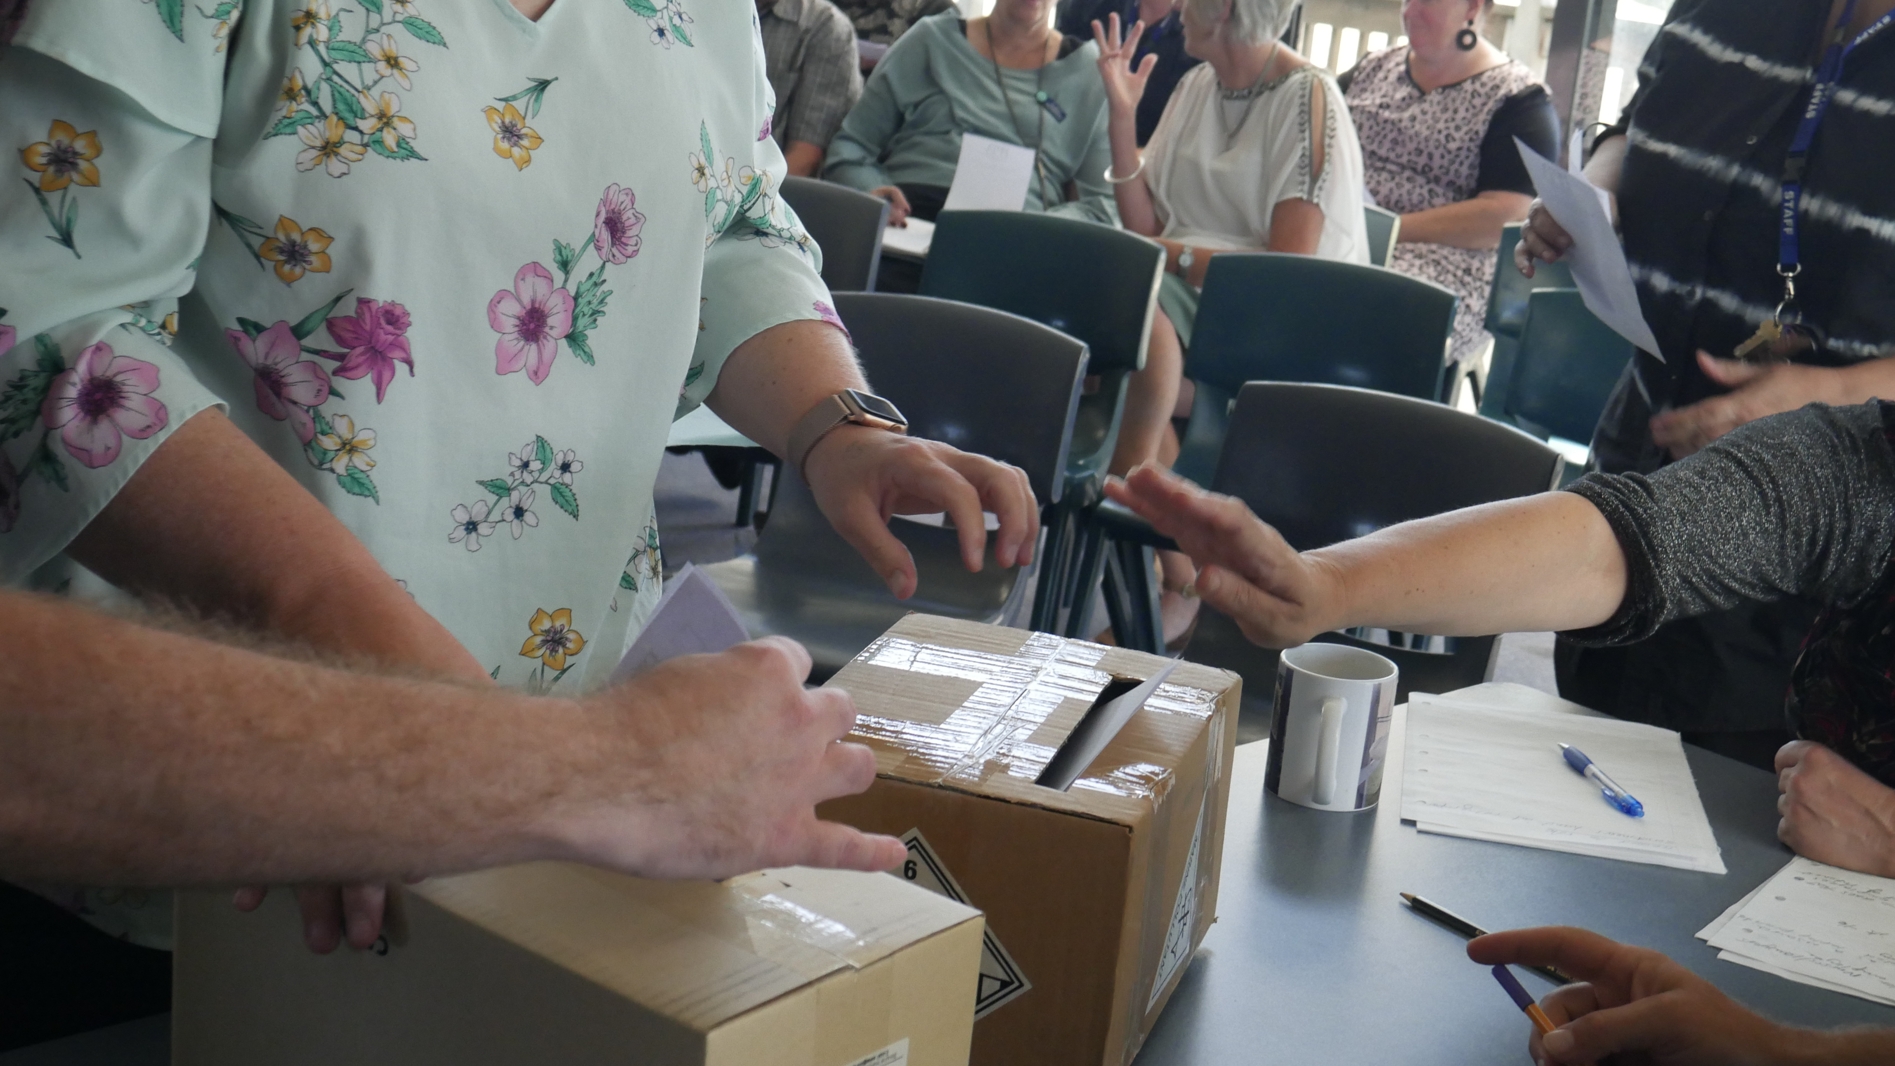
Teaching Council Fees

Slide 2

Fees increase recap
Paid Union Meetings
- the feedback so far
3. Common questions
4. Where to from here?

Slide 3
A reminder…
The Teaching Council has announced it intends to increase fees from $221. It is consulting on two options:
$470 for everyone
$300 for PCTs (beginner teachers) and $500 for everyone else

Slide 4
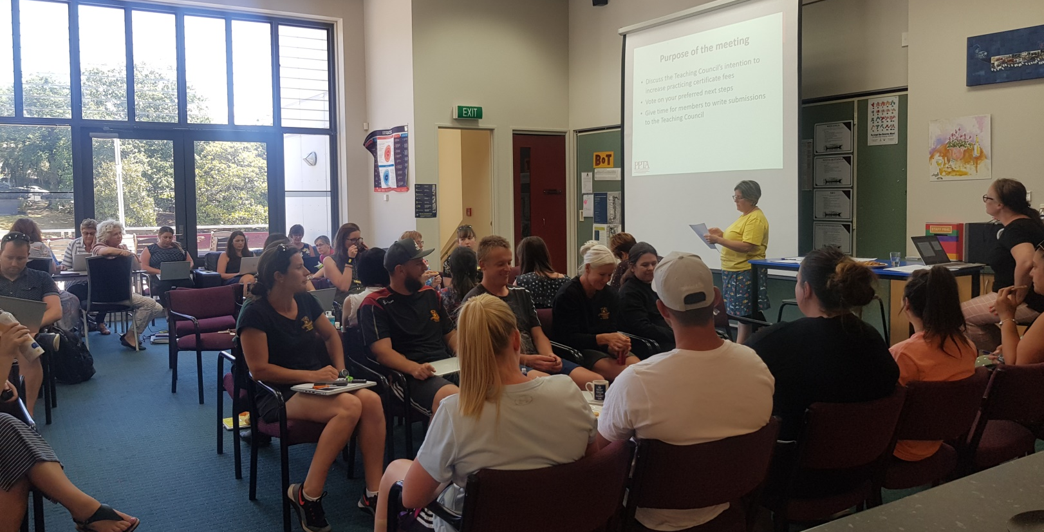
Paid Union Meetings – the picture so far
The last PUMs do not finish until March 13th, so please be aware that this is DRAFT DATA – it is an indication, not a final result.

Slide 5
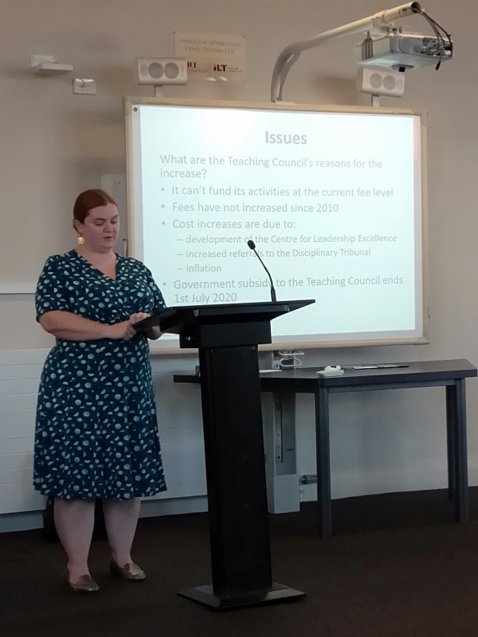
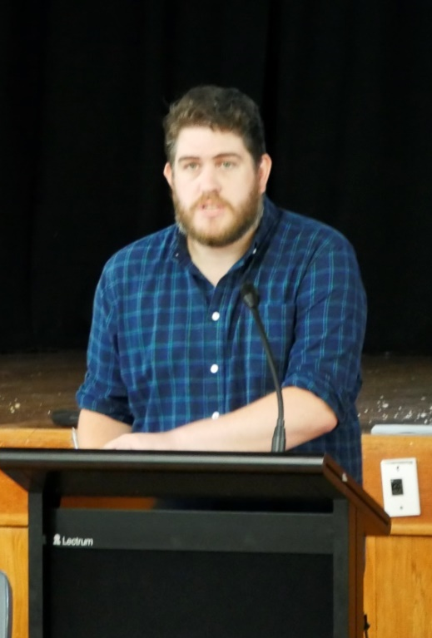
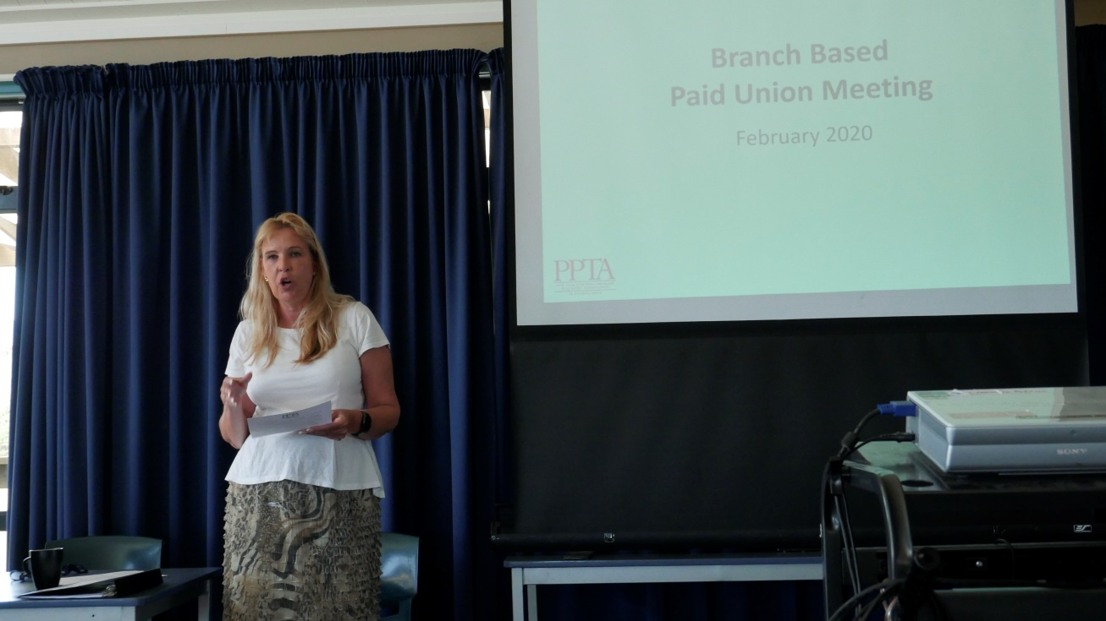
Let’s hear it for the Branch Chairs!
(and Regional Committees and the Executive Committee)
At least 335 Branch-based Paid Union Meetings have been notified across the country.
10,800 members have had their say.

Slide 6
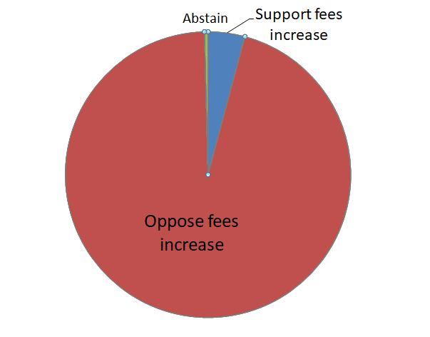
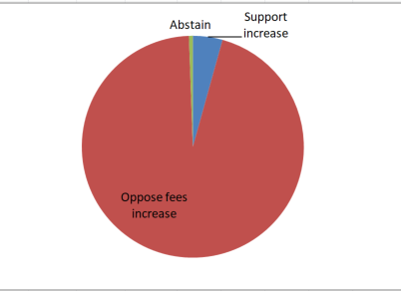
Do you support the two options for fee increases put forward by Teaching Council?

Slide 7
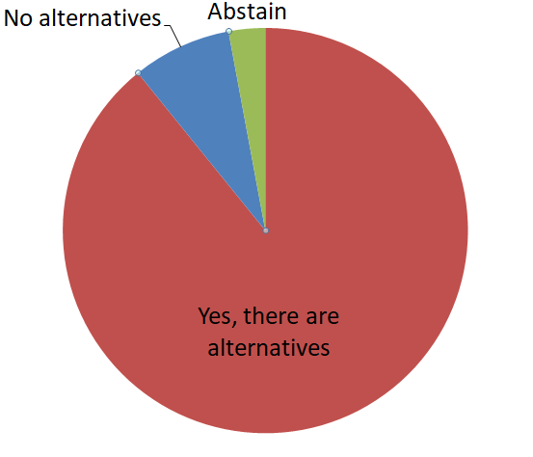
Are there alternatives to increasing
Teaching Council fees?

Slide 8
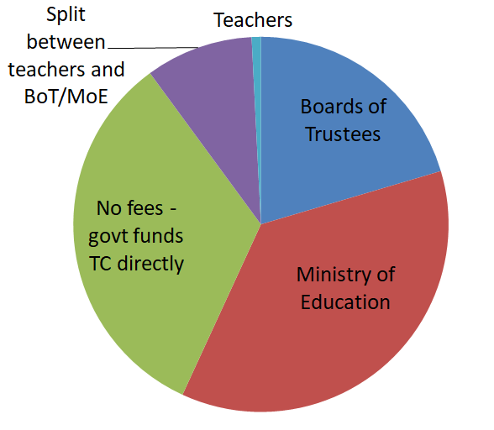
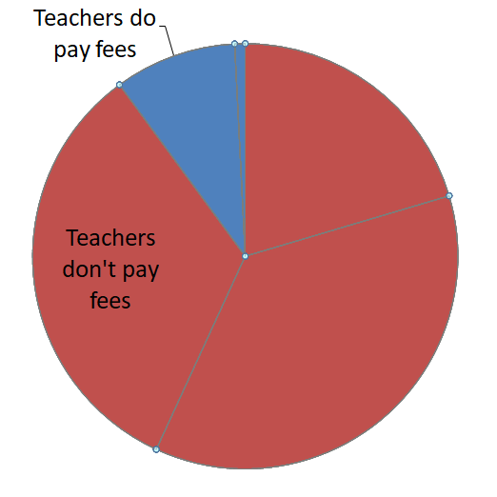
Who should pay the Teaching Council fees?

Slide 9
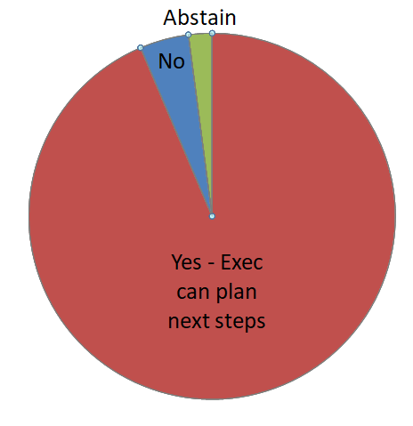
In the event that the Teaching Council implements its proposed fee increase, do you approve the PPTA executive to implement next steps?

Slide 10
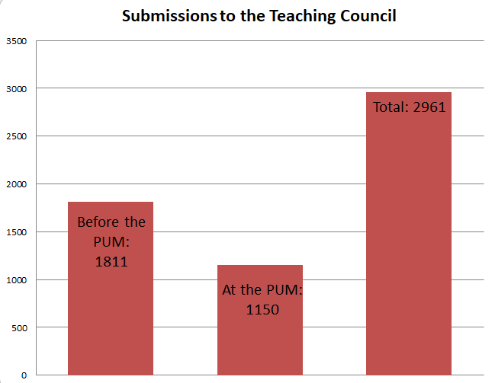
Submissions to the Teaching Council

Slide 11
To summarise:
Teachers do not support the proposed fee increases
Teachers believe there are alternatives to teachers paying these fees themselves
Their preferred option is to have the Government (in form of the MoE, the BoTs or directly) fund the Teaching Council
They approve the Exec to take next steps should the fee increases go ahead
The PUMs allowed time for over 1,000 extra submissions to be made.

Slide 12
General Feedback
Members generally accept the need for teachers to be registered and for their to be a disciplinary body to keep standards high.
But object to HUGE increase and bad faith consultation process.
They do not understand how the Teaching Council benefits them, or how the Council is spending its money.
They do not consider the Council to be an appropriate location for Professional Learning.
Notes:
Members vote

Slide 13
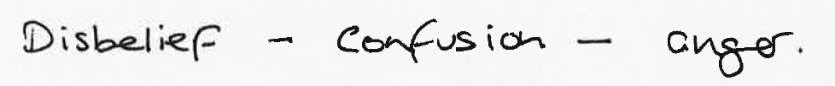
General Feedback
Ideally they wish to have their fees provided by the Ministry of Education as their employer.
However many would be willing to continue to pay reasonable fees:
Increases linked to inflation or to teacher salary increases
Across 5 years instead of 3
Paid in fortnightly instalments not a bulk fee
Teachers are also very concerned about equity, recruitment and retention and would like to see consideration of a pro-rata system linked to income rather than a blanket fee.
Notes:
Members vote

Slide 14

General Feedback
To sum up members’ sentiments
→ If teachers are to pay for the Teaching Council it must be limited to its core functions in order to limit its costs.
→If the Teaching Council wishes to extend beyond these core functions, the government must fund it.
Notes:
Members vote

Slide 15
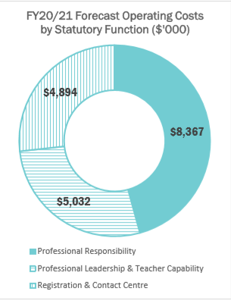
Common questions
1. What does the Teaching Council actually spend it’s money on?
Notes:
Members vote

Slide 16
Common questions
2. Why are the costs for conduct and competency processes SO expensive and what is being done about it?
Changes to legislation in July 2015 meant that cases that must be considered by the Disciplinary Tribunal of the Teaching Council have tripled. More staff have been needed to manage this increased case load and because the Disciplinary Tribunal is quasi-judicial costs for these cases are higher.
The Teaching Council Chief Executive indicated at the last national executive meeting that they also think the 2015 changes have gone too far.
We have been looking at all the conduct processes at the Tribunal and have come up with a number of recommendations for improvements. We will be pursuing these with the Teaching Council. Some of these could happen now, some of them would require legislative changes.
Notes:
Members vote

Slide 17
Common questions
3. Will there be any more fees increases after this?
The Teaching Council have indicated they wish to increase the fees by 2.3% per year every year.
Fee: | After three years:
$221 (current rate, no increase) | $236.60
$300 | $321.18
$500 (proposed increase) | $535.30
Notes:
Members vote

Slide 18
Common questions
4. What on earth is this Centre of Leadership Excellence and why am I paying for it?
A “digital workspace” (not an actual building)
Originally designed to provide leadership for those in CoL leadership positions
Has expanded its aims to provide leadership for all those in, or aspiring to be in, leadership positions in schools.
The Teaching Council envisages itself as the “brains” of the Centre, responsible for the vision, and sees the MoE as the “brawns” who will provide the Professional Development
The Teaching Council sees this as part of its role of providing leadership as it is required to do in the legislation
Notes:
Members vote

Slide 19
Common questions
5. If we can’t strike, what can we do if the fees go up to $500?
Boycott fees? A high risk action!
A “day of action” on July 1st (could include protests, Social Media campaigns, etc)
“Letter-writing” campaigns in branches – email your local MP
Lobby the government – it’s an election year
Notes:
Members vote

Slide 20
It’s not too late to make a submission!
Make a submission to Teaching Council
Until March 13th: https://survey.publicvoice.co.nz/s3/teachingcouncilfeesppta
Write a collective email to the Teaching Council from their branch
Email address: feedback@teachingcouncil.nz
Write to your local MP, Minister Hipkins, or the Prime Minister to express concern
Link here: https://www.parliament.nz/en/mps-and-electorates/members-of-parliament/

